Slide 1
California’s Fiscal Outlook
California Association of School Business Officials
November 21, 2019

Slide 2
Economic Outlook

Slide 3
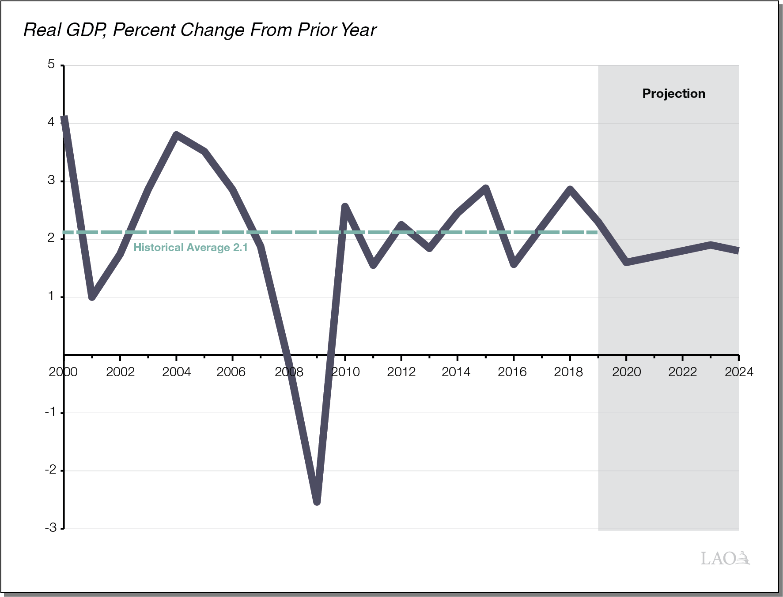
National Economy Projected to Experience Slow Growth in Coming Years

Slide 4
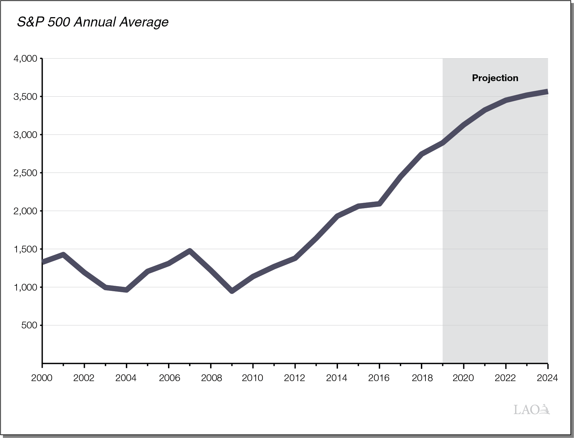
After Steady Run Up, Stock Prices Projected to Begin Leveling Off

Slide 5
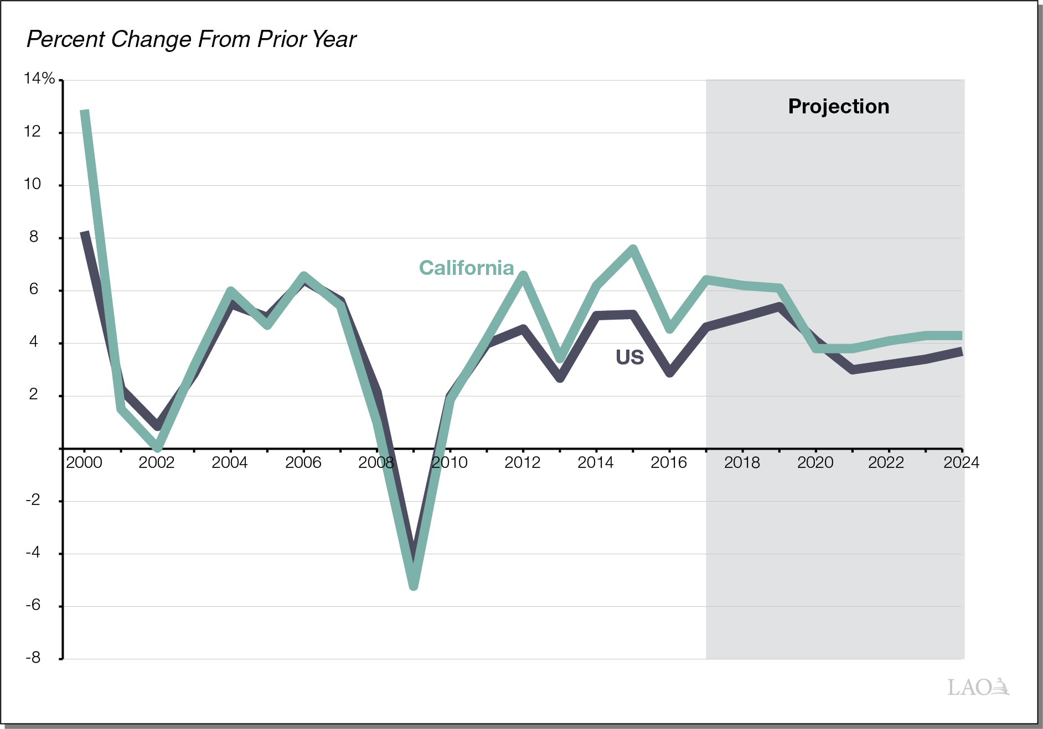
Growth in Wages and Salaries Projected to Slow

Slide 6
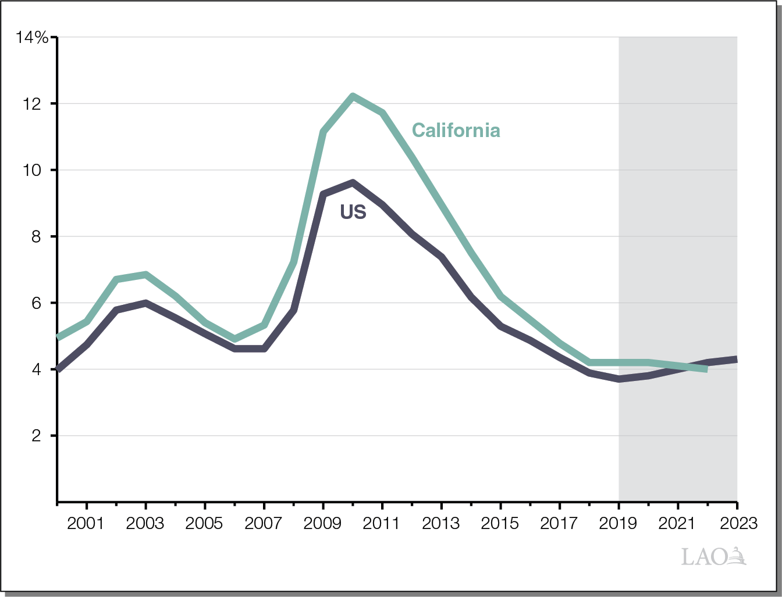
Unemployment Rate Is Projected to Remain Low

Slide 7
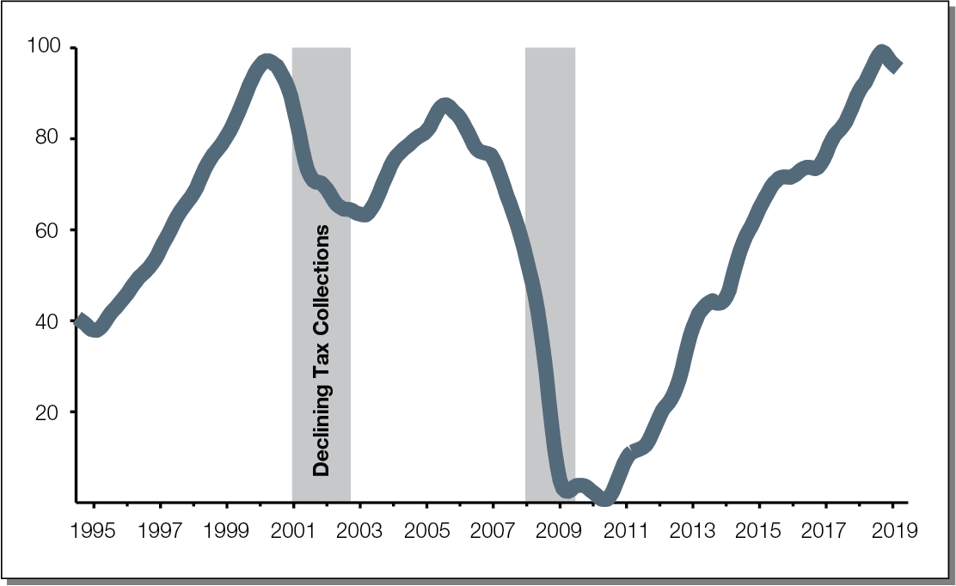
Recent Drops in State Fiscal Health Index Could Be Harbinger of Slowdown

Slide 8
California’s Housing Outlook

Slide 9
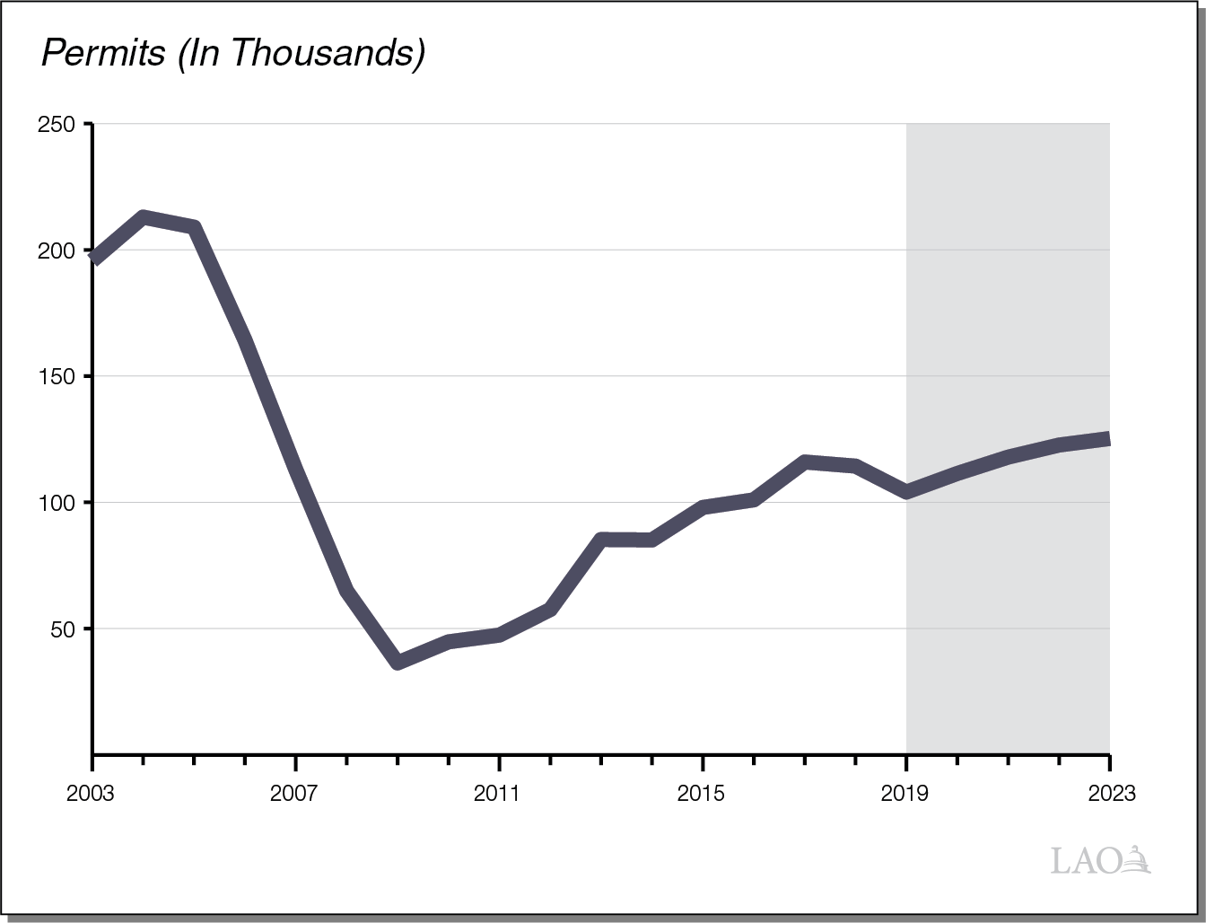
Number of California Housing Permits Projected to Tick Up Over Period

Slide 10
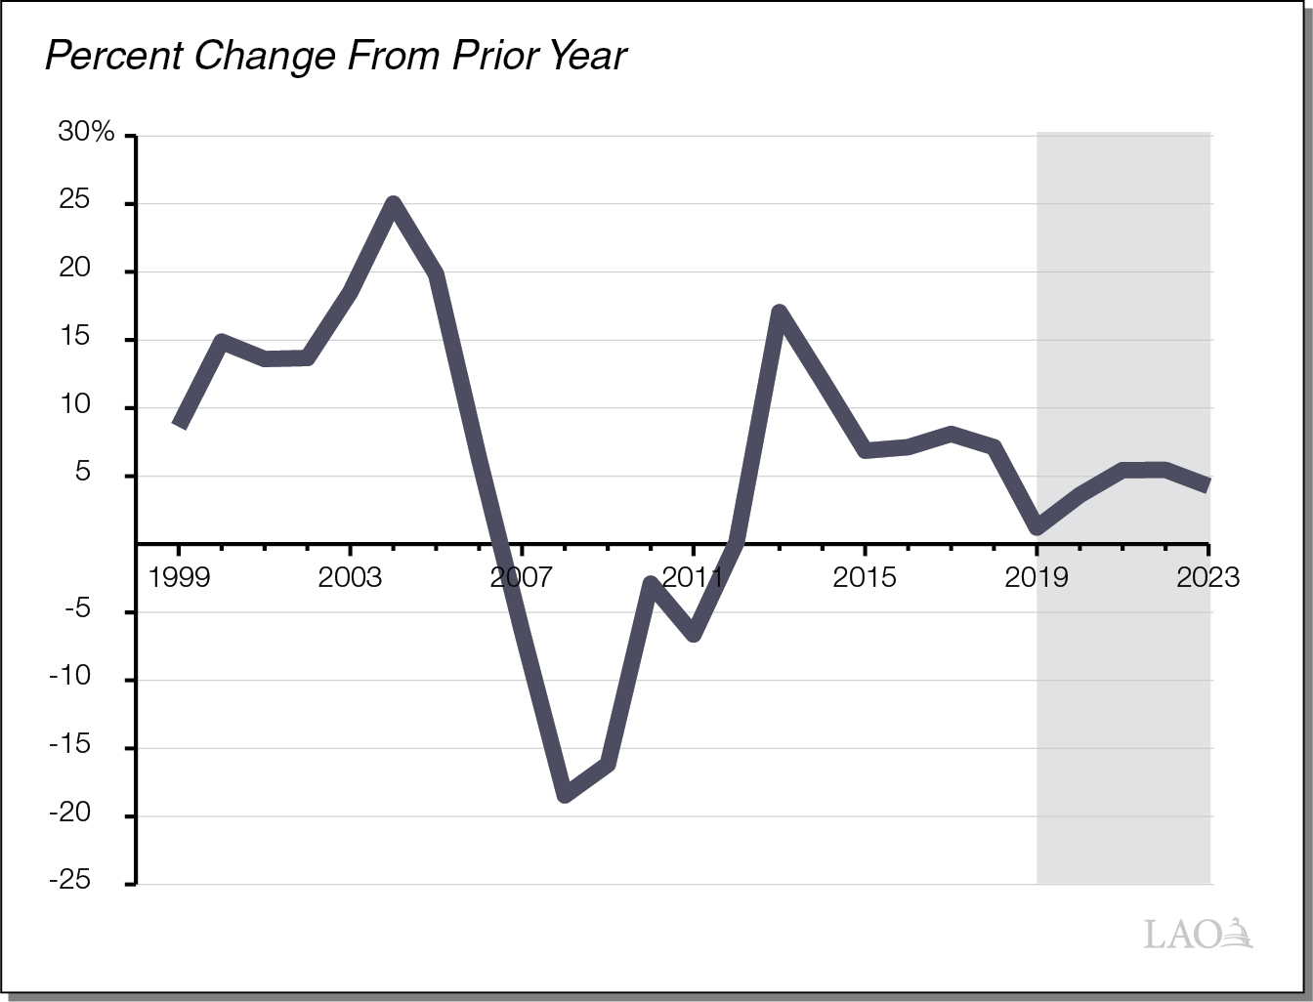
Home Prices in California Are Projected to Grow Slowly Over Period

Slide 11
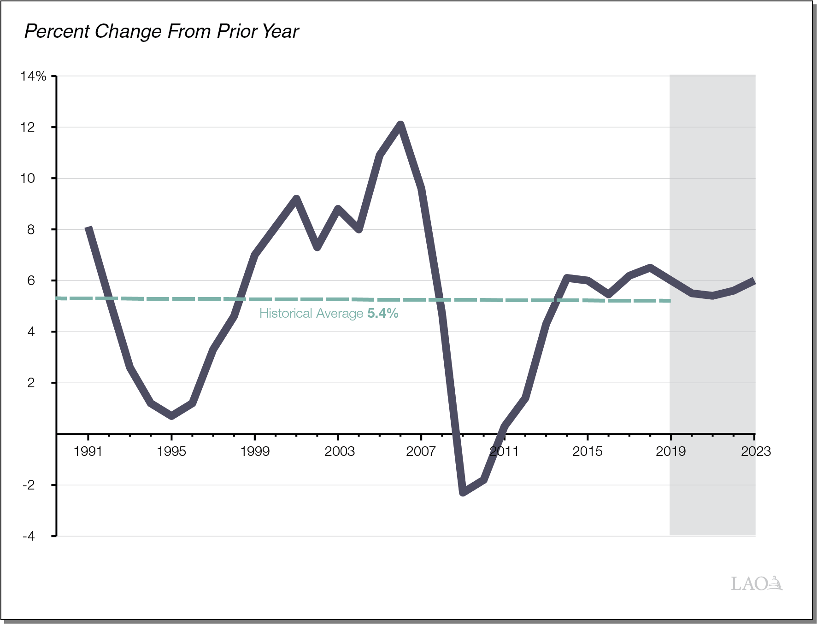
Growth in Assessed Property Values Projected to Hover at Historical Average

Slide 12
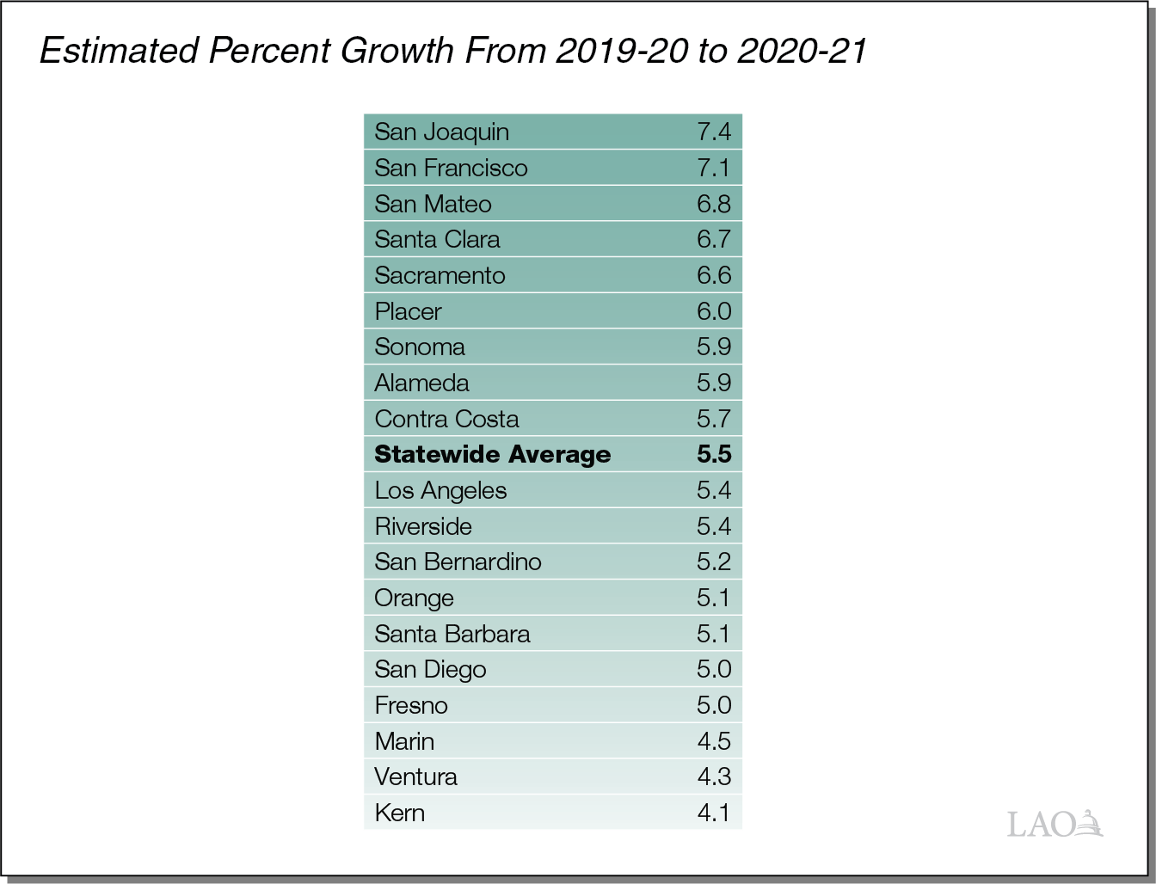
Growth in Assessed Values Varies Significantly Across the State

Slide 13
State Outlook

Slide 14
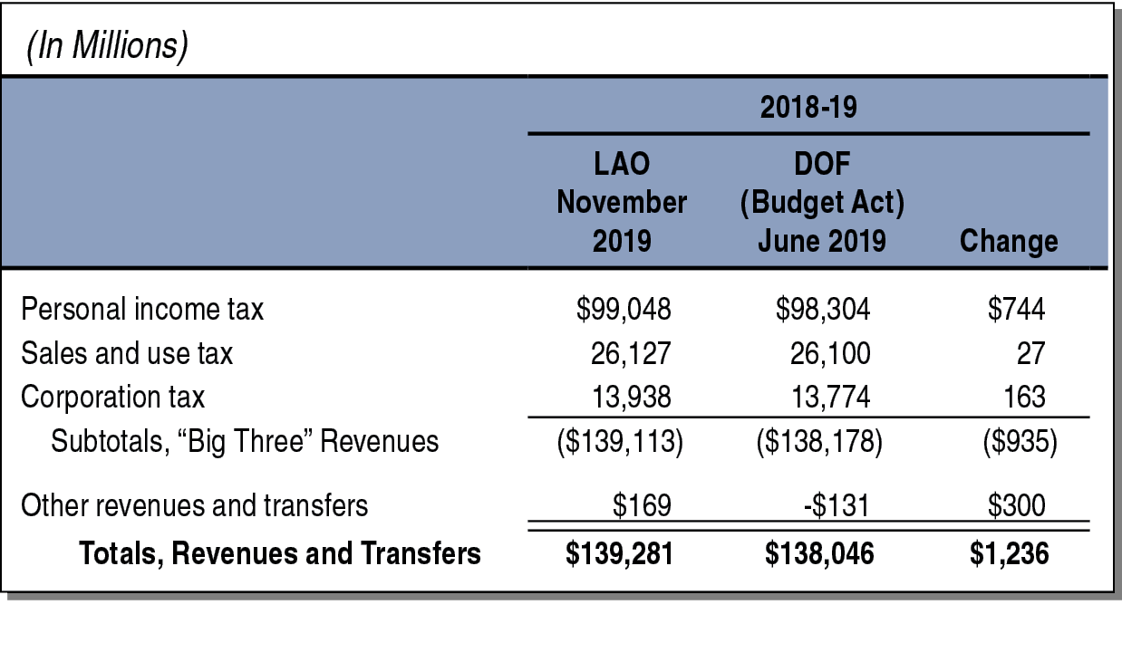
Big Three Revenues Up an Estimated $935 Million in 2018-19

Slide 15
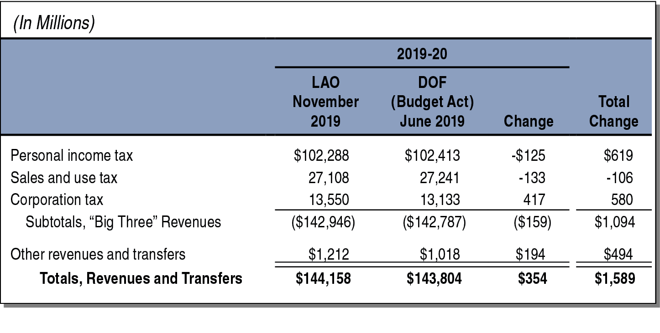
Big Three Revenues Up an Estimated $159 Million in 2019-20

Slide 16
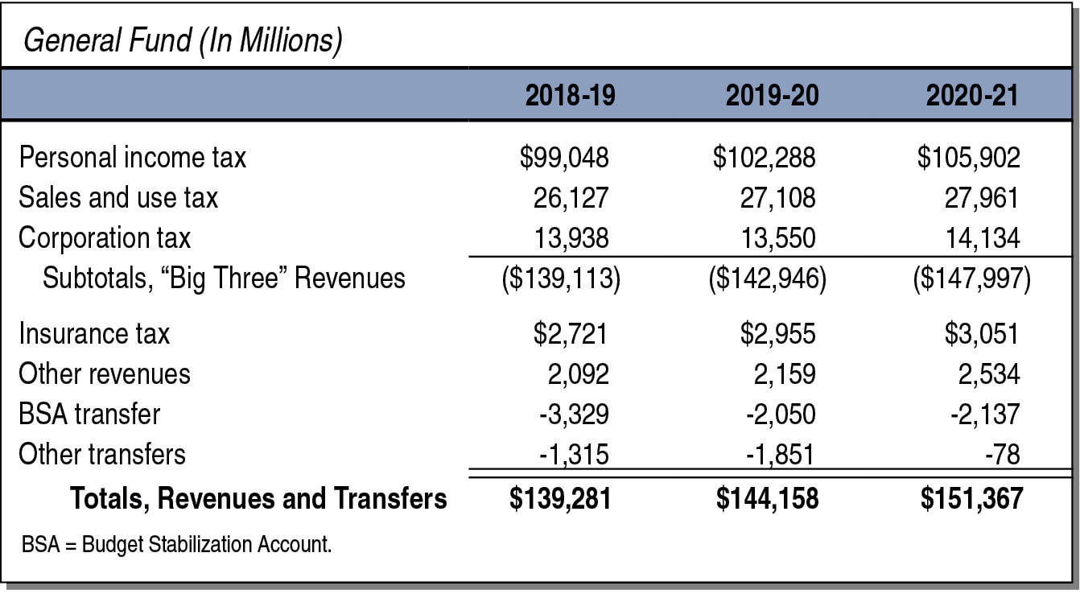
Revenues Expected to Continuing Growing in 2020-21

Slide 17
State Reserves Projected to Grow in 2020-21

Slide 18
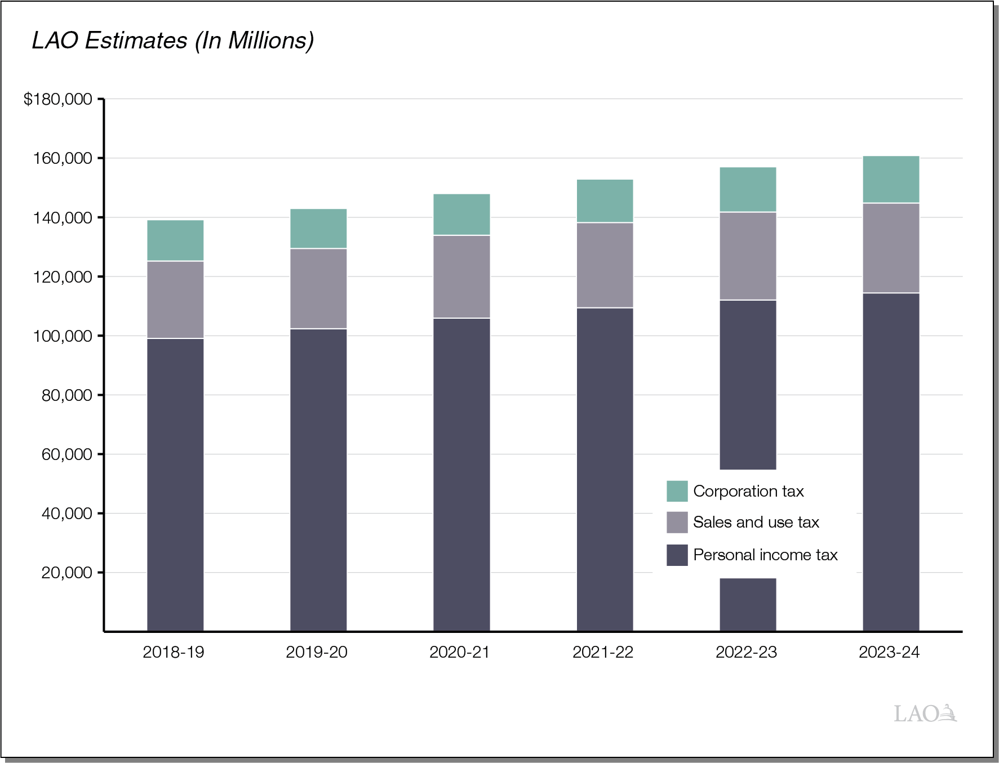
State Revenues Continue Rising Under Economic Growth Scenario

Slide 19
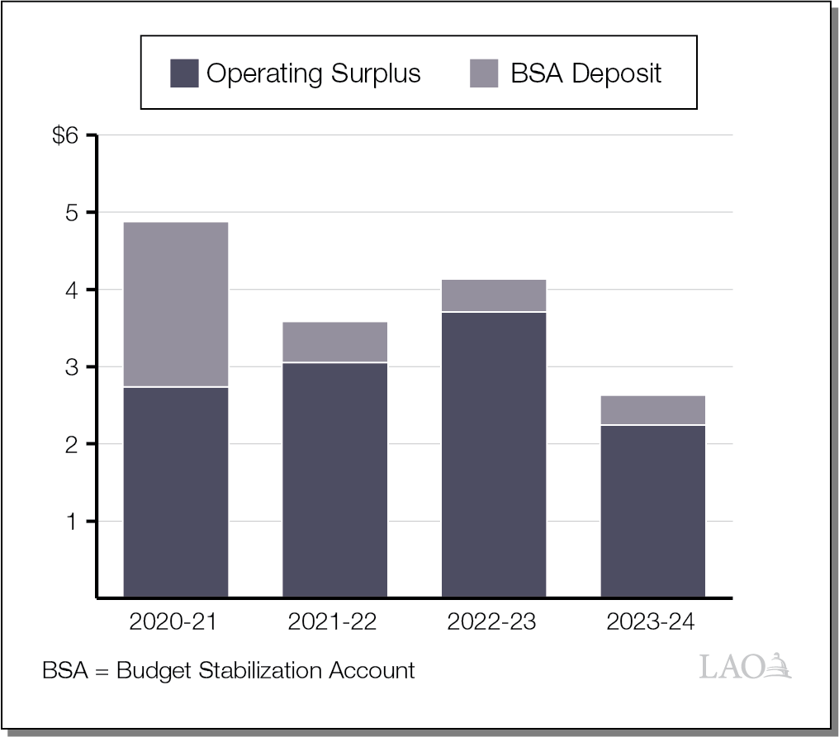
Ongoing Surpluses Around $3 Billion Under Economic Growth Baseline Scenario

Slide 20
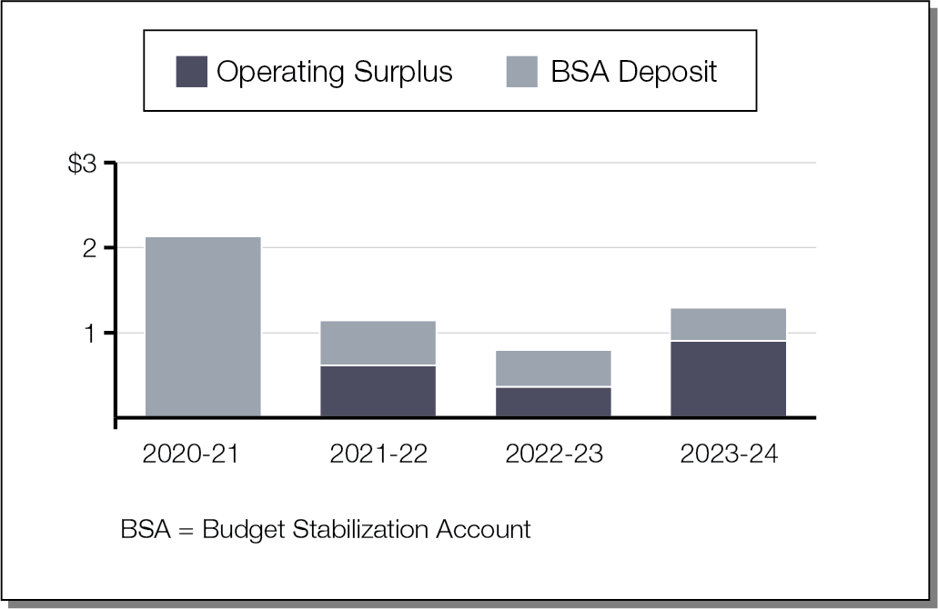
Surpluses Decline to Less Than $1 Billion Under Alternative Expenditure Scenario

Slide 21
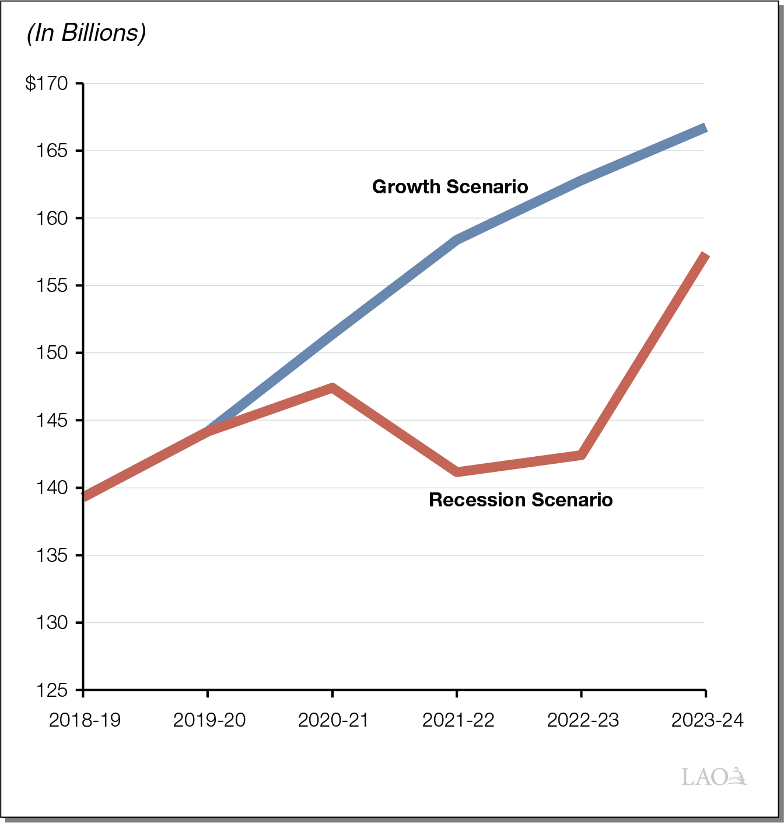
State Revenue Levels Differ Substantially Under Two Economic Scenarios

Slide 22
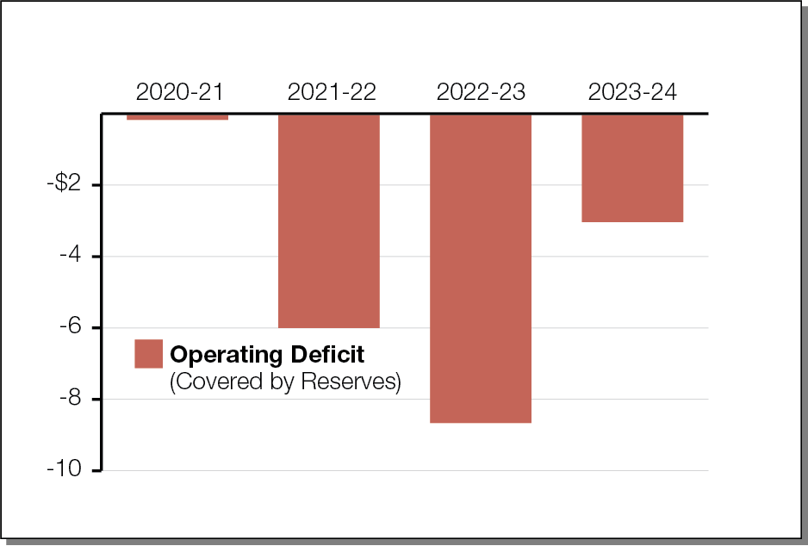
Without Significant New Spending, California Could Weather a Typical Recession

Slide 23
School Near-Term Outlook

Slide 24
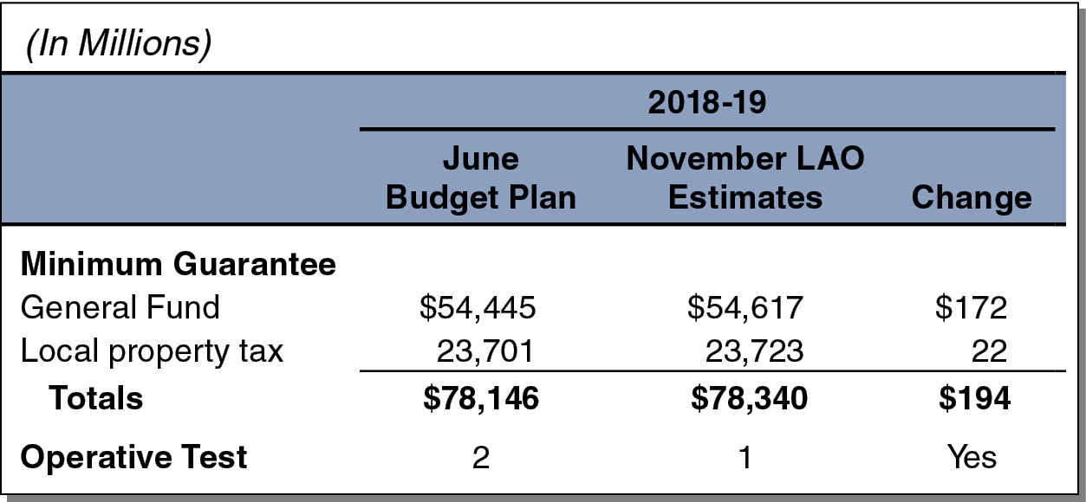
Minimum Guarantee Is Up Slightly in 2018-19

Slide 25
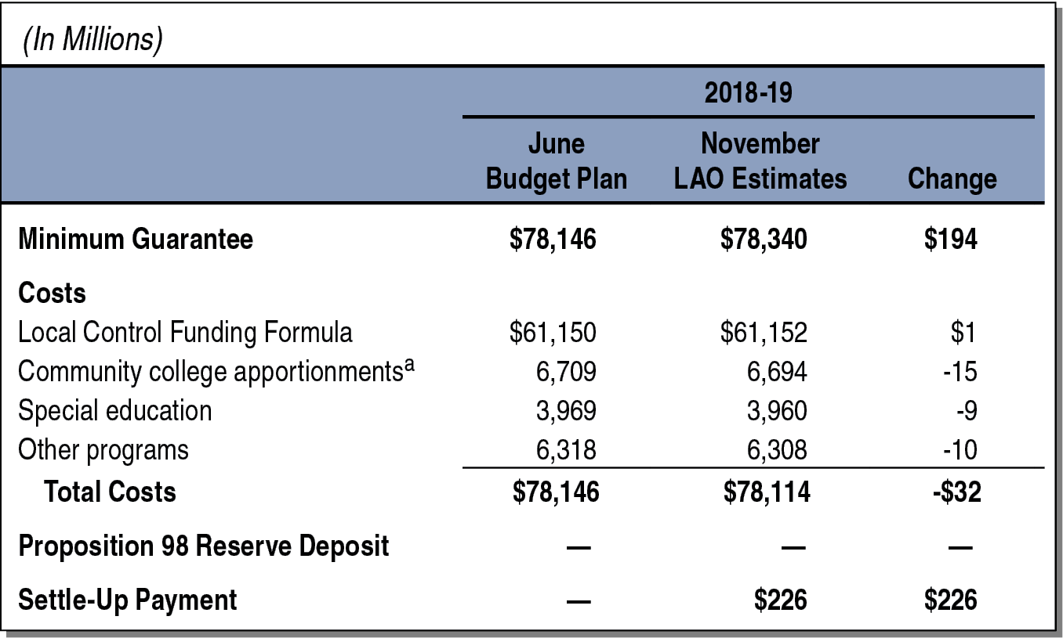
2018-19 Updates Result in Estimated $226 Million Settle-Up Payment

Slide 26
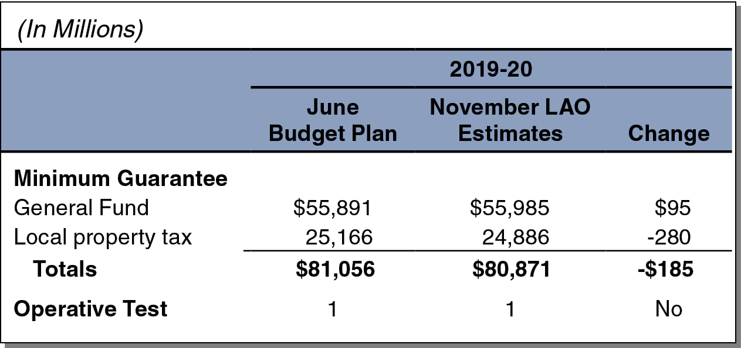
Minimum Guarantee Is Down Slightly in 2019-20

Slide 27
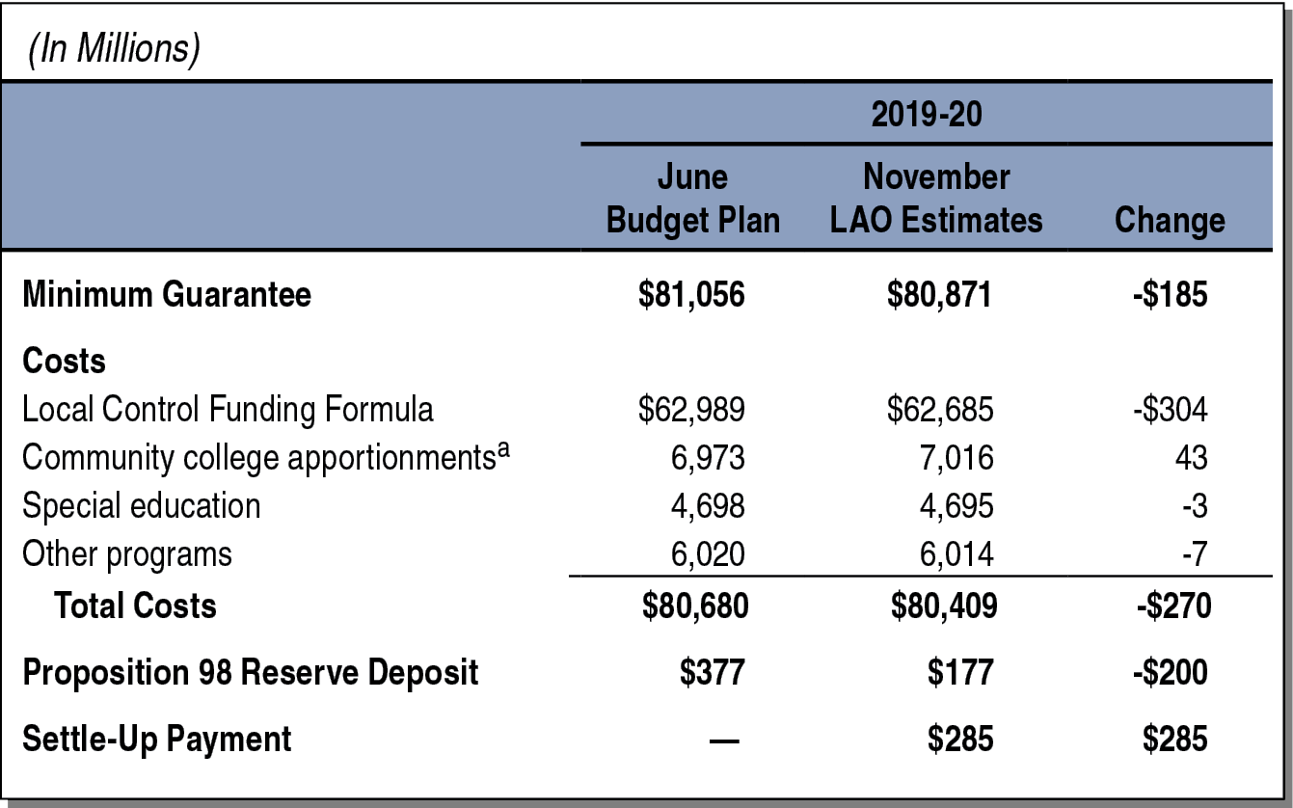
2019-20 Updates Result in Estimated $285 Million Settle-Up Payment

Slide 28
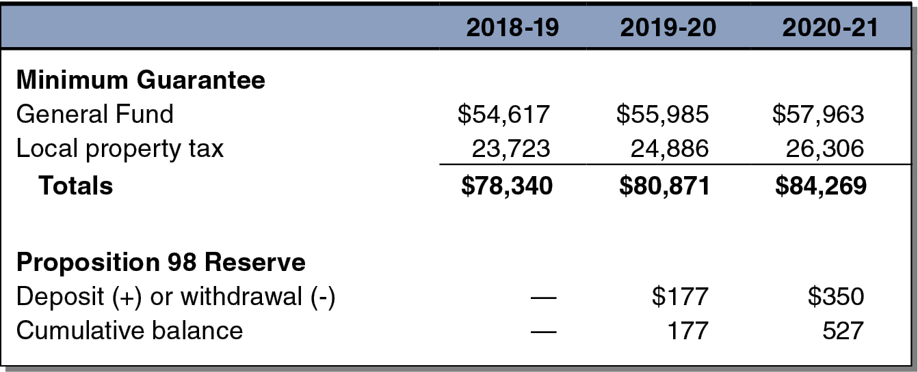
Minimum Guarantee Projected to Rise Moderately in 2020-21

Slide 29
School Outlook Through 2023-24

Slide 30
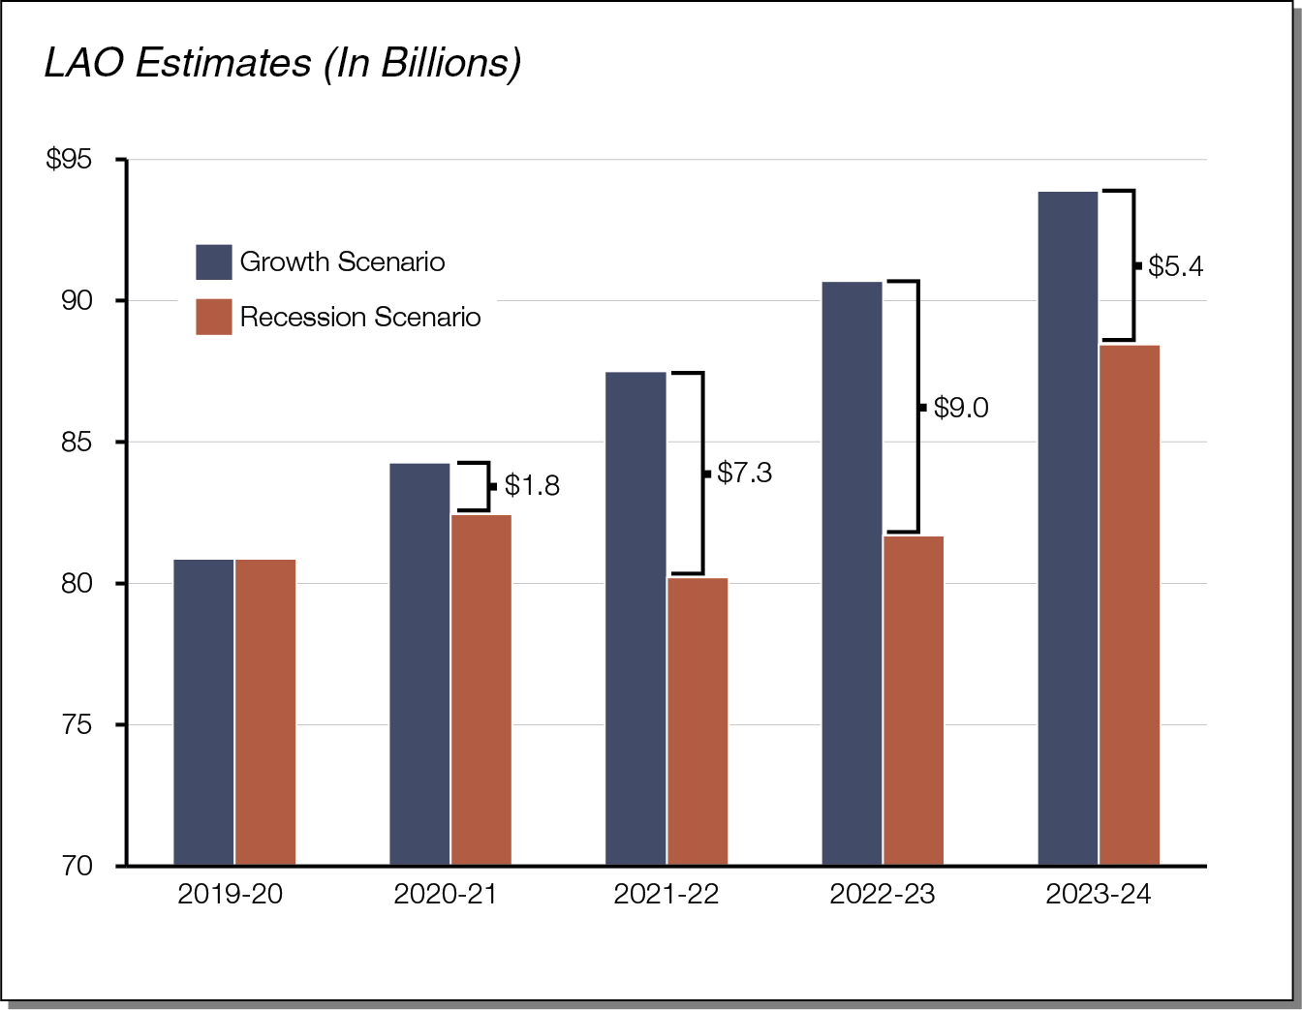
Minimum Guarantee Differs by Billions of Dollars Under Two Scenarios

Slide 31
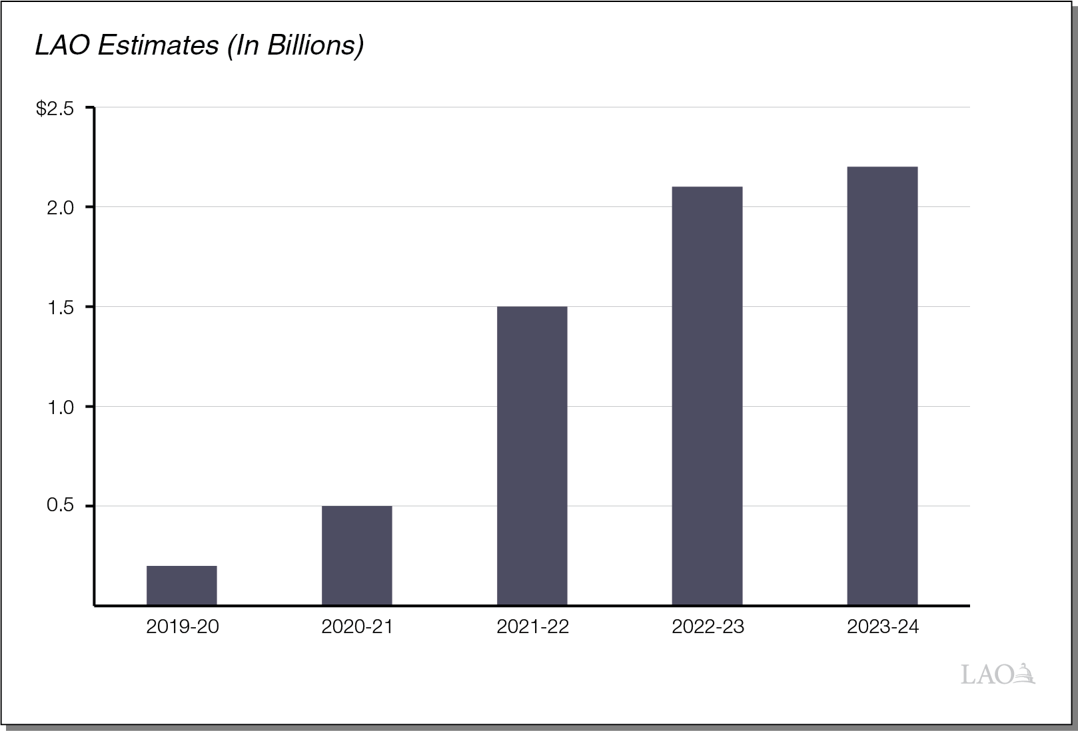
Proposition 98 Reserve Rises in Economic Growth Scenario

Slide 32
School Cost Pressures and Spending Trade-Offs

Slide 33
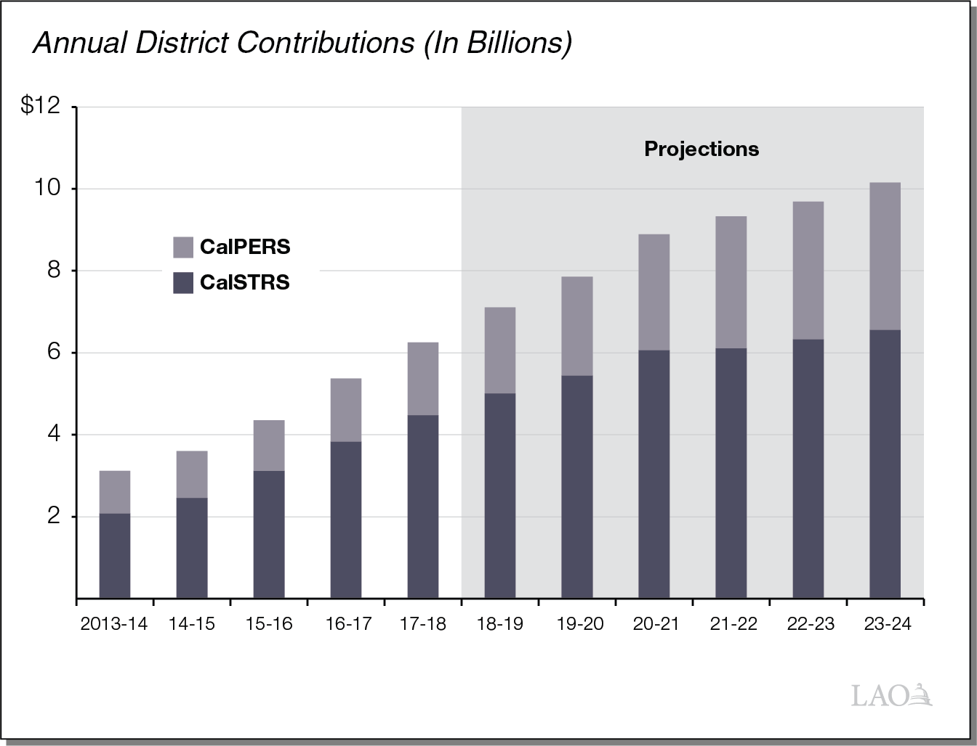
School Pension Costs Rising Over the Period

Slide 34
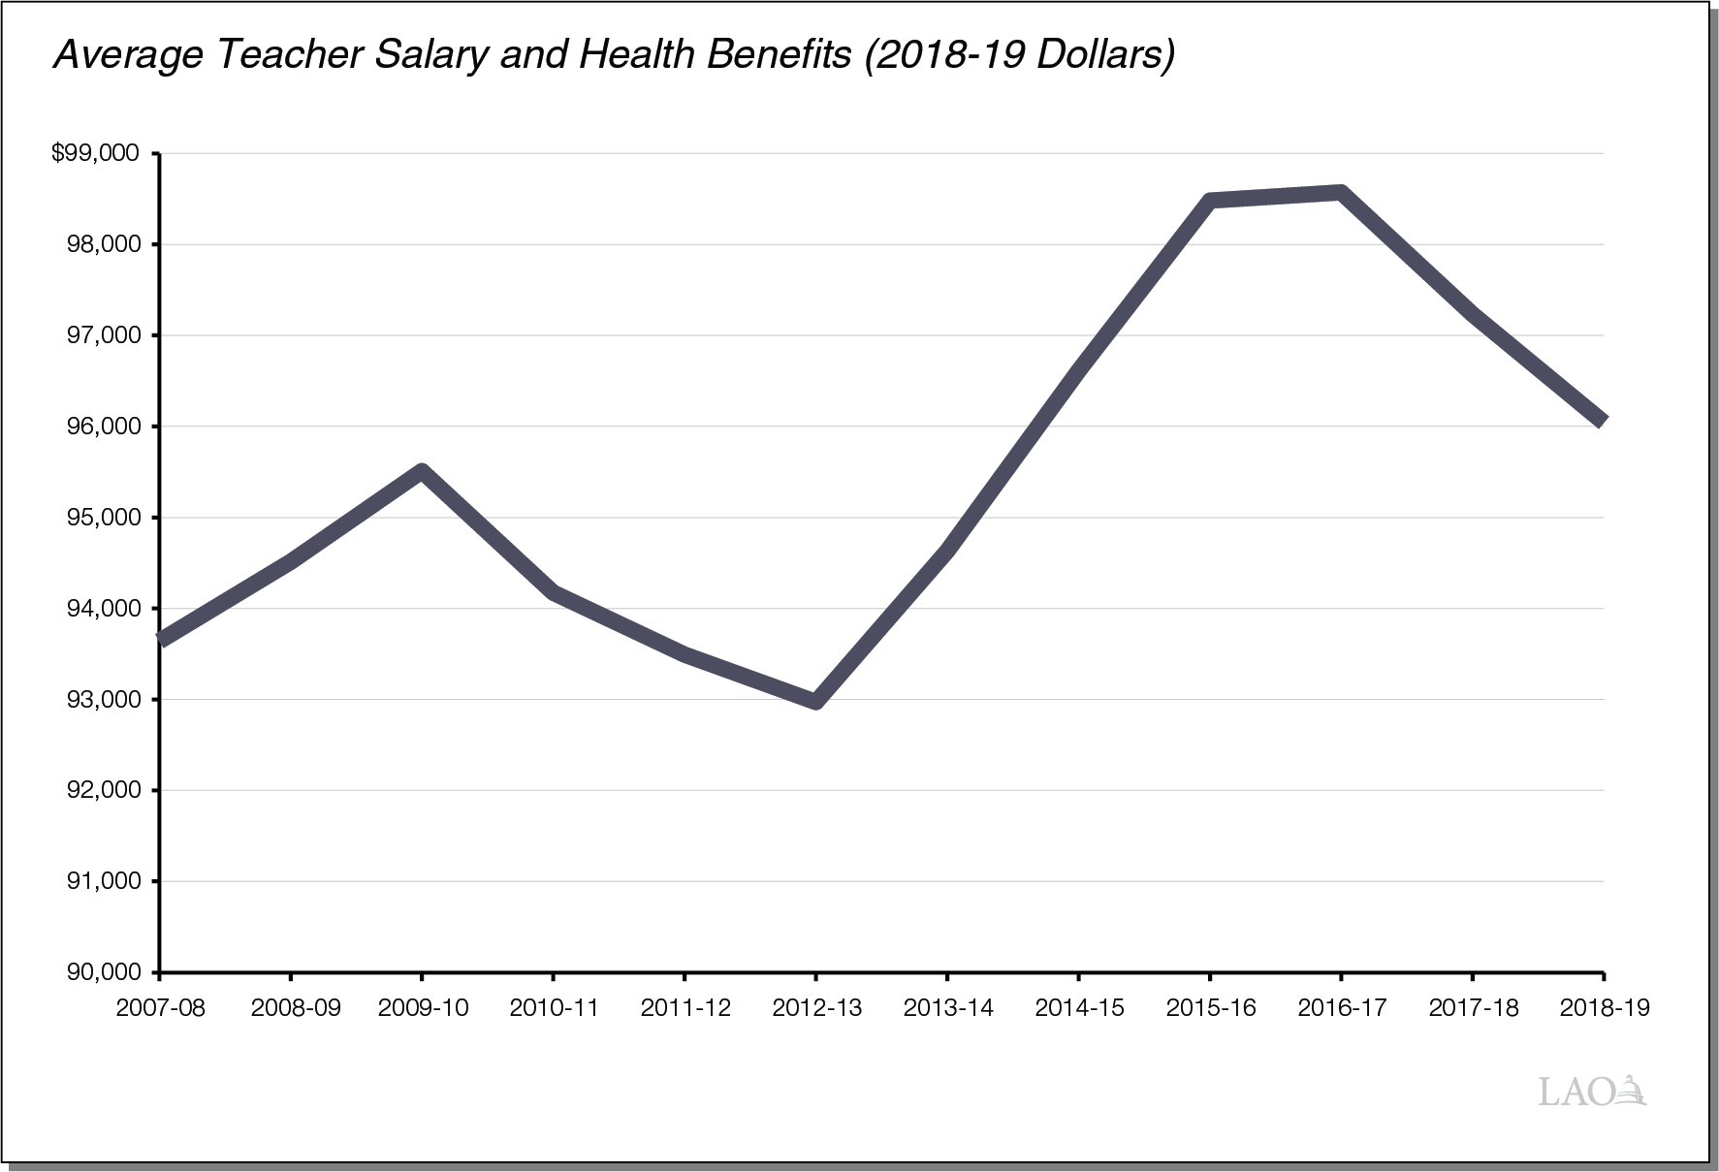
Teacher Compensation in California Is Close to All-Time High

Slide 35
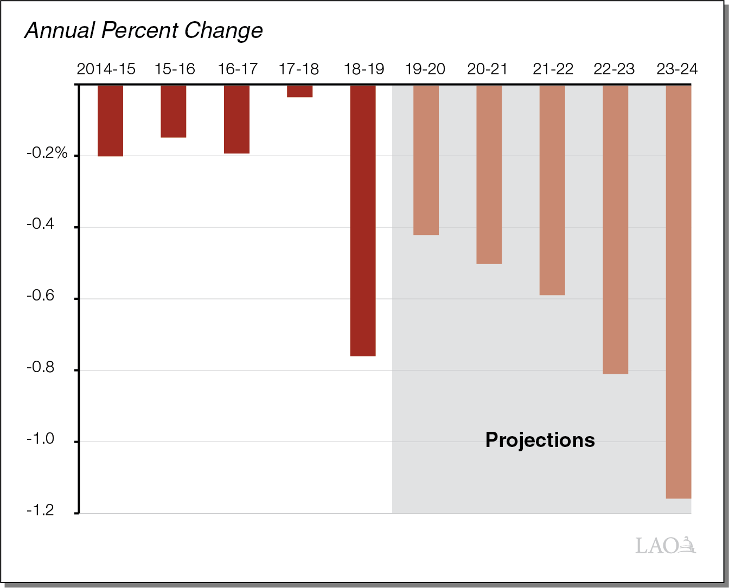
Declines in K-12 Attendance Projected to Accelerate

Slide 36
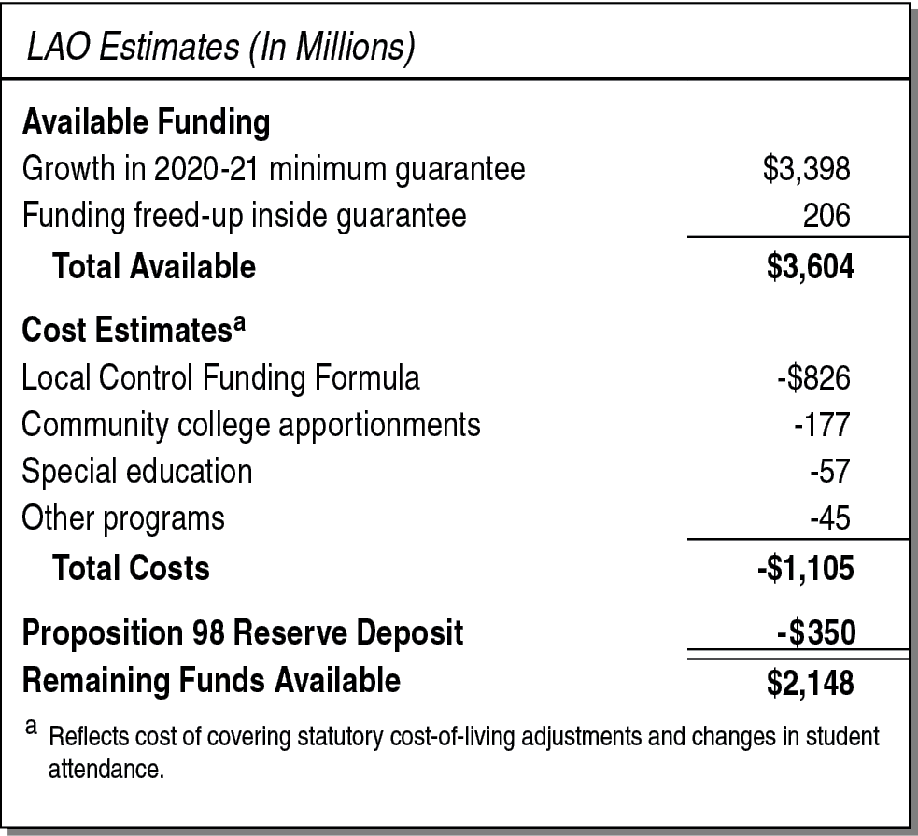
Substantial Funding Available for New Proposition 98 Commitments

Slide 37
Ballot Measures Seeking to Raise School Funding

Slide 38
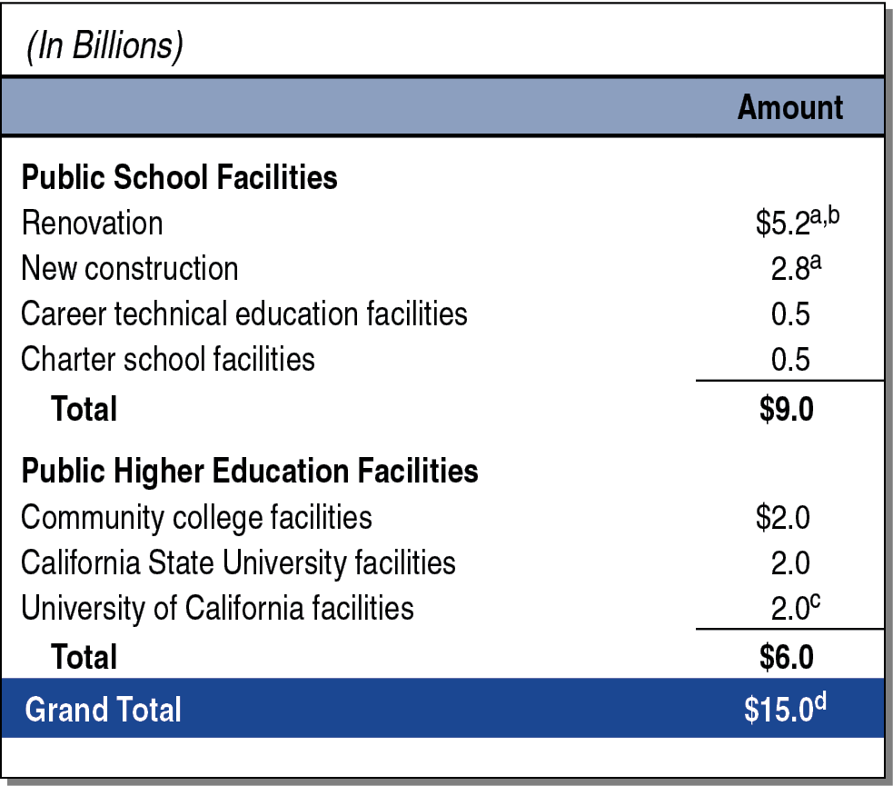
March 2020 Measure Seeks $15 Billion for Education Facilities

Slide 39
Split-Roll Property Tax Initiative Seeks Billions Ongoing for State and School Operations
Assesses Commercial and Industrial Properties at Their Market Value
Allocates Additional Revenue to a Mix of Local Agencies
About 60 percent for cities, counties, and other local agencies.
About 40 percent for K-14 education. Of this amount, 89 percent would be for schools and 11 percent for community colleges.
School Share Allocated According to LCFF
Takes Effect Starting in 2022-23

Slide 40
Income Tax Initiative Seeks $15 Billion Ongoing for School Operations
Increases Personal and Corporate Income Tax Rates
Affects individuals with incomes exceeding $1 million.
Affects corporations with profits exceeding $1 million.
Allocates All Additional Revenue to K-14 Education
Allocates 89 percent to schools, 11 percent to community colleges.
School Share Allocated According to LCFF
From the school share, $500 million would be set aside annually for teaching computer science and purchasing technology.
Takes Effect Starting in 2021

