Slide 1
California’s Fiscal Outlook
California School Boards Association
Annual Education Conference
November 29, 2018

Slide 2
Economic Outlook

Slide 3
Slow Economic Growth Expected Over Next Few Years
Consensus Economic Outlook:
Slow growth in U.S. GDP.
Flattening of stock prices.
Strong wage growth in California and country in 2018 and 2019, slower growth thereafter.
Slow job growth.
Very low unemployment.

Slide 4
Cooling of Housing Market Expected Over Next Few Years
Housing Outlook:
Steady construction activity.
Rising supply of homes.
Tighter mortgage lending standards.
Higher interest rates.
Slower growth in home prices.

Slide 5
Near-Term State Outlook

Slide 6
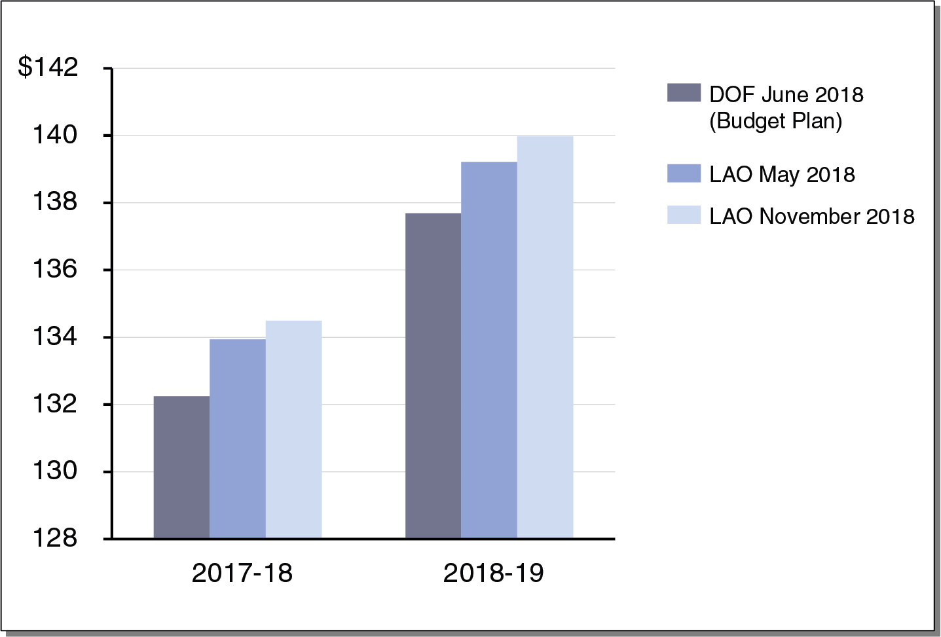
Revenue for 2017-18 and 2018-19 Exceeding Budget Expectations
General Fund Tax Revenues (In Billions)

Slide 7
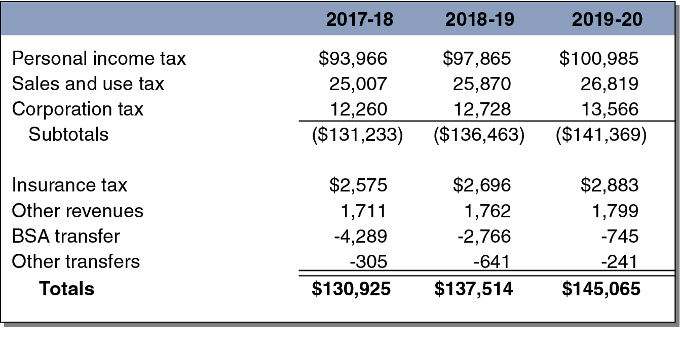
Moderate Revenue Growth Projected for 2019-20
LAO Estimates of General Fund Revenue and Transfers (In Millions)

Slide 8
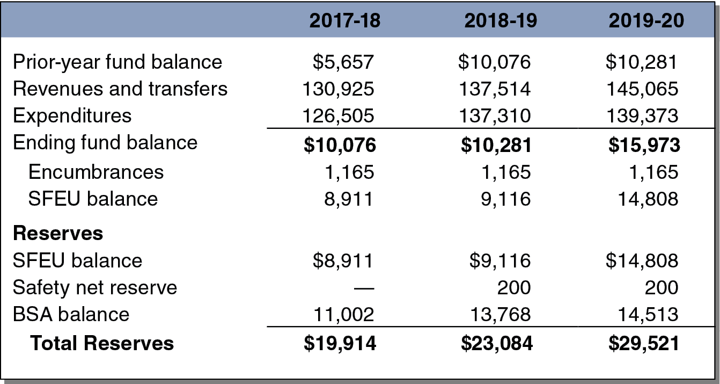
State Bottom Line Projected to Be Healthy Over Near Term
LAO Estimates of General Fund Budget (In Millions)

Slide 9
Near-Term School Outlook

Slide 10
Minimum Guarantee and K-14 Funding Down for 2017-18
Proposition 98 Estimates (In Millions)

Slide 11
Minimum Guarantee and K-14 Funding Also Down for 2018-19
Proposition 98 Estimates (In Millions)

Slide 12
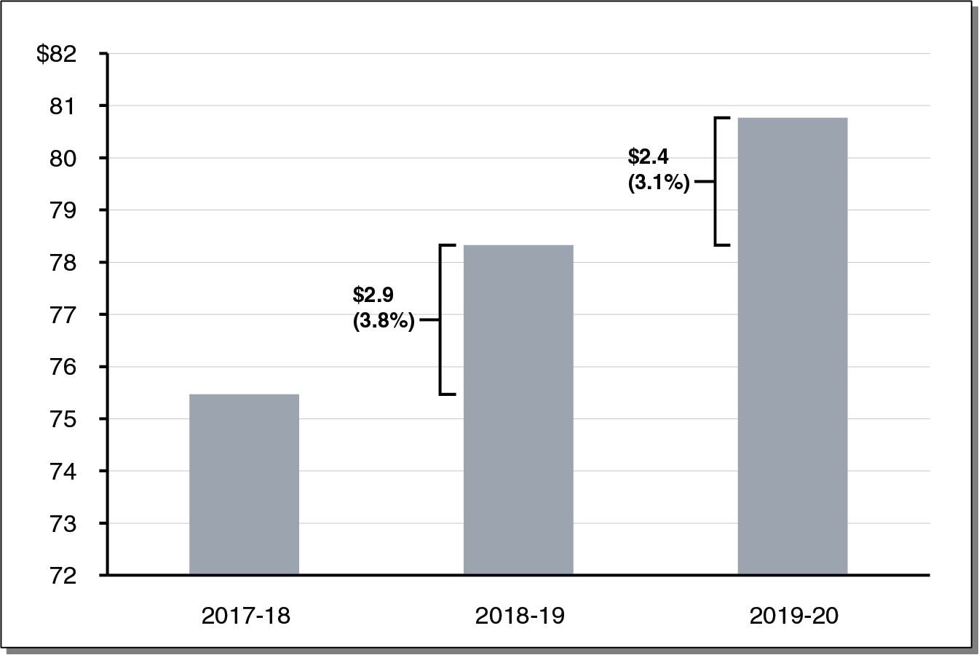
Minimum Guarantee Increasing Moderately Over Near Term
(In Billions)

Slide 13
State Outlook Through 2022-23

Slide 14
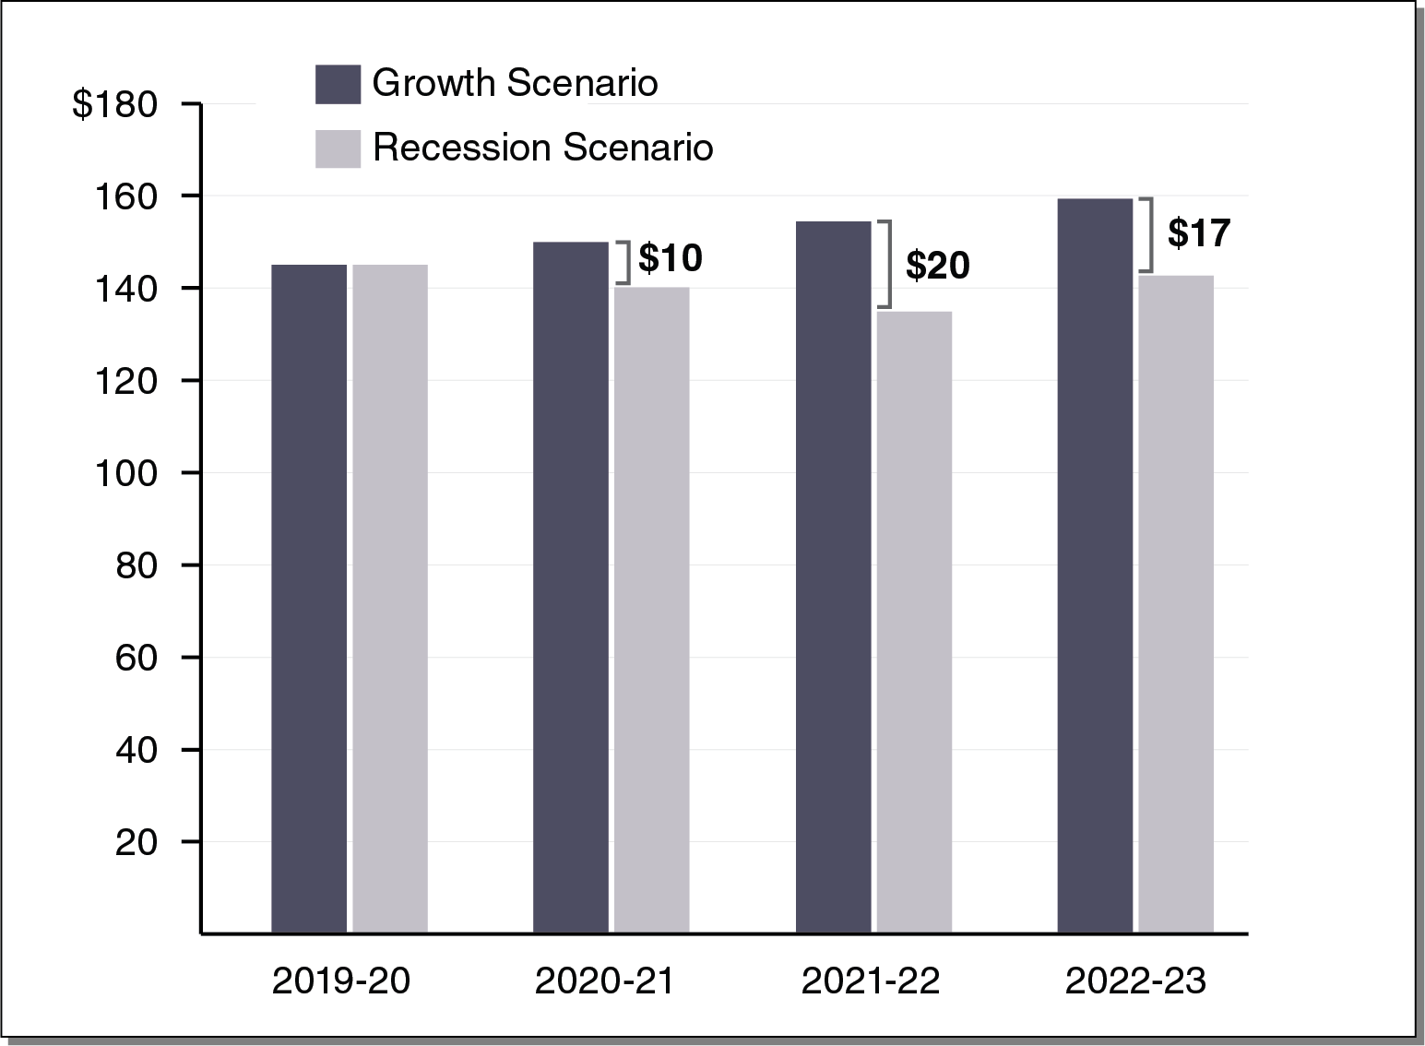
Revenues Notably Higher Under Growth Scenario
Total General Fund Revenues and Transfers (In Millions)

Slide 15
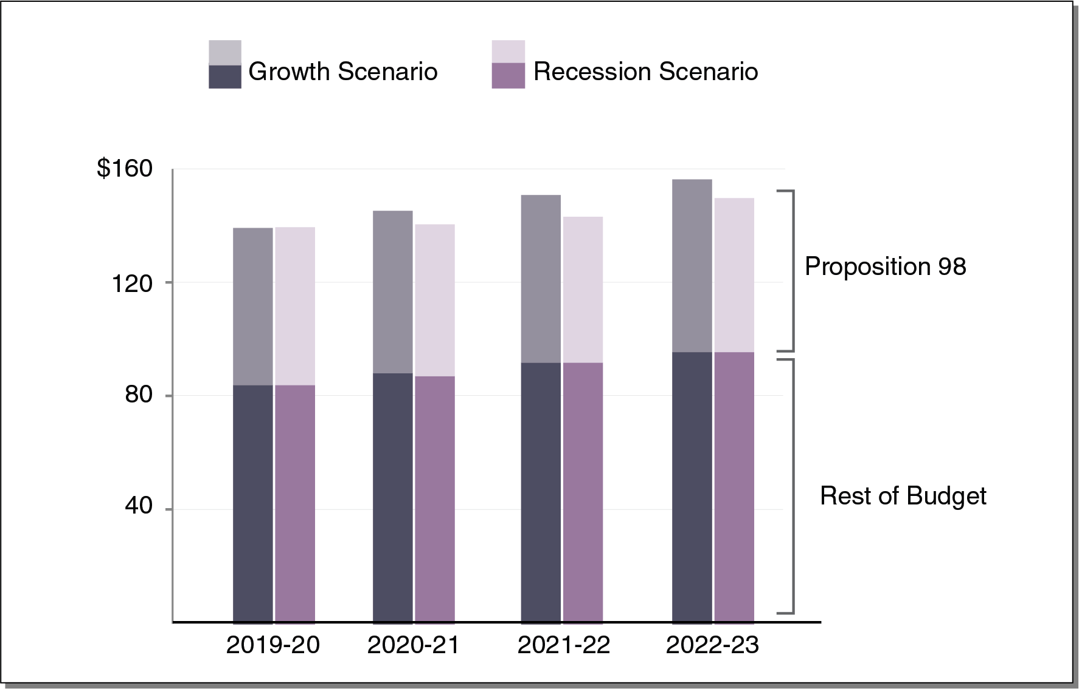
Education Spending Most Affected Under Two Scenarios
(In Billions)

Slide 16
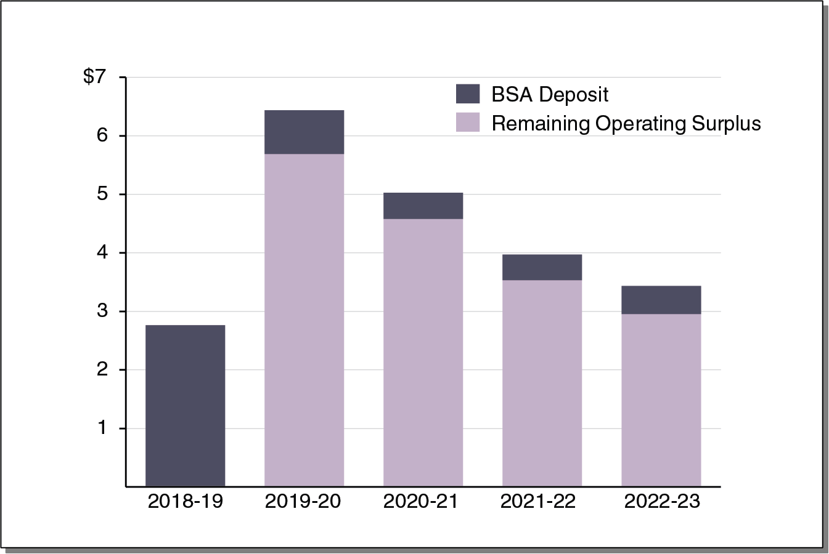
Sizeable Surpluses Under Growth Scenario Assuming No New 2019-20 Commitments
(In Billions)

Slide 17
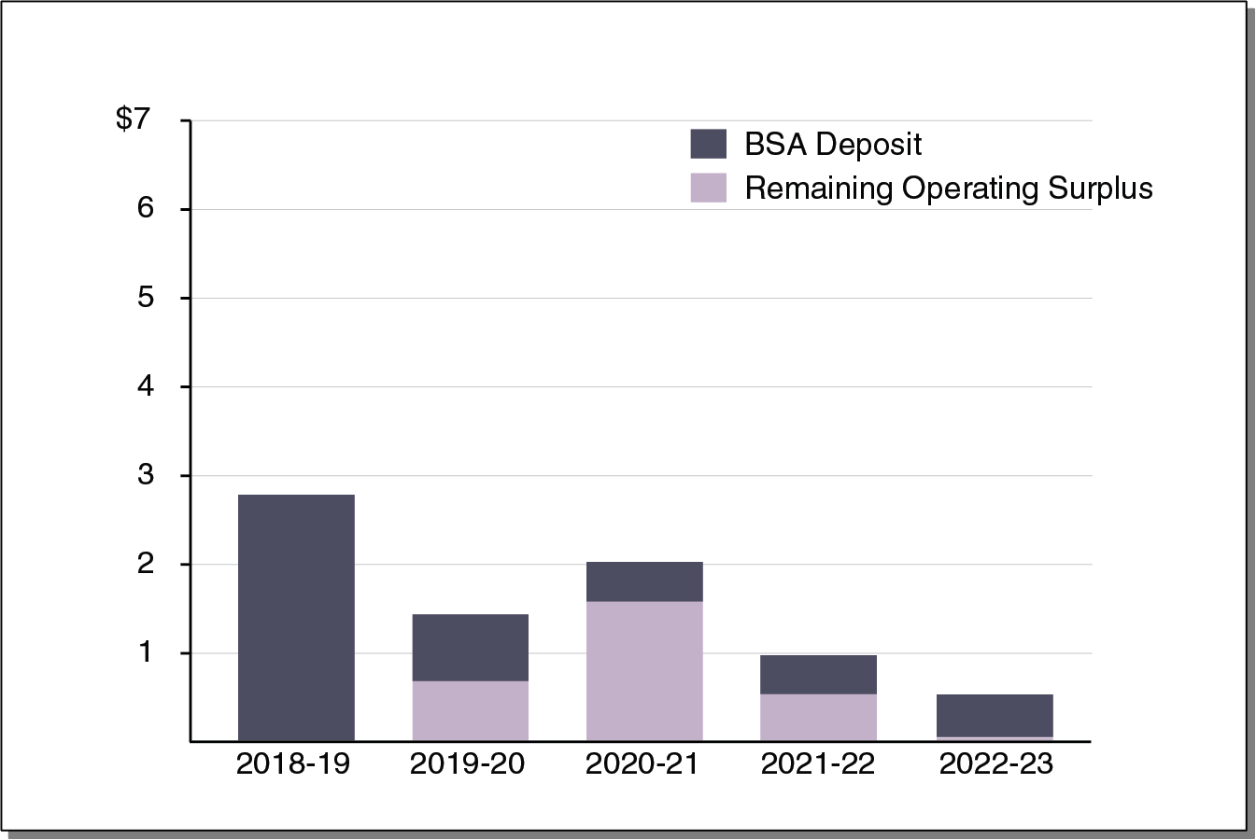
Much Smaller Surpluses Under Growth Scenario if New 2019-20 Commitments Made
(In Billions)
Note: Assumes Legislature makes an additional $2 billion in one-time and
$3 billion in ongoing spending increases or tax reductions in 2019-20.

Slide 18
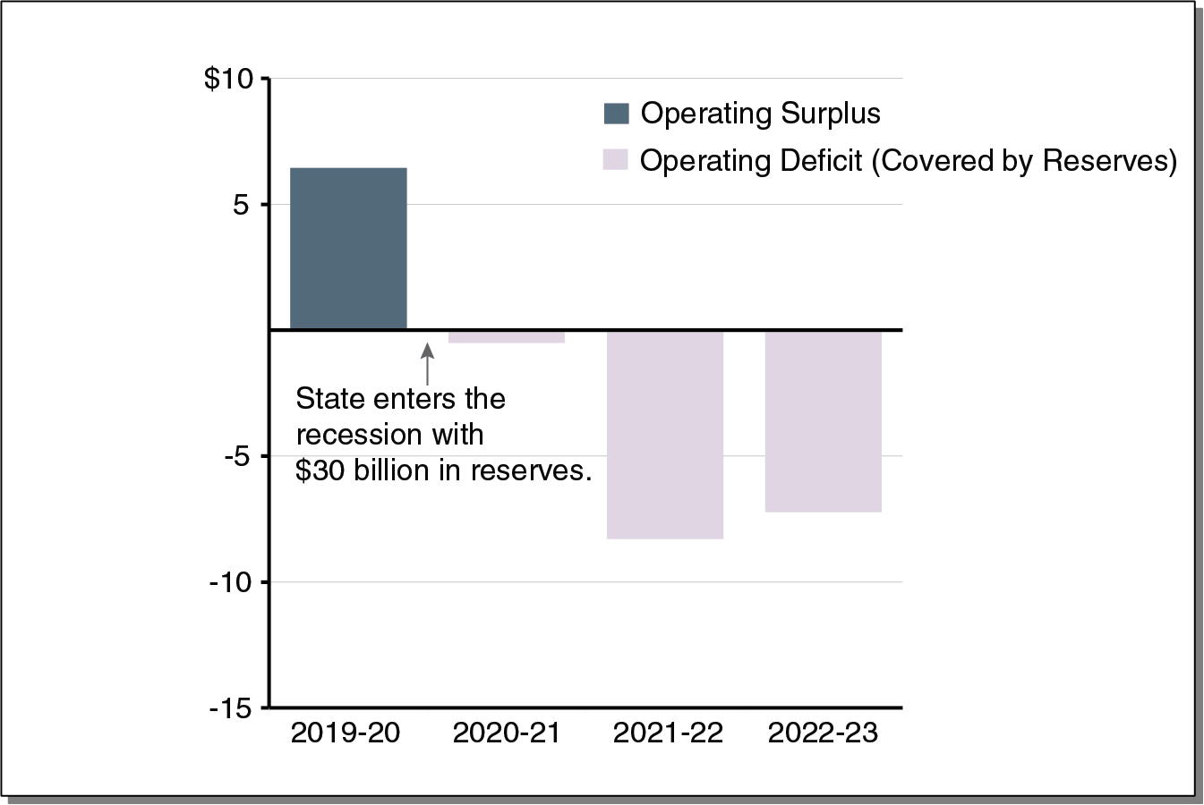
Reserves Cover Operating Deficits Under Recession Scenario if No New 2019-20 Commitments
(In Billions)

Slide 19
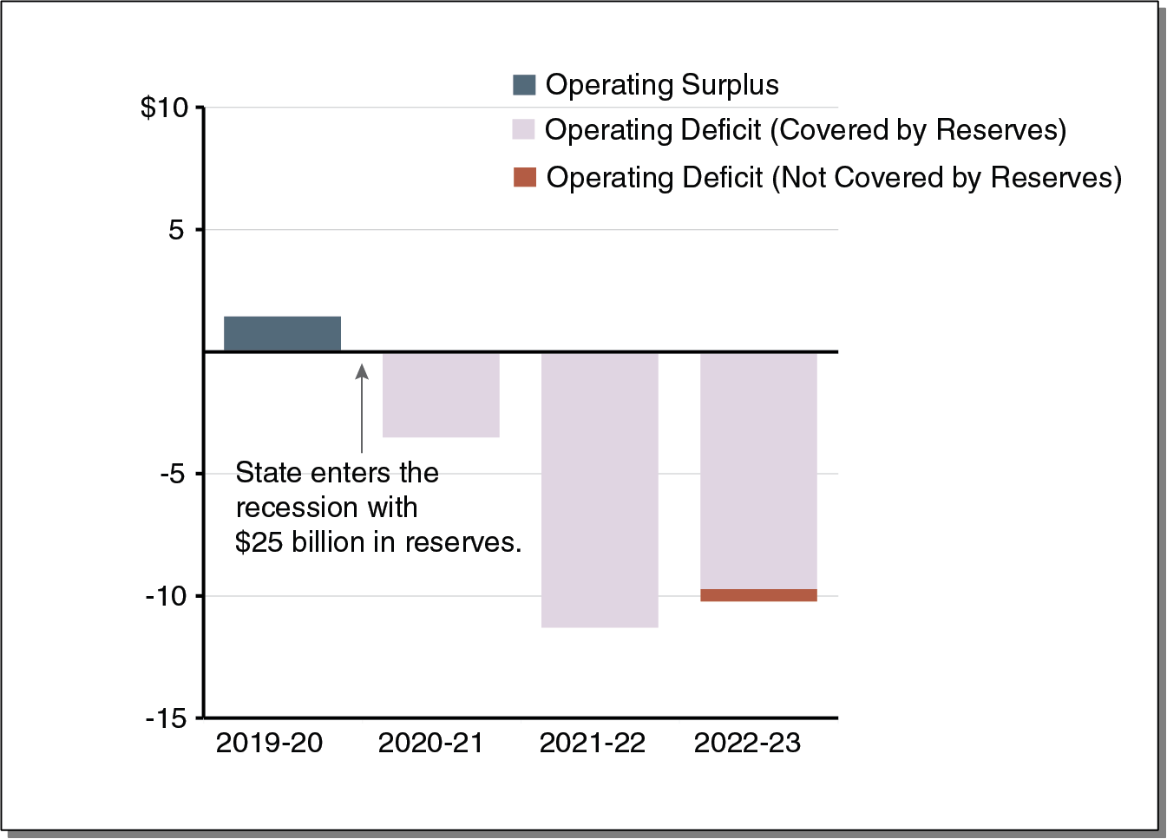
Reserves Would Be Depleted Under Recession Scenario if New 2019-20 Commitments Made
(In Billions)

Slide 20
Education Outlook Through 2022-23

Slide 21
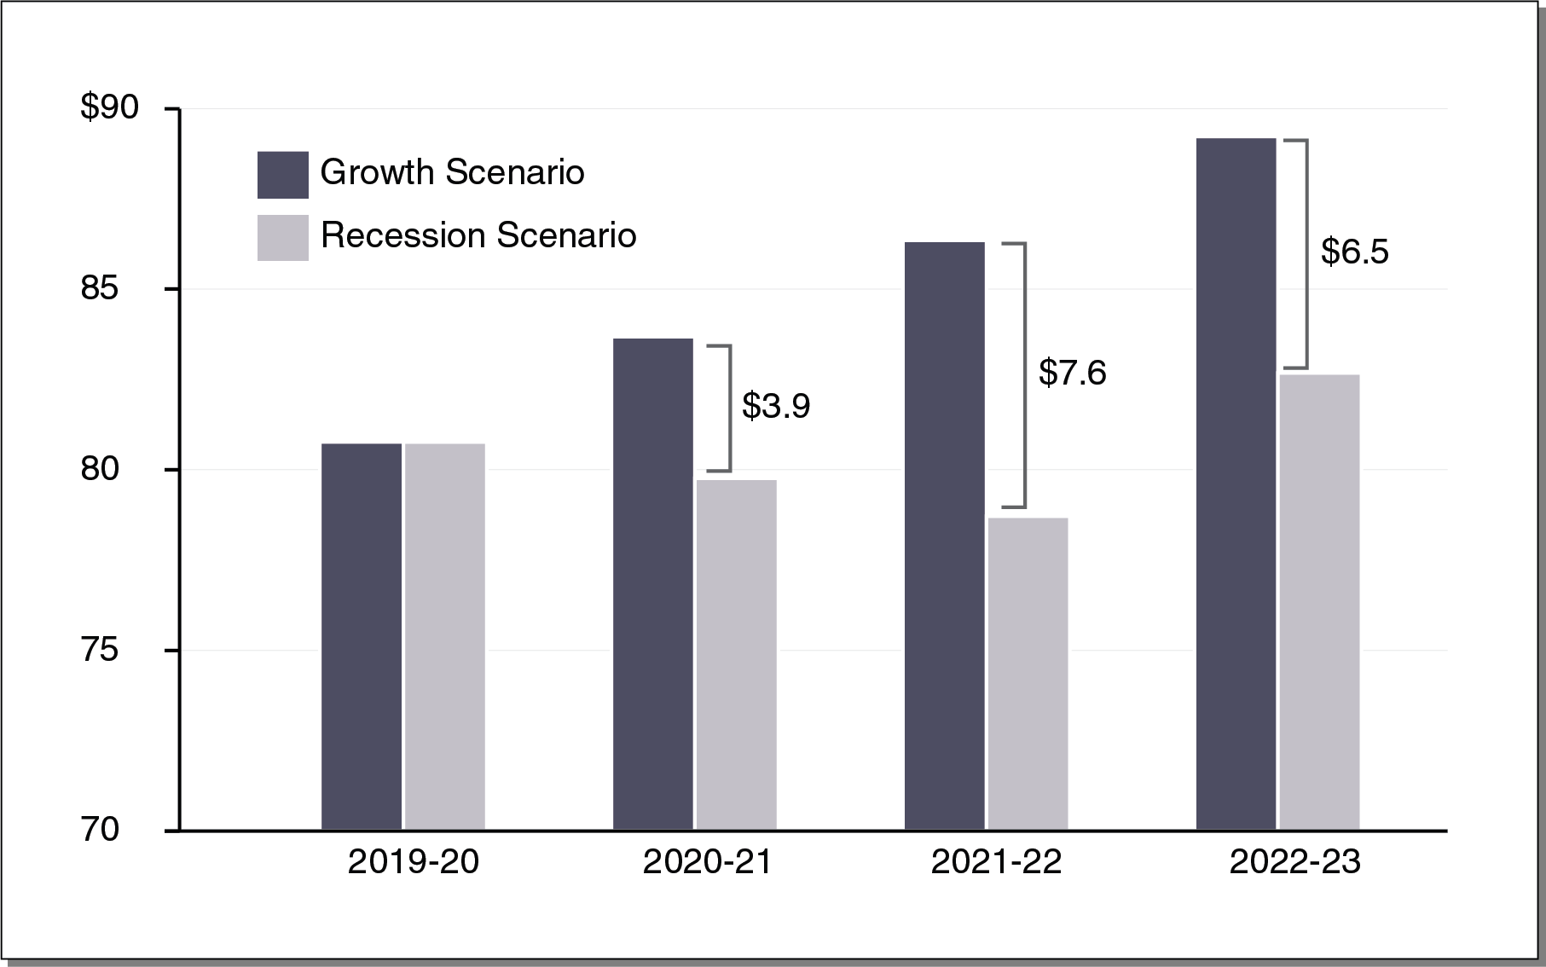
Minimum Guarantee Differs by Billons of Dollars Under the Two Scenarios
(In Billions)

Slide 22
Key District Budget Trends

Slide 23
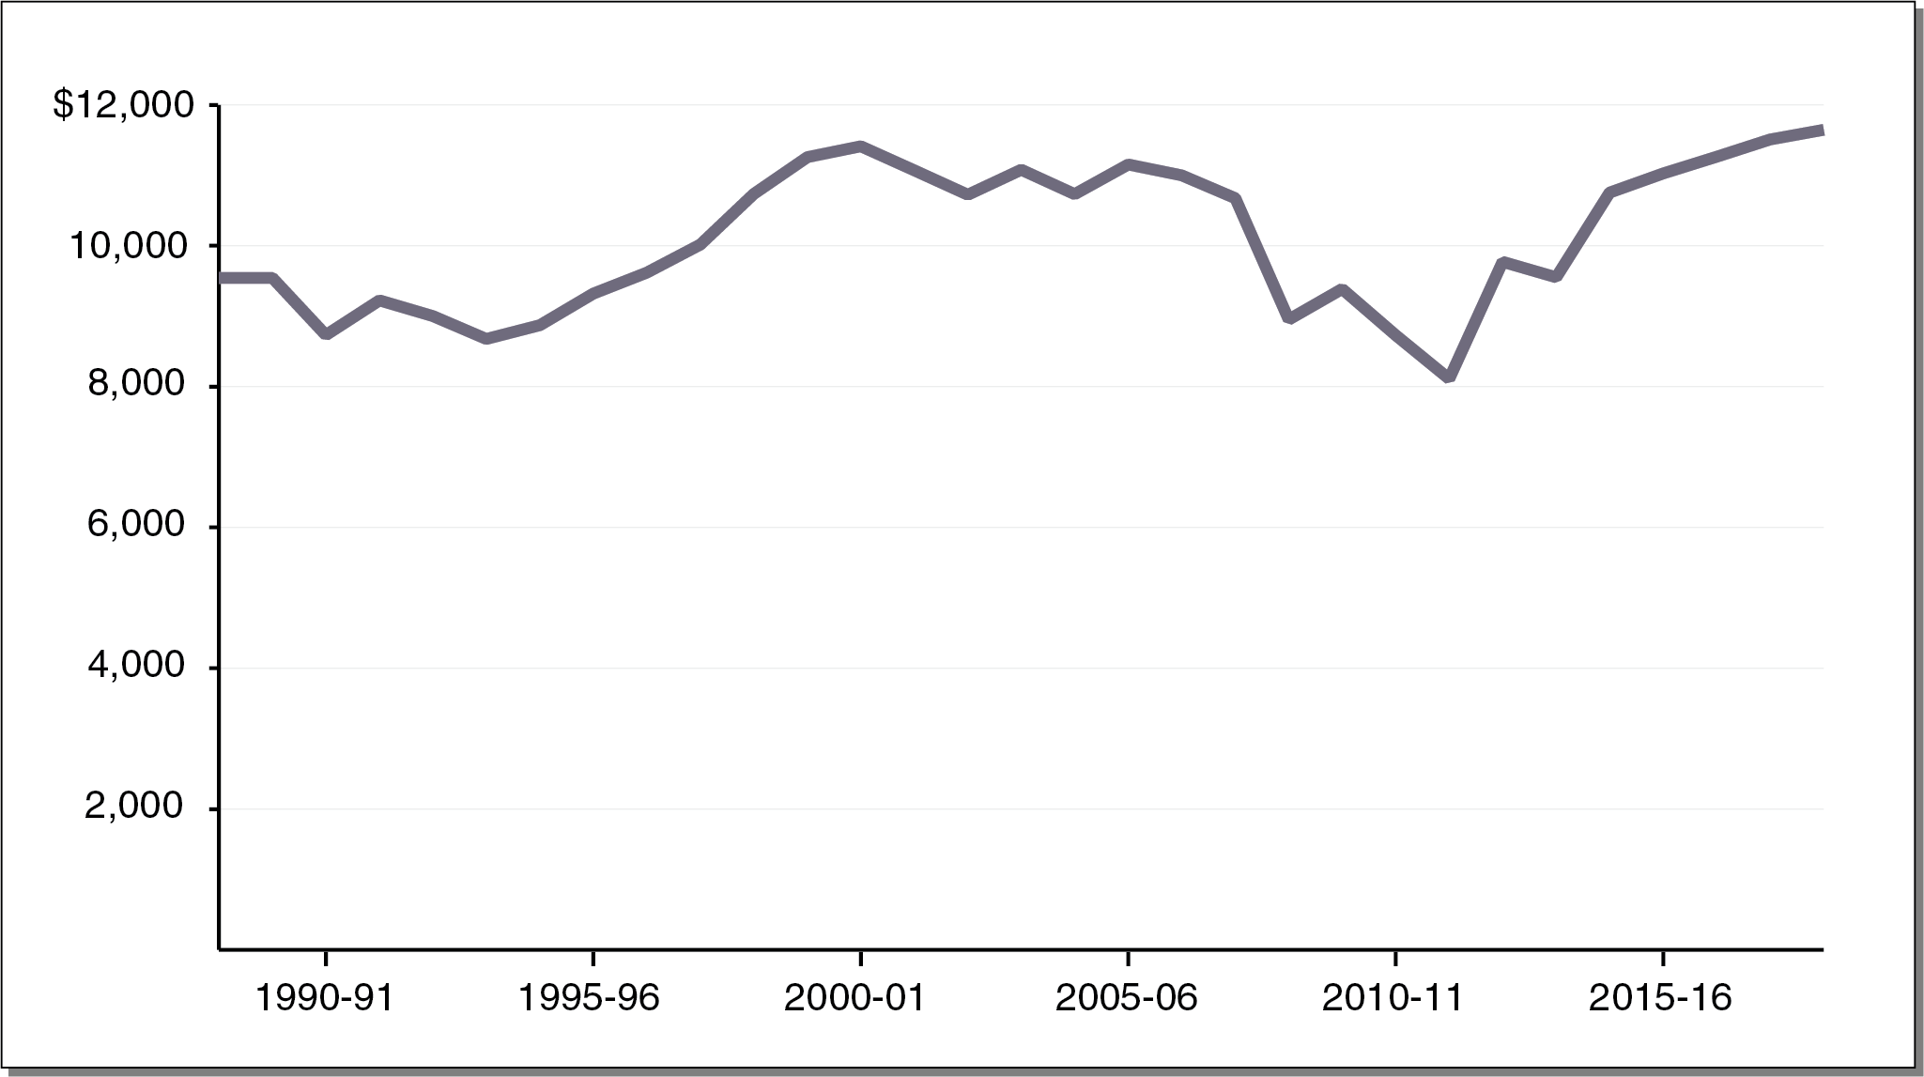
Proposition 98 Funding Per Student at All-Time High
Inflation Adjusted, 2018-19 Dollars

Slide 24
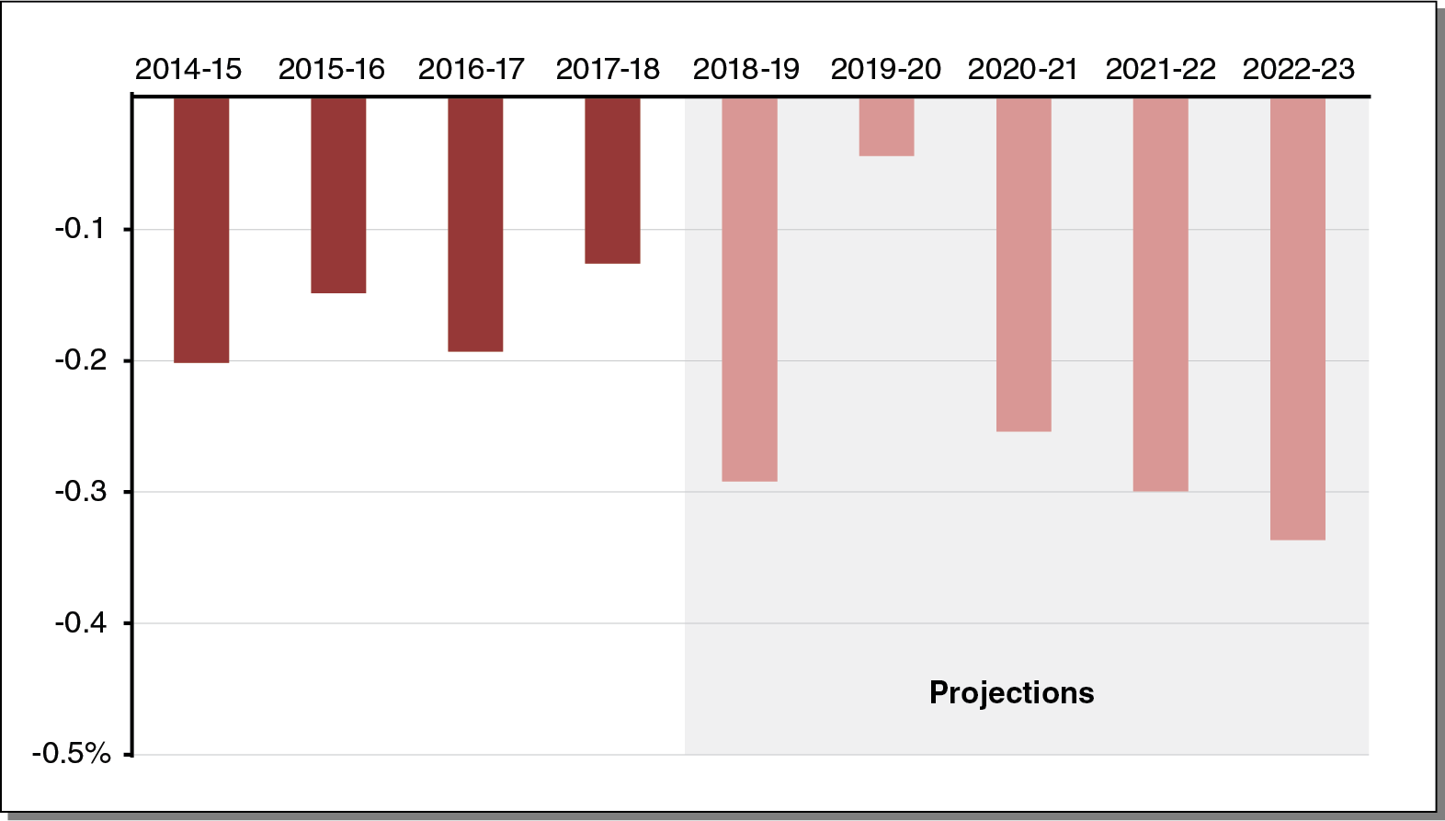
K-12 Attendance Projected to Continue Declining
Annual Percent Change

Slide 25
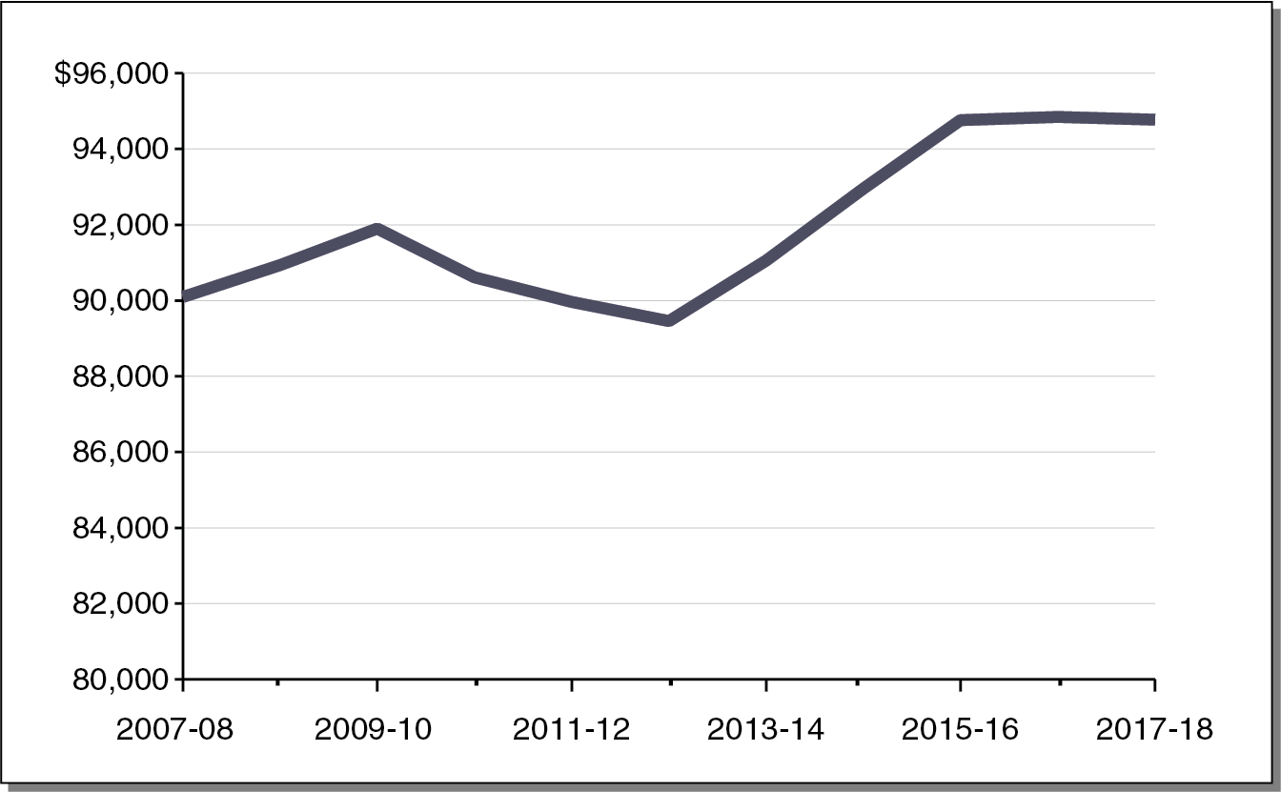
Average Teacher Salary and Benefits Growing Over Time
Inflation Adjusted, 2017-18 Dollars

Slide 26
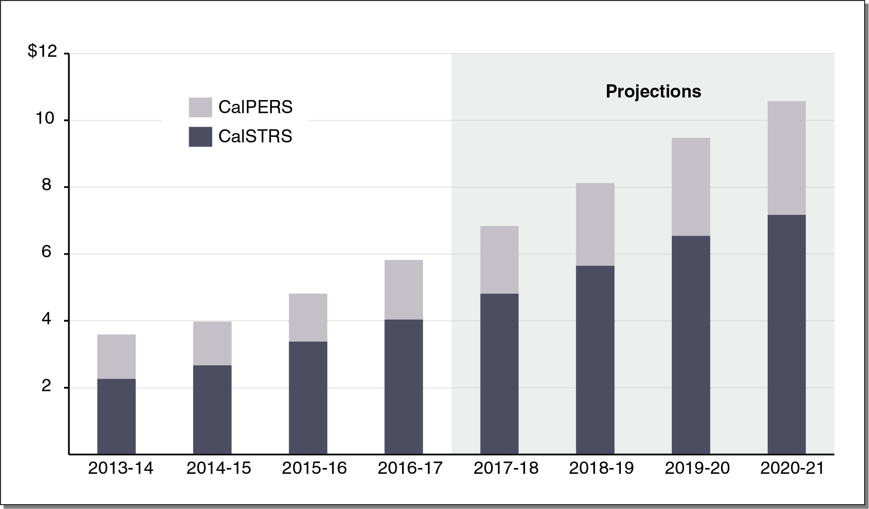
Pension Costs Projected to Continue Rising
Annual District Contributions (In Billions)

Slide 27
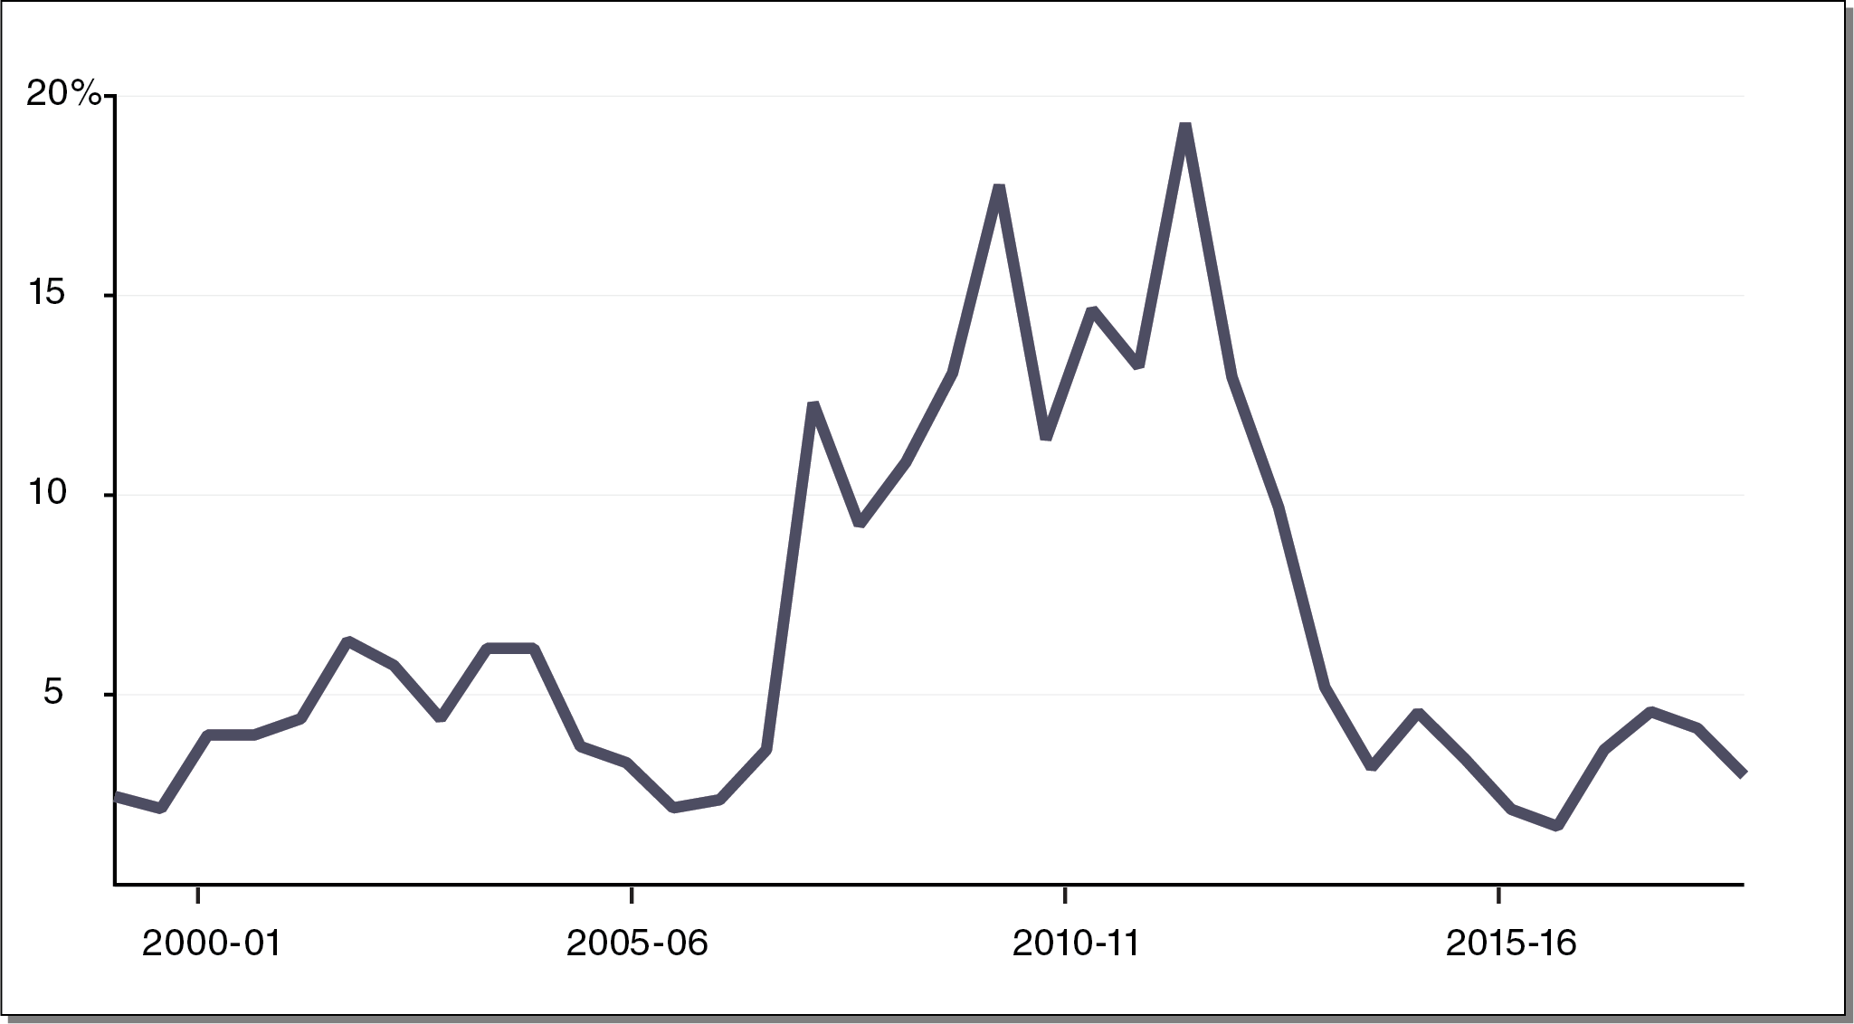
Share of School Districts in Fiscal Distress at Historically Low Levels
Note: “Fiscal distress” defined as a district receiving a qualified
or negative rating from its county office of education.

