Slide 1
CCC Budget and Policy Update
California Community College (CCC) Financial Aid Directors
April 4, 2016

Slide 2
2016-17 Budget Proposals

Slide 3
Overview of Governor’s Budget Plan
CCC Funding (In Millions)
Funds | 2015-16 Revised | 2016-17 Proposed | Change From 2015-16
Proposition 98 Funds
General Fund | $5,373 | $5,447 | $74
Local property taxes | 2,624 | 2,812 | 188
Subtotals | ($7,997) | ($8,259) | ($262)
Other Funds
Non-Proposition 98 General Fund | $440 | $524 | $84
Enrollment fees | 420 | 426 | 6
Lottery | 202 | 202 | —
Special funds and reimbursements | 95 | 95 | —
Totals | $9,154 | $9,506 | $352

Slide 4
Governor’s CCC Proposals
Ongoing Funding Proposals (In Millions)
Proposal | Amount
Create new career technical education (CTE) program | $200
Fund 2 percent enrollment growth | 115
Make CTE Pathways Program ongoing | 48
Augment Basic Skills Initiative | 30
Provide 0.47 percent cost-of-living adjustment | 31
Increase funding for Institutional Effectiveness Initiative | 10
Improve systemwide data security | 3
Increase apprenticeship reimbursement rate | 2
Total | $438

Slide 5
Governor’s CCC Proposals
One-Time Funding Proposals (In Millions)
Proposal | Amount
Fund deferred maintenance and instructional equipment | $290
Pay down mandate backlog | 76
Fund innovation awards at community colleges | 25
Fund “zero-textbook-cost degree” programs | 5
Total | $396

Slide 6
Workforce Education

Slide 7
Governor’s Budget: Workforce Education
$200 Million for New Career Technical Education (CTE) Program
Implements Strong Workforce Task Force recommendations to expand availability of CTE.
Requires collaborative regional planning.
Chancellor’s Office allocates funding to regions. Districts within each region decide how to use it.

Slide 8
Governor’s Budget: Workforce Education
Makes CTE Pathways Program Ongoing
Program was set to expire at end of 2014-15, extended one year through 2015-16.
Increases Funding Rate for Apprenticeship Instruction
Keeps rate aligned with noncredit career development and college preparation course funding rates.

Slide 9
LAO Assessment: Workforce Education
A Few Task Force Recommendations Could Require Funding or Legislation
Supplemental funding for high-cost programs, financial aid for CTE students, removing statutory barriers to hiring CTE instructors.
Proposal Does Not Link Funding to Root Issues
Equipment needs and small class sizes are main cost drivers.
Proposal Does Not Address Other Notable Issues
Financial aid for CTE students.
Statutory barriers to hiring CTE instructors.

Slide 10
LAO Recommendations: Workforce Education
Consolidate Planning Processes
Replace Governor’s Proposal With Better-Structured Program Linked to Cost Drivers
Reject Continuation of CTE Pathways Program
Remove Legal Barriers to Hiring CTE Instructors
Consider Increasing Cal Grant C Award Amount
Adopt Apprenticeship Rate Increase

Slide 11
Other Proposals

Slide 12
Enrollment Growth
Background
Systemwide, CCC falling short of meeting 2015-16 enrollment target (3 percent).
Governor’s Proposal
2 percent enrollment growth for 2016-17.
Recommendation
Use updated information in May to make final enrollment decisions.

Slide 13
Governor’s Budget: Basic Skills
Augments Basic Skills Initiative by $30 Million
Brings annual funding to $50 million.
Expands Purpose of Initiative
Adds four activities to allowable uses of funding, including boosting use of open educational resources.
Introduces Performance Funding Into Program

Slide 14
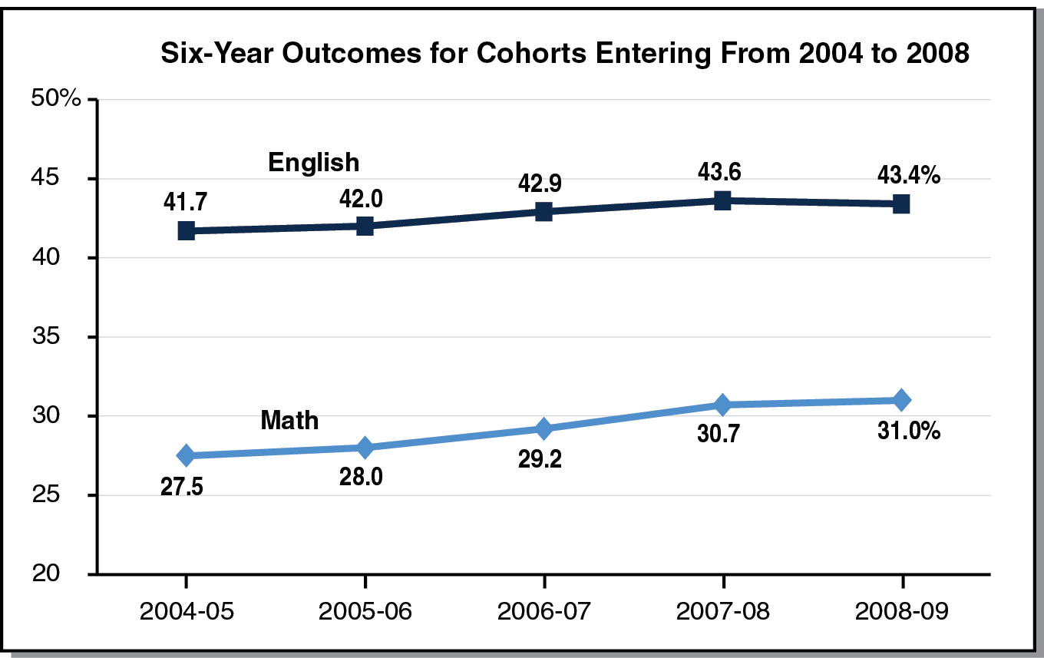
LAO Assessment: Basic Skills
Basic Skills Initiative Has Had Limited Impact on Systemwide Outcomes

Slide 15
LAO Assessment: Basic Skills
Two New Basic Skills Grant Programs Created in 2015-16 May Improve Success
Community Colleges Basic Skills and Student Outcomes Transformation Program ($60 million).
Basic Skills Partnership Pilot Program ($10 million).

Slide 16
LAO Recommendations: Basic Skills
Recommend Rejecting Governor’s Proposal to Augment Basic Skills Initiative
Consider instead boosting transformation program.
Consider increasing ongoing funding in future based on results of transformation and partnership pilots.
Recommend Modifying Basic Skills Initiative Requirements and Transitioning to Performance Funding

Slide 17
Other Ongoing CCC Proposals
$10 Million Augmentation for Institutional Effectiveness Partnership Initiative
Proposal worth considering, but recommend caution regarding speed of growth.
$3 Million to Improve Systemwide Data Security
Recommend adopting proposal.

Slide 18
One-Time CCC Funding Proposals
$290 Million for Deferred Maintenance and Instructional Support
Recommend funding maintenance backlog but requiring accompanying plan to retire backlog.
$25 Million for Innovation Awards
Recommend rejecting proposal.
$5 Million for Zero-Textbook-Cost Degrees
Recommend modifying proposal for broader impact.

Slide 19
State Financial Aid Budget
Governor’s Budget
Provides $2.3 billion for California Student Aid Commission (CSAC).
Assumes $50 million in Cal Grant savings in 2015-16.
Assessment
Data suggests more savings from Middle Class Scholarship Program (several tens of millions of dollars).
Recommendation
Require updated estimates at May Revision.

Slide 20
Legislative Proposals

Slide 21
Selected Bills
AB 1449 (Lopez)
Makes students without high school credential eligible for transfer entitlement.
AB 1583 (Santiago)
Expands eligibility for CCC fee waivers and creates new CCC aid program.
AB 1721 (Medina)
Increases Cal Grant B access award to $3,000, transfer entitlement age to 31, transfer entitlement window to three years, and competitive awards to 30,000.
AB 1892 (Medina)
Raises maximum Cal Grant C award for students at all segments to $3,000.
SB 1314 (Block)
Makes CCC baccalaureate students eligible for Cal Grant A tuition awards.
SB 1357 and 1358 (Block)
1357 provides $1,500 supplement to CCC Cal Grant B recipients; 1358 extends Cal Grant A and B eligibility to six years or equivalent.

Slide 22
Selected Bills
AB 2520 (Rodriguez)
Requires CSAC to report on ways to increase financial aid participation.
SB 1450 (Glazer)
Caps California State University tuition and fees and provides registration priority for freshman and transfer students participating in a California Promise Program.
AB 1741 (Rodriguez)
Provides $25 million for a (different) California College Promise Innovation Grant Program.
SB 66 (Leyva)
Aligns CTE outcome measures and makes occupational licensing data available to CCC.

Slide 23
lao.ca.gov

