Slide 1
Budget Outlook
California County Superintendents Educational Services Association
February 19, 2016

Slide 2
State Budget

Slide 3
Governor’s Budget Expenditures
(Dollars in Millions)

Slide 4
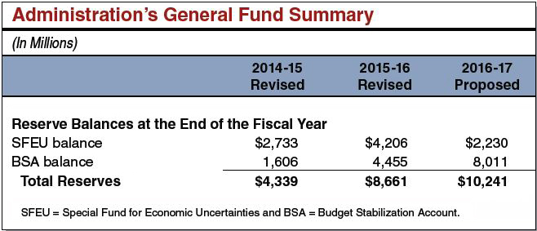
Reserves Grow Under Governor’s Budget Plan

Slide 5
Constitutional Spending Requirements
Reserves
Proposition 2 Debt Payments
Proposition 98

Slide 6
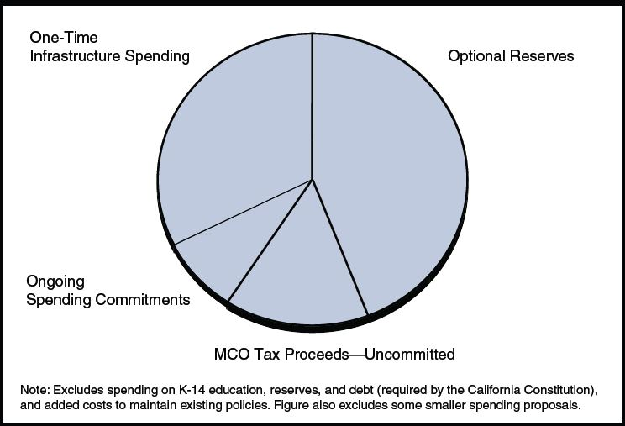
Discretionary Spending Proposals

Slide 7
Education Budget

Slide 8
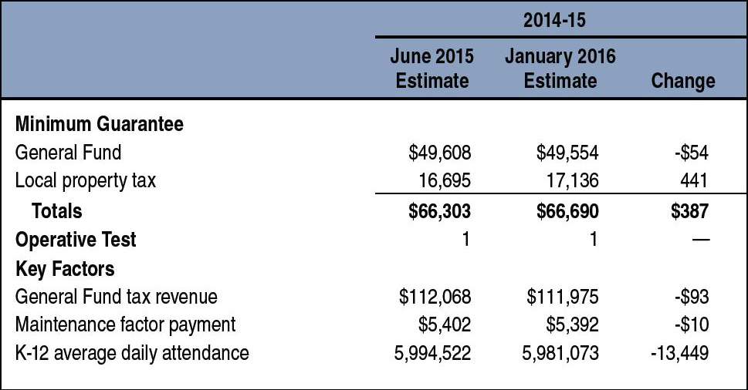
Updating Estimate of 2014-15 Minimum Guarantee
(Dollars in Millions)

Slide 9
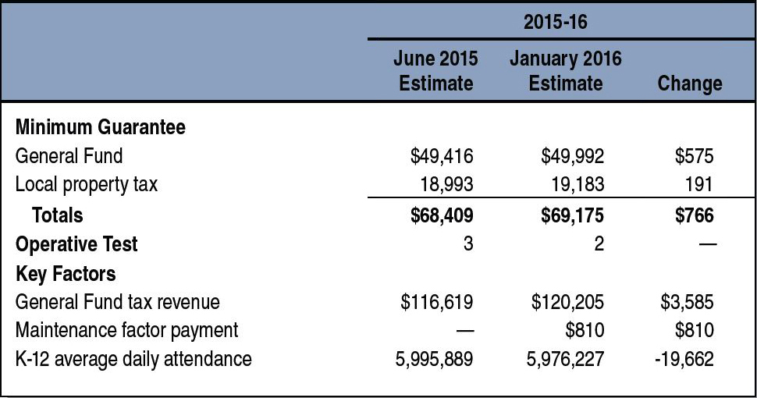
Updating Estimate of 2015-16 Minimum Guarantee
(Dollars in Millions)

Slide 10
2016-17 K-12 Funding
(Dollars in Millions)

Slide 11
Proposition 98 Property Tax Revenue Estimates
Reflects Governor’s Budget (Dollars in Millions)

Slide 12
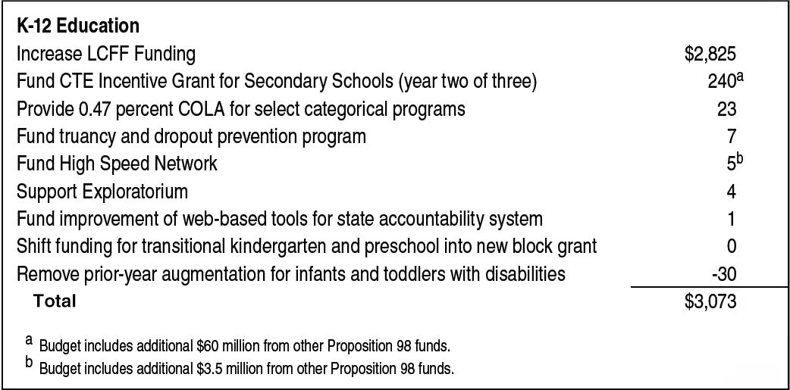
2016-17 Proposition 98 Changes
(In Millions)

Slide 13
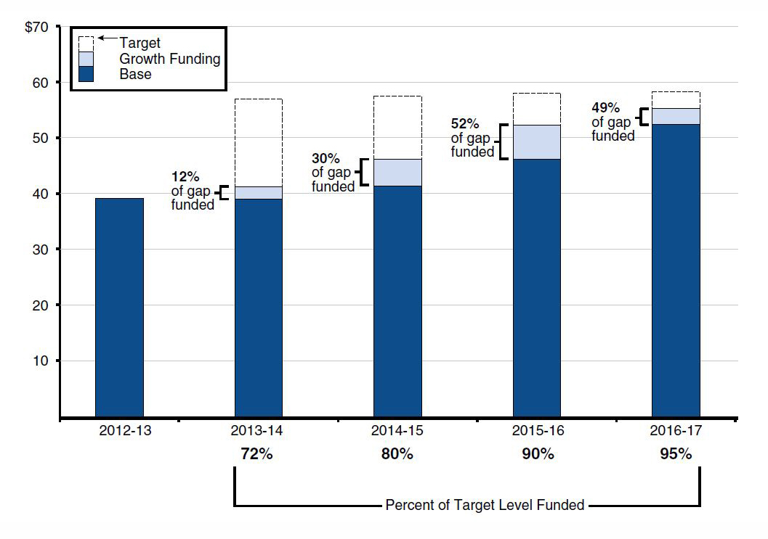
Tracking Funding for Local Control Funding Formula
(In Billions)

Slide 14
Assessment of Overall Plan
General Fund Revenue Estimates Solid
Property Tax Estimates Too Low
Cushion Against Economic Downturn Small

Slide 15
Preschool

Slide 16
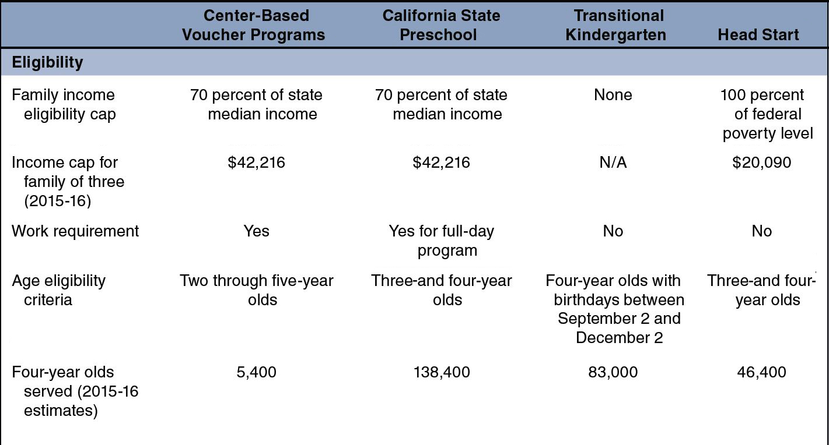
Major Preschool Programs in California: Eligibility Criteria

Slide 17
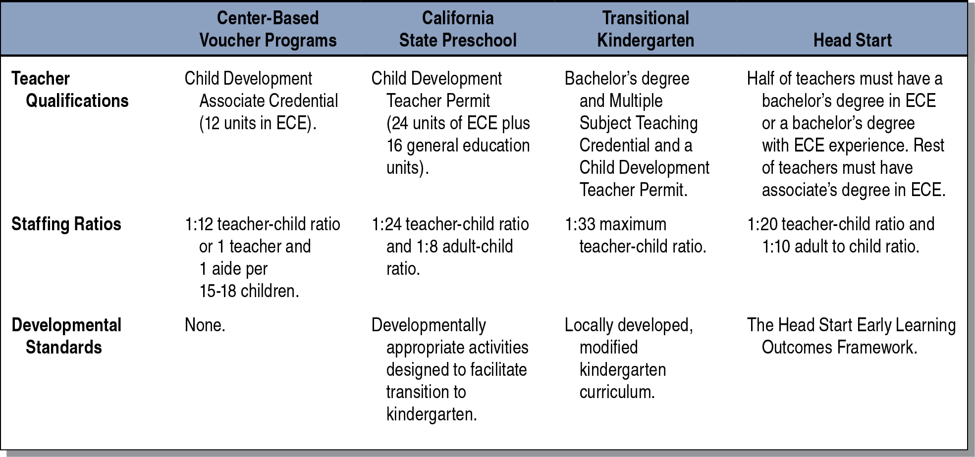
Major Preschool Programs in California: Standards

Slide 18
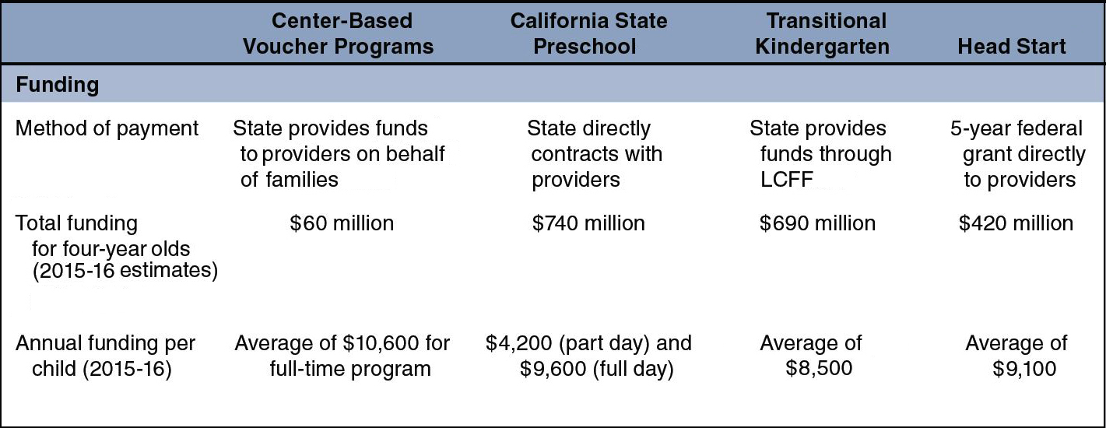
Major Preschool Programs in California: Funding

Slide 19
Preschool: Governor’s Proposal
Consolidate Three Funding Streams
Prioritize Low-Income and At-Risk Children
Allow Eligibility to Be Determined Locally
Allow Discretion in Determining Services
Address Other Details in Months Ahead

Slide 20
Preschool: Assessment
Positives:
Consolidating funds.
Focusing on low-income and at-risk children.
Shortcomings:
Allowing eligibility to be determined locally.
Lack of plan to keep funds linked with children.

Slide 21
Preschool: LAO Recommendations
Consolidate All Preschool Funding
Establish Eligibility Criteria
Link Funding to Children
Offer Full-Day Program to Working Families
Require Developmentally Appropriate Activities
Phase In

Slide 22
Education Mandates

Slide 23
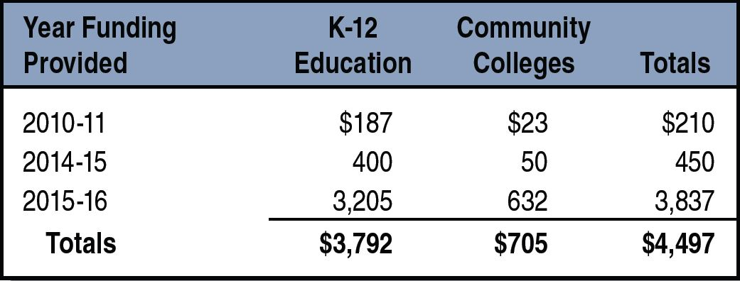
Funding for Education Mandates Backlog Since 2010-11
(In Millions)

Slide 24
Mandate Backlog: Governor’s Proposal
Provides $1.3 billion for K-12 backlog
Distributes on per-student basis ($214)

Slide 25
Mandate Backlog: Assessment
Half of School Districts and One-Third of COEs Have No Outstanding Claims
Large Variation in Remaining Claims
Retiring Backlog on Per-Student Basis Unrealistic

Slide 26
Distribution of LEAs’ Outstanding Mandate Claims
Claims per Student

Slide 27
Mandate Backlog: LAO Recommendations
Create $2.6 Billion Payment Plan
Provide $450 Per Student
Provide COEs Extra $20 Per Student for Countywide ADA
Provide COEs Minimum Grant
Write-off Remaining Claims Through 2015-16

Slide 28
Special Education

Slide 29
Special Education: Governor’s Proposals
Remove Last Year’s $30 Million Augmentation for Infant and Toddler Programs
Provide $30 Million (One Time) for Schoolwide Systems of Support

Slide 30
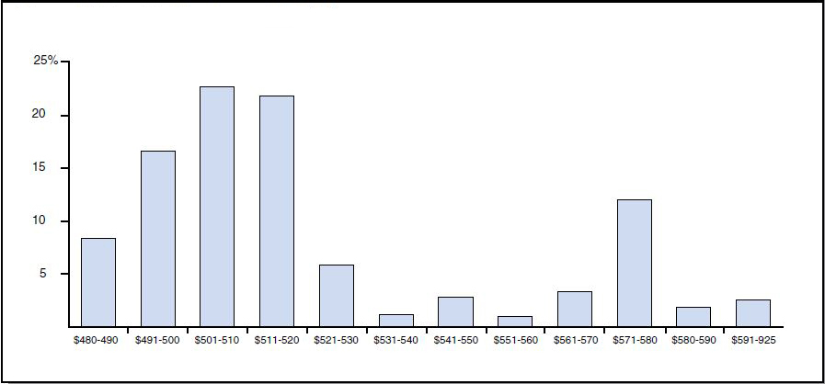
Special Education Per-Student Funding Rates Vary
Share of Statewide Attendance, 2013-14

Slide 31
Special Education: Recommendations
Provide $140 Million for Equalization
Undertake Comprehensive Study of Infant and Toddler Programs
Reject $30 Million Augmentation for Schoolwide Systems of Support

Slide 32
Local Control Funding Formula for
County Offices of Education

Slide 33
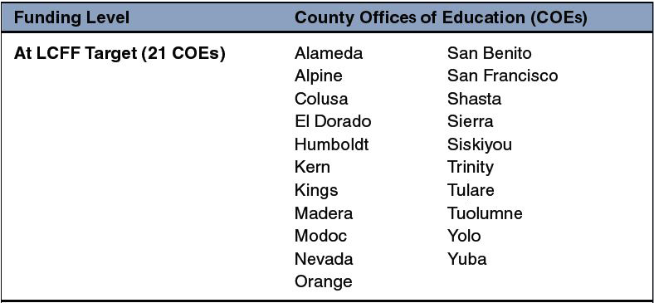
21 COEs at Their LCFF Target Funding Levels
Based on LAO Estimates, 2015-16

Slide 34
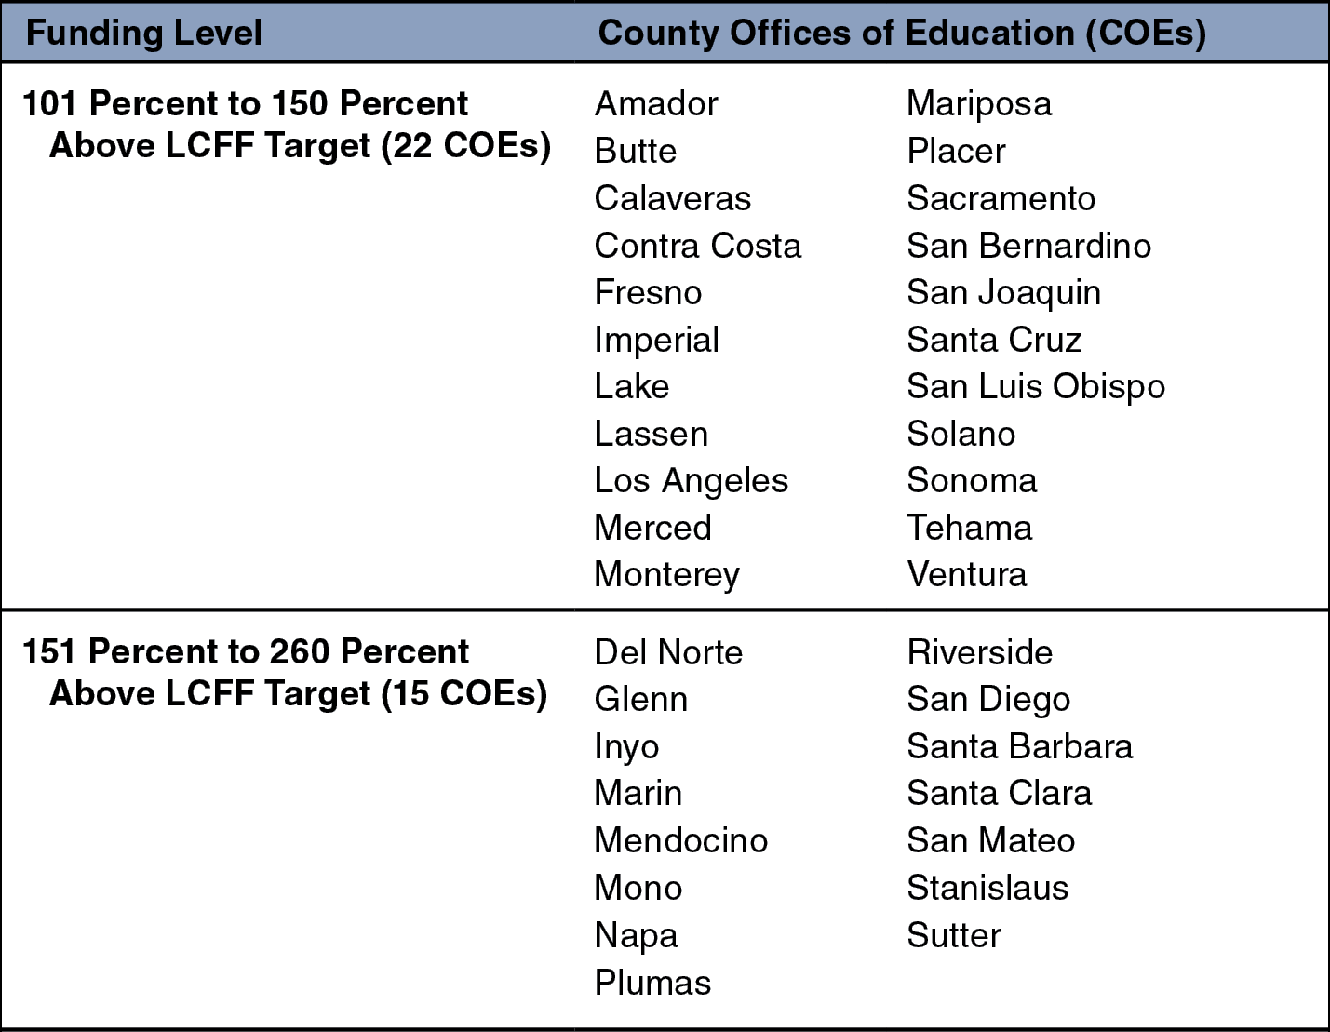
Almost Two-Thirds of COEs Funded Above LCFF Target
Based on LAO Estimates, 2015-16

Slide 35
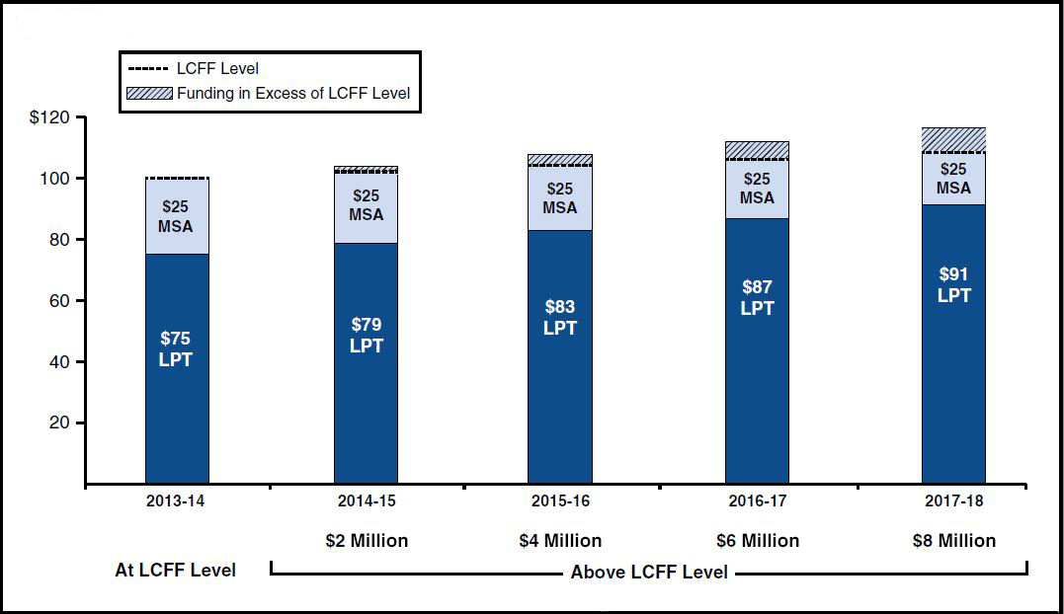
Illustration of How COE Minimum State Aid Is Working at Cross-Purposes With LCFF
(In Millions)

Slide 36
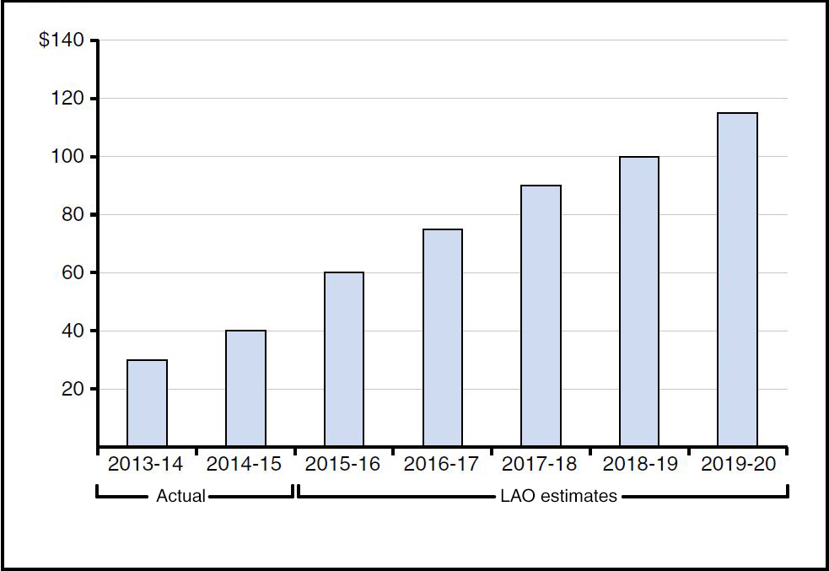
COE Minimum State Aid Obligations Are Growing
(In Millions)

Slide 37
Other Issues

Slide 38
Other Issues
Proposition 30 Tax Extension
CalSTRS and CalPERS Cost Increases
State School Deposit/Local Reserve Caps

