Slide 1

California’s
Fiscal Outlook
California School Boards Association
December 3, 2015

Slide 2
State’s Fiscal Outlook

Slide 3
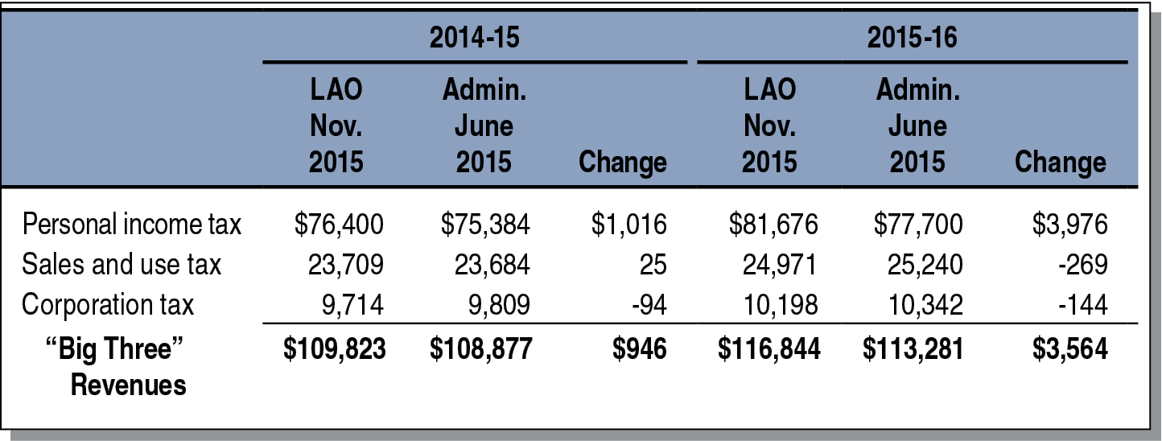
State Revenues Up in 2014-15 and 2015-16
General Fund and Education Protection Account Combined (In Millions)

Slide 4
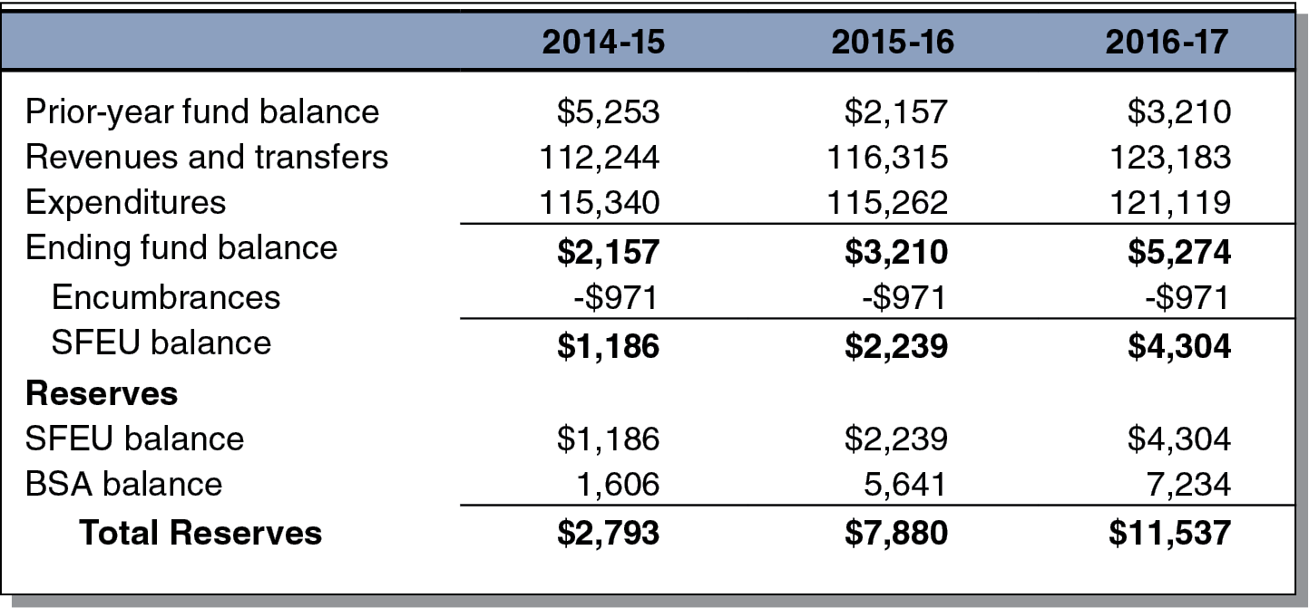
State’s General Fund Condition
Healthy in 2016-17
Estimates Under Main Scenario (In Millions)

Slide 5
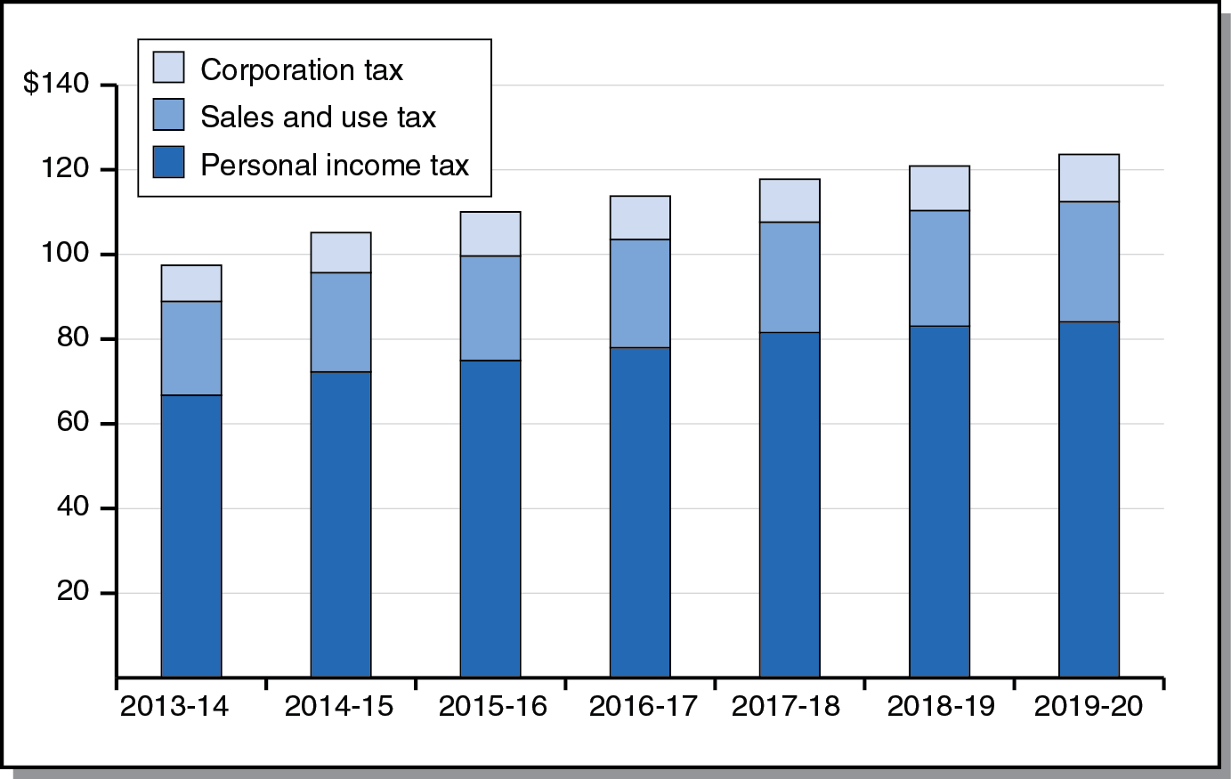
All Big State Revenue Sources
Grow Throughout Forecast Period
Big Three Revenues Under Main Scenario (In Billions)

Slide 6
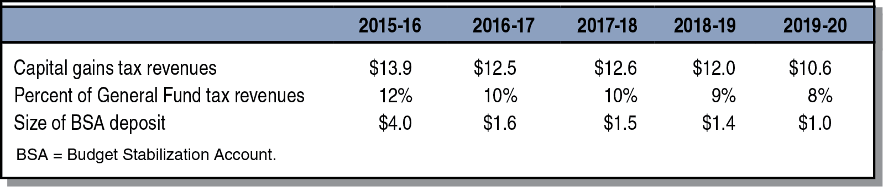
Annual Rainy Day Deposits Become Smaller Each Year of Forecast Period
Estimates Under Main Scenario (Dollars in Billions)

Slide 7
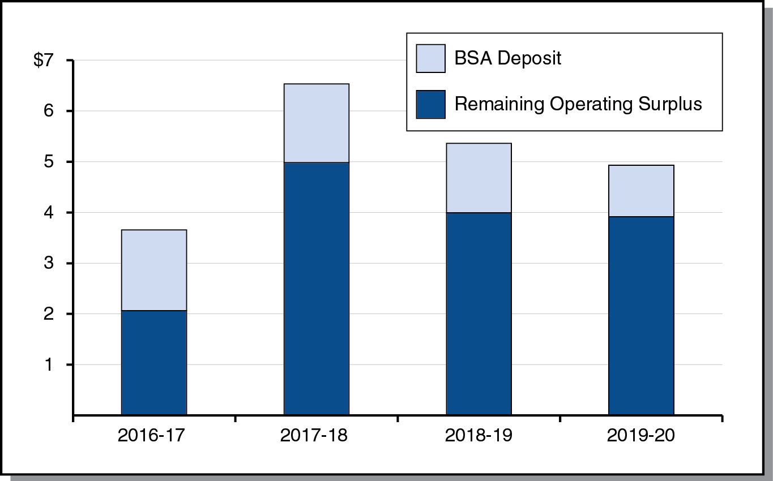
Under Main Scenario, Operating Surpluses Each Year of Period
(In Billions)

Slide 8
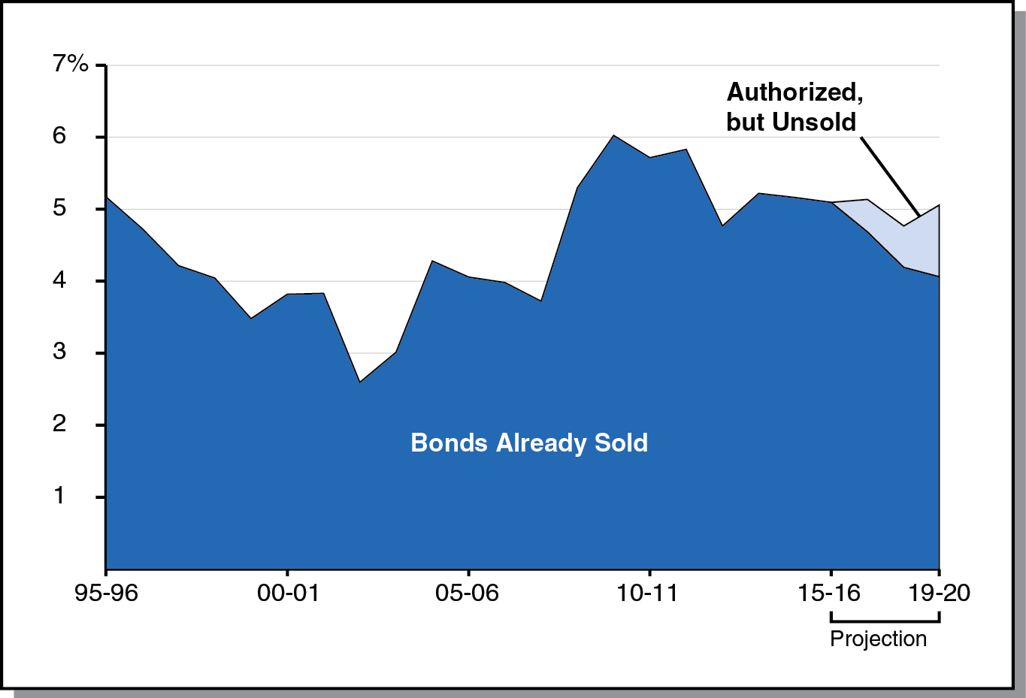
Debt-Service Ratio
Expected to Remain Around 5 Percent
Percent of General Fund Revenues and Transfers Spent on Debt Service

Slide 9
Education Outlook

Slide 10
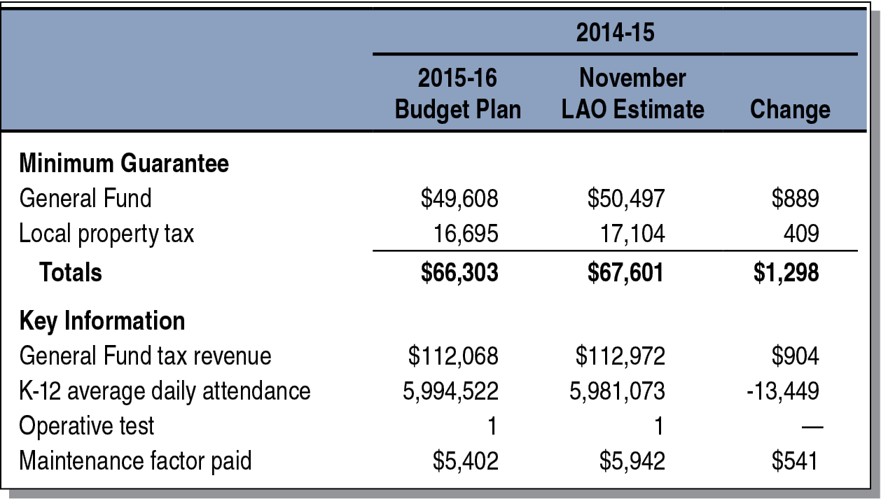
2014-15 Minimum Guarantee Up
From Budget Act Estimates
(Dollars in Millions)

Slide 11
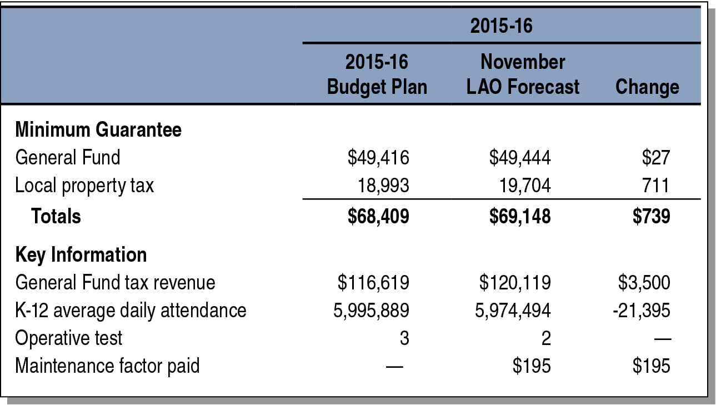
2015-16 Minimum Guarantee Up
From Budget Act Estimates
(Dollars in Millions)

Slide 12
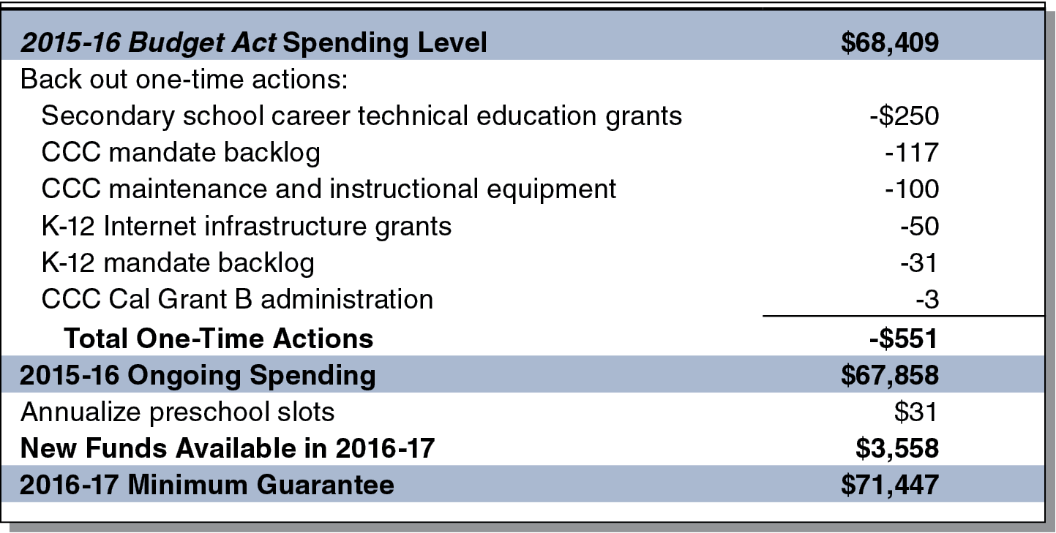
$3.6 Billion Increase in Proposition 98 Funding Projected for 2016-17
LAO Main Scenario (In Millions)

Slide 13
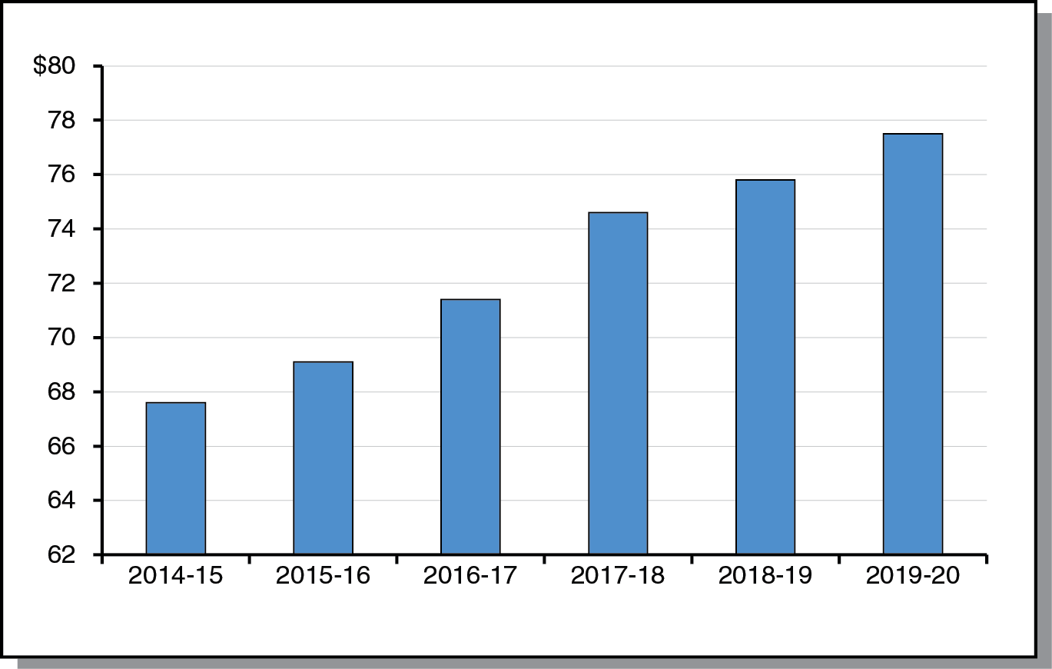
Minimum Guarantee Almost $10 Billion Higher in 2019-20 Than 2014-15
LAO Main Scenario (In Billions)

Slide 14
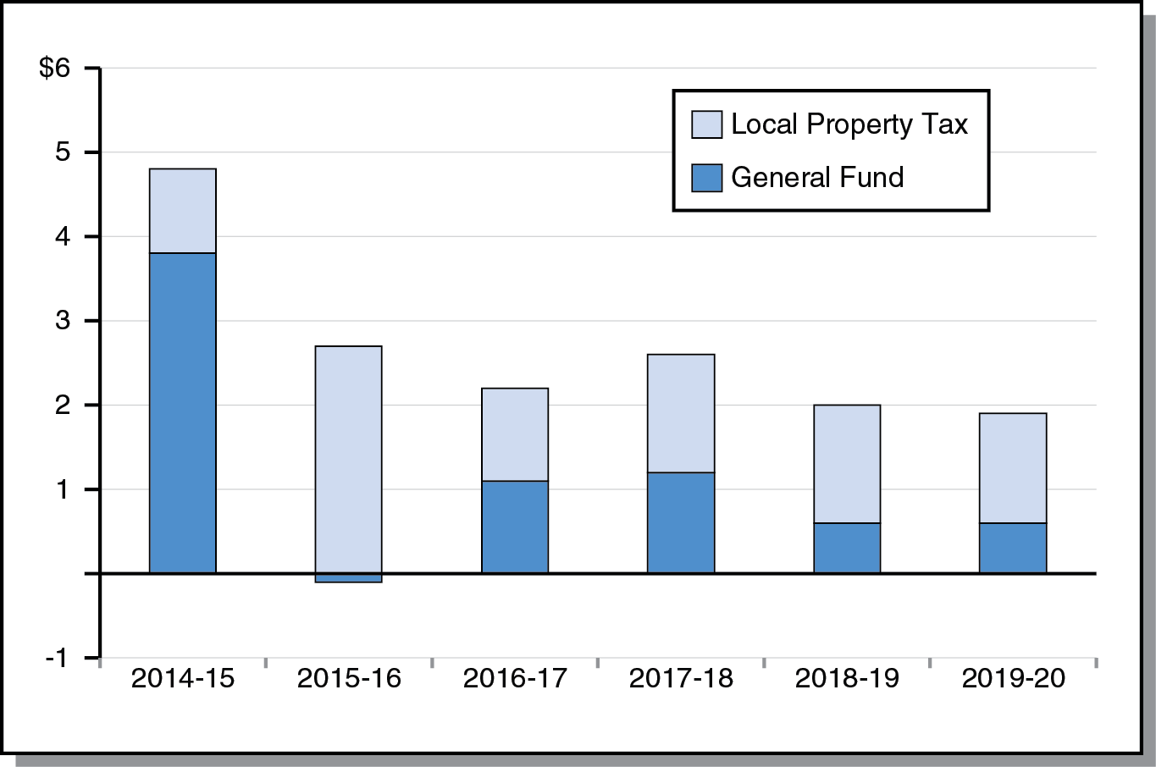
Increases in Guarantee Borne Disproportionately by Local Property Tax
Change From Prior Year (In Billions)

Slide 15
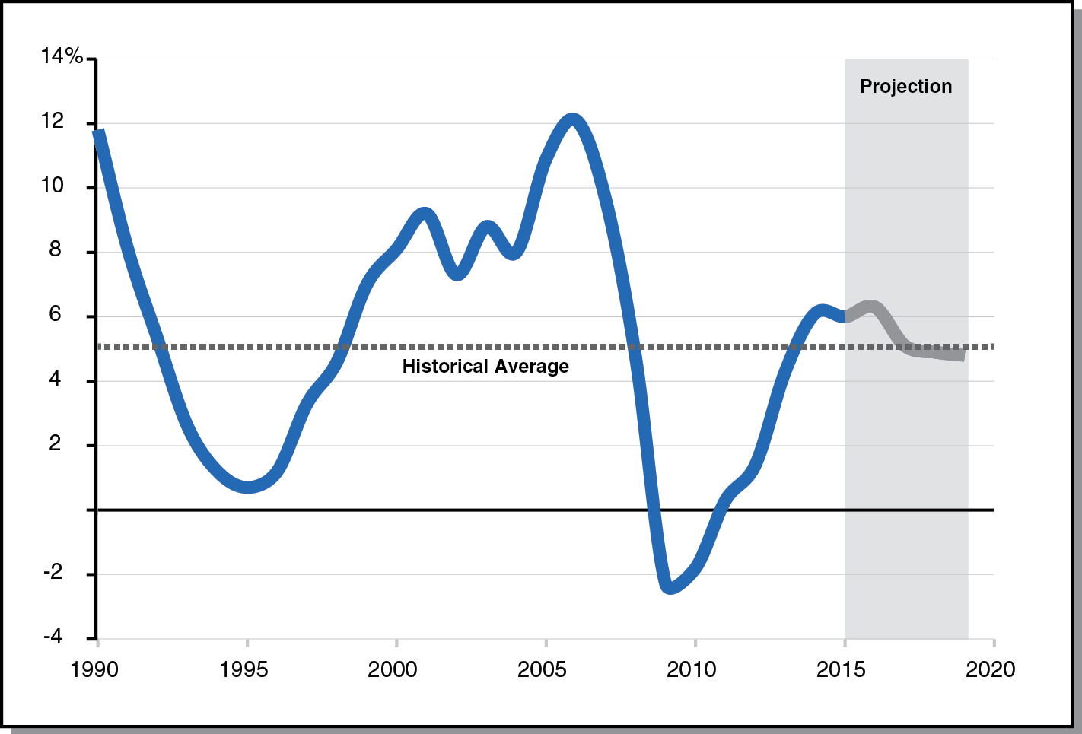
Assessed Property Values Grow
Moderately Throughout Forecast Period
Percent Change From Prior Year

Slide 16
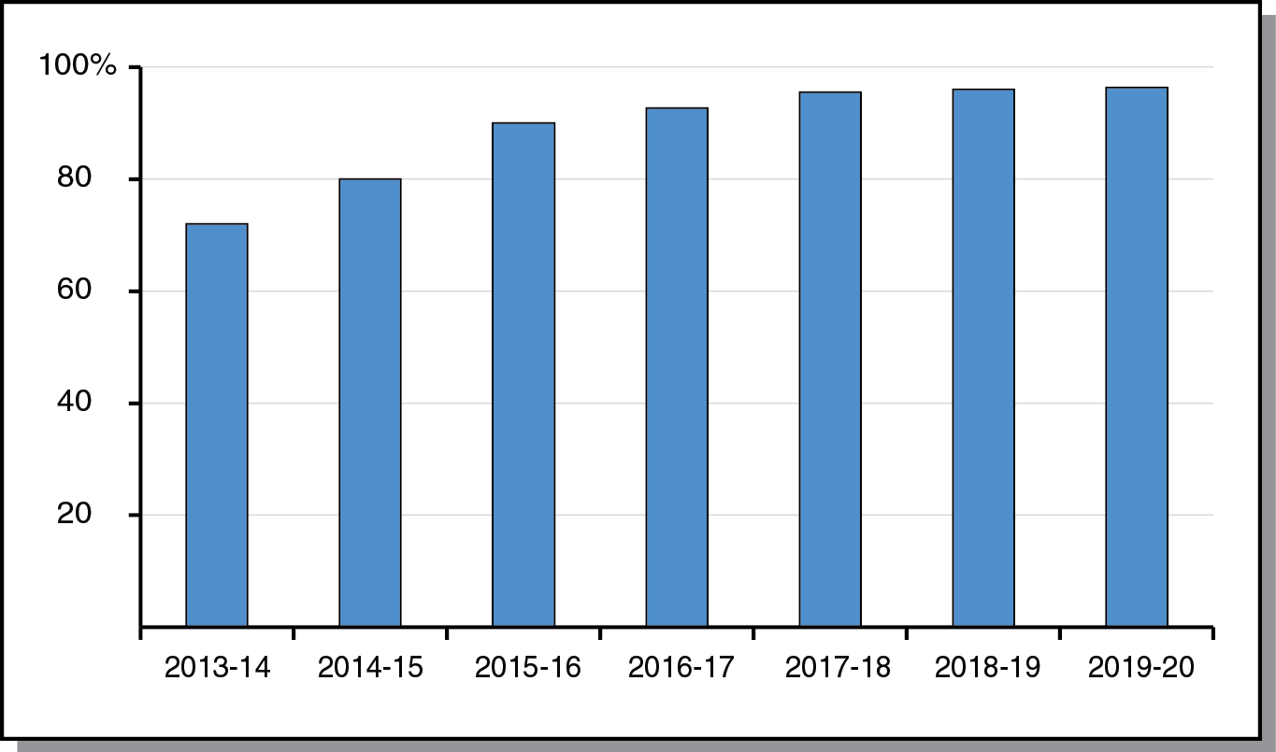
Local Control Funding Grows More Quickly During First Half of Forecast Period
Percent of Target Funded

Slide 17
Effect of State Revenues on Minimum Guarantee Changes Throughout Period
2014-15: Highly Sensitive
2015-16: Highly Insensitive
2016-17: Somewhat Sensitive
Remainder of Period: Somewhat Sensitive

Slide 18
Other Outlook Scenarios

Slide 19
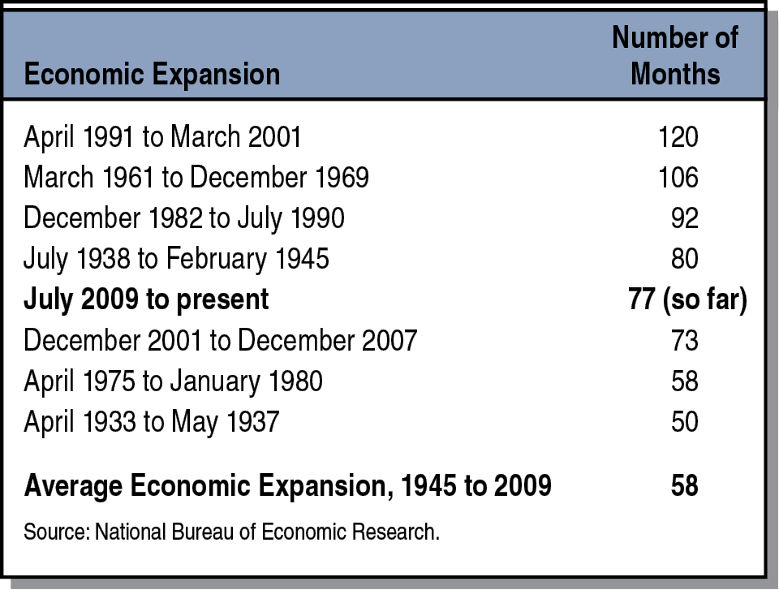
Current Economic Expansion
Already Among Longest in U.S. History
Data Since 1854

Slide 20
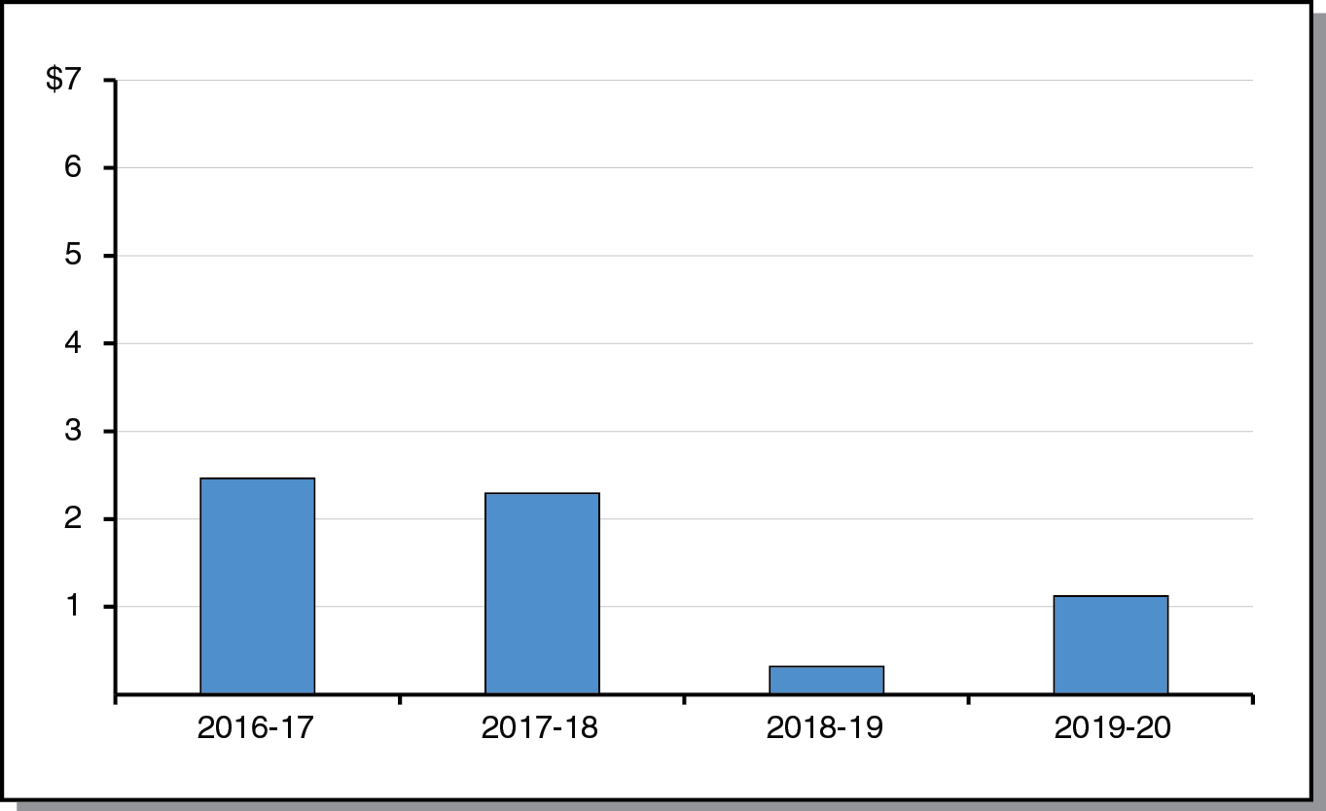
Slowdown Scenario:
Smaller Operating Surpluses
(In Billions)

Slide 21
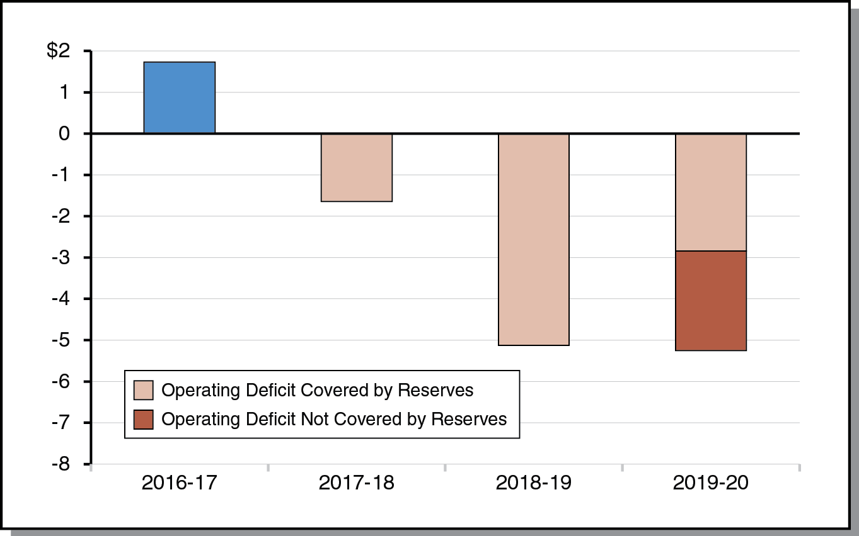
Recession Scenario: Reserves
Cover Operating Deficits Until 2019-20
(In Billions)

Slide 22
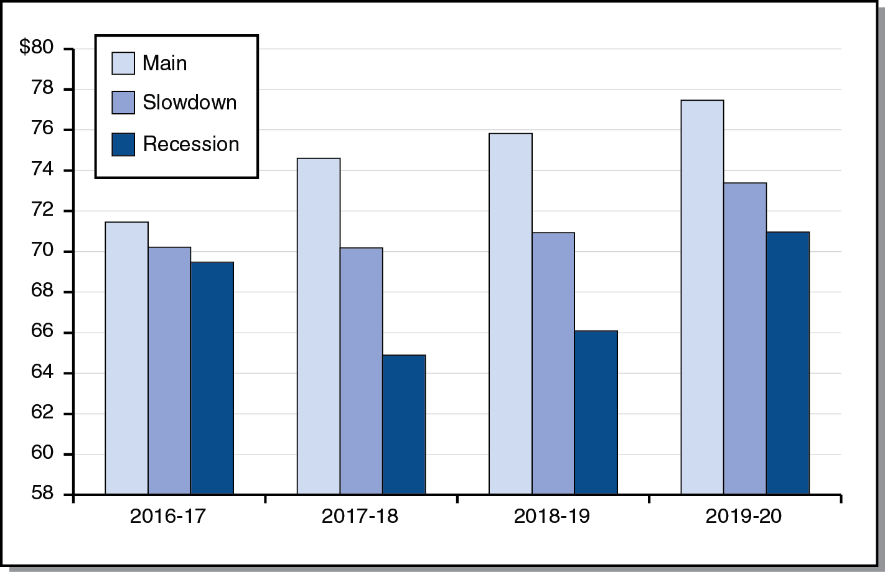
Comparing Proposition 98 Minimum Guarantee Under Three Scenarios
(In Billions)

