Slide 1

California’s Fiscal Outlook
California Association of School Business Officials, CBO Symposium
November 19, 2015

Slide 2
National and State Economic Outlook

Slide 3
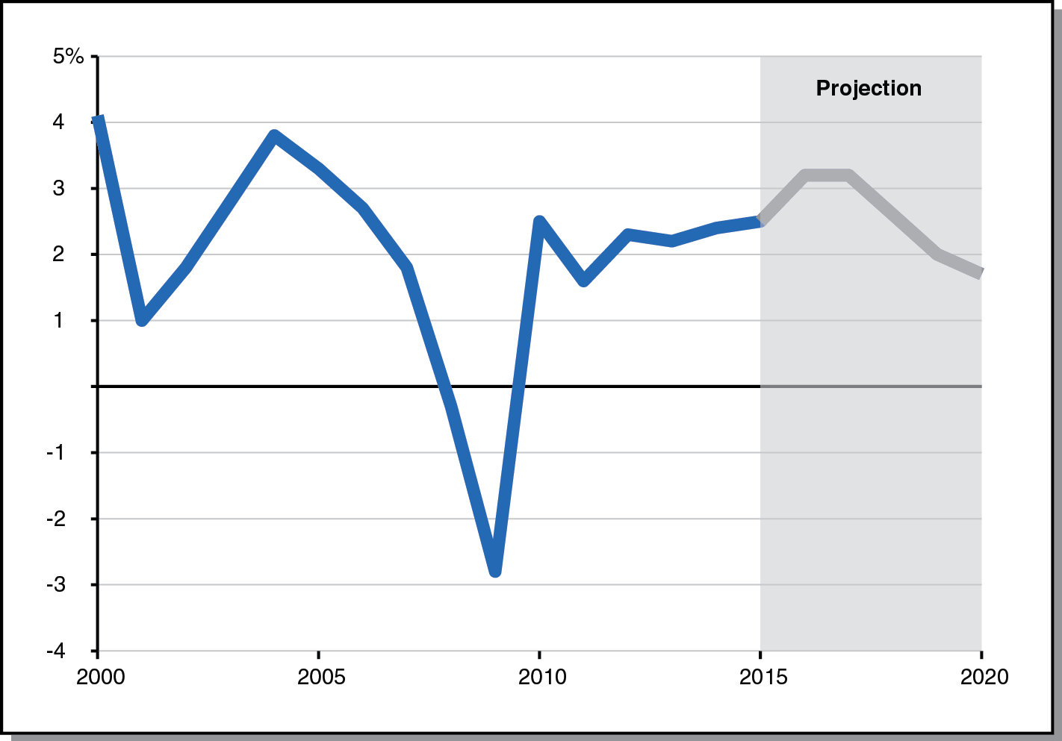
U.S. Economy Expands Throughout Forecast Period
Real Gross Domestic Product, Percent Change From Prior Year

Slide 4
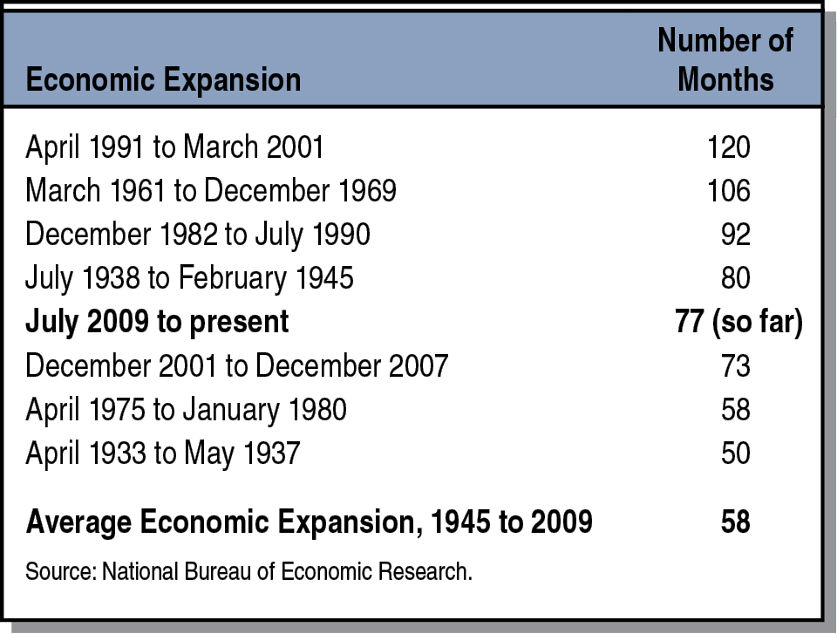
Current Economic Expansion Already Among Longest in U.S. History
Data Since 1854

Slide 5
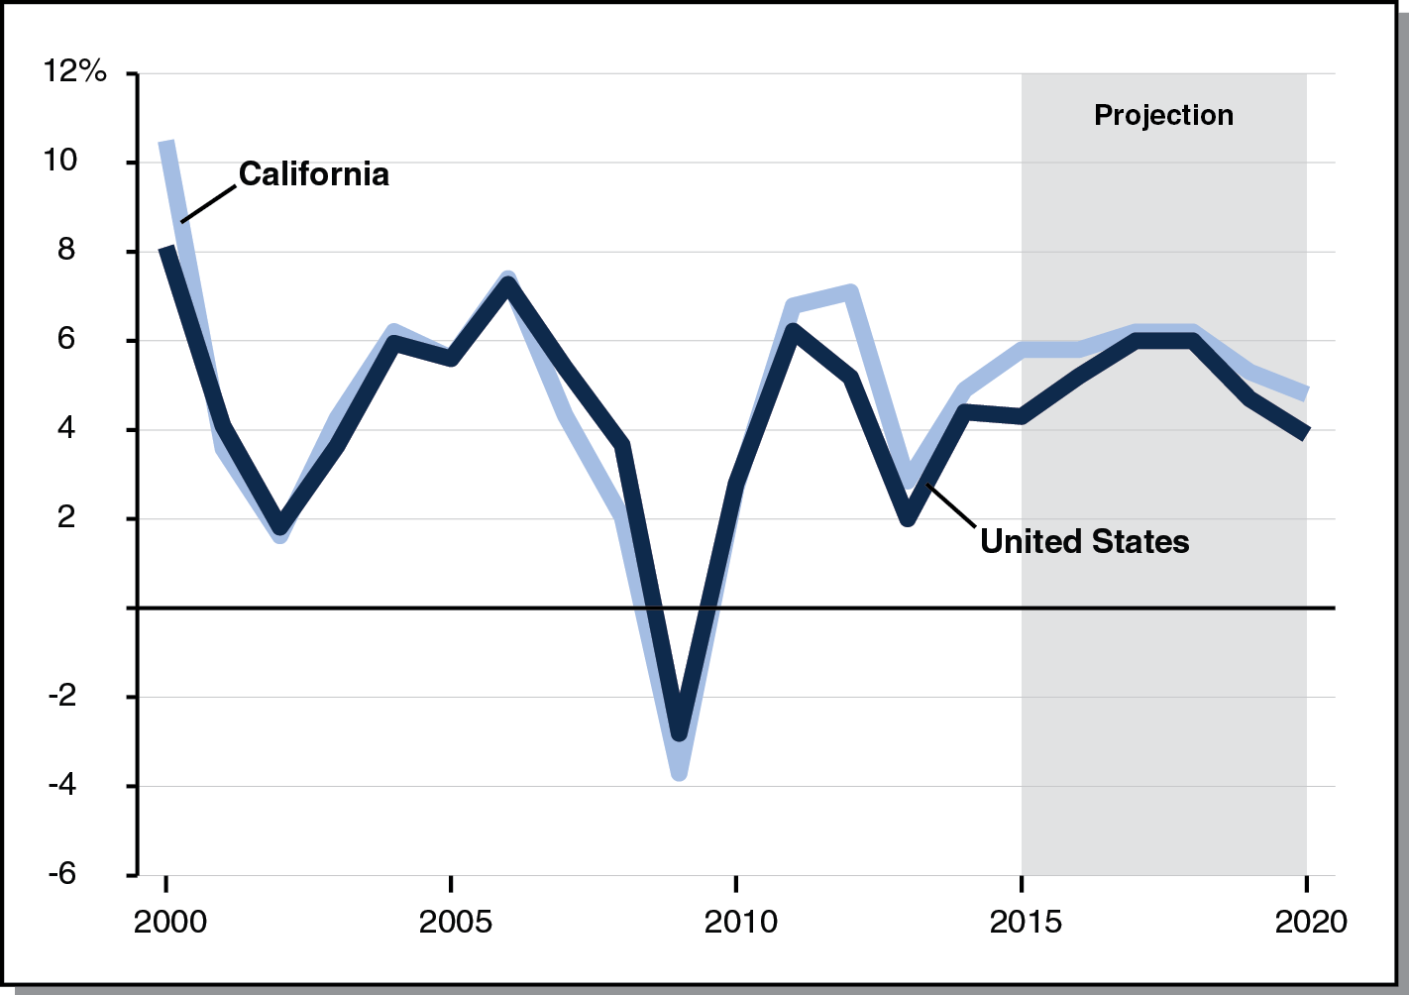
Growth in Personal Income StrongThroughout Forecast Period
Percent Change From Prior Year

Slide 6
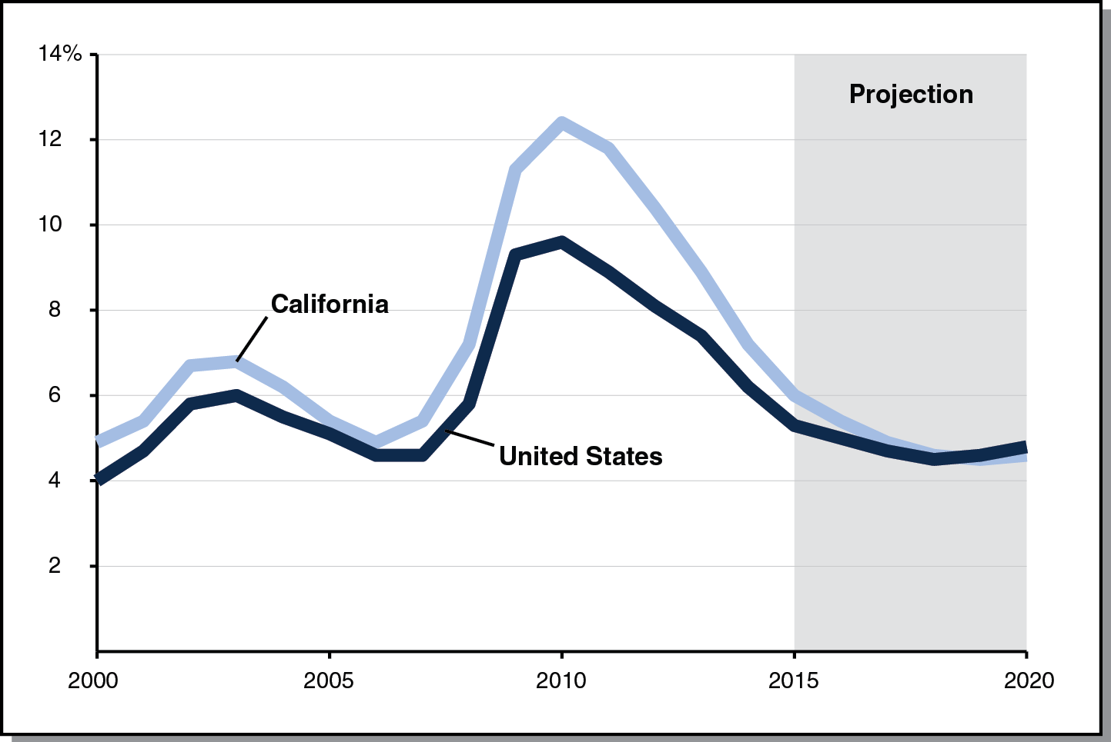
Unemployment Rate Drops Throughout Most of Forecast Period
Percent Change From Prior Year

Slide 7
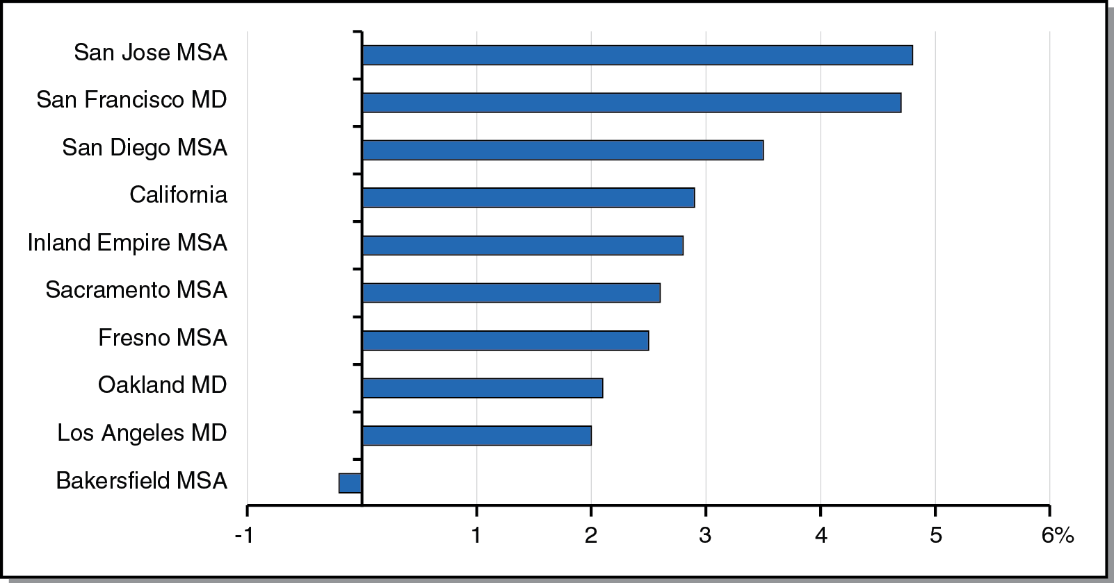
Bay Area Job Growth Has Outpaced Rest of State
Percent Job Growth From Prior Year, As of September 2015

Slide 8
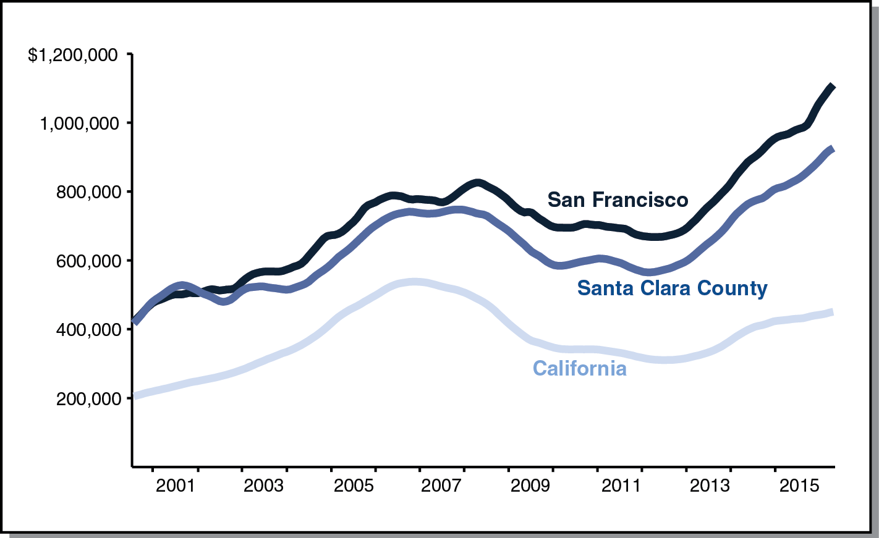
Bay Area Home Prices Have Outpaced the Rest of the State
Median Home Price

Slide 9
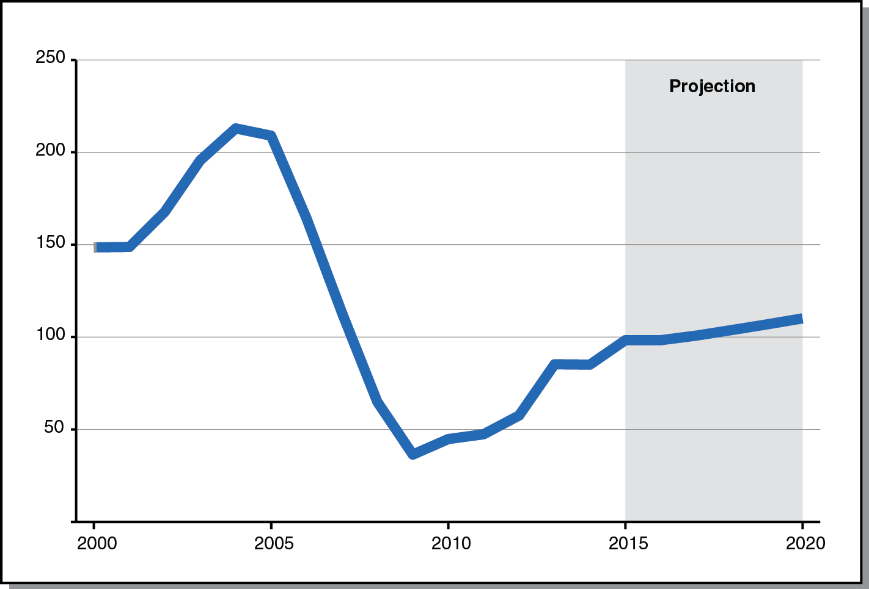
California Housing Permits Increase Throughout Forecast Period
Permits, In Thousands

Slide 10
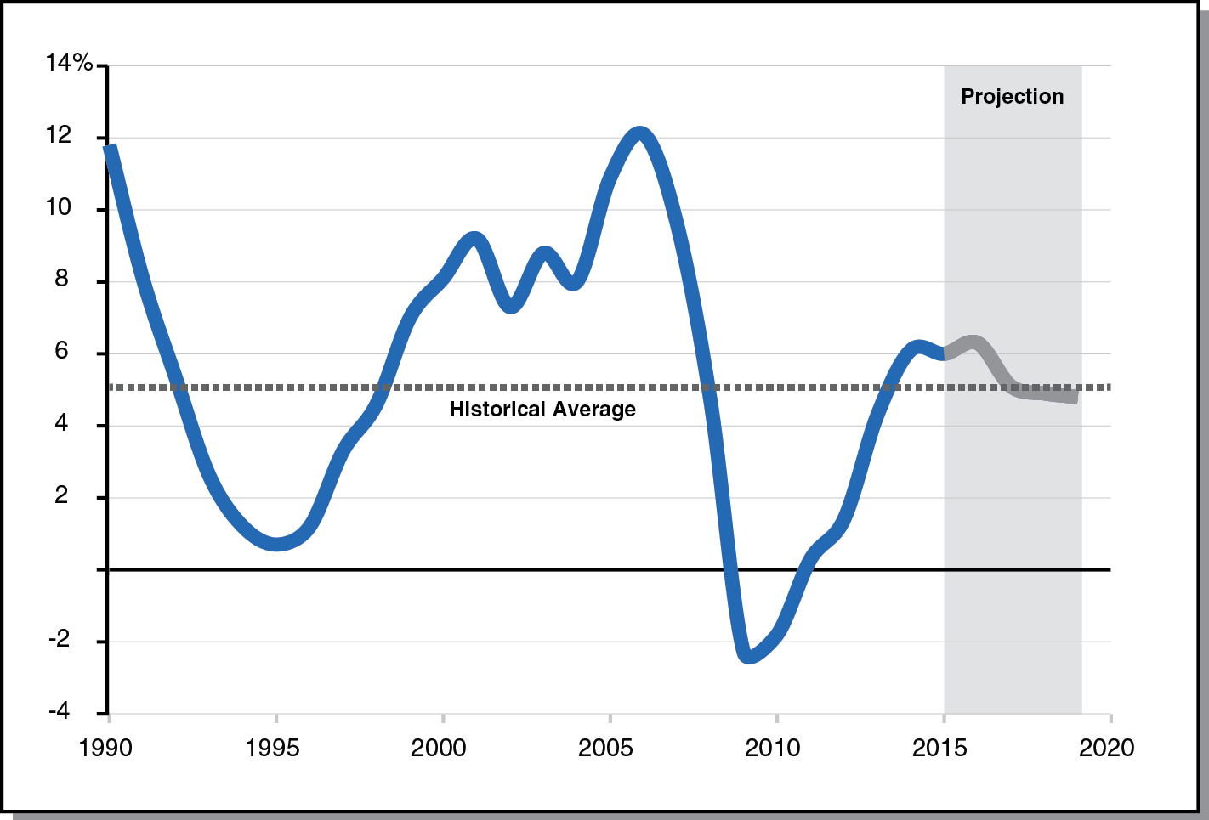
Assessed Property Values Grow Moderately Throughout Forecast Period
Percent Change From Prior Year

Slide 11
State’s Fiscal Outlook

Slide 12
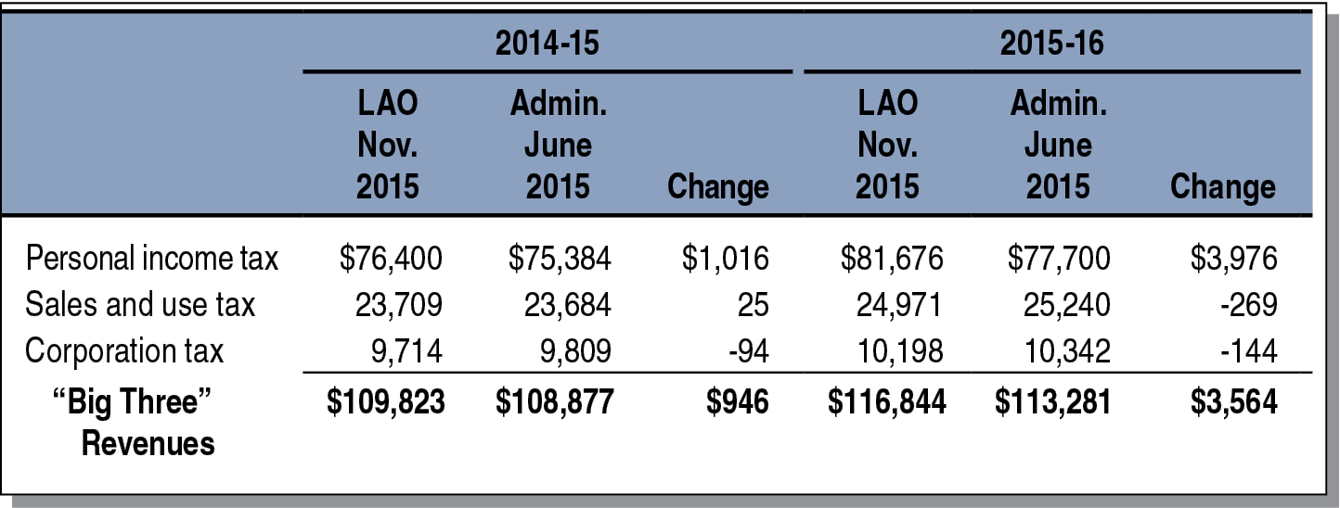
State Revenues Up in 2014-15 and 2015-16
General Fund and Education Protection Account Combined (In Millions)

Slide 13
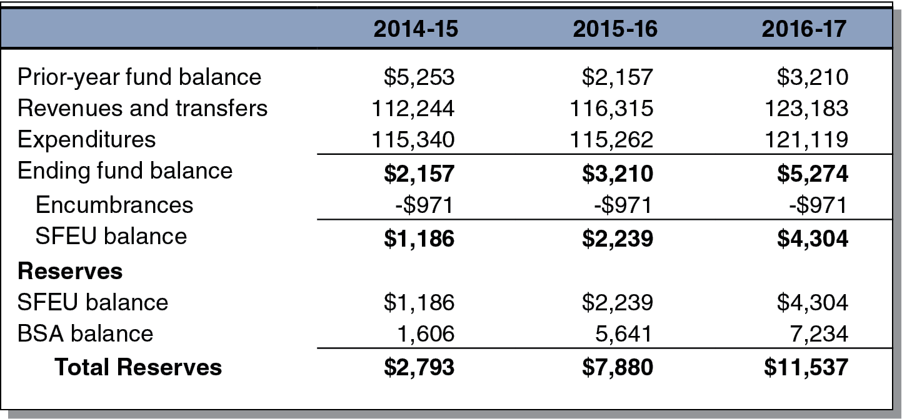
State’s General Fund Condition Healthy in 2016-17
Estimates Under Main Scenario (In Millions)

Slide 14
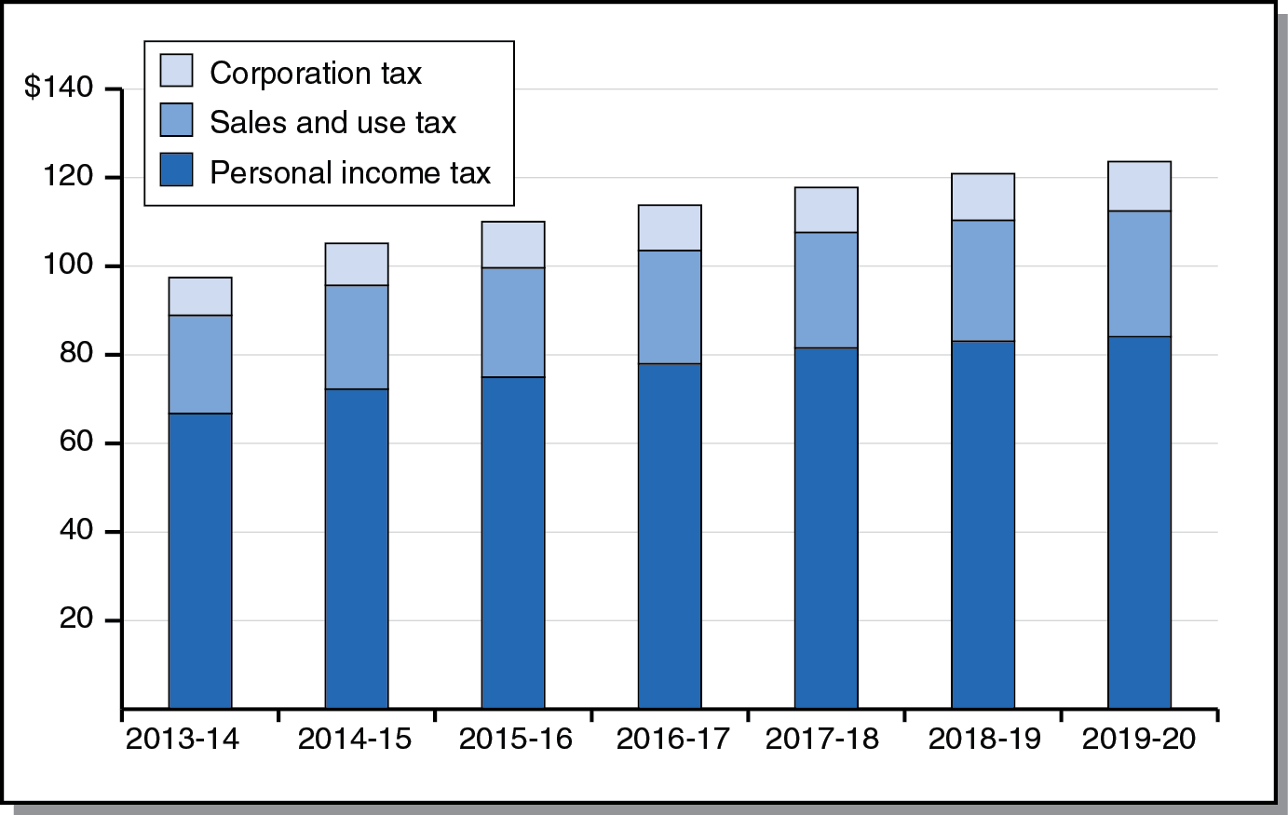
All Big State Revenue Sources Grow Throughout Forecast Period
Big Three Revenues Under Main Scenario (In Billions)

Slide 15
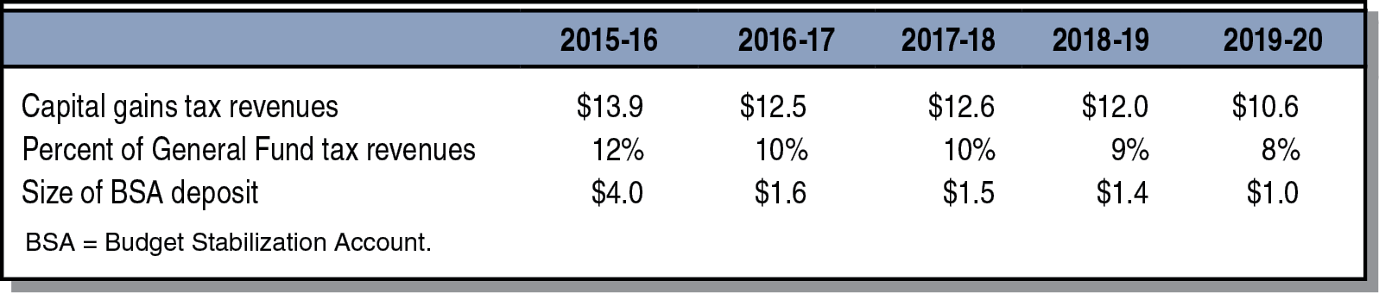
Annual Rainy Day Deposits Become Smaller Each Year of Forecast Period
Estimates Under Main Scenario (Dollars in Billions)

Slide 16
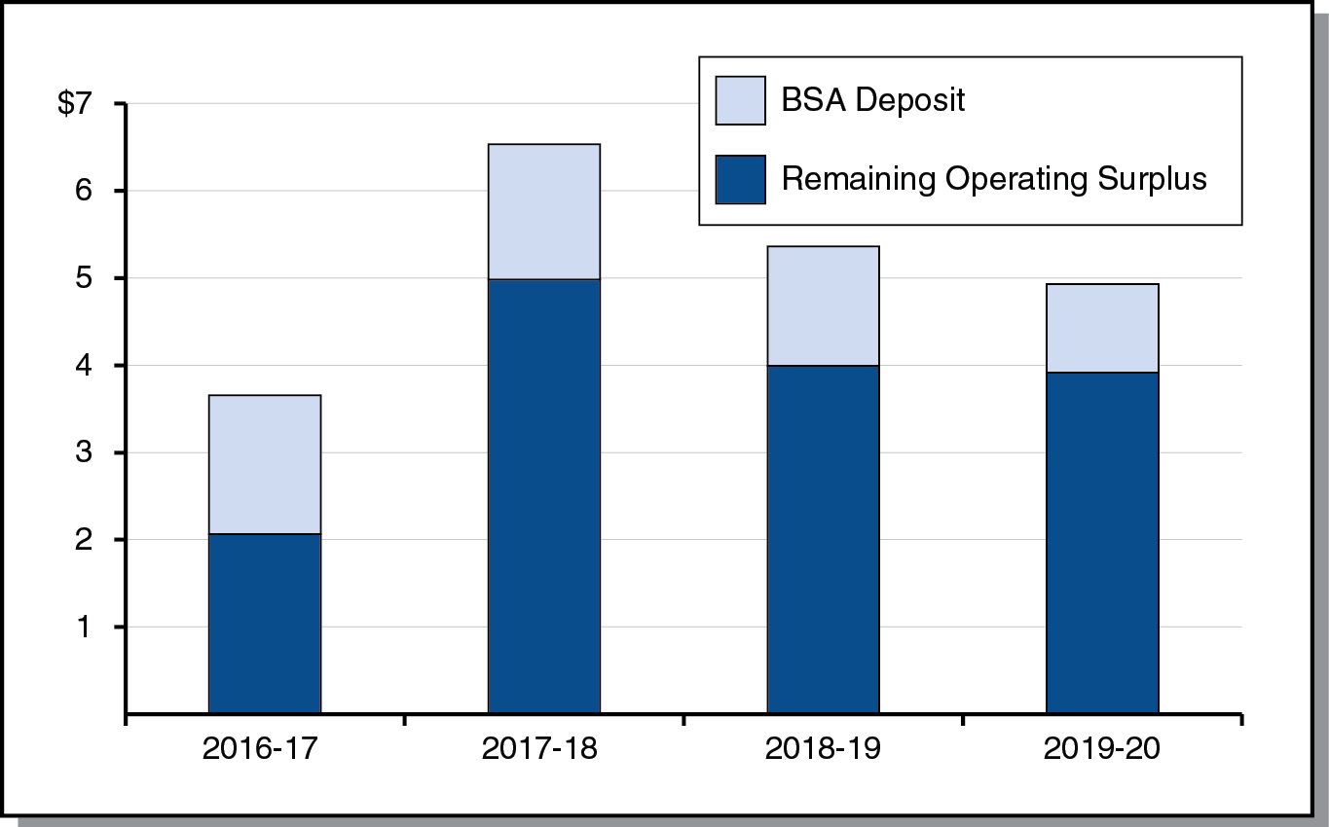
Main Scenario: Operating Surpluses
(In Billions)

Slide 17
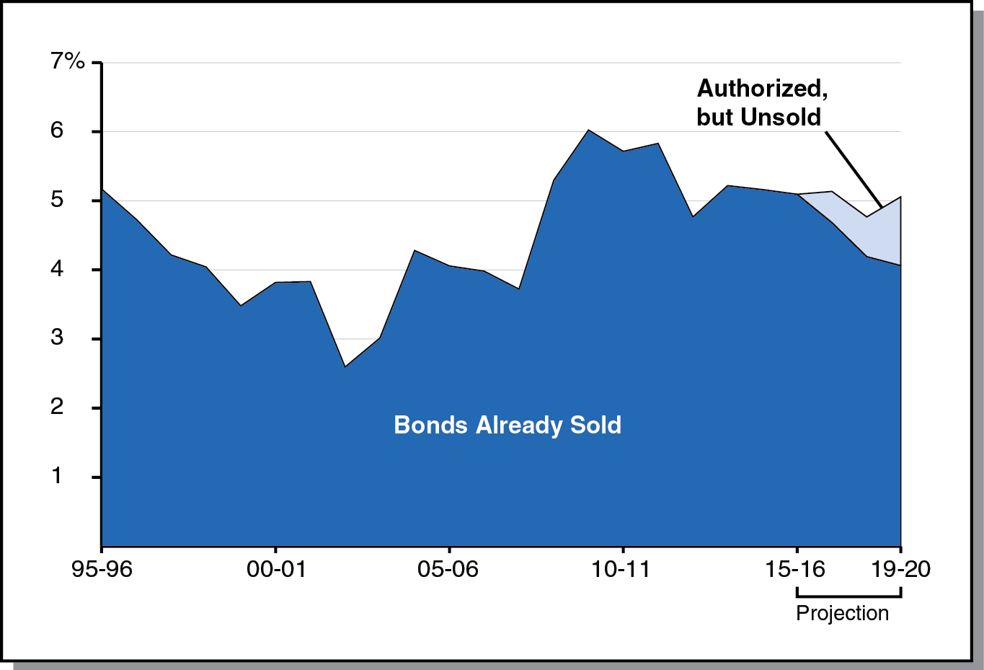
Debt-Service Ratio Expected to Remain Around 5 Percent
Percent of General Fund Revenues and Transfers Spent on Debt Service

Slide 18
Education Outlook

Slide 19
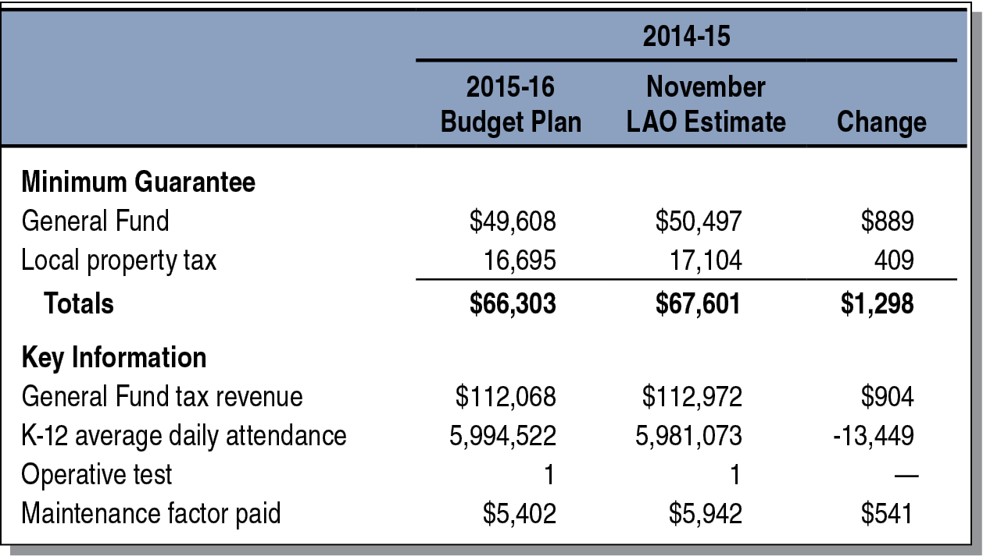
2014-15 Minimum Guarantee Up From Budget Act Estimates
(Dollars in Millions)

Slide 20
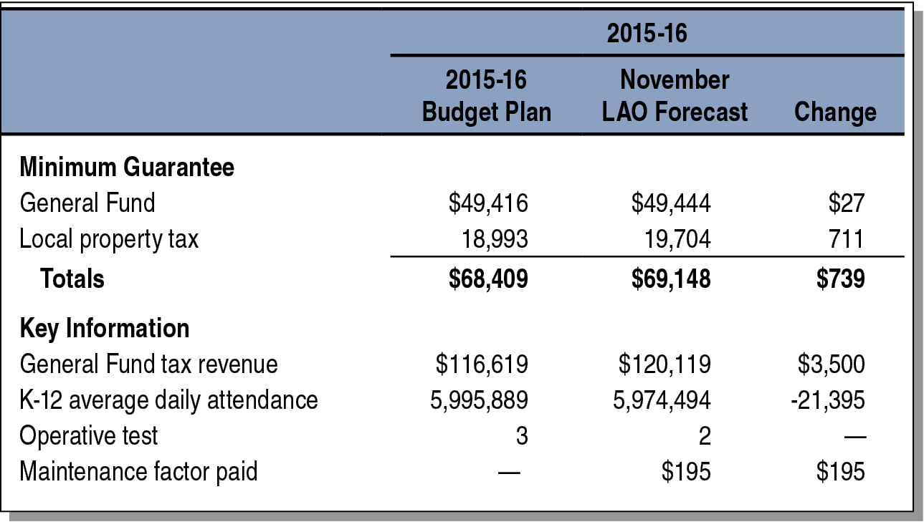
2015-16 Minimum Guarantee Up From Budget Act Estimates
(Dollars in Millions)

Slide 21
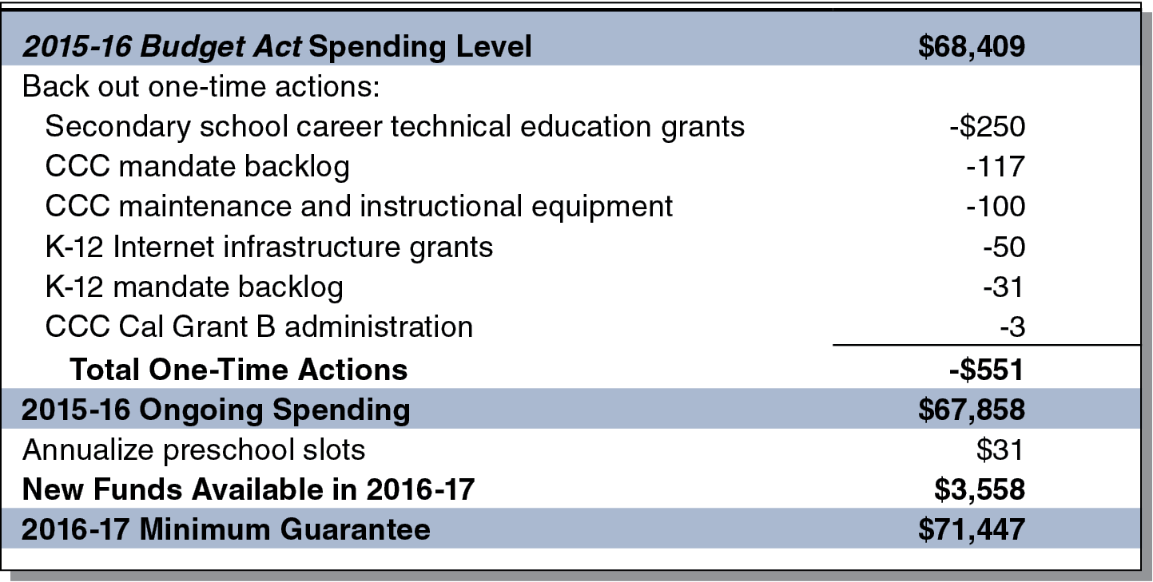
$3.6 Billion Increase in Proposition 98 Funding Projected for 2016-17
LAO Main Scenario (In Millions)

Slide 22
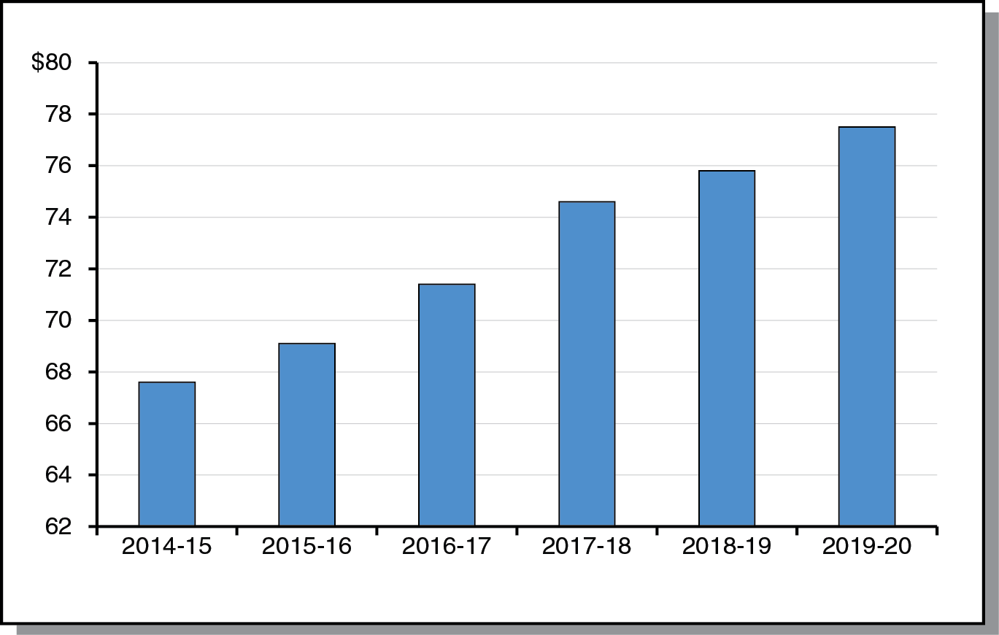
Minimum Guarantee Almost $10 Billion Higher in 2019-20 Than 2014-15
LAO Main Scenario (In Billions)

Slide 23
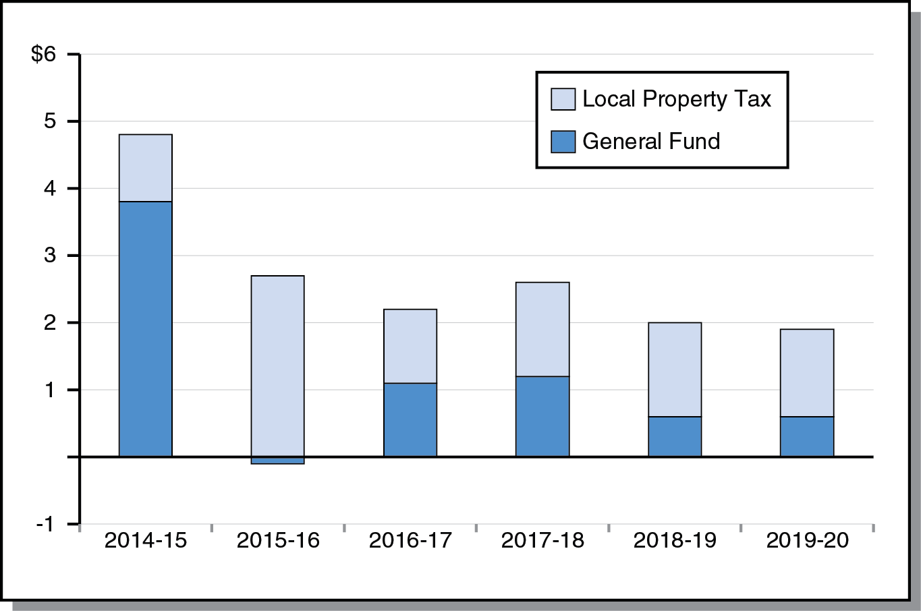
Increases in Guarantee Borne Disproportionately by Local Property Tax
Change From Prior Year (In Billions)

Slide 24
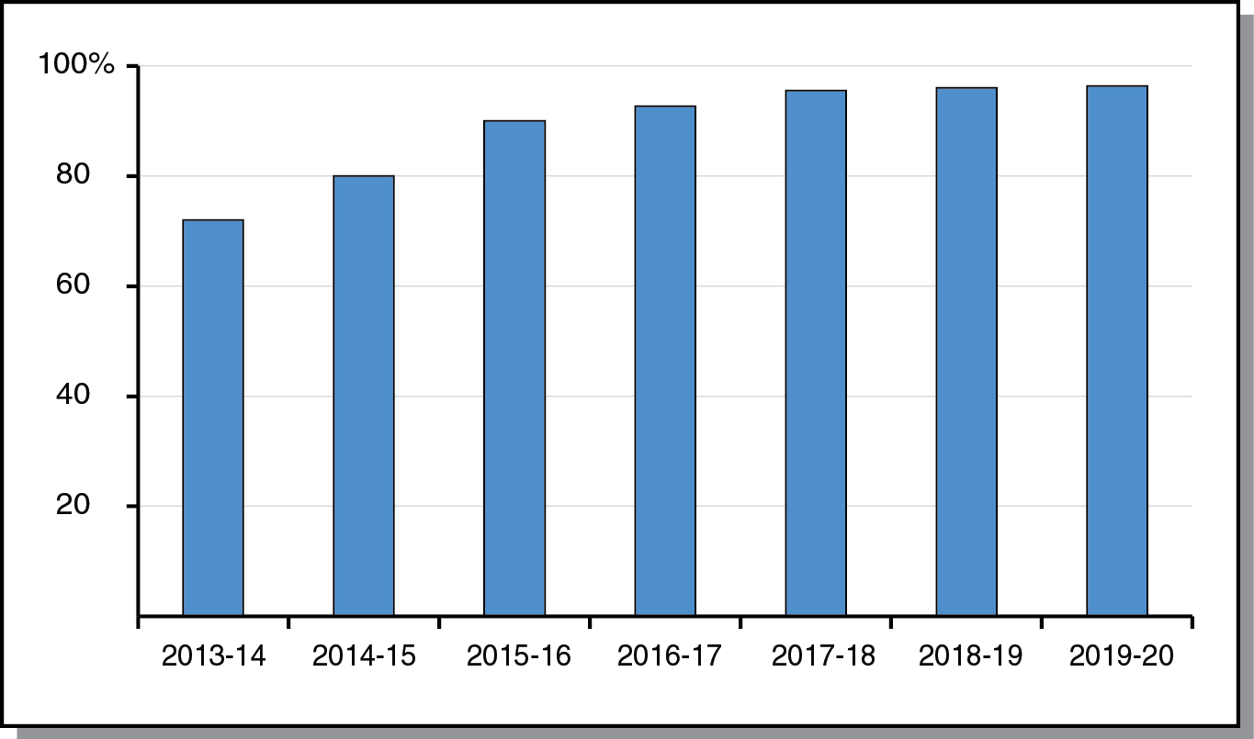
Local Control Funding Grows More Quickly During First Half of Forecast Period
Percent of Target Funded

Slide 25
Effect of State Revenues on Minimum Guarantee Changes Throughout Period
2014-15: Highly Sensitive
2015-16: Highly Insensitive
2016-17: Somewhat Sensitive
Remainder of Period: Somewhat Sensitive

Slide 26
Other Outlook Scenarios

Slide 27
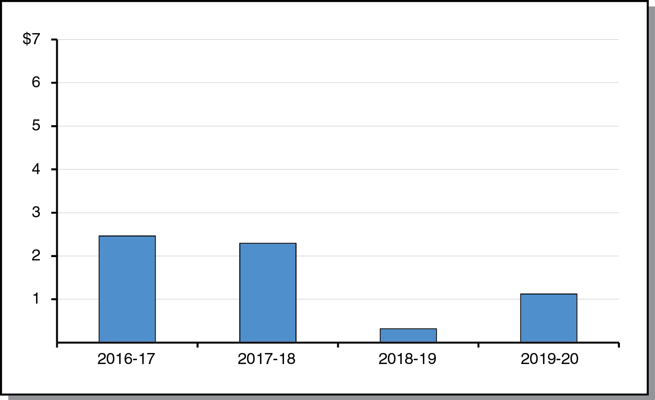
Slowdown Scenario: Smaller Operating Surpluses
(In Billions)

Slide 28
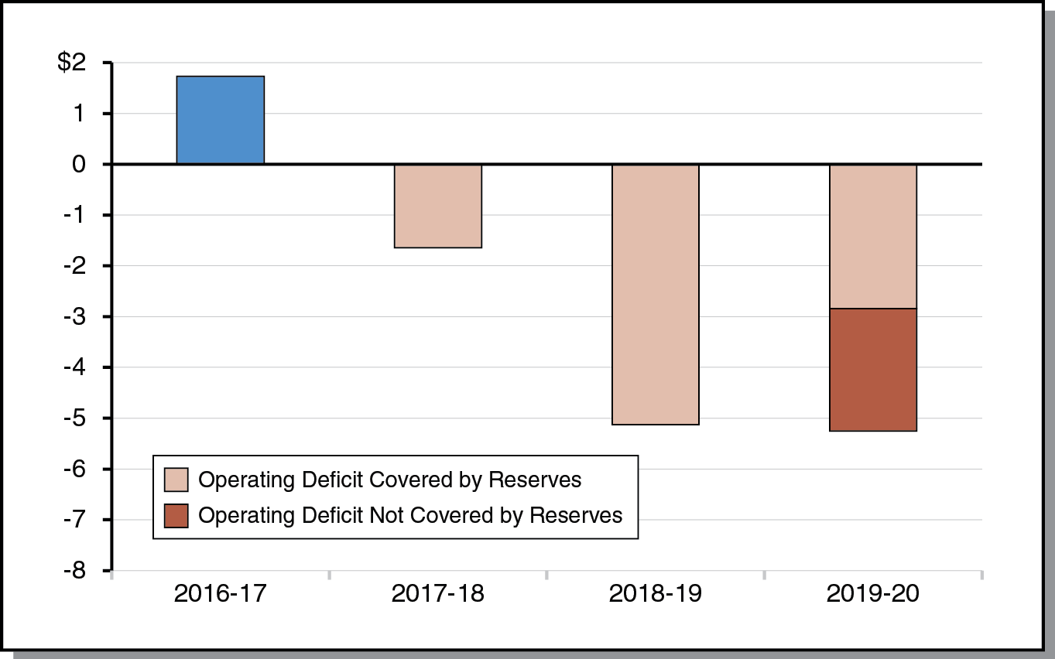
Recession Scenario: Reserves Cover Operating Deficits Until 2019-20
(In Billions)

Slide 29
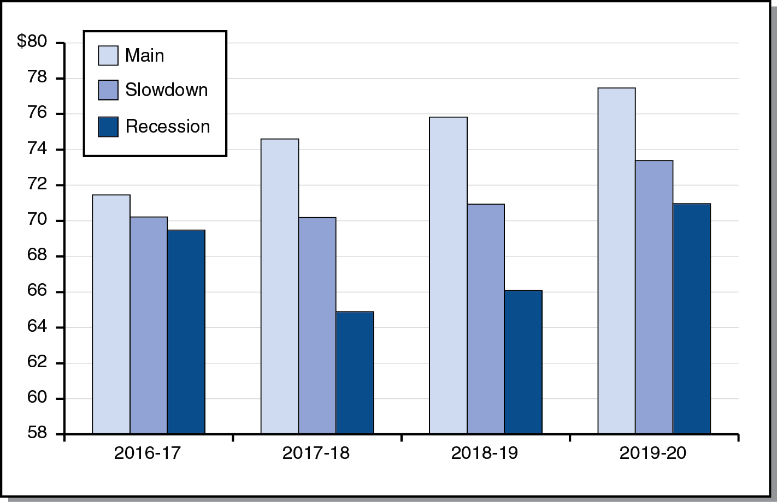
Comparing Proposition 98 Minimum Guarantee Under Three Scenarios
(In Billions)

