Slide 1
Higher Education Budget and Policy Update
Legislative Analyst’s Office
Presented to:
CCC All Financial Aid Directors’ Meeting
April 2, 2014
www.lao.ca.gov

Slide 2
The State’s Overall
Fiscal Situation

Slide 3
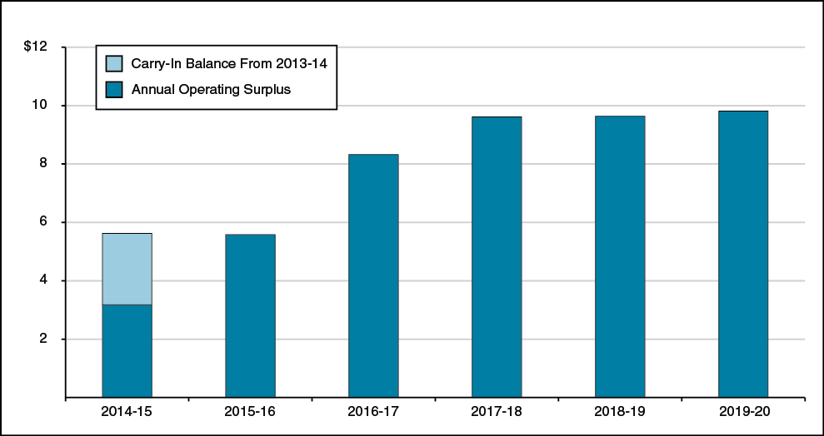
Operating Surpluses Projected Throughout Forecast Period
General Fund and Education Protection Account Combined
(In Billions)

Slide 4
What Is Not Included in Projections
Inflation Adjustments (Unless Statutorily Required)
Paying Off Budgetary Liabilities
Paying Off Various Unfunded Retirement Liabilities
Policy Proposals

Slide 5
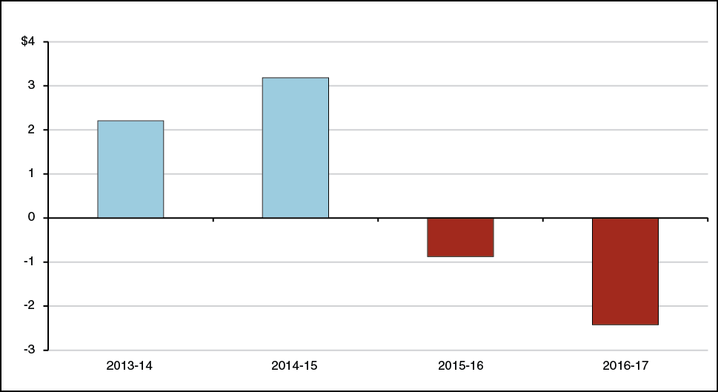
Operating Deficits Return Under Hypothetical Recession Scenario
General Fund and Education Protection Account Combined
(In Billions)

Slide 6
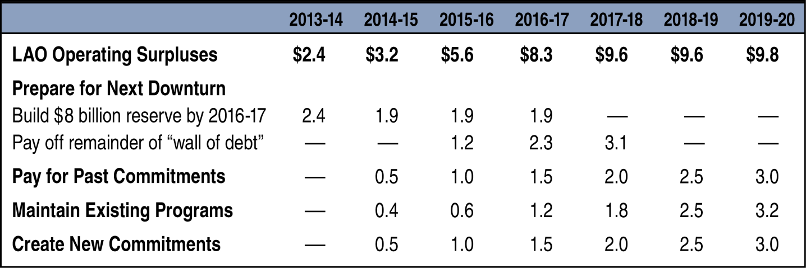
An Approach to Using
Possible Surpluses
General Fund and Education Protection Account Combined
(In Billions)

Slide 7
2014-15 State Budget

Slide 8
Fiscal Environment Much Improved
Economy: Continued Moderate Growth
  California personal income growth of
  5.4 percent in 2014.
  California employment growth of
  2.2 percent in 2014-15.
Revenues: Strong Growth in General Fund Revenues
  Strong personal income tax growth.
  Solid sales tax growth.

Slide 9
Where Is the New Money Going?
Paying Down Debt
  Proposition 98 deferrals, deficit financing bonds.
Additional Spending
  Proposition 98.
  University and financial aid funding increases.
  One-time spending for deferred maintenance.

Slide 10
Rainy-Day Reserve Proposal
Various Proposals to Build Up Reserves
  ACA 4: based on above average revenue growth.
  Governor: based on “excess” capital gains.
Attempting to Address State’s Highly Volatile Revenue Structure

Slide 11
The Positives
Pays Down Debts
Limits New Commitments
Builds Up Reserve Over Time
Highlights Infrastructure Issues

Slide 12
Concerns
Higher Education
  Funding not tied to priorities.
No Set-Aside for Unfunded Liabilities

Slide 13
Higher Education Budget

Slide 14
Governor’s Proposal for Universities
Unallocated Base Increases
No Enrollment Targets
California State University’s (CSU’s) Support and Capital Budgets Merged
Performance and Sustainability Plans
Tuition Freeze

Slide 15
LAO Alternative
Traditional Workload Budget
  Specify enrollment targets and fund enrollment growth, if needed.
  Fund inflation and other cost increases.
  Target funding for state priorities.
  Budget CSU capital projects explicitly.
Share of Cost Tuition Policy

Slide 16
Governor’s Financial Aid Proposals
Fund Increased Cal Grant Costs
Fund Phase-In of Middle Class Scholarships
Fix Unintended Consequence of Cal Grant Renewal Eligibility Change
Use Student Loan Operating Fund and Federal Funds to Offset General Fund Costs

Slide 17
LAO Recommendations:
Adopt Cal Grant Augmentation
Adopt Eligibility Change
Prioritize Middle Class Scholarship Awards and Set Time Limit Comparable to Other Aid Programs

Slide 18
Major Higher Education Issues

Slide 19
Key Areas of Focus for Legislature
Financial Aid
Performance and Accountability
Enrollment (Assembly)
Capital Projects
Oversight of Private Postsecondary Schools

Slide 20
Cal Grant Bills
Assembly Bills
  Additional competitive awards and two-year averaging (AB 1976, Quirk-Silva).
  Adjustments to institutional eligibility standards
  (AB 1538, Eggman) and process (AB 1590, Wieckowski).
  Additional disclosures (AB 330, Chau).
  Mandate for Electronic Grade Point Average Submission (AB 2016, Ting).
  Expanded high school entitlement window
  (AB 2566, Weber).

Slide 21
Cal Grant Bills (Continued)
Senate Bills
  Tax Credit and special fund for access award (SB 174 and SB 798, De Léon).
  Cal Grant C for long-term unemployed
  (SB 1028, Jackson).
  Renewal awards at ineligible institutions
  (SB 1149, Galgiani).

Slide 22
Other Bills
Financial Aid
  Pay It Forward/Pay It Back
  (AB 1456, Jones-Sawyer).
  State approval for GI Bill Eligibility
  (AB 2099, Frazier).
  Model contracts for Electronic Aid Disbursement (SB 845, Correa).

Slide 23
Other Bills
Various Higher Education Areas
  California Community College baccalaureate degree pilot (SB 850, Block).
  Four-year, $12,000 degree pilot (AB 1924, Logue).
  Academic preparation programs and priority enrollment (AB 1977, R. Hernandez).
  Special session courses (AB 2153, Gray).
  Oil severance tax law (SB 1017, Evans).
  Education bond act (AB 2235, Buchanan).

