Slide 1

California’s
Fiscal Outlook
California Association of School Business Officials, CBO Symposium
November 20, 2014

Slide 2
National and State Economies

Slide 3
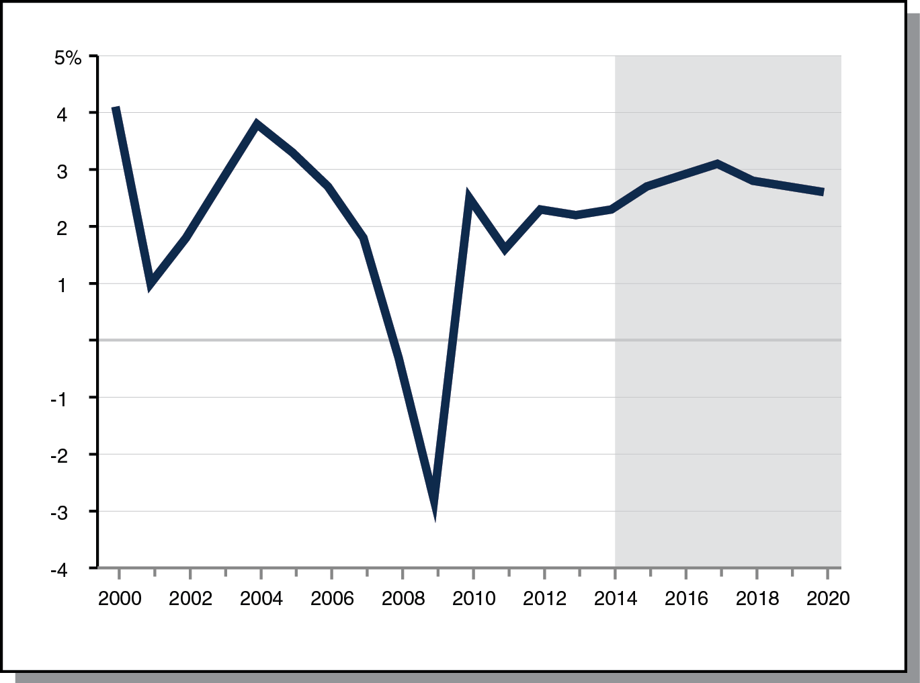
Economic Expansion Well Underway,
Assumed to Extend Throughout Forecast Period
Real Gross Domestic Product, Percent Change From Prior Year

Slide 4
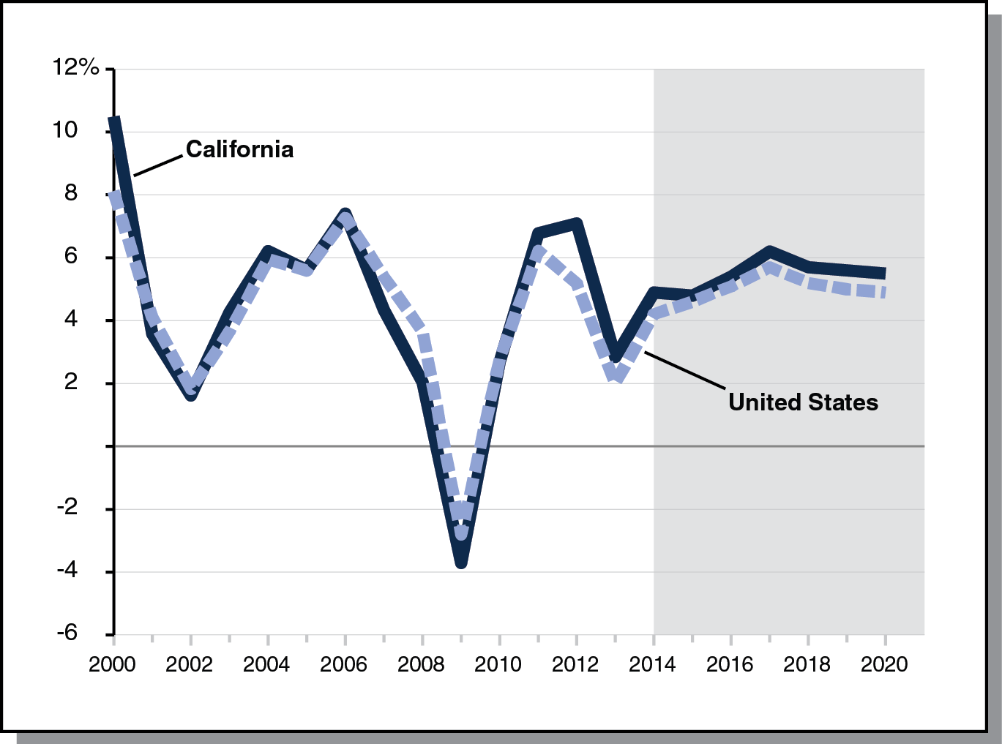
Personal Income Hovering Around 5 Percent Throughout Forecast Period
Percent Change From Prior Year

Slide 5
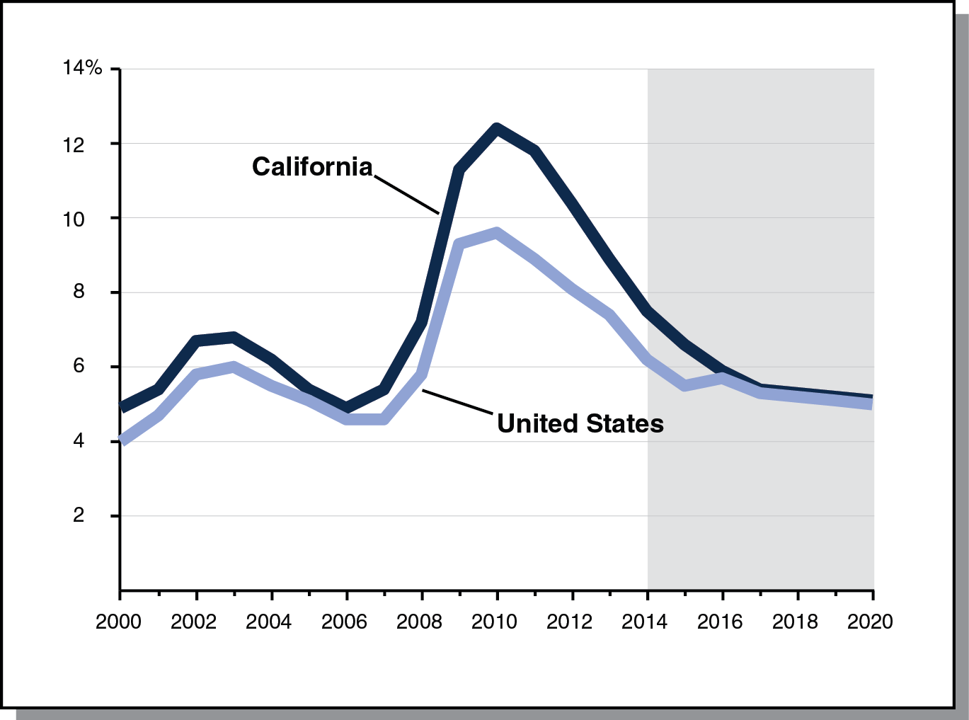
Unemployment Rate
Dropping Throughout Forecast Period
Percent Change From Prior Year

Slide 6
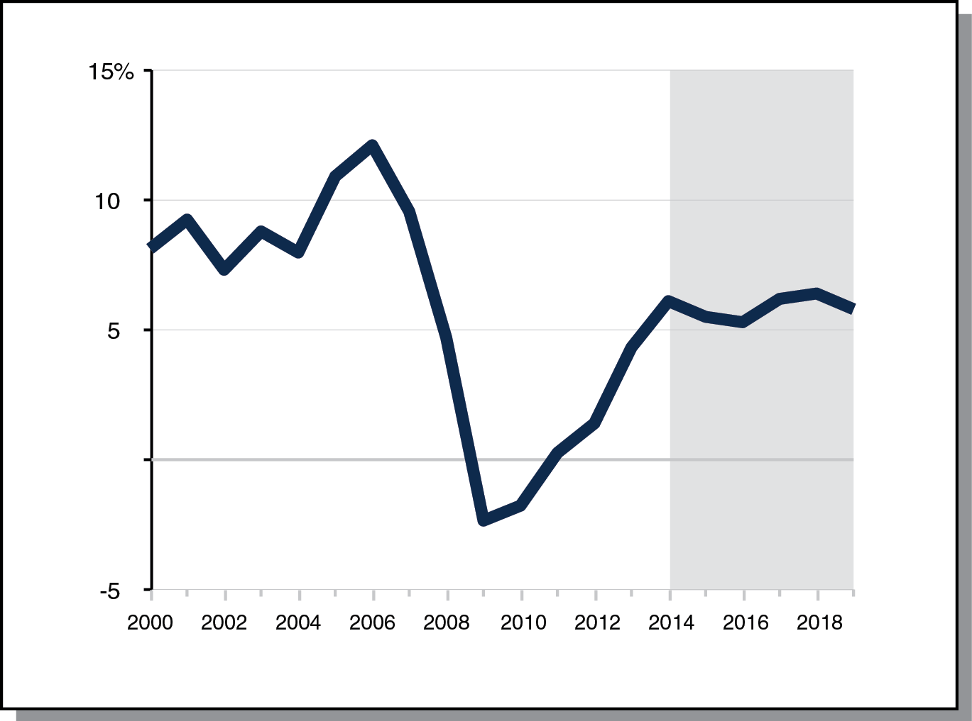
Assessed Property Values Growing Moderately Throughout Forecast Period
Percent Change From Prior Year

Slide 7
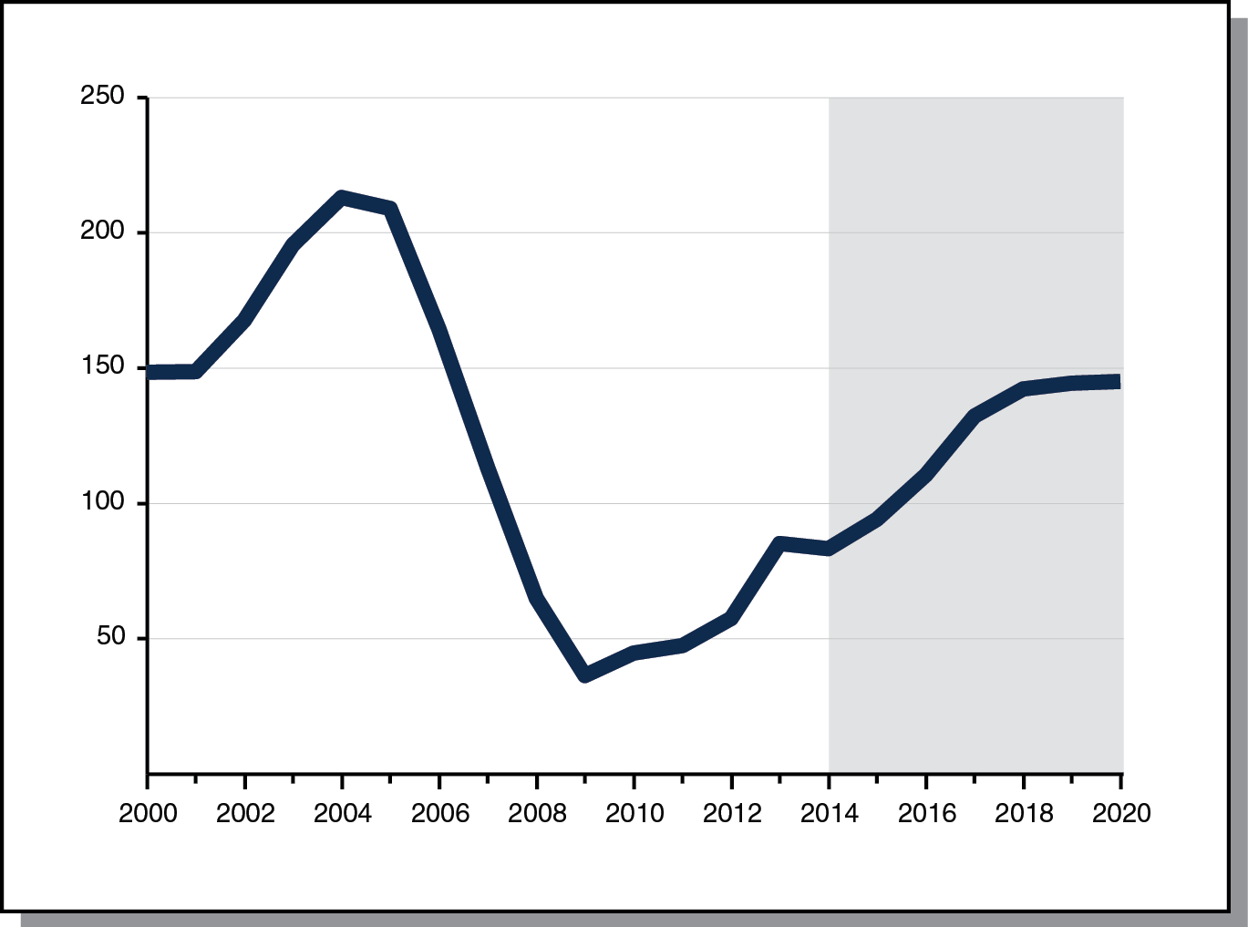
California Housing Permits
Increasing Throughout Forecast Period
Permits (In Thousands)

Slide 8
State’s Fiscal Outlook

Slide 9
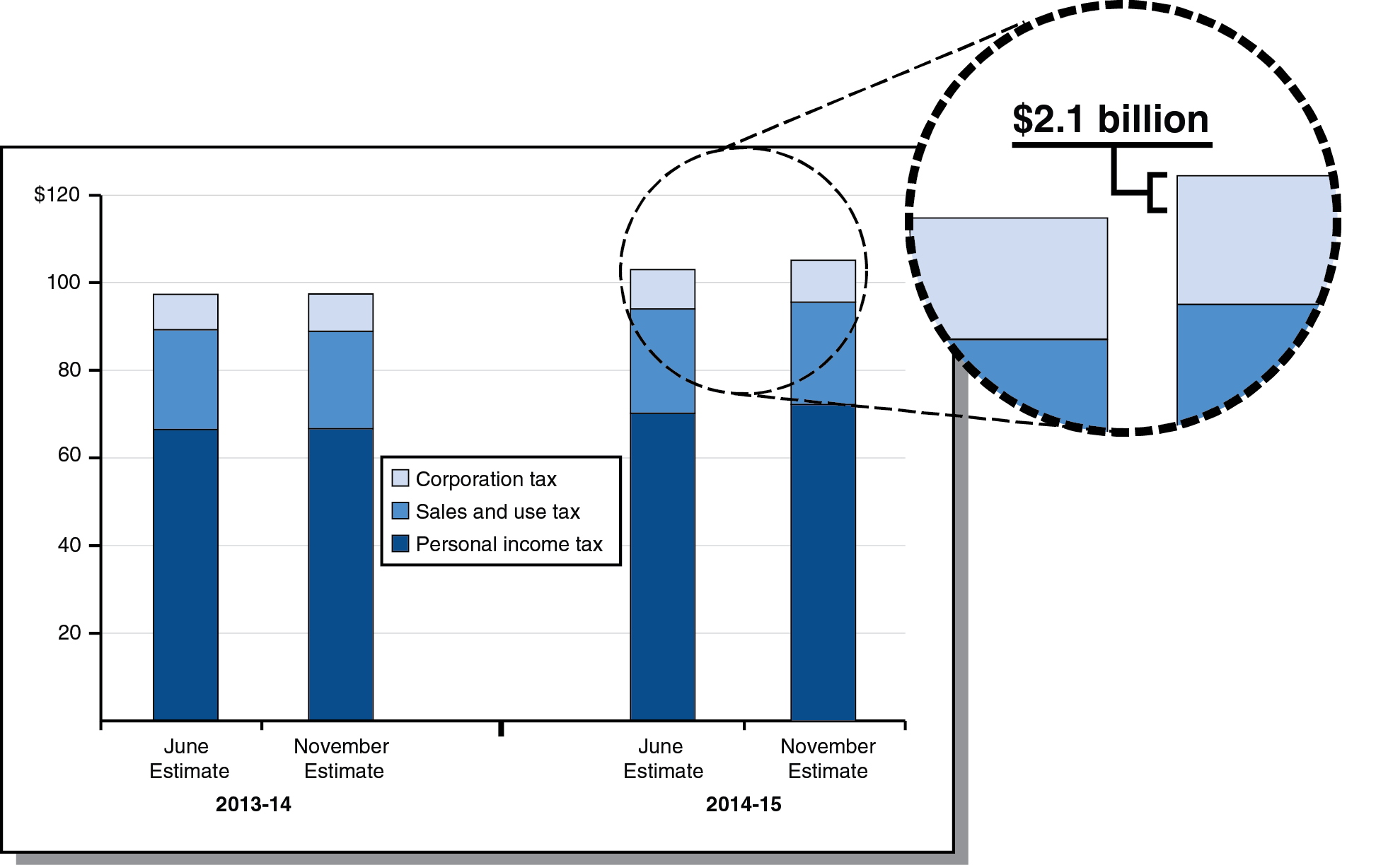
Revenue Up Slightly in 2013-14,
More Notably in 2014-15
Big Three Revenues (In Billions)

Slide 10
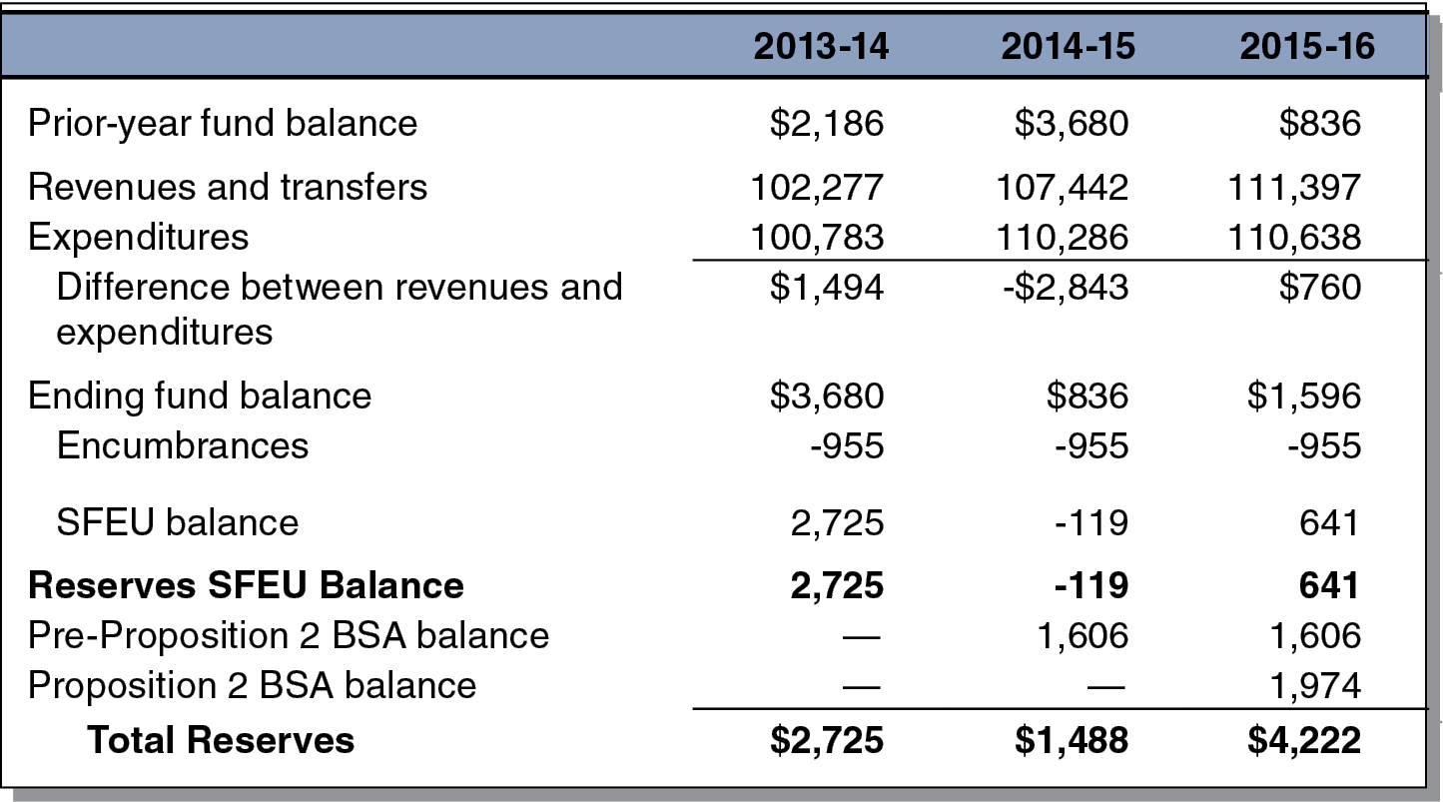
LAO General Fund Condition
Under Main Scenario
(In Millions)

Slide 11
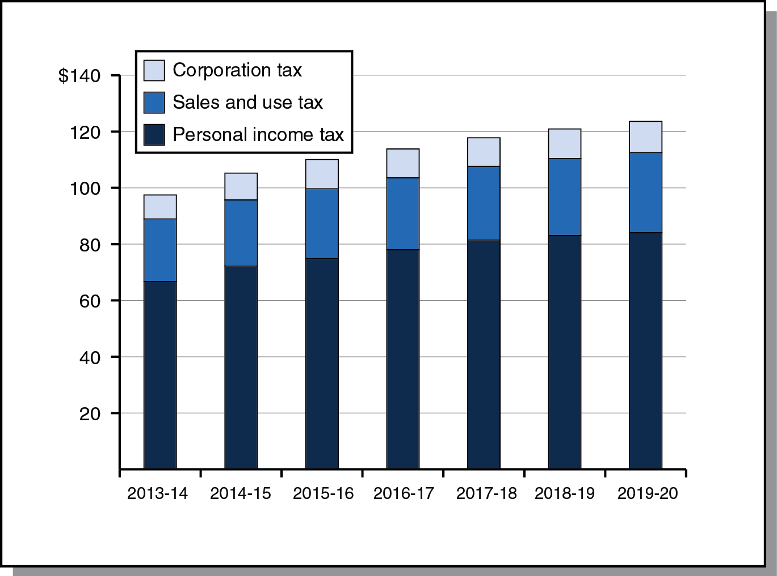
Revenue Outlook
Big Three Revenues Under Main Scenario (In Billions)

Slide 12
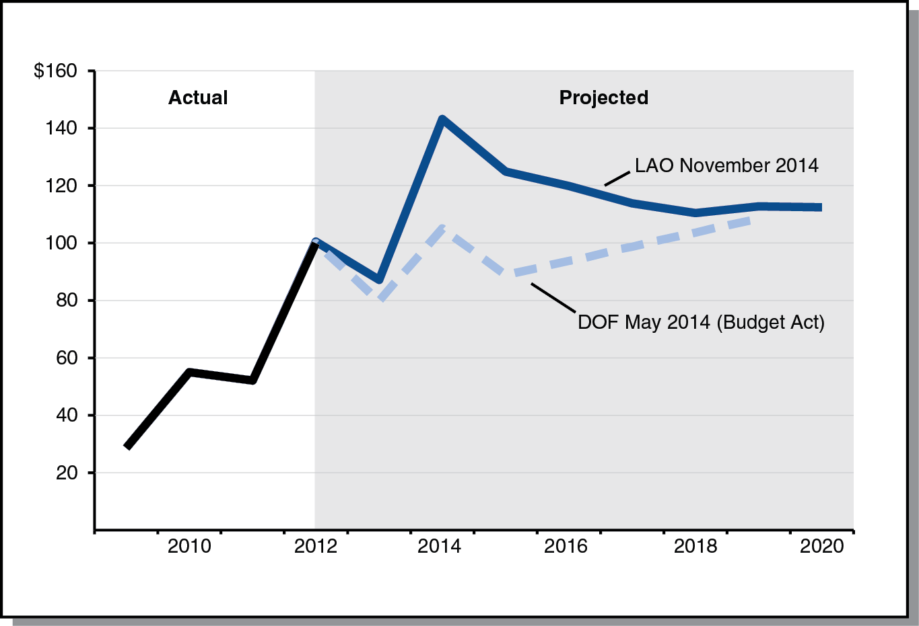
LAO Main Scenario:
Lower Capital Gains After 2014
Net Capital Gains on Resident Tax Returns (In Billions)

Slide 13
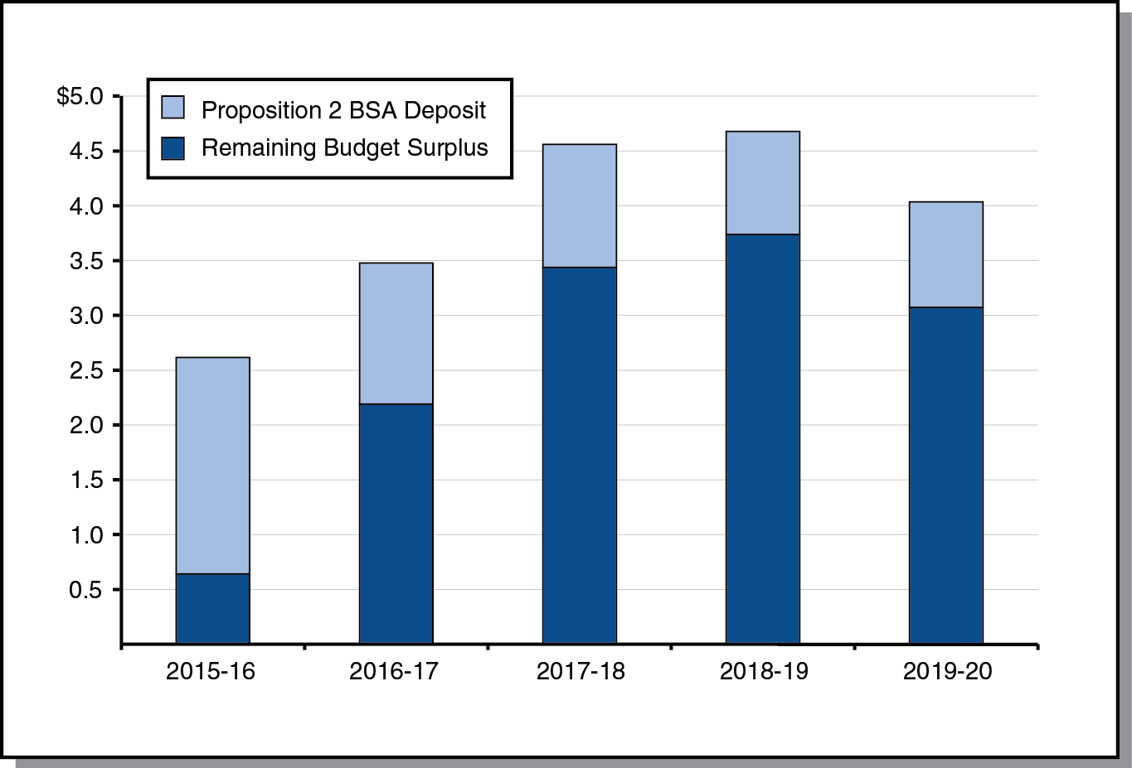
LAO Main Scenario:
Reserve Deposits and Future Surpluses
(In Billions)

Slide 14
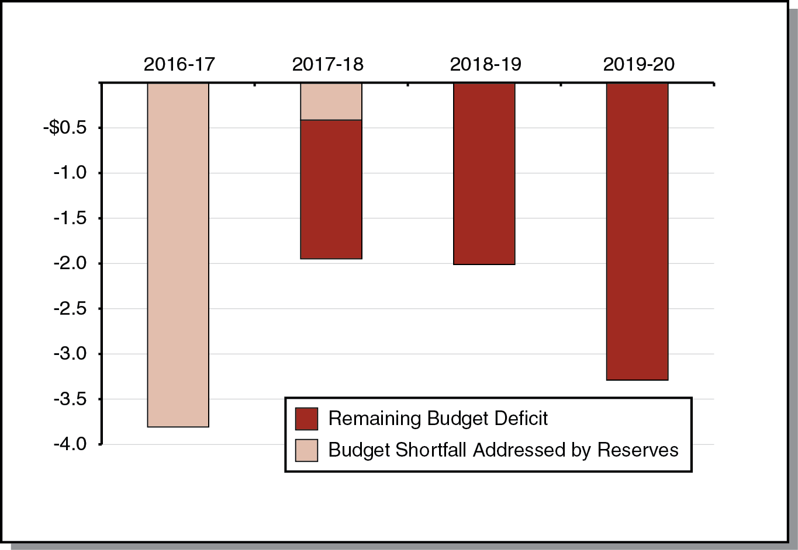
$4.2 Billion Reserve Could Cover 2016-17 Shortfall in Hypothetical Economic Slowdown
(In Billions)

Slide 15
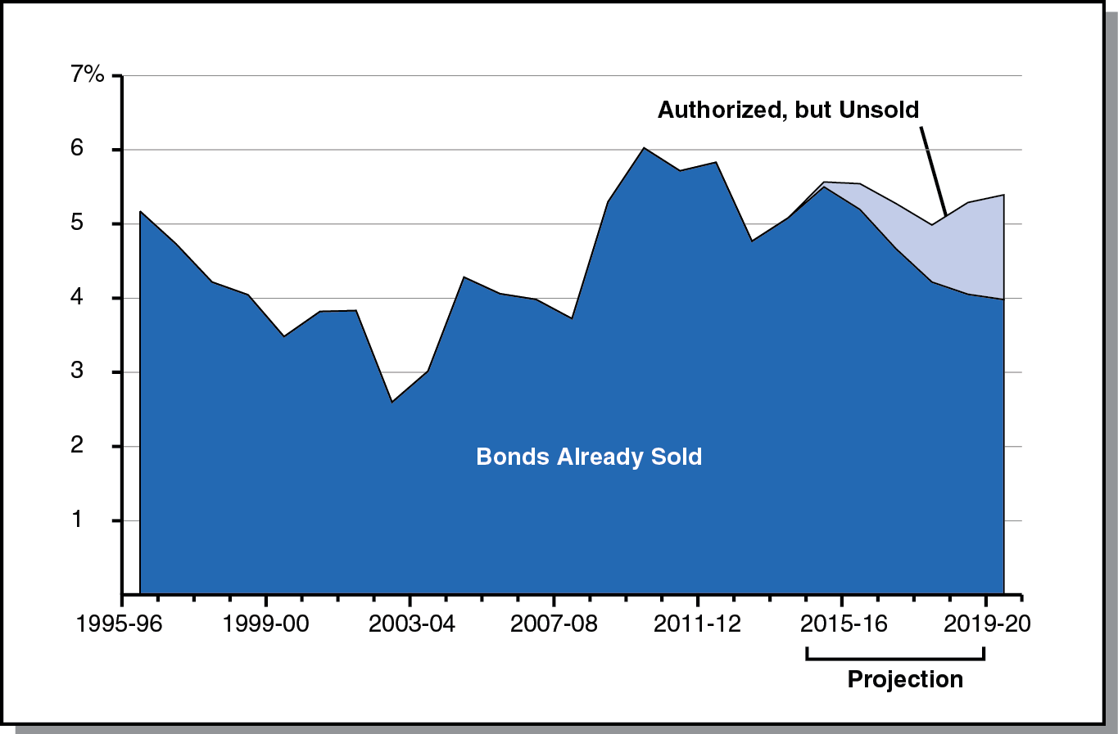
LAO Main Scenario:
Debt-Service Ratio Remains Under 6 Percent
Percent of General Fund Revenues Spent on Debt Service

Slide 16
Education Outlook

Slide 17
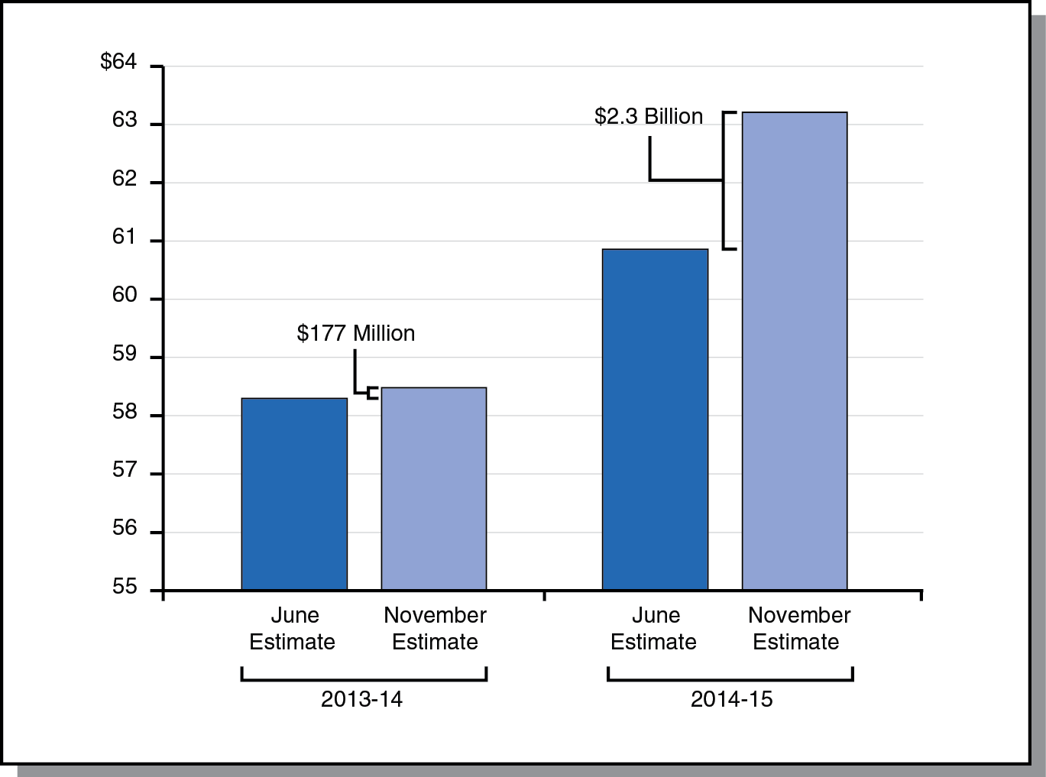
2013-14 Minimum Guarantee Up Slightly, 2014-15 Guarantee Up Significantly
Under LAO Scenario (In Billions)

Slide 18
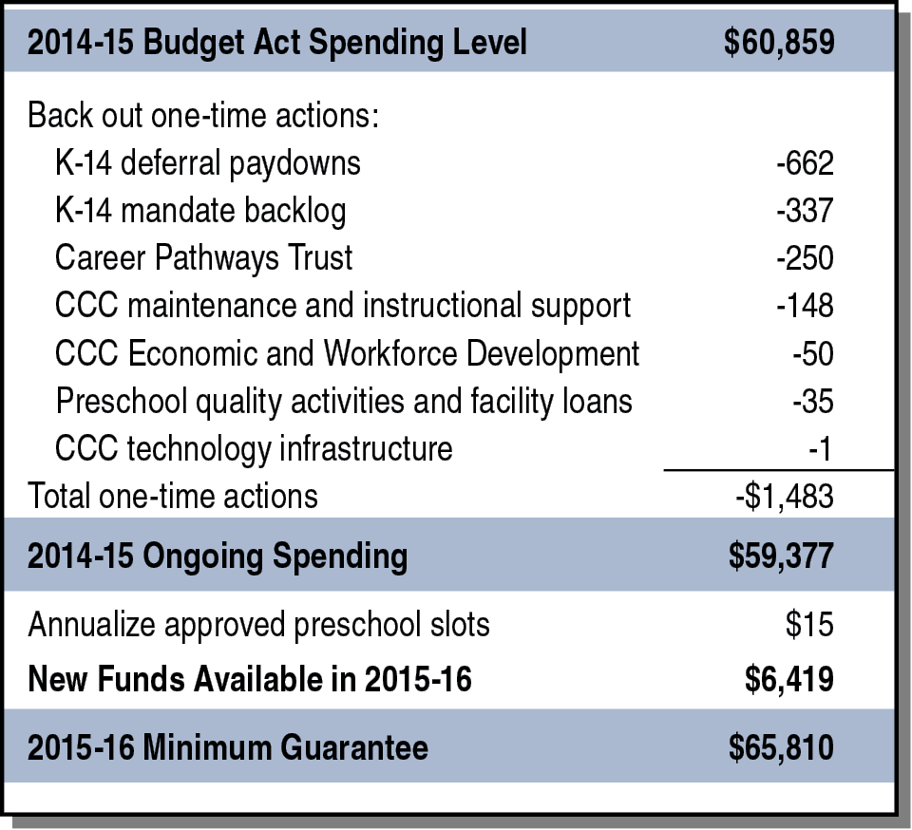
Considerable New Proposition 98 Funding
Projected for 2015-16
LAO Main Scenario (In Millions)

Slide 19
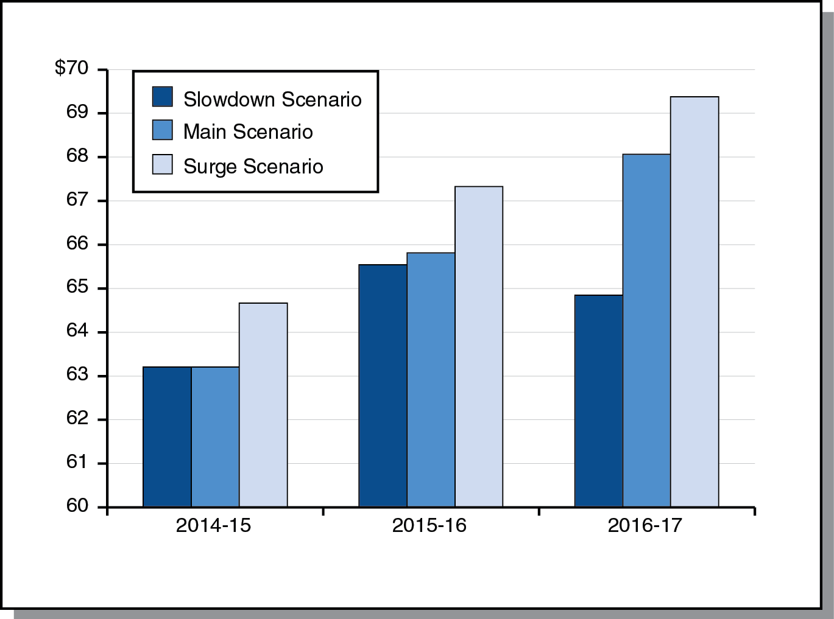
Under Slowdown Scenario, Guarantee Drops Between 2015-16 and 2016-17
(In Billions)

Slide 20
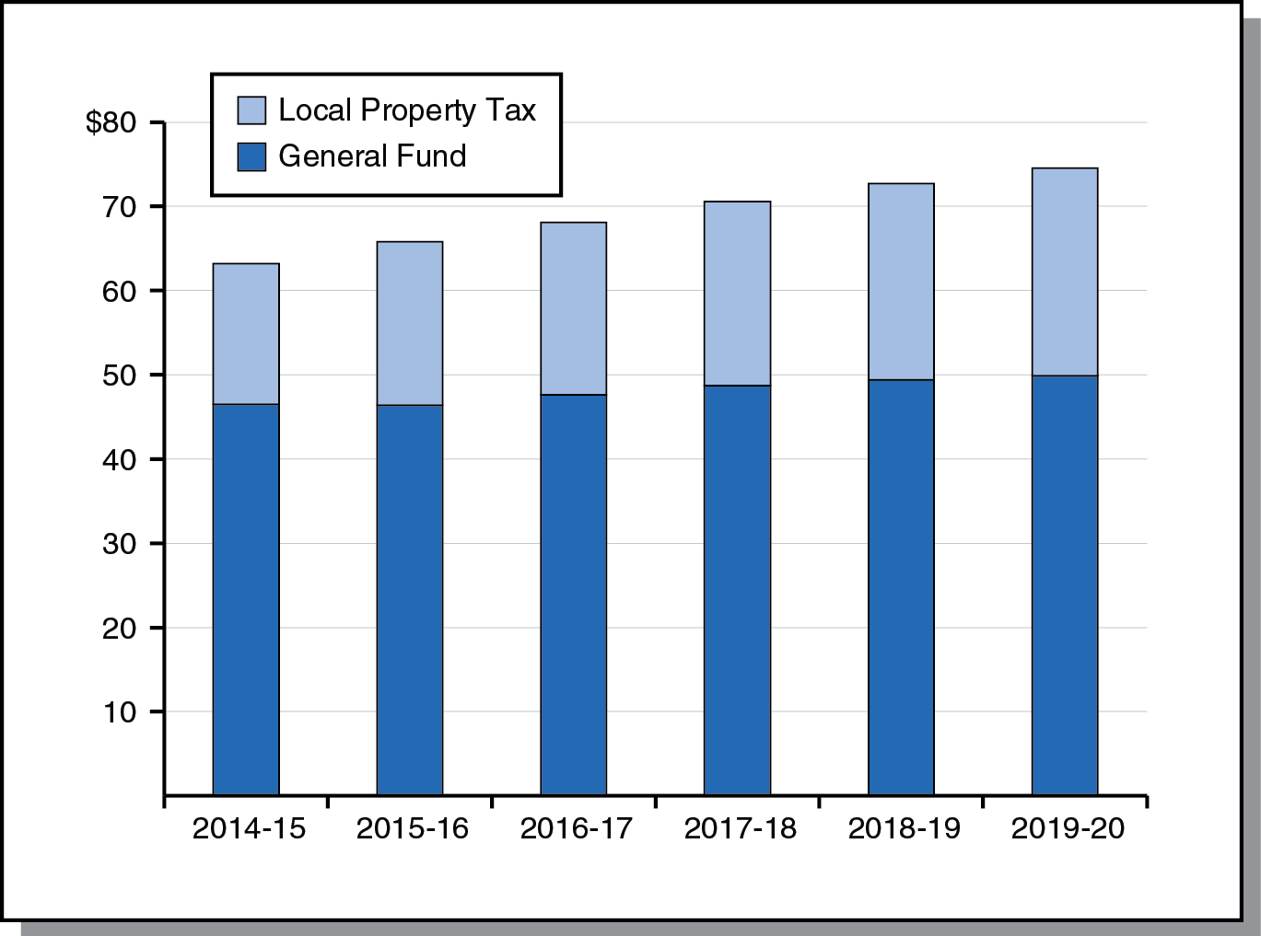
Proposition 98 Outlook
Estimate of Minimum Guarantee Under LAO Main Scenario (In Billions)

Slide 21
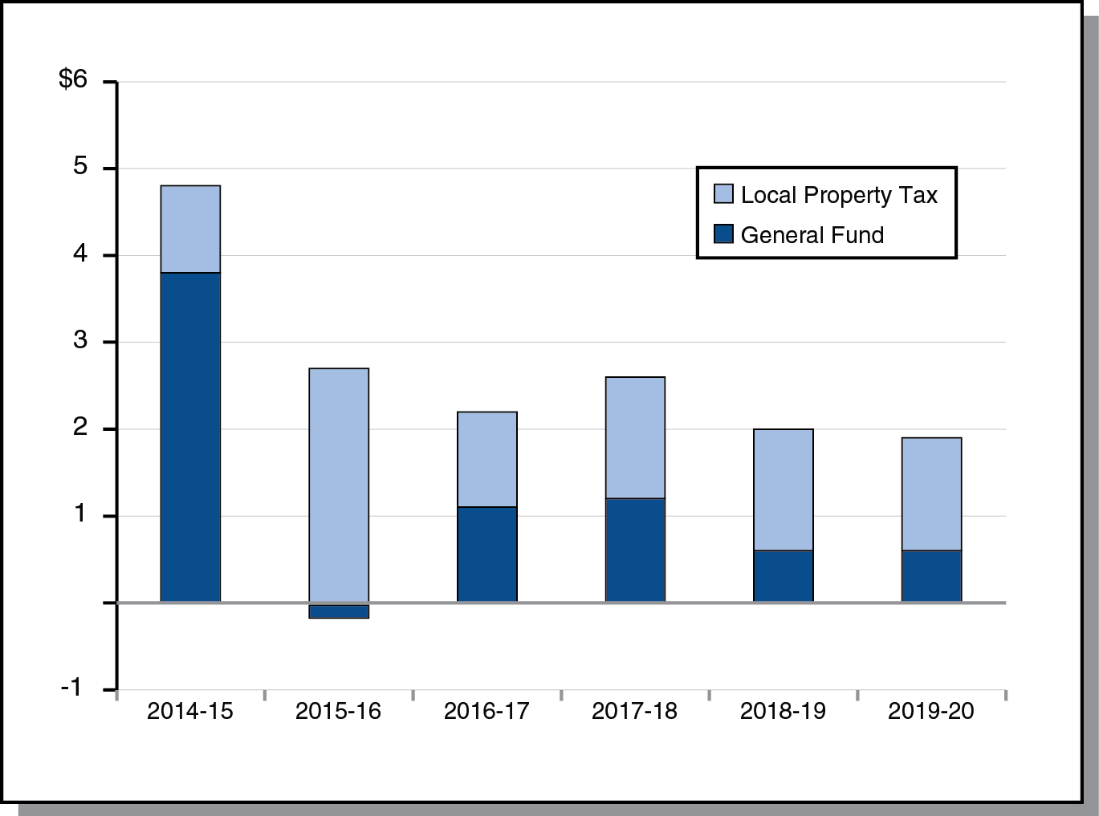
Increase in Guarantee Largely Funded by Growth in Local Property Tax Revenue
Change From Prior Year (In Billions)

Slide 22
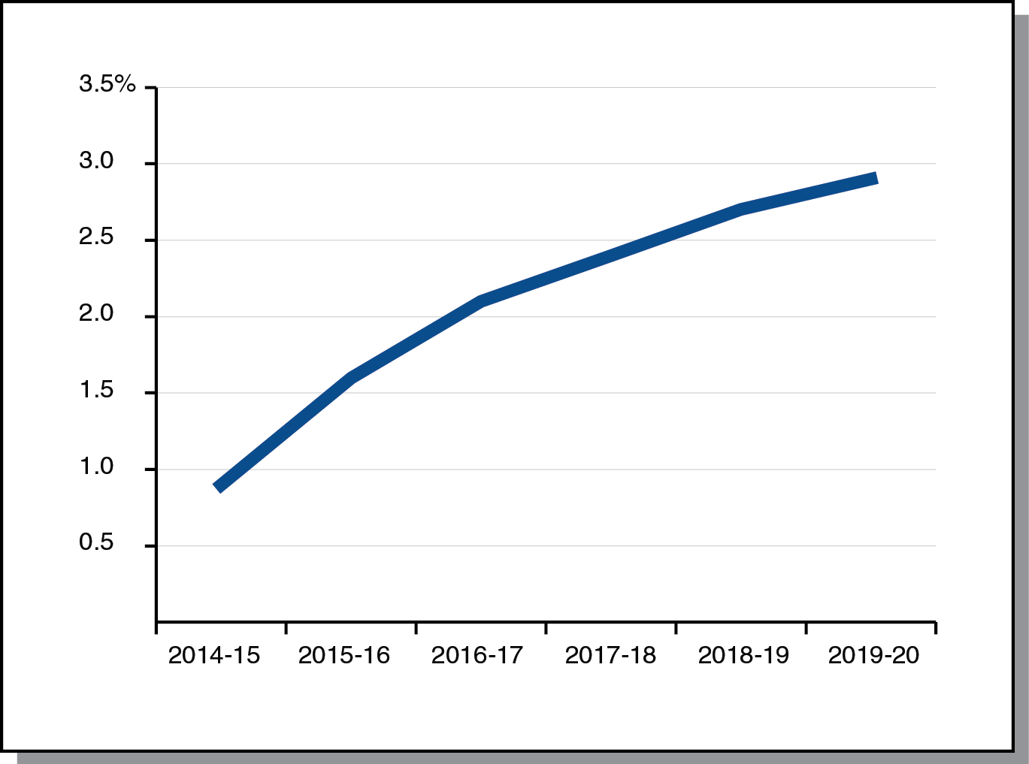
K-14 Cost-of-Living Adjustment on the Rise Throughout Forecast Period
Percent Change From Prior Year

Slide 23
Proposition 2

Slide 24
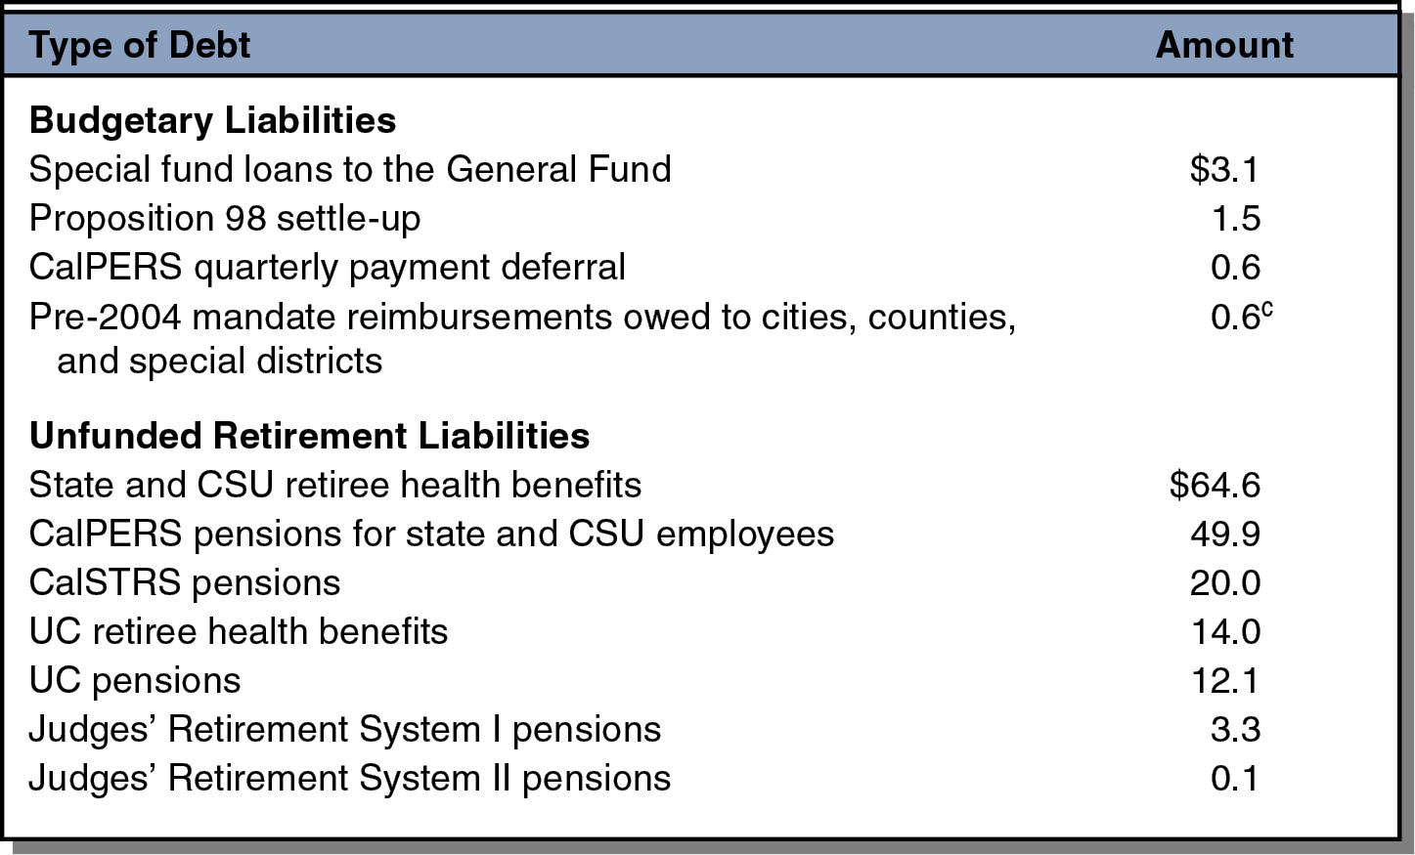
Debts Eligible for Proposition 2
Debt Payments
(In Billions)

Slide 25
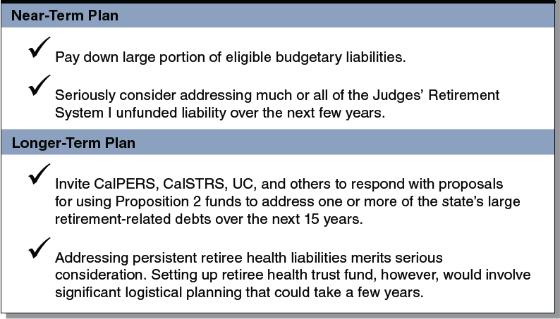
LAO Suggested Approach for
Proposition 2 Debt Payments
(In Billions)

