Slide 1
An Overview of the State’s Economy and Demographics
Legislative Analyst’s Office
Presented to:
Assembly Committee on Jobs, Economic Development, and the Economy
February 5, 2013
www.lao.ca.gov

Slide 2
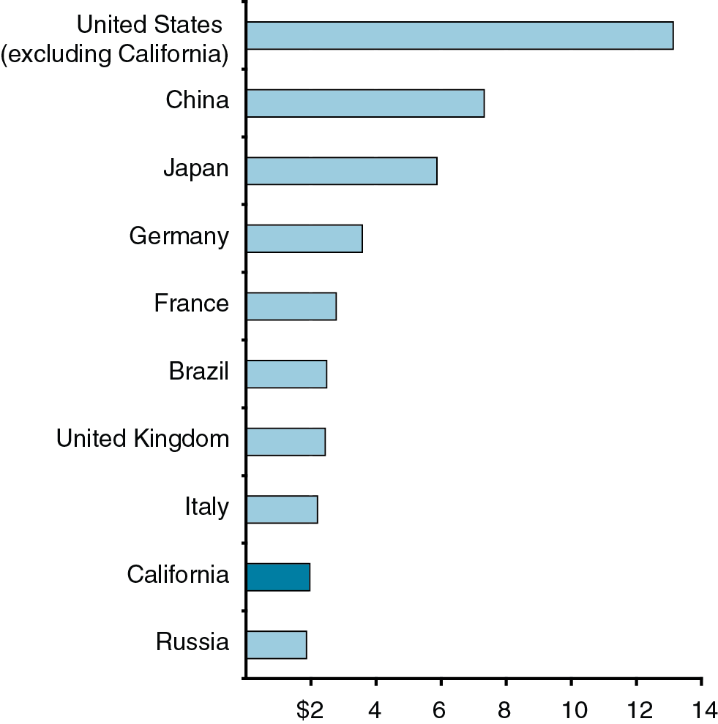
California’s Economy Is Ninth-Largest in the World
Gross Domestic Product in 2011 (In Trillions)

Slide 3
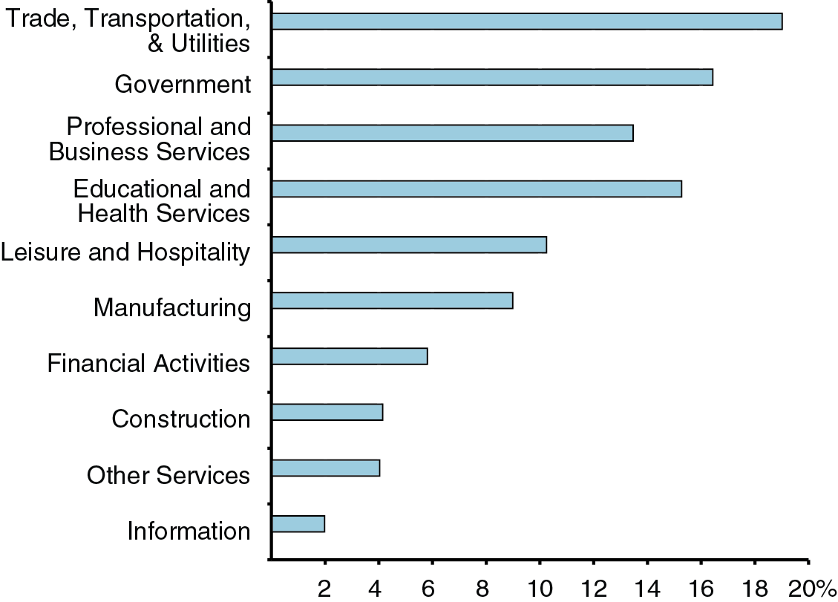
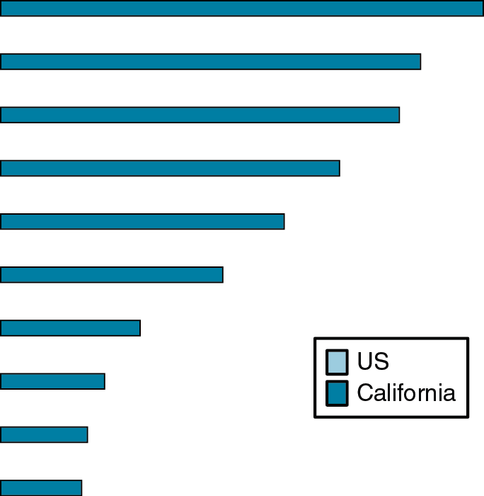
California’s Mix of Jobs by Industry Is Similar to the U.S.
Percentage of Nonfarm Employment, August 2012

Slide 4
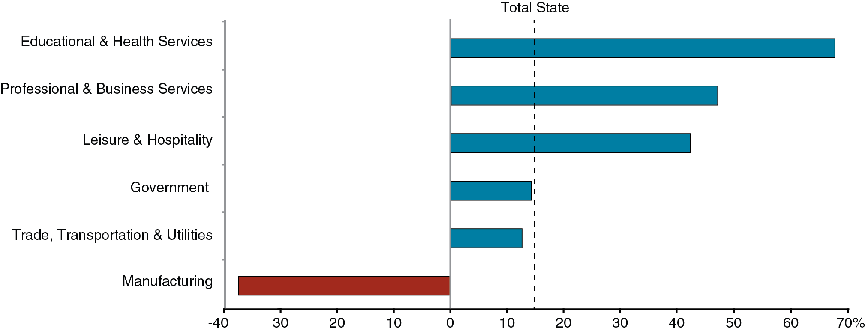
Changes in California’s Job Mix Since 1990
Percent Change in Jobs, 1990 to 2012

Slide 5
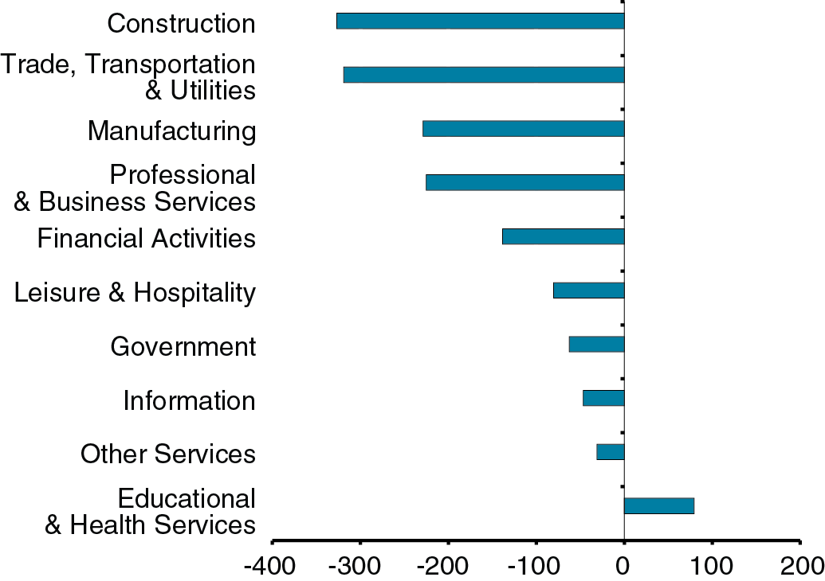
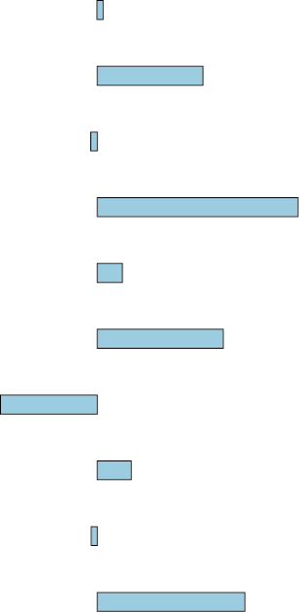
Jobs Since the Recession: Some Sectors Are Struggling
Change in California Employment (In Thousands)

Slide 6
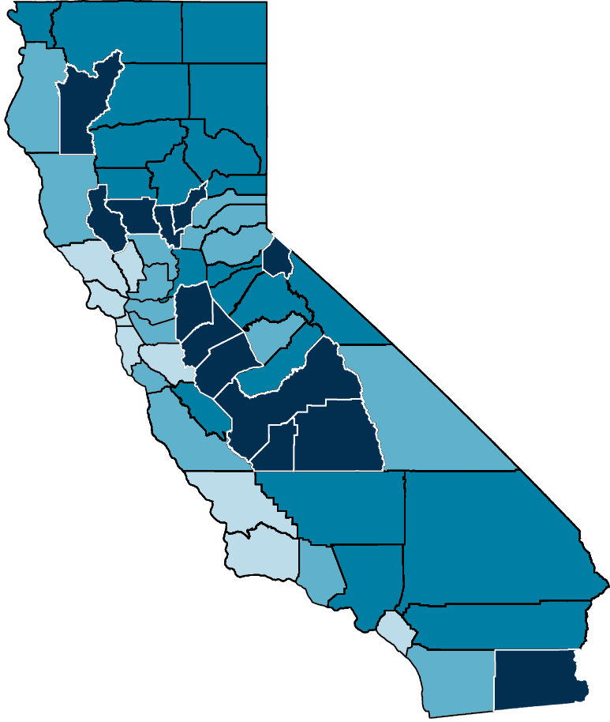
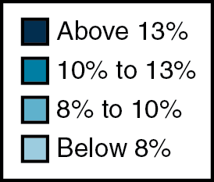
Unemployment Varies Significantly Throughout California

Slide 7
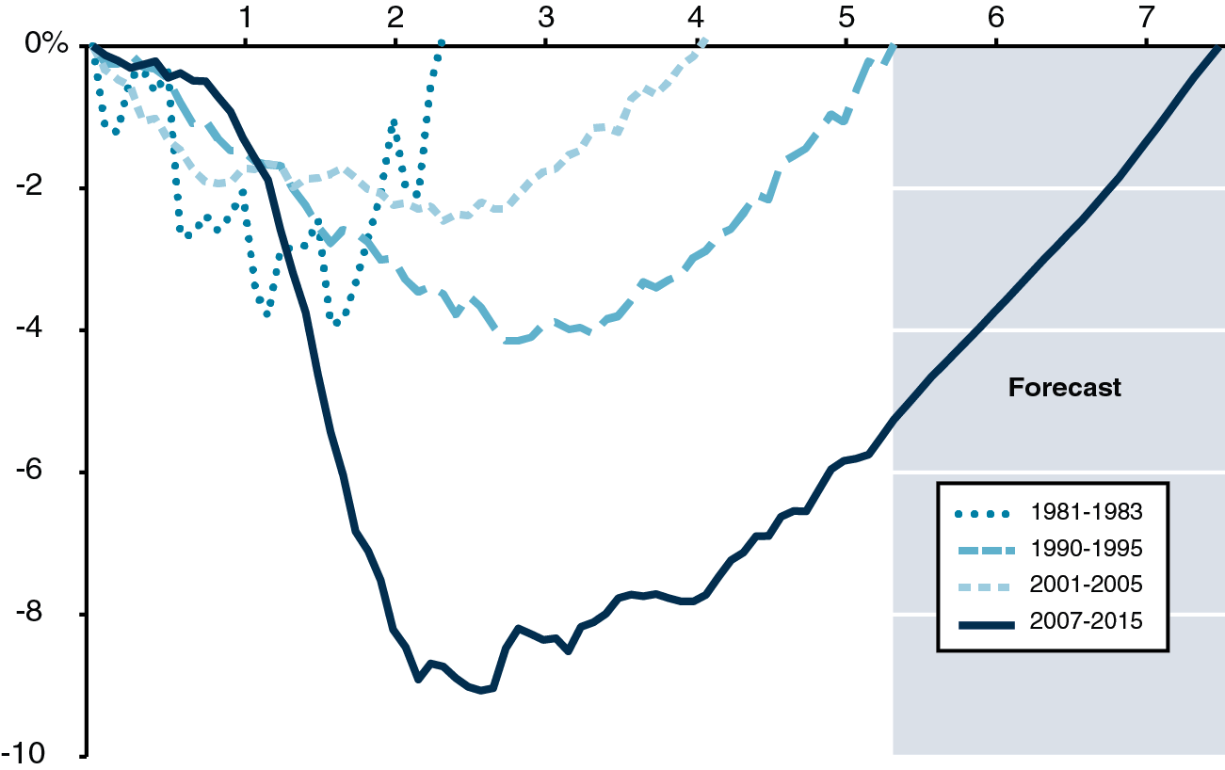
Jobs in California Recovering Much More Slowly Than in Prior Recoveries
Job Loss and Years to Return to Pre-Recession Employment Peak

Slide 8
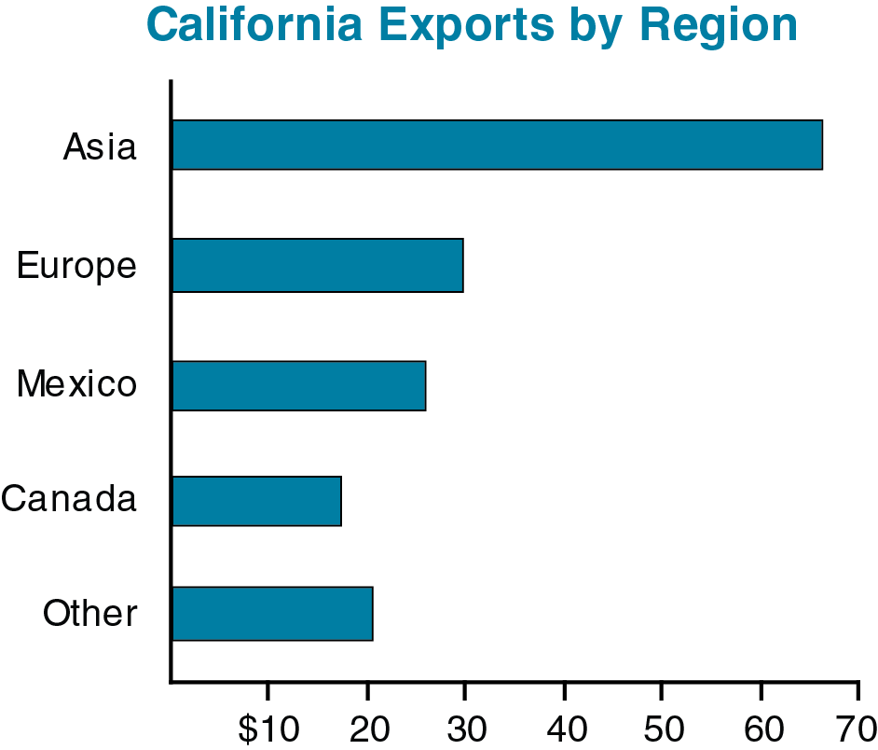
Trade Is an Important Source of California Economic Activity
2011 International Exports (In Billions)

Slide 9
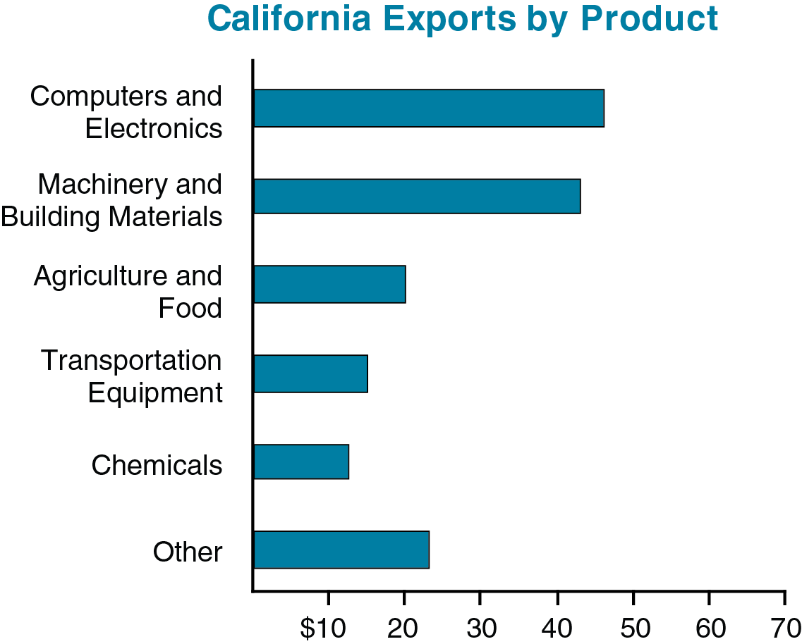
Trade Is an Important Source of California Economic Activity
2011 International Exports (In Billions)

Slide 10
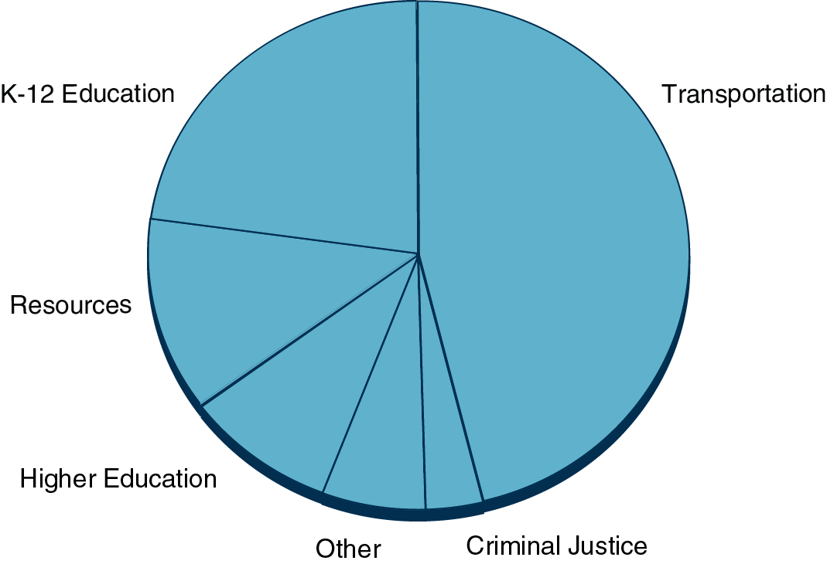
Most State Infrastructure Spending Is for Transportation and Education
Infrastructure Spending, 2006-07 to 2010-11

Slide 11
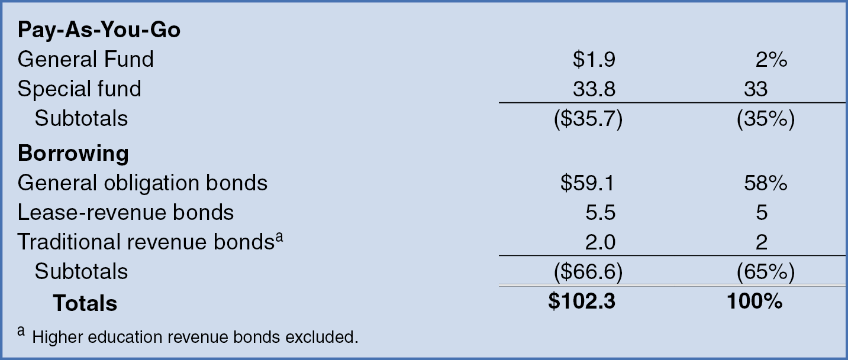
How Does the State Pay for Infrastructure?
2000-01 Through 2009-10 (Dollars in Billions)

Slide 12
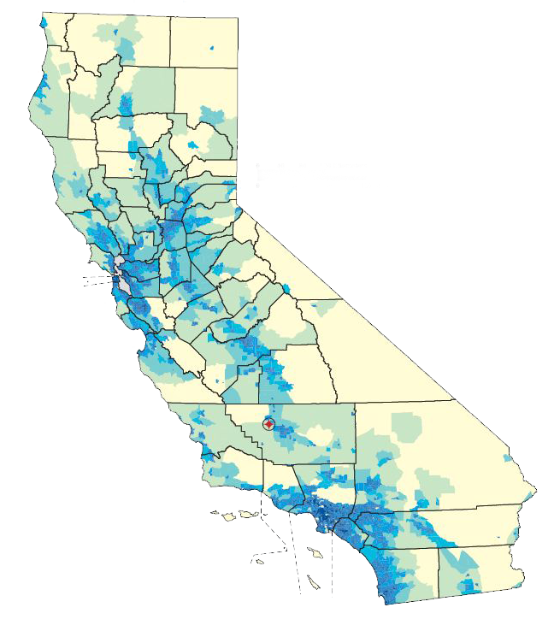
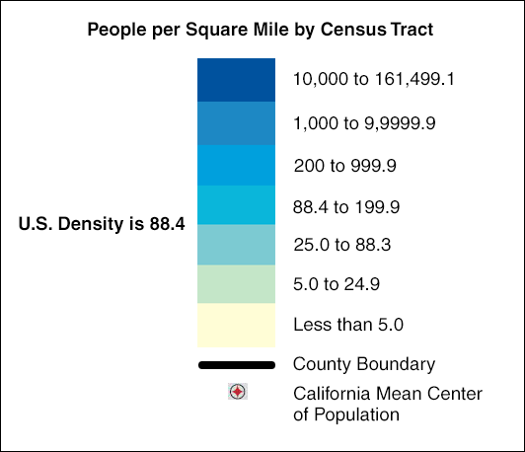
Population Density By Census Tract

Slide 13
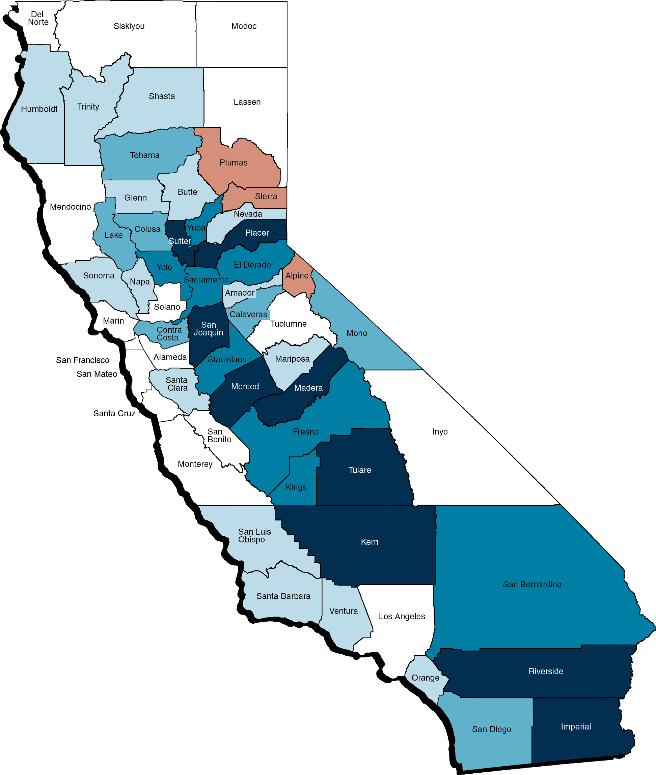
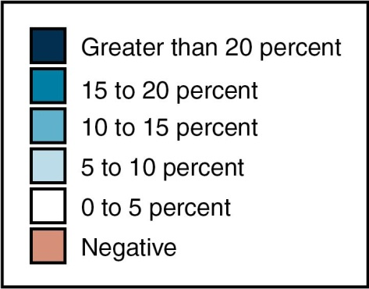
Population Growth By County
(2000 Through 2010)

Slide 14
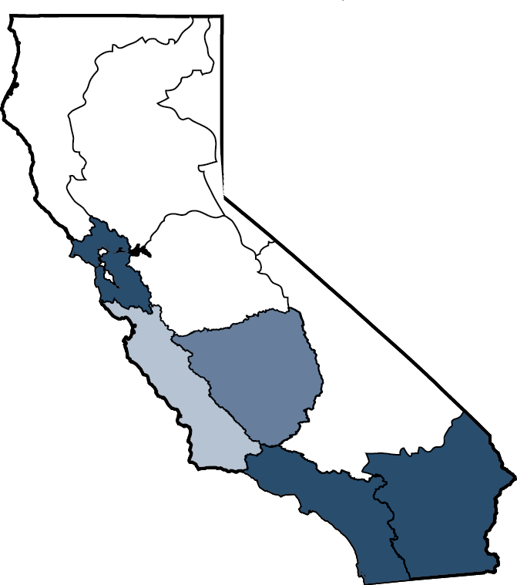
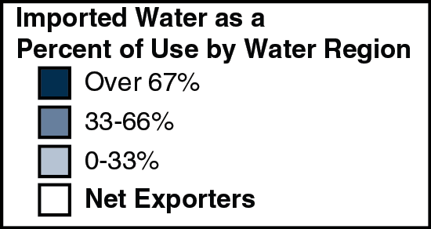
Population Centers Rely Heavily on Imported Water

Slide 15
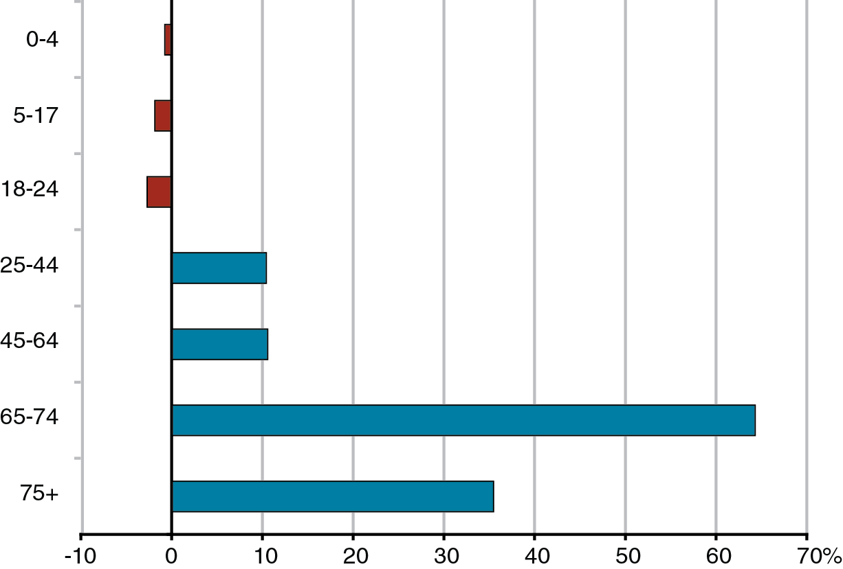
California’s Elderly Population Will Grow Rapidly in the Next Decade
LAO Projected Growth by Age Group, 2010 Through 2020

Slide 16
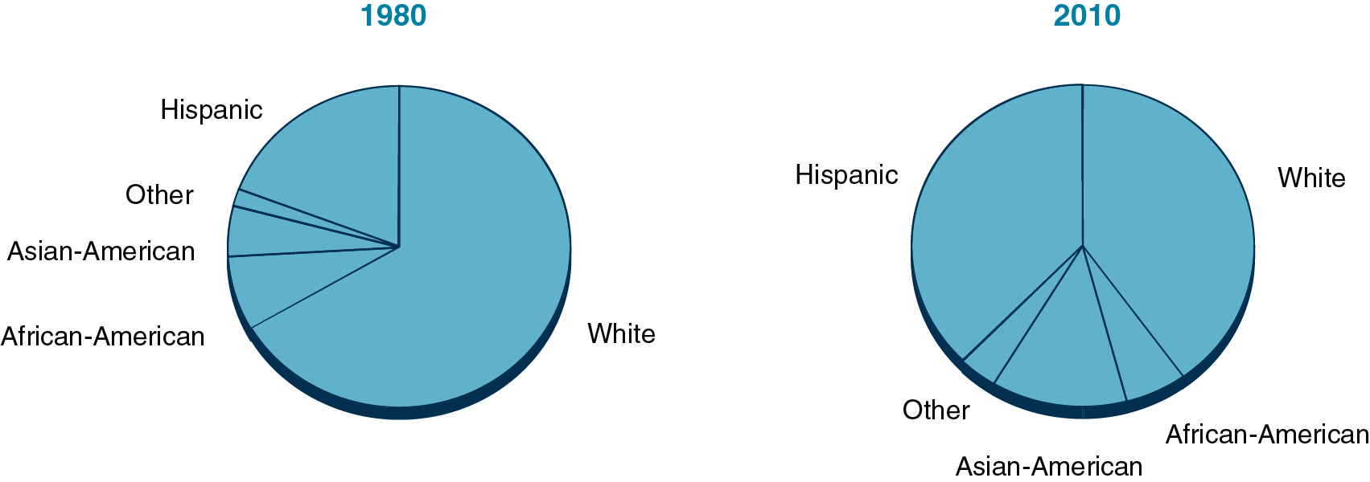
California’s Racial and Ethnic Makeup Has Changed Since 1980
Share of Population in Each Group

