Slide 1
State Budget Update
Legislative Analyst’s Office
Presented to:
California School Boards Association
May 19, 2012
www.lao.ca.gov

Slide 2
Overview of
May Revision

Slide 3
May Revision Identifies $15.7 Billion Budget Problem
State Budget Problem $6.5 Billion Higher Than Estimated in January
Lower revenue estimates ($4.3 billion).
Higher Proposition 98 General Fund costs ($2.4 billion).
Lower anticipated net costs in other areas (-$0.2 billion).

Slide 4
Governor Proposes Package of Budget-Balancing Solutions
2011-12 and 2012-13 General Fund Benefit (In Millions)

Slide 5
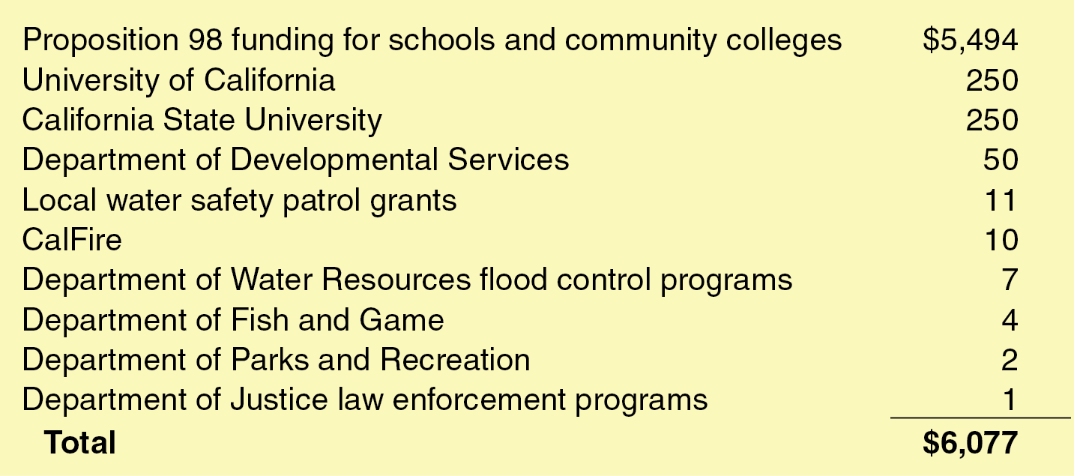
Governor’s Updated Trigger Plan
2012-13 General Fund Benefit (In Millions)

Slide 6
Assessment of
May Revision

Slide 7
LAO Assessment of Updated Plan
General Fund Revenue Estimates Reasonable
RDA-Related Revenue Estimates Likely Too High
Using our estimates, budget problem would be about $900 million higher.
RDA Cash Asset Shift Highly Uncertain

Slide 8
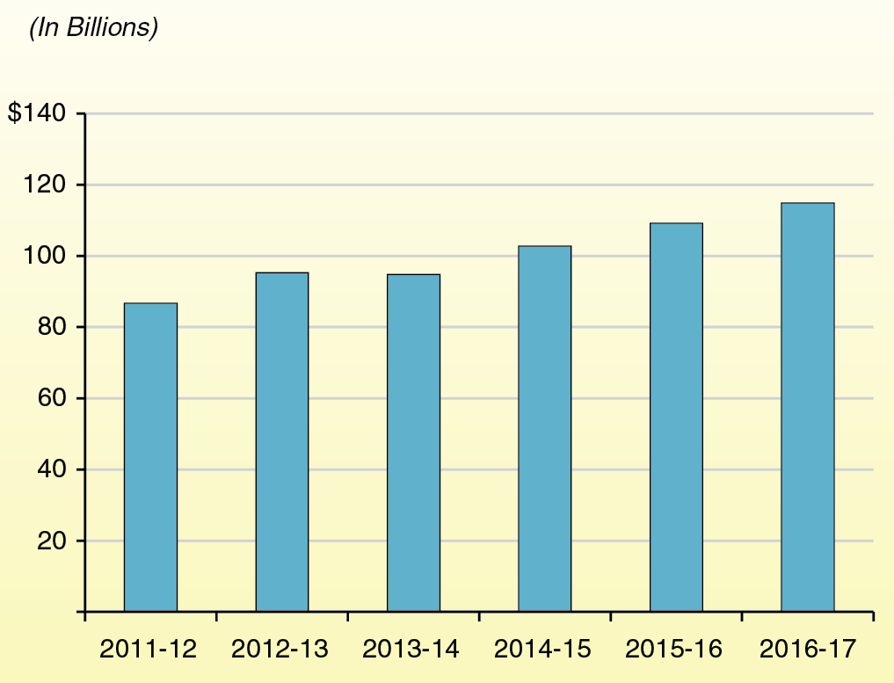
LAO May 2012 General Fund Revenue Forecast

Slide 9
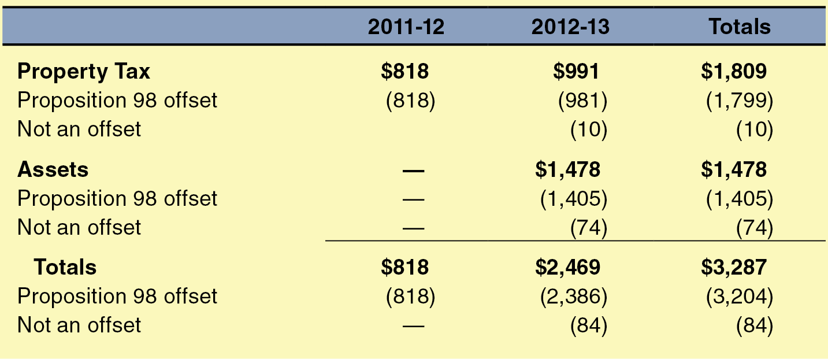
Administration’s Estimates of K-14 Redevelopment-Related Funds
(In Millions)

Slide 10
Overview of Updated
Proposition 98 Package

Slide 11
Changes in Proposition 98 Minimum Guarantee
(In Millions)

Slide 12
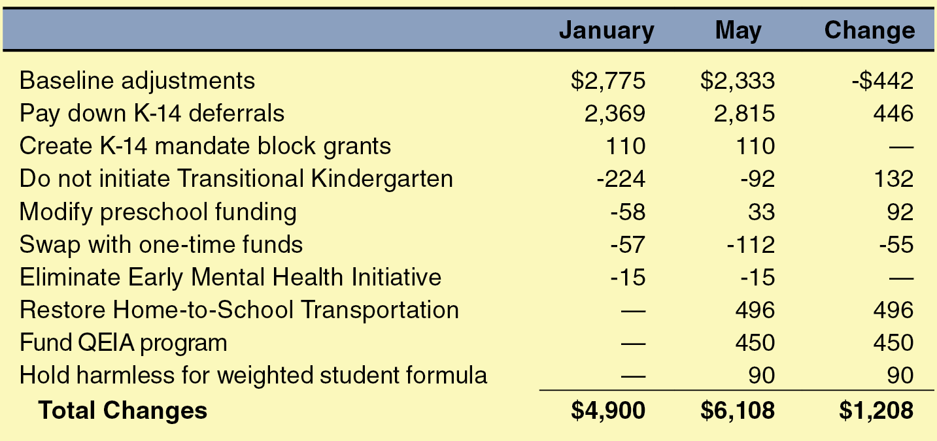
Changes in 2012-13 Proposition 98 Spending
(In Millions)

Slide 13
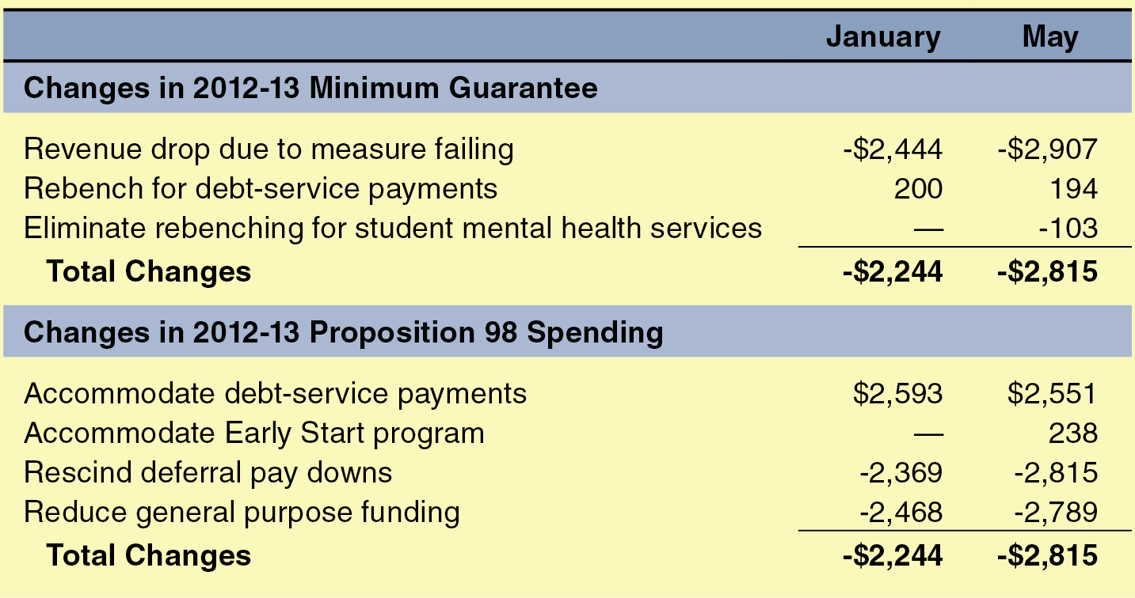
Changes to Governor’s Proposition 98 Trigger Plan
(In Millions)

Slide 14
Assessment of Updated
Proposition 98 Package

Slide 15
LAO Assessment of Updated Plan
Serious Concerns With Maintenance Factor Application
Serious Concerns With Rebenching Adjustments

Slide 16
Questionable Maintenance Factor Interpretation
Eliminates Underlying Rationale for Having Maintenance Factor
Produces Irrational Outcomes

Slide 17
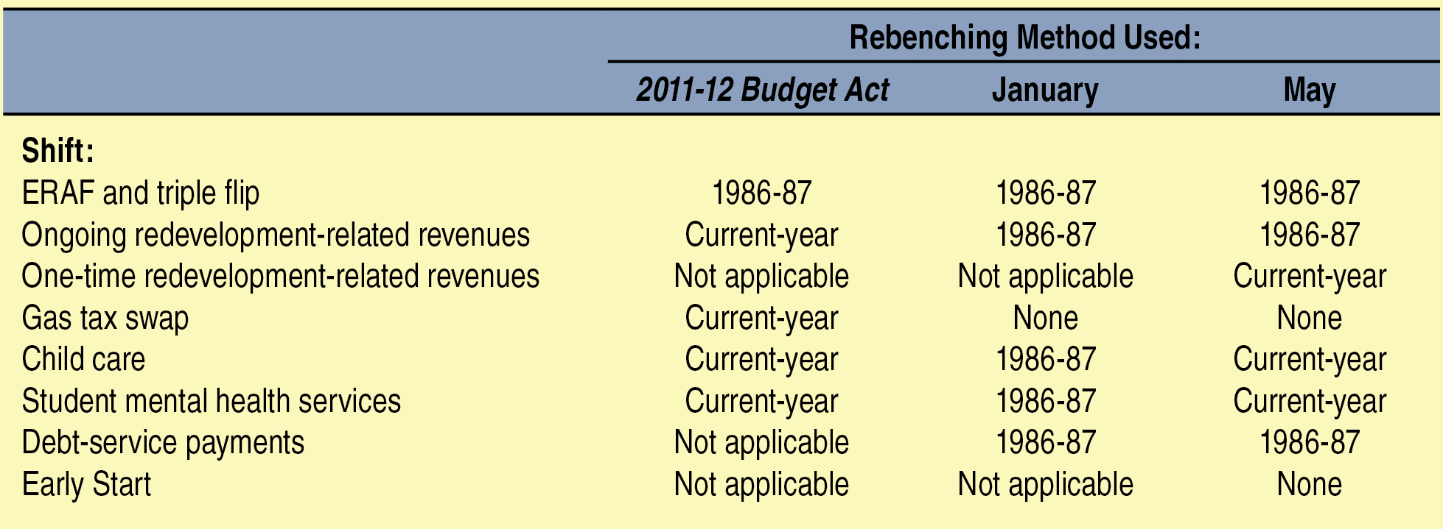
Inconsistency in Rebenching Adjustments

Slide 18
Alternative
Proposition 98 Package

Slide 19
Alternative Proposition 98 Basic Plan
Based on Reasonable Maintenance Factor Application, Consistent Rebenchings
Little to No Effect on Programmatic Funding for Schools
Funds the Guarantee
Frees Up $1.9 Billion for Rest of Budget

Slide 20
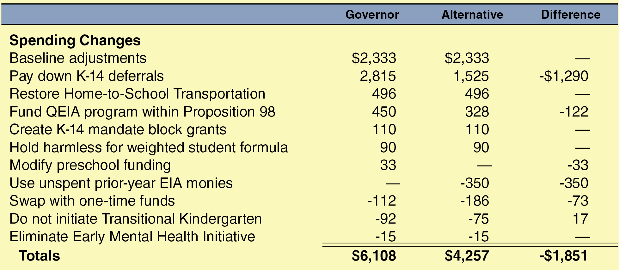
Side-by-Side Comparison: Basic Plans
(In Millions)

Slide 21
Alternative Proposition 98 Trigger Plan
Contains No New Rebenchings
Does not shift debt service payments and Early Start into the guarantee.
Funds the Guarantee
Reduces Programmatic Funding for Schools Notably Less Than Governor
Spreads Pain of Trigger Cuts

Slide 22
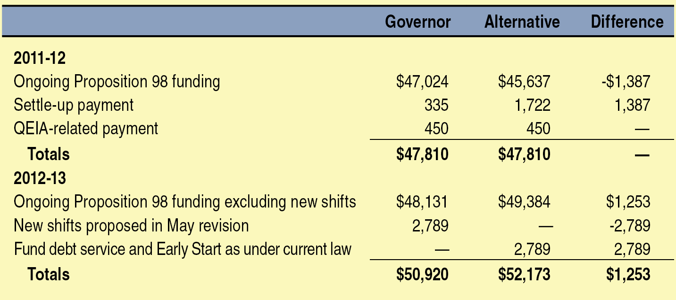
Side-by-Side Comparison: Trigger Plans
(In Millions)

