Slide 1
State Budget Update
Jennifer Kuhn
Legislative Analyst’s Office
Presented to: CCSESA
February 24, 2012
www.lao.ca.gov

Slide 2
Overview of
Governor’s January Budget

Slide 3
Major Components of Governor’s Budget Package
Estimates budget problem at $9.2 billion.
Proposes net $10.1 billion in solutions.
Assumes voters approve November 2012 tax measure.
Proposes $5.4 billion in trigger reductions if measure fails.

Slide 4
Budget-Balancing Actions
$7.2 billion in new revenues.
$4.0 billion in expenditures cuts.
$1.4 billion in other savings.
$2.5 billion offsetting increase in Proposition 98 guarantee.

Slide 5
Proposition 98:
Governor’s Basic Budget Plan

Slide 6
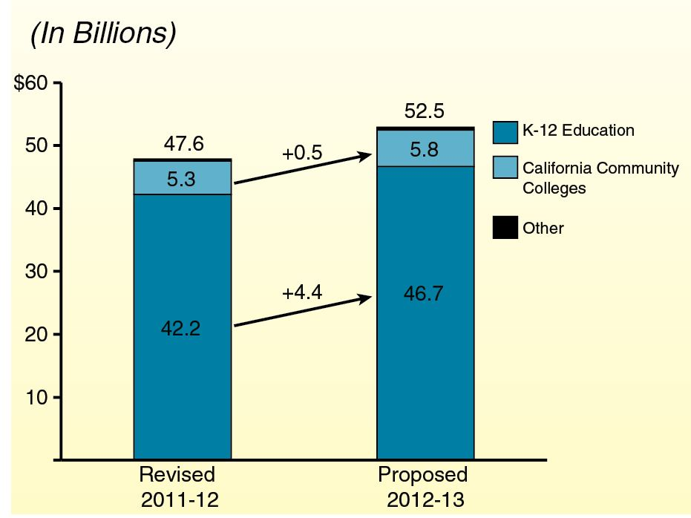
Proposition 98 Funding

Slide 7
Five Major Proposals
Backfill one-time actions ($3.0 billion).
Pay down deferrals ($1.8 billion).
Create mandate block grant ($200 million).
Hold harmless: weighted student formula ($90 million).
Do not initiate Transitional Kindergarten program ($224 million savings).

Slide 8
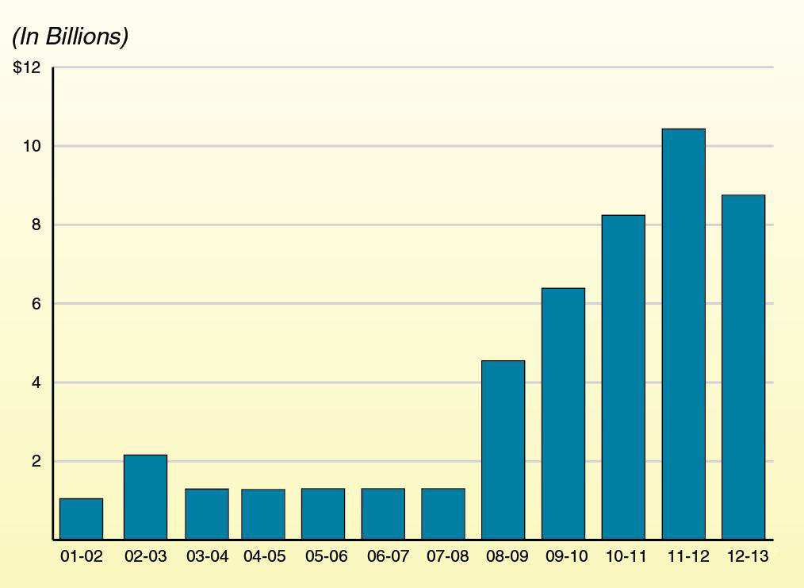
Deferrals Over Time

Slide 9
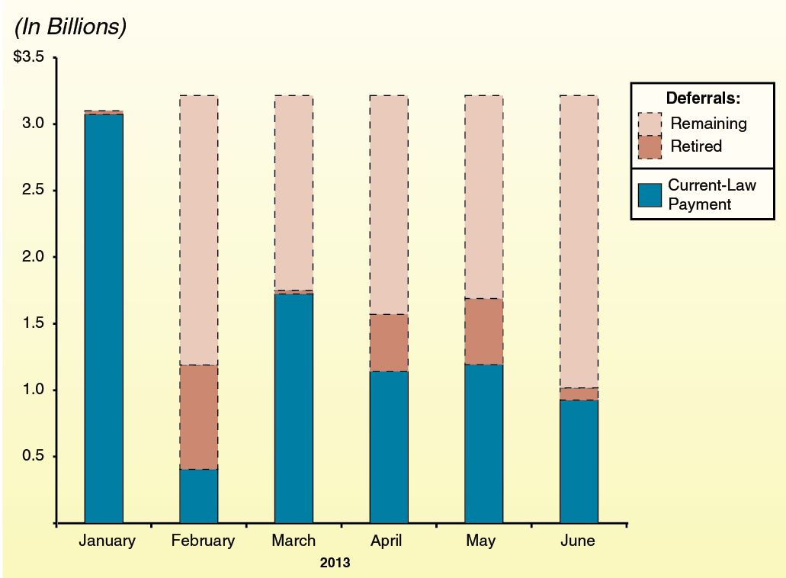
Proposes to Retire $1.8 Billion in Deferrals

Slide 10
Education Mandates Block Grant
Eliminates about half of K-12 mandates.
Provides $178 million in block grant funding for remaining activities.
Sets district funding rate at $30 per pupil.
Allows LEAs to select between block grant and existing reimbursement process.

Slide 11
Weighted Student Formula
Removes strings associated with 7 currently standalone programs.
Creates weighted student formula.
Phases in formula over 6 years.
Directs SBE to develop new accountability system.

Slide 12
Basic Plan Linked With Tax Measure
Governor estimates his tax measure would raise $6.9 billion initially:
$2.2 billion accrued to 2011-12.
$4.7 billion attributed to 2012-13.
Impact on Proposition 98:
About $900 million increase in 2011-12.
About $2.4 billion increase in 2012-13.

Slide 13
LAO Recommendations
If new revenues materialize, use for paying down deferrals in 2012-13.
Create mandate block grant.
Adopt either weighted student formula or a few large block grants.
Do not initiate TK program.

Slide 14
Proposition 98:
Governor’s Back-Up Budget Plan

Slide 15
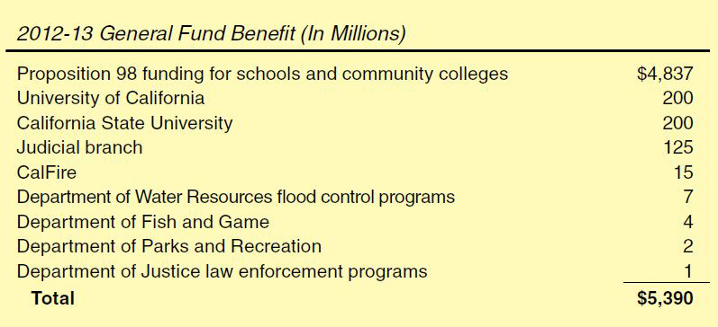
Proposed “Trigger” Reductions

Slide 16
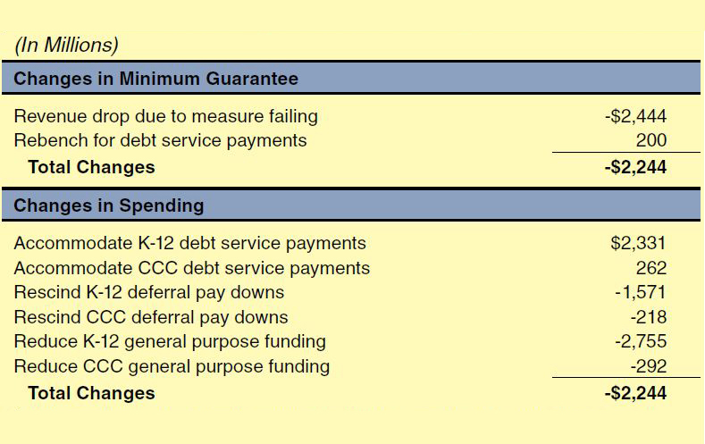
Back-Up Plan: Major Components

Slide 17
Two Concerns With Back-Up Plan
Serious policy concerns with debt service proposal.
Treatment of realignment revenues risky.

Slide 18
Two Approaches to Building Back-Up Plan
Assume midyear cuts if measure fails.
Assume midyear augmentations if measure passes.

Slide 19
LAO Recommendations
Reconsider debt service proposal.
Provide more flex options, effective July 1:
Remove additional categorical and mandate requirements.
Allow for shorter school year.
Eliminate or suspend penalties for exceeding statutory class size caps.
Authorize special post-election layoff window.

Slide 20
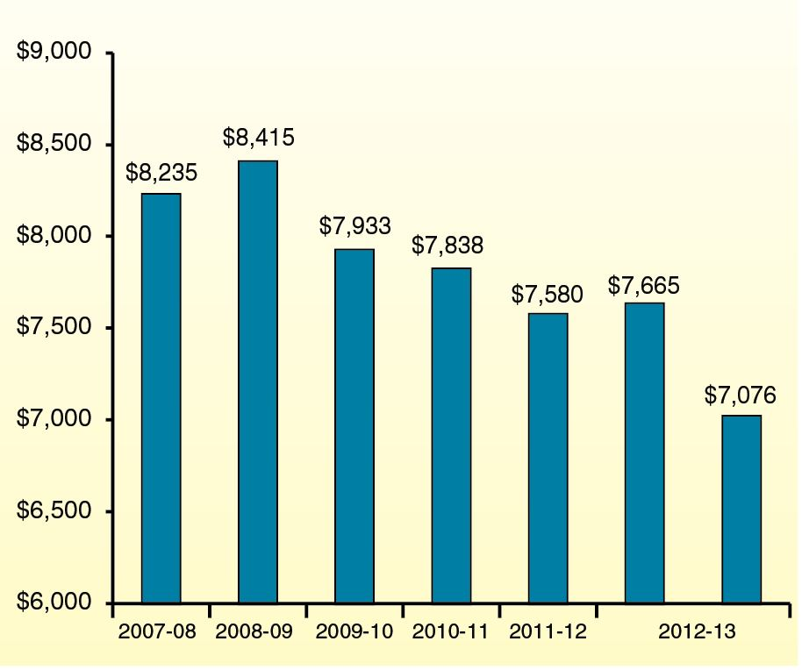
Programmatic Per-Pupil Funding

Slide 21
Proposition 98:
Governor’s Multiyear Payment Plan

Slide 22
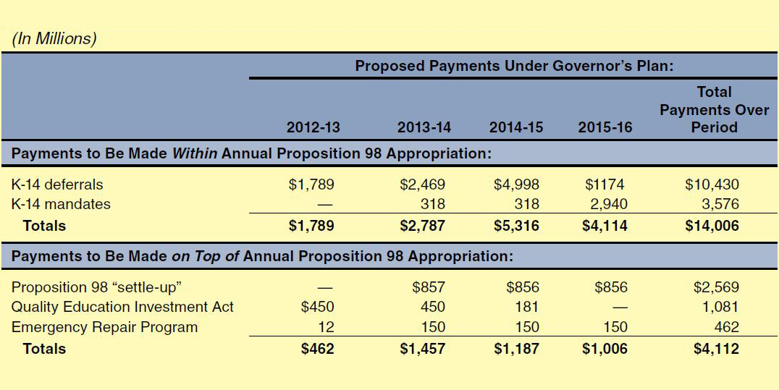
Governor’s Multiyear Payment Plan
Proposition 98:
Governor’s Multiyear Payment Plan

Slide 23
Use Governor’s Plan As Starting Point
To increase likelihood plan is consistently implemented:
Extend payment period.
Spread payments more evenly over period.
Designate settle-up funds for mandates or deferrals.
Redirect QEIA program savings to other obligations.

Slide 24
Other Major Issues
Preschool funding
Child care reductions
Ballot measures

