Slide 1
The 2023-24 Budget: Crafting Climate, Resources, and Environmental Budget Solutions
Senate Budget and Fiscal Review Subcommittee No. 2 on Resources, Environmental Protection, and Energy
March 2, 2023

Slide 2
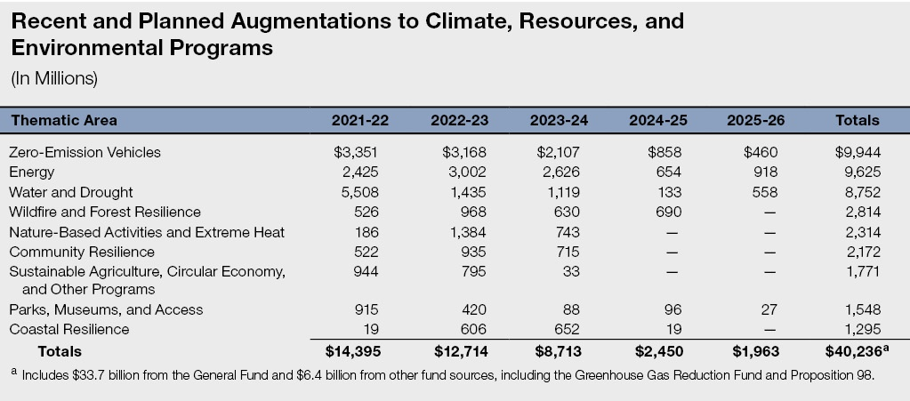

Slide 3
Status of Recent Augmentations
Departments Still in the Process of Implementing New Funding
Data Indicate a Significant Amount of Recent Funding Has Not Yet Been Committed
  As of February 2023, $11.4 billion out of $27 billion provided in 2021-22 and 2022-23 is uncommitted.
Outcomes and Success of Recent Augmentations Largely Still Unknown

Slide 4
State Facing a Multibillion-Dollar Budget Problem
Deteriorating Revenue Picture Since June
Revenues Currently Estimated to be Insufficient to Cover Planned Expenditures
Roughly $20 Billion Shortfall for 2023-24
Out-Year Operating Deficits Projected
Budget Outlook Could Be Even Worse

Slide 5
Governor’s Proposals
$5.8 Billion in Budget Solutions Across Five Years, including $5.5 Billion in 2023-24
  $4.1 billion in reductions ($3.8 billion in 2023-24).
  $1.7 billion in fund shifts ($875 million in 2023-24).
  $800 million in funding delays.
$2.2 Billion in Potential “Trigger” Restorations
Greenhouse Gas Reduction Fund (GGRF) Trigger Restoration Approach
Some New Spending

Slide 6
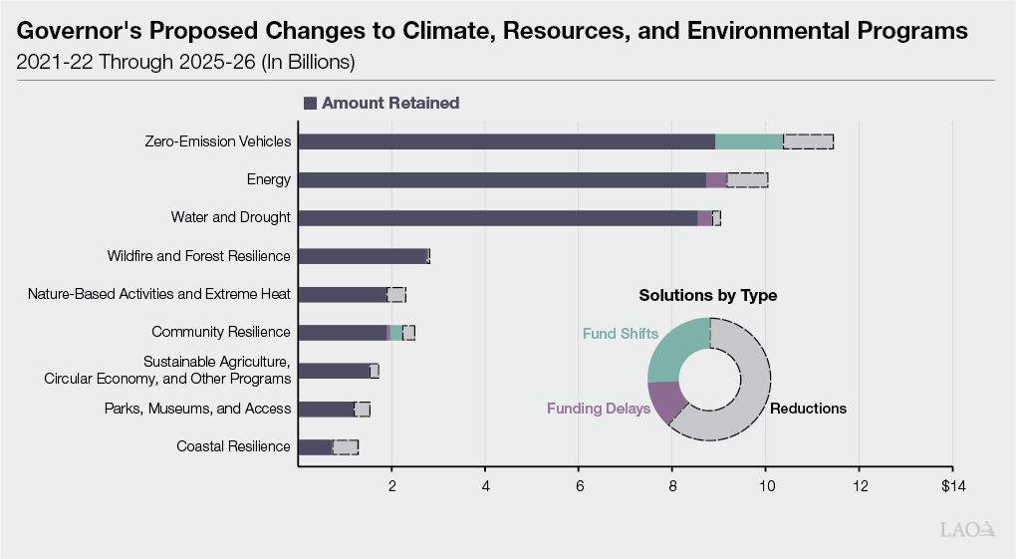

Slide 7
Overarching Assessment
While Need for Programs Remains, Identifying Budget Solutions Is Appropriate
Overall Approach Is Reasonable, but Specific Choices Reflect the Governor’s Priorities
Fund Shifts Not Without Trade-Offs
Triggers Would Minimize Legislative Authority
Portion of Governor’s Solutions Used to “Make Room” for New Spending
Additional Solutions May Be Needed

Slide 8
Overarching Recommendations
Adopt Package of Solutions Based on Legislative Prioritization Criteria
  Preserve activities that reflect legislative priorities and goals.
  Preserve funding that is needed to urgently address pressing needs.
  Avoid solutions that would cause major disruptions.
  Consider other available resources.

Slide 9
Overarching Recommendations
Be Selective When Opting to Delay Funding
Reject Both General Fund and GGRF Trigger Proposals
Use Spring Budget Process to Identify Additional Potential Budget Solutions
Weigh Relative Priority of New Spending Against Existing Commitments
Request Additional Information on Federal Funding
Conduct Oversight of Spending and Outcomes

