Slide 1

California’s
Fiscal Outlook
California School Boards Association
December 1, 2016

Slide 2
State’s Fiscal Outlook Through 2017-18

Slide 3
2016-17 Reserve Revised
Down by $1 Billion
LAO Estimates
Revenues Down $1.7 Billion
Expenditures Down $1.2 Billion
Entering Balance Down $510 Million

Slide 4
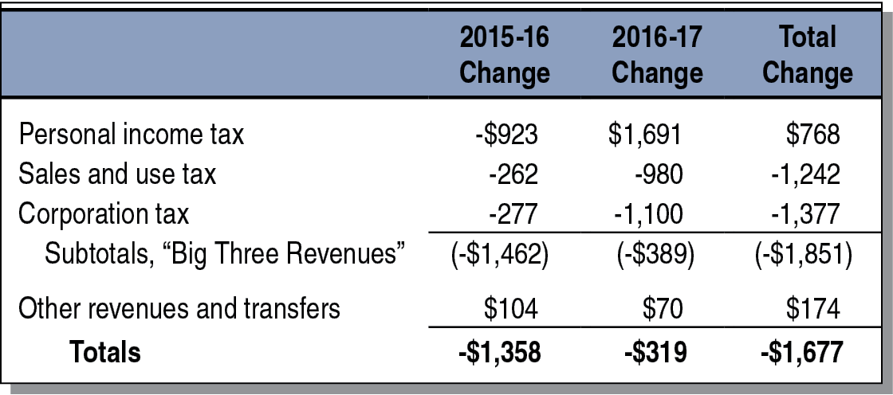
Revenues Down $1.7 Billion From
June 2016 Budget Act Assumptions
State General Fund, LAO Projections (Dollars in Millions)

Slide 5
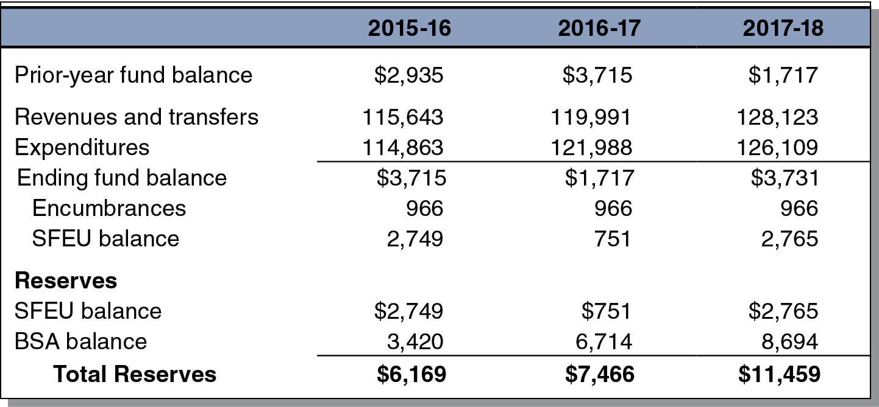
State Projected to End 2017-18
With $11.5 Billion Reserve
State General Fund Condition, LAO Projections (In Millions)

Slide 6
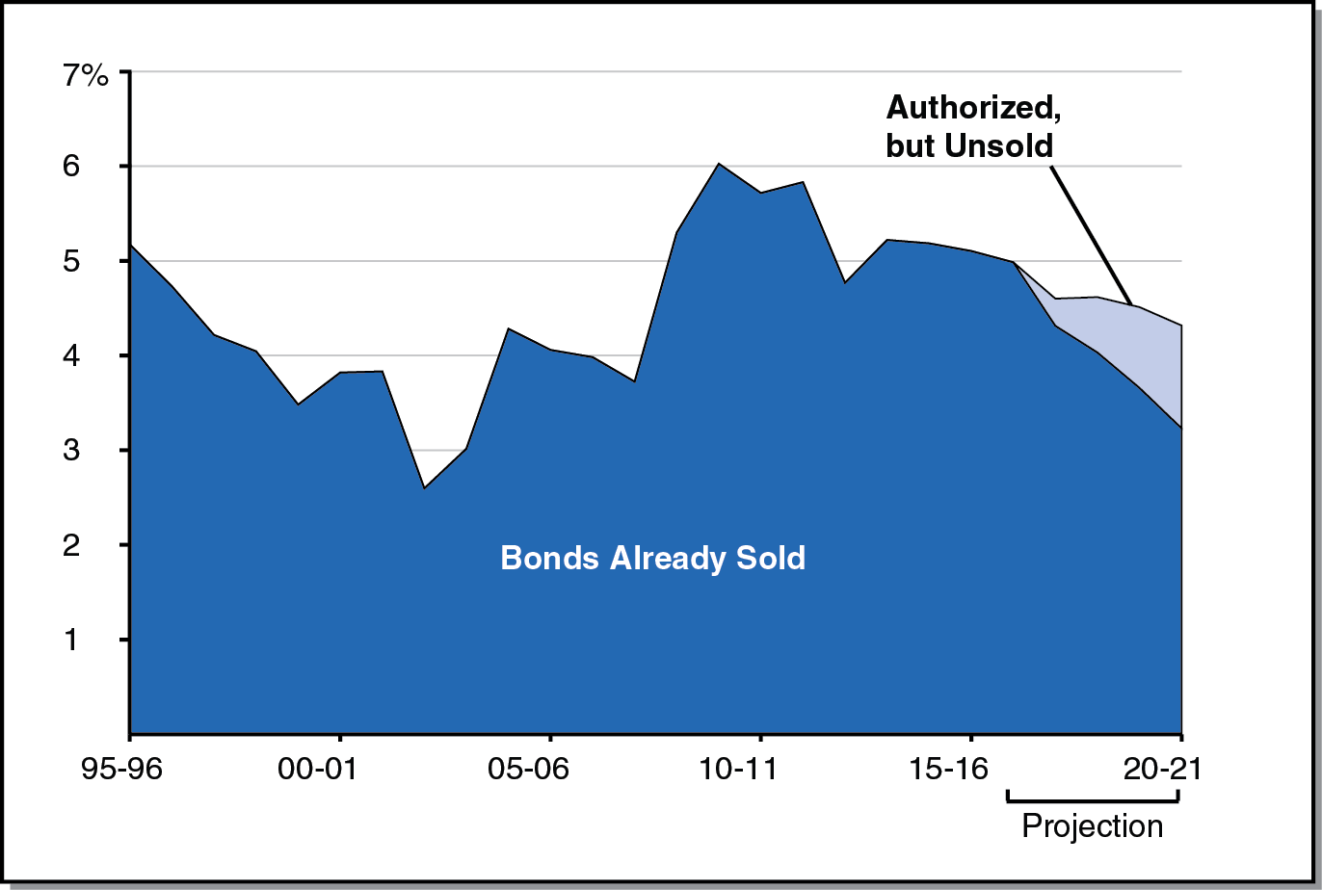
Debt-Service Ratio Expected to Decline Somewhat Throughout Forecast Period
Debt-Service Costs as Share of Annual General Fund Revenues, LAO Projections

Slide 7
Education Outlook Through 2017-18

Slide 8
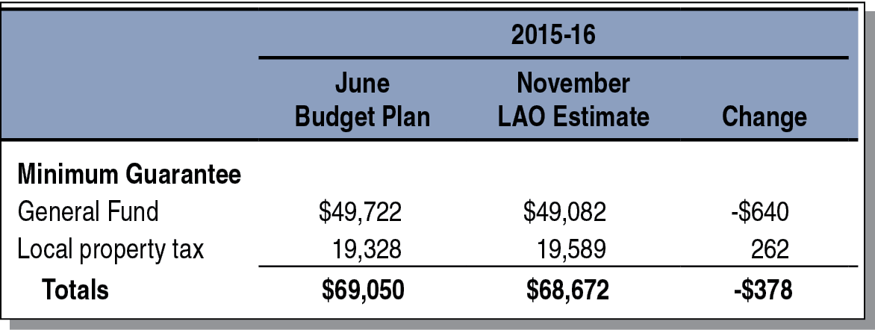
2015-16 Minimum Guarantee Slightly Down
From June Budget Act Estimates
(In Millions)

Slide 9
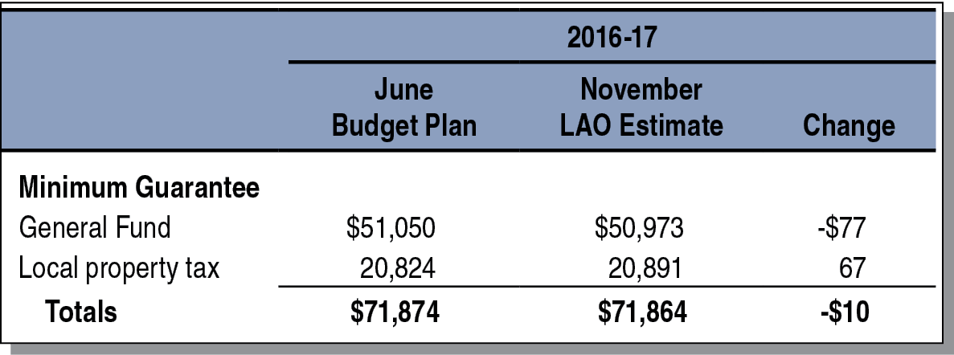
2016-17 Minimum Guarantee Virtually Unchanged From June Budget Act Estimates
(In Millions)

Slide 10
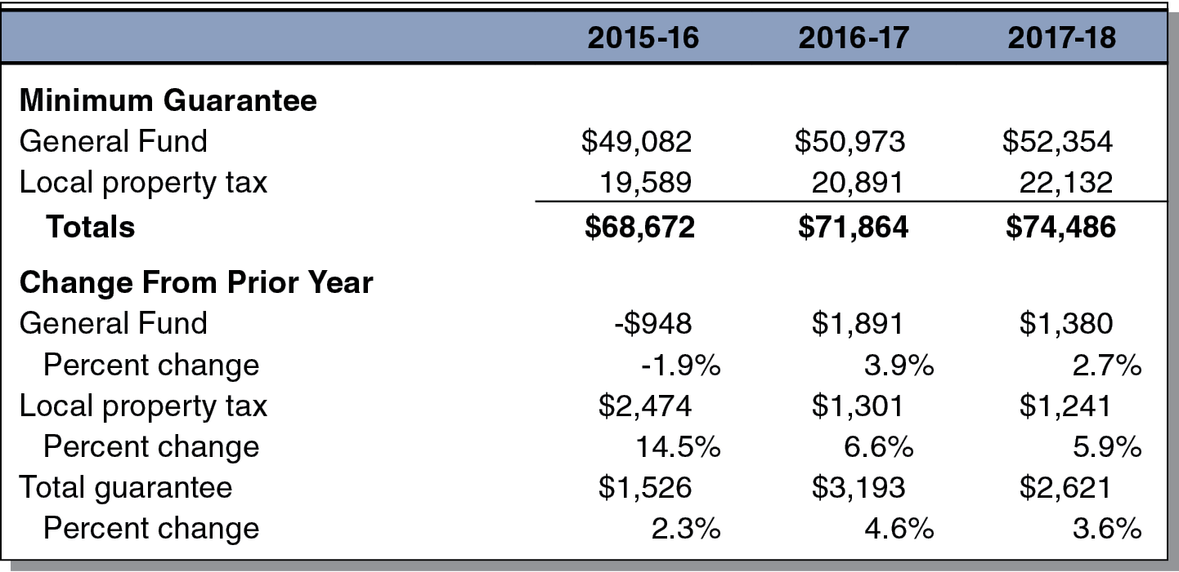
Proposition 98 Minimum Guarantee Projected to Grow Steadily Through 2017-18
LAO Projections (Dollars in Millions)

Slide 11
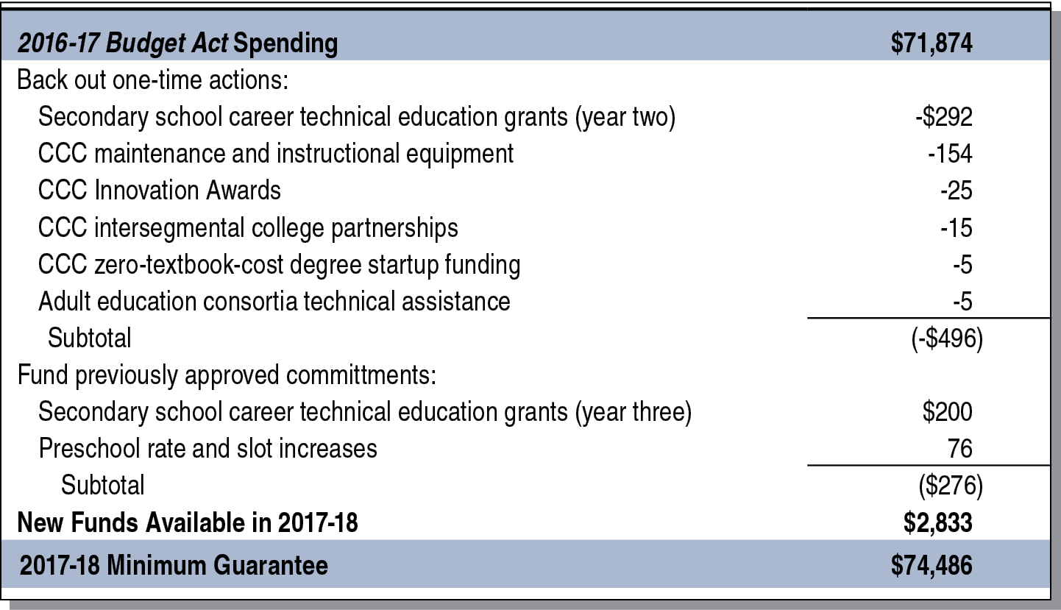
$2.8 Billion in Additional Funding Available for
Proposition 98 Priorities in 2017-18
LAO Projections (In Millions)

Slide 12
State’s Fiscal Outlook Through 2020-21

Slide 13
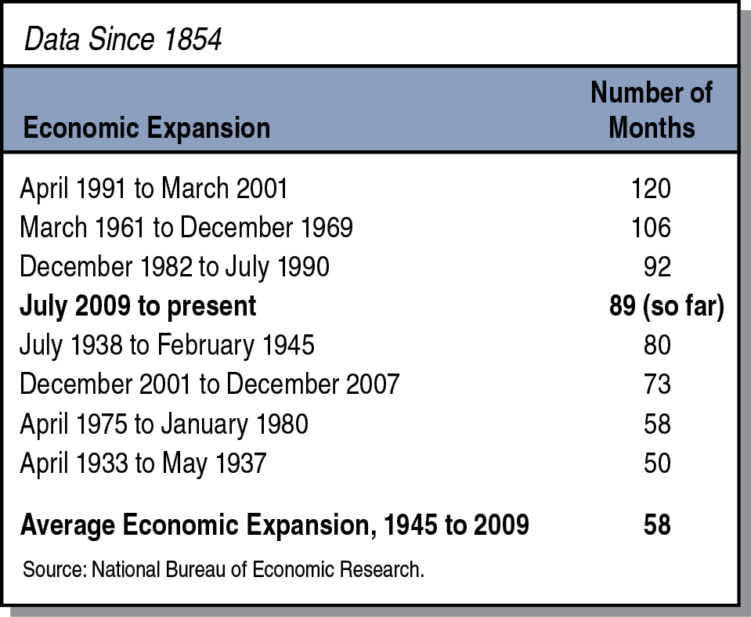
Current Economic Expansion Already Among Longest in U.S. History

Slide 14
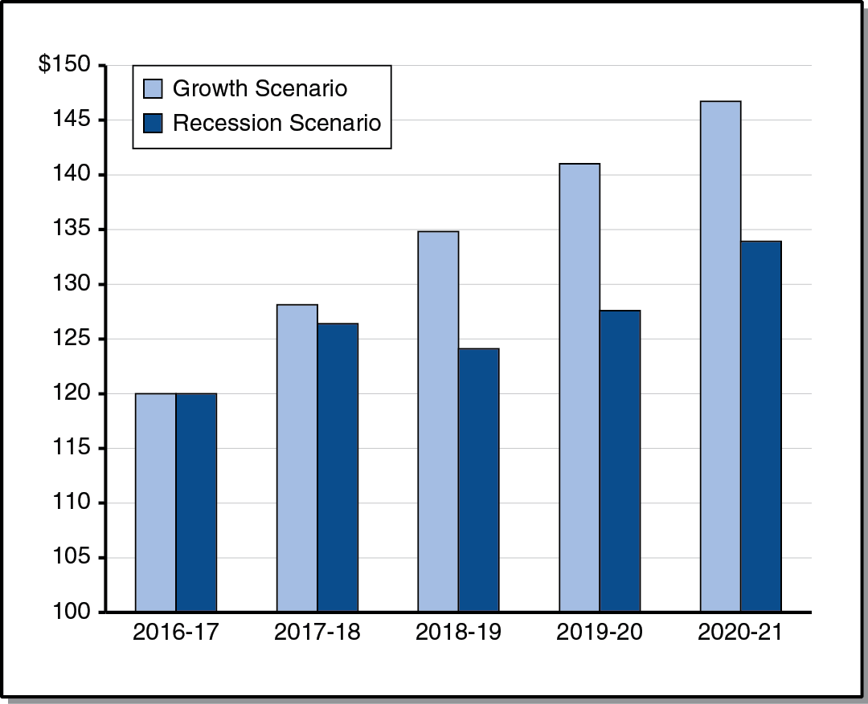
Comparing State Revenues
Under Two Economic Scenarios
LAO Projections (In Billions)

Slide 15
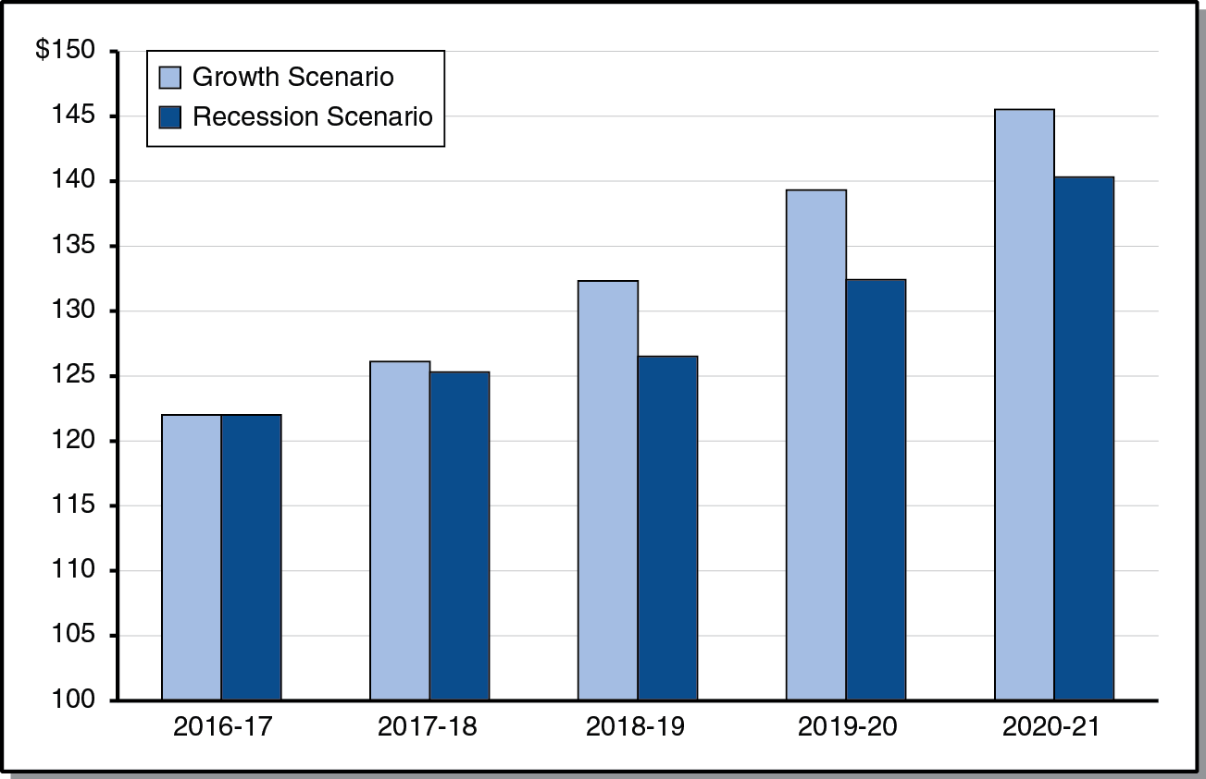
Comparing State Spending
Under Two Economic Scenarios
LAO Projections (In Billions)

Slide 16
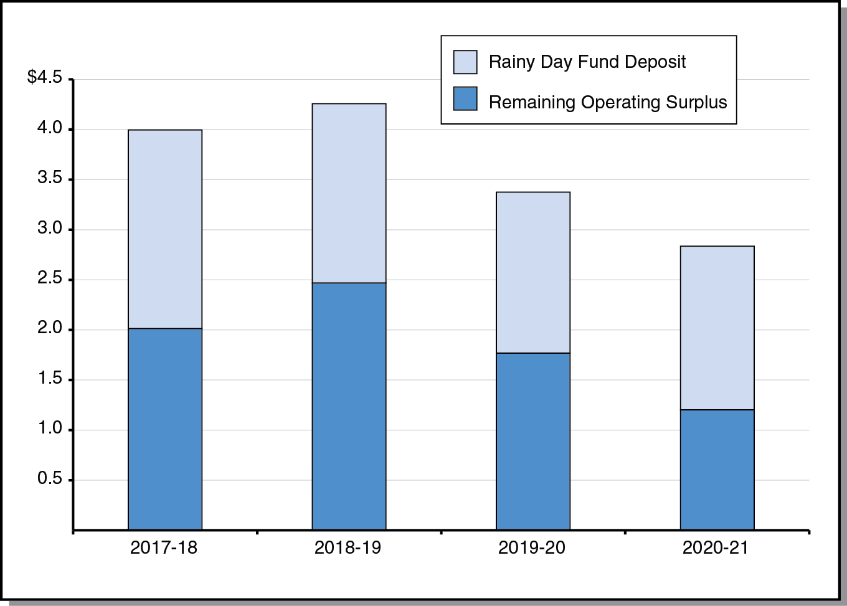
General Fund Surpluses and
Reserve Deposits Under Economic Growth Scenario
LAO Projections (In Billions)

Slide 17
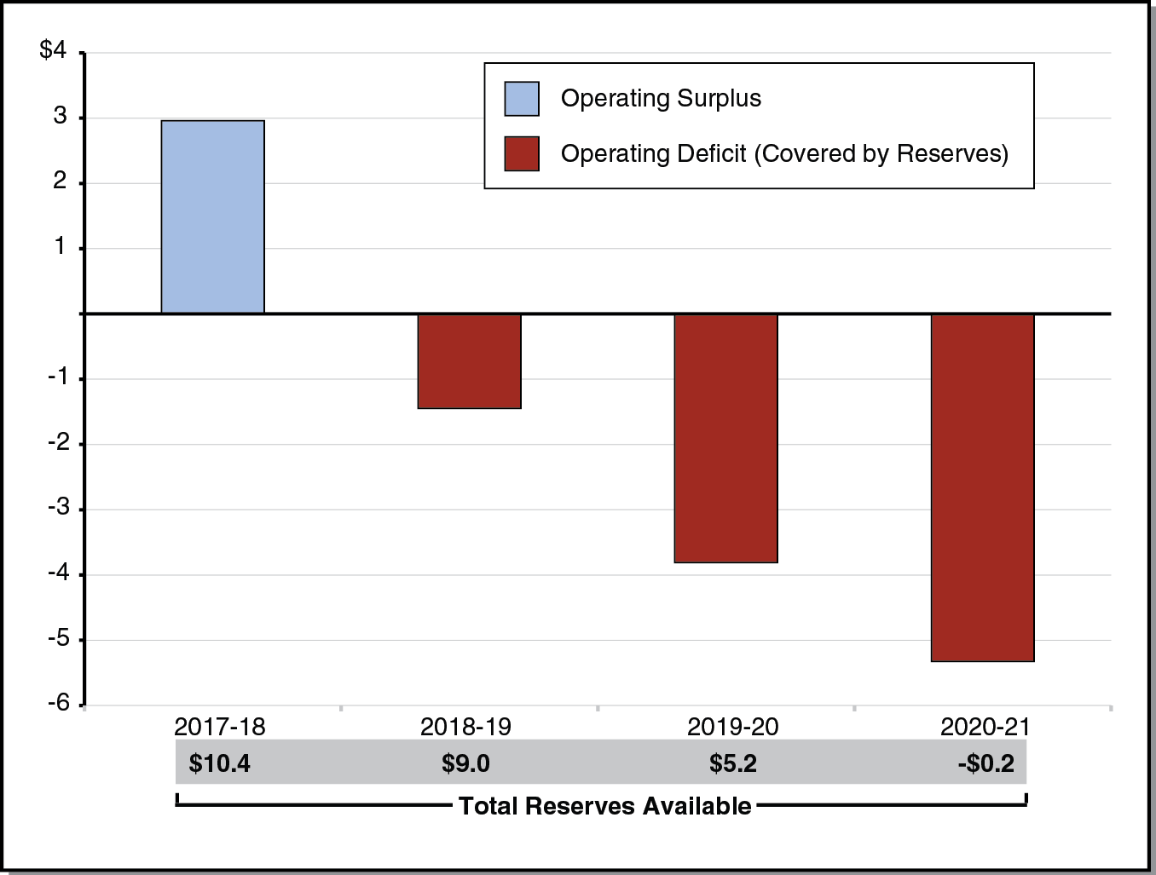
Reserve Covers Operating
Deficits in Mild Recession Scenario
LAO Projections (In Billions)

Slide 18
Education Outlook Through 2020-21

Slide 19
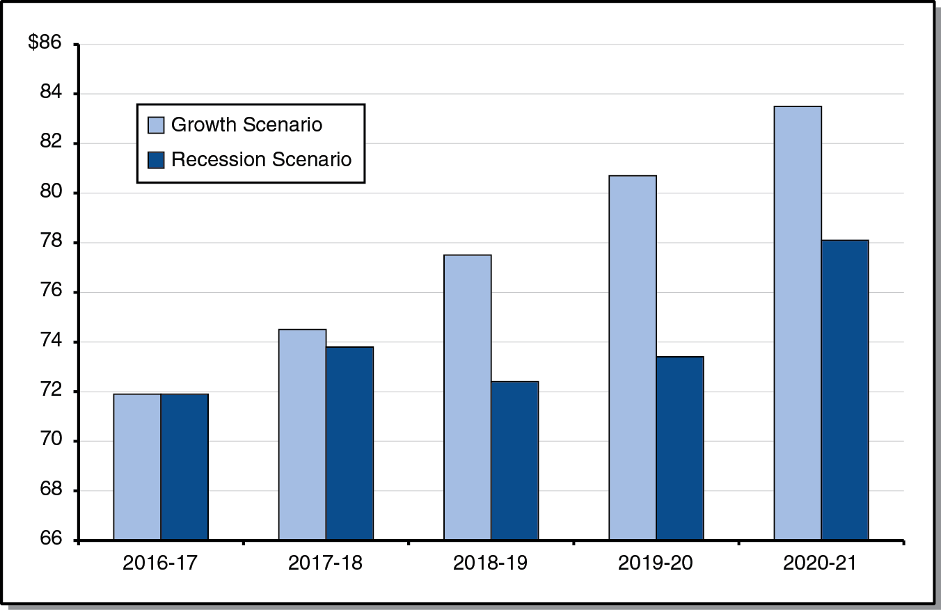
Comparing Minimum Guarantee
Under Two Economic Scenarios
LAO Projections (In Billions)

Slide 20
Other Outlook Factors
LAO Projections
Property Tax Revenue Projected to Rise Steadily
K-12 COLA Projected to Remain Low
K-12 Attendance Projected to Decline
Projected Pace of LCFF Implementation Varies by Scenario

Slide 21
Pension Costs
LAO Projections
$6 Billion Higher Annual Costs by 2020-21
Reflects One-Quarter of New Proposition 98 Funding Under Growth Scenario
Reflects One-Third of New Proposition 98 Funding Under Recession Scenario

