Slide 1
State Economic Outlook
Legislative Analyst’s Office
Presented to:
California Association of Chief Business Officers
April 3, 2014
www.lao.ca.gov

Slide 2
State Budget

Slide 3
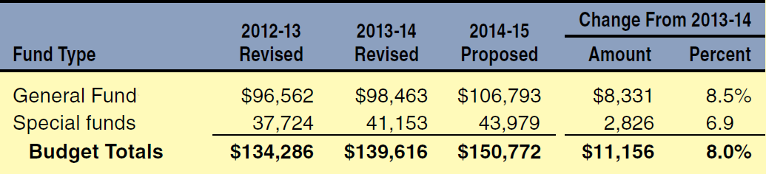
Governor’s Budget Expenditures
(Dollars in Millions)

Slide 4
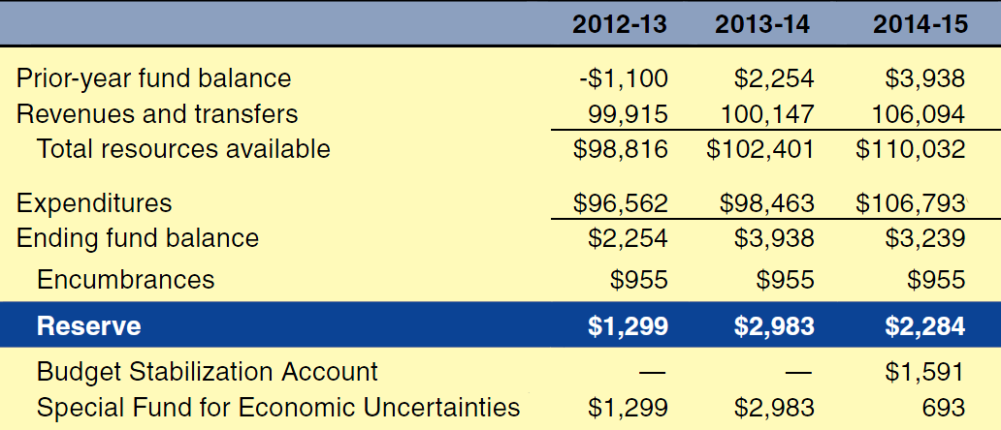
Governor’s Budget
General Fund Condition
Includes Education Protection Account (In Millions)

Slide 5
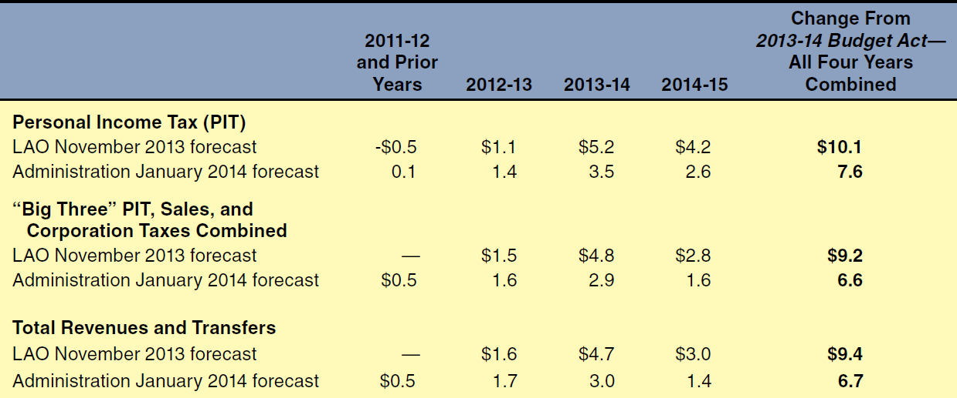
Comparing State Revenue Forecasts
General Fund and Education Protection Account Combined (In Billions)

Slide 6
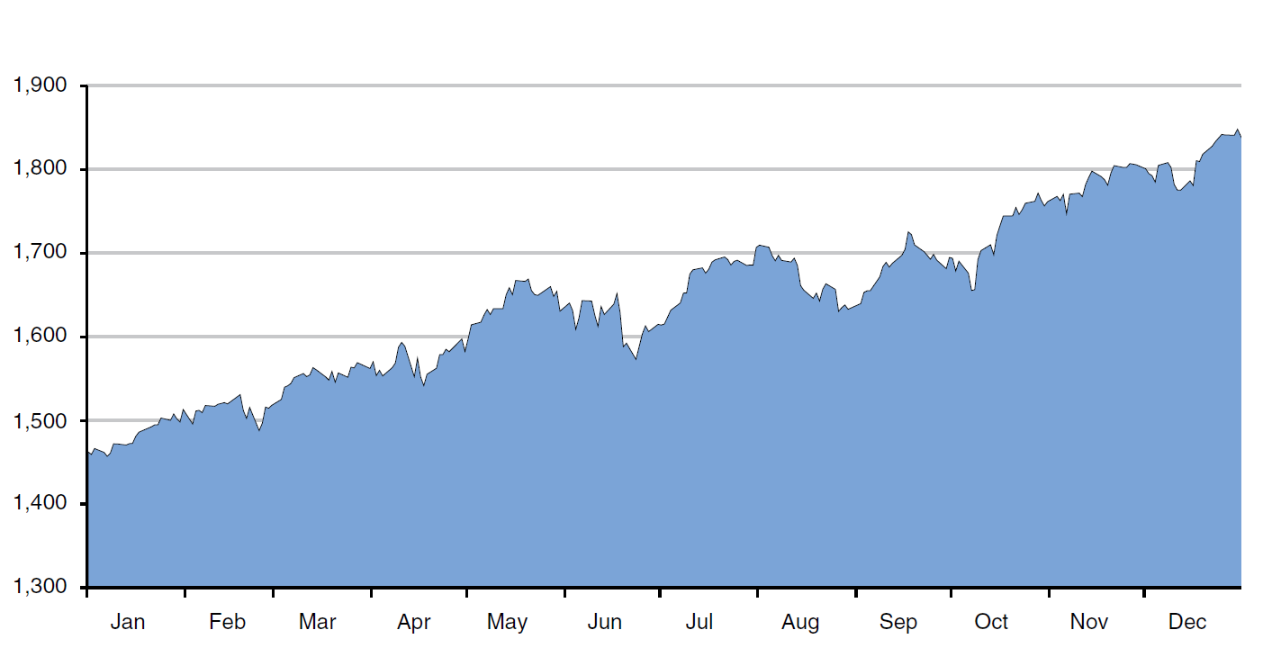
S&P 500 Index Rose Notably During 2013

Slide 7
Education Budget

Slide 8
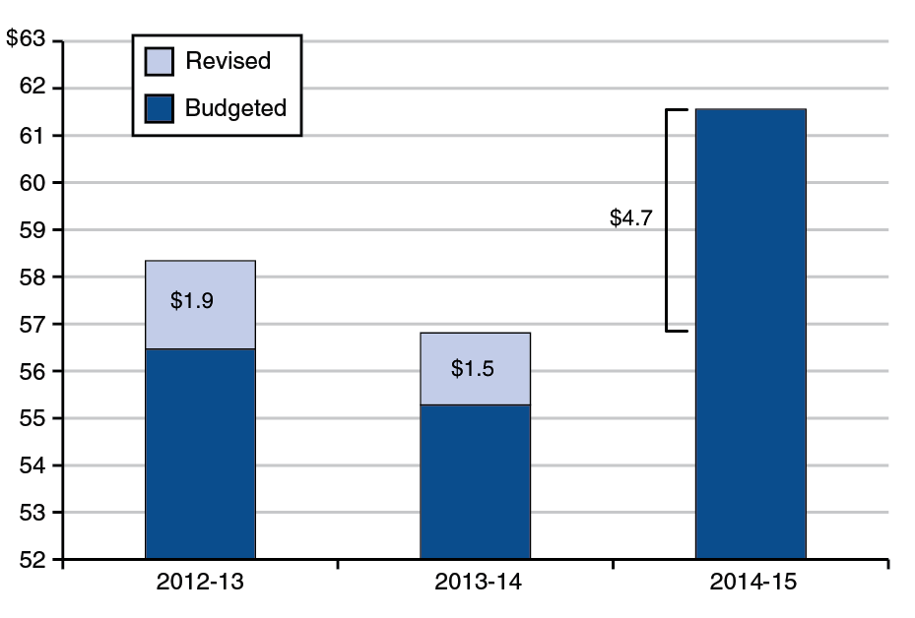
Proposition 98 Minimum Guarantee
(In Billions)

Slide 9
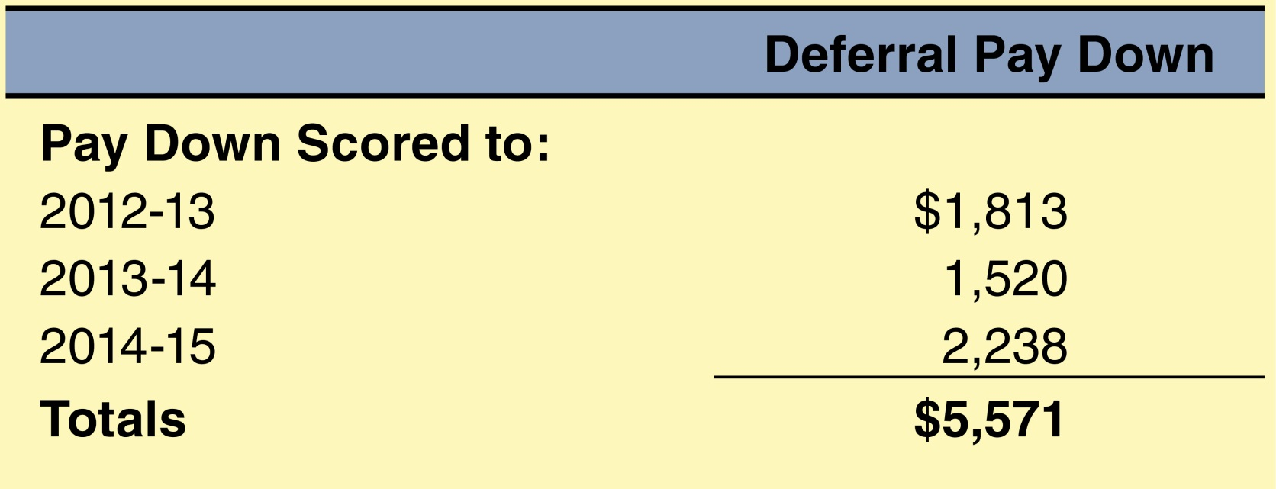
Governor Proposes to Pay Down
All Outstanding K-12 Deferrals
(In Millions)

Slide 10
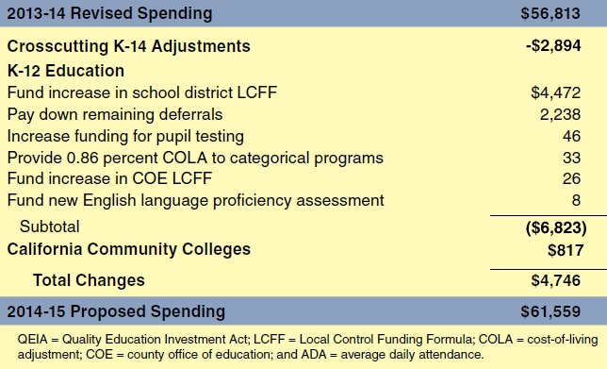
Major 2014-15 K-12 Proposals
(In Millions)

Slide 11
Second-Year Implementation of Local Control Funding Formula
$45.5 Billion
80 Percent Funded
11 Percent Increase From 2013-14 Level
Closes 28 Percent of Gap to Target Level

Slide 12
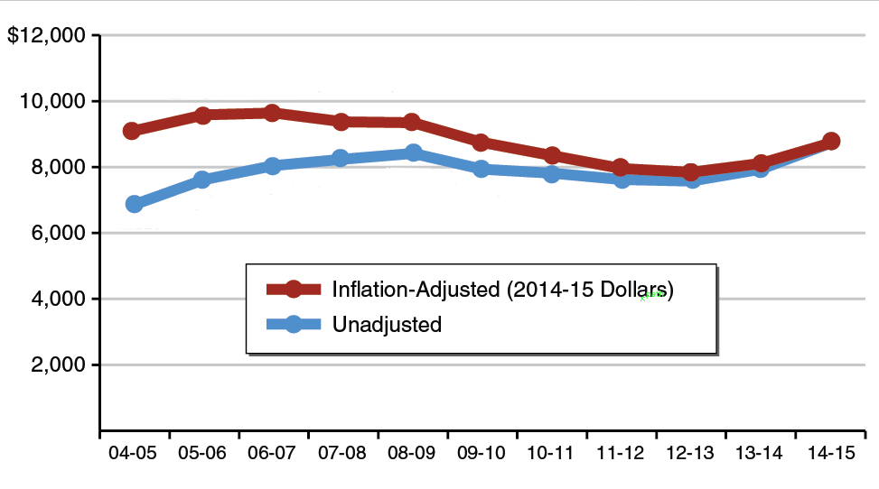
K-12 Per-Pupil Funding

Slide 13
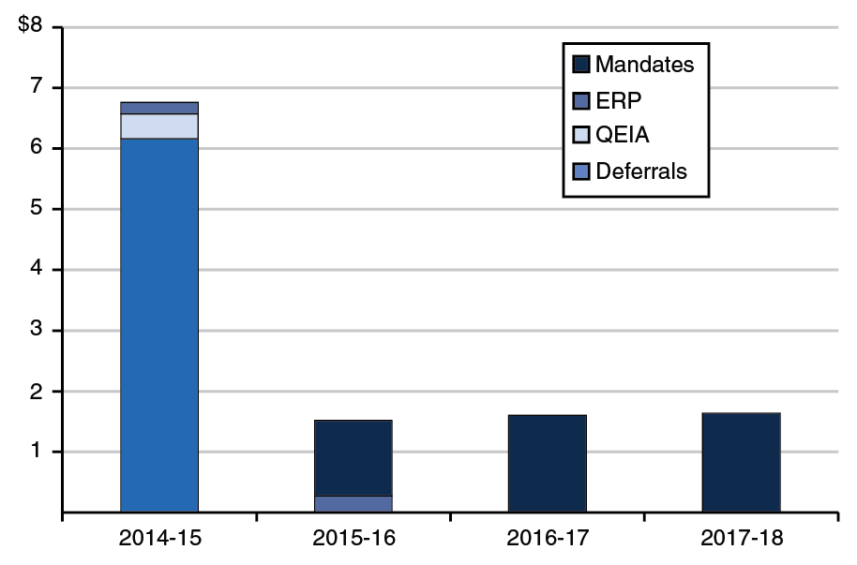
Proposition 98 Wall of Debt Plan
(In Billions)

Slide 14
Key Issues

Slide 15
Proposition 98 Reserve
Makes Deposits When Capital Gains Revenues Strong
Makes Withdrawals When Guarantee Insufficient to Fund Growth and
Cost-of-Living Adjustment
Intent to Stabilize Funding Laudable
Formula Unlikely to Have Significant Effect

Slide 16
CalSTRS Unfunded Liabilities
Longstanding Funding Problems
Focus on 30-Year Funding Plan
Set Aside Some Money Now
Examine State’s Role Now and in Future

Slide 17
Use of One-Time Monies
Proposition 98 Funds
  Deferral paydowns.
  Mandate backlog.
  Emergency Repair Program.
Non-Proposition 98 Funds
  CalSTRS liabilities.
  Deferred maintenance.

Slide 18
Other Education Issues
Career Technical Education
Independent Study
Home-to-School Transportation
Education Mandates
Deferred Maintenance
Restructuring Child Care System

