Slide 1
State Budget Update
Legislative Analyst’s Office
C.A.S.H. Fall Conference
October 15, 2013
www.lao.ca.gov

Slide 2
Update on U.S. Economy

Slide 3
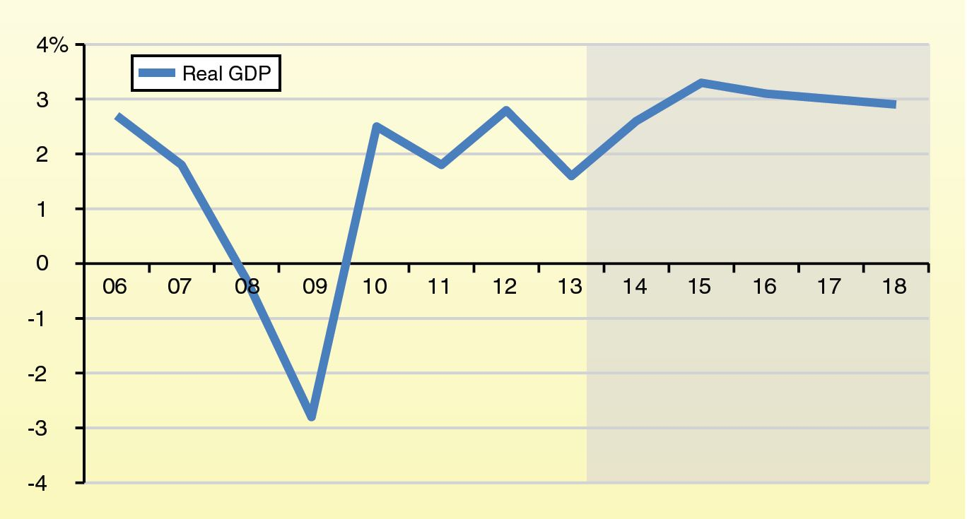
Gross Domestic Product Projected to Grow About 3 Percent Annually
Year-to-Year Percent Change

Slide 4
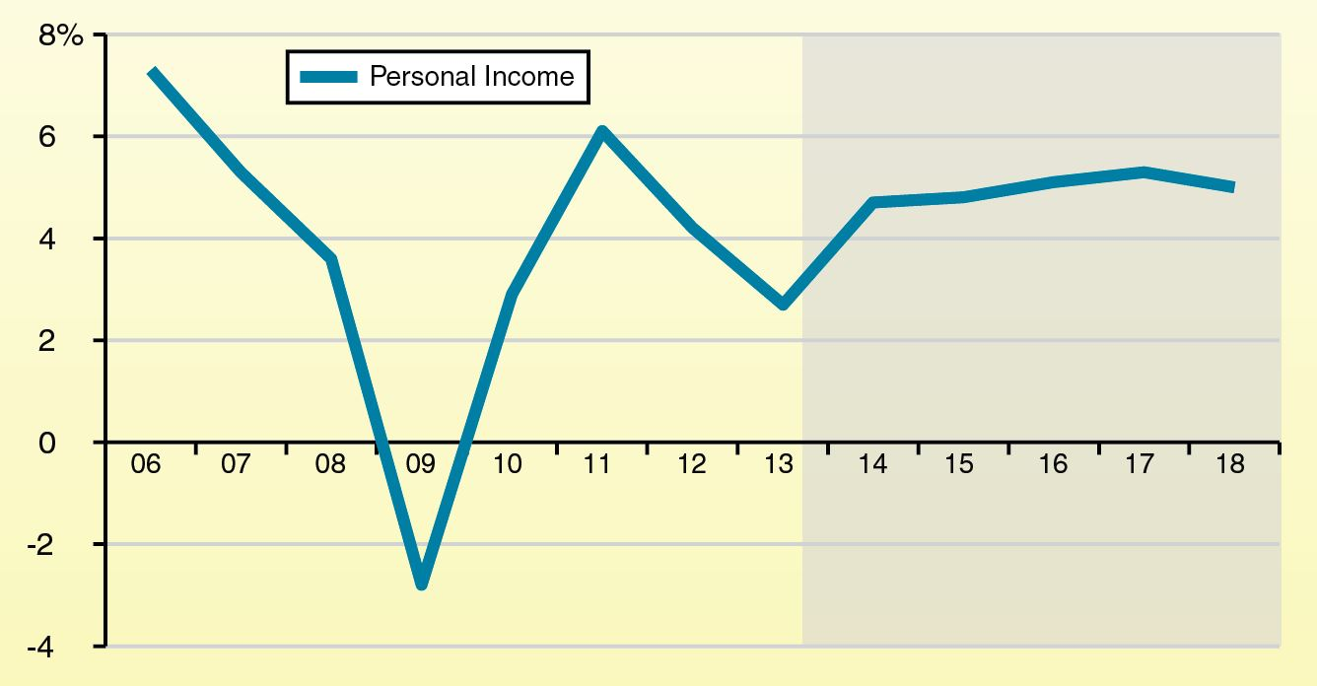
Personal Income Projected to Grow About 5 Percent Annually
Year-to-Year Percent Change

Slide 5
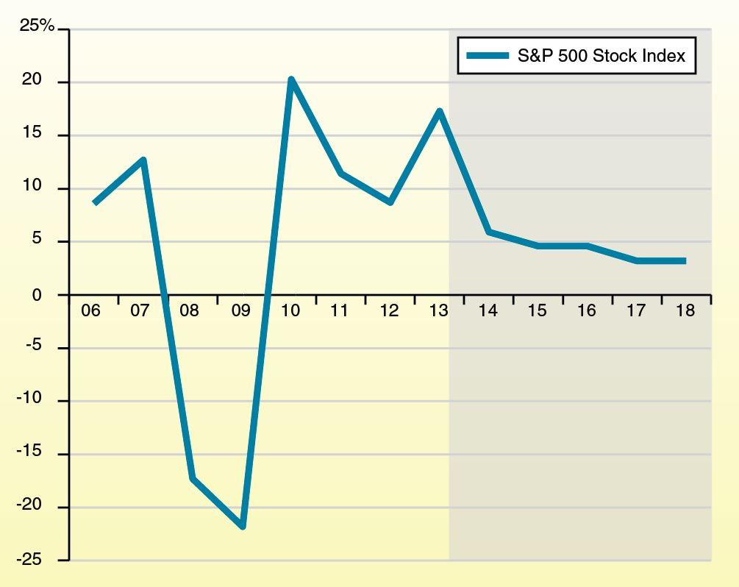
S&P 500 Volatile
But Projected to Grow Over Period
Year-to-Year Percent Change

Slide 6
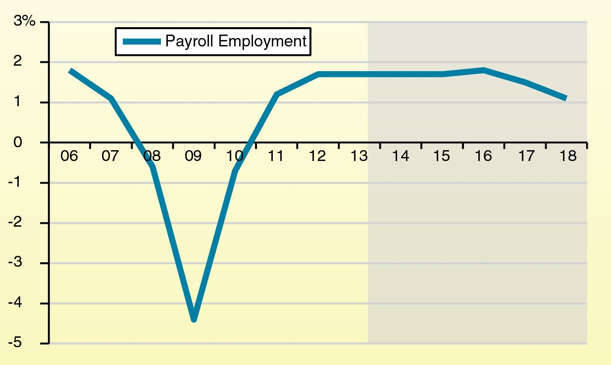
Employment Projected to Grow
Less Than 2 Percent Annually
Year-to-Year Percent Change

Slide 7
Major Concerns
Federal Shutdown
Debt Ceiling Impasse
Downturn in Stock Market

Slide 8
Update on California Economy

Slide 9
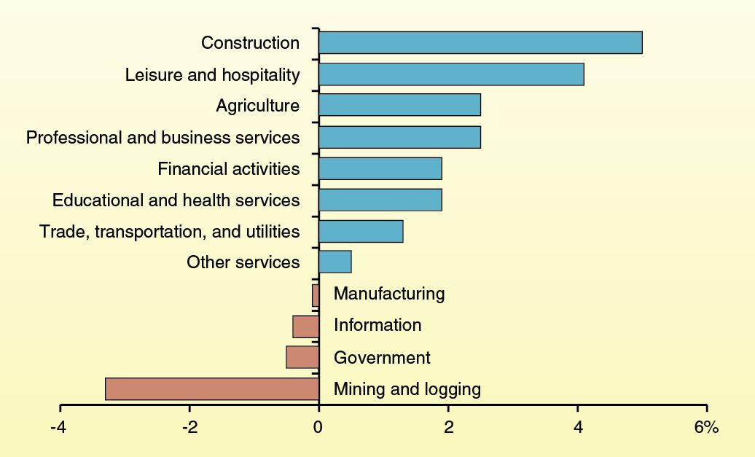
Payroll Employment Growing
In Eight Industry Sectors
Percent Change From August 2012 to August 2013

Slide 10
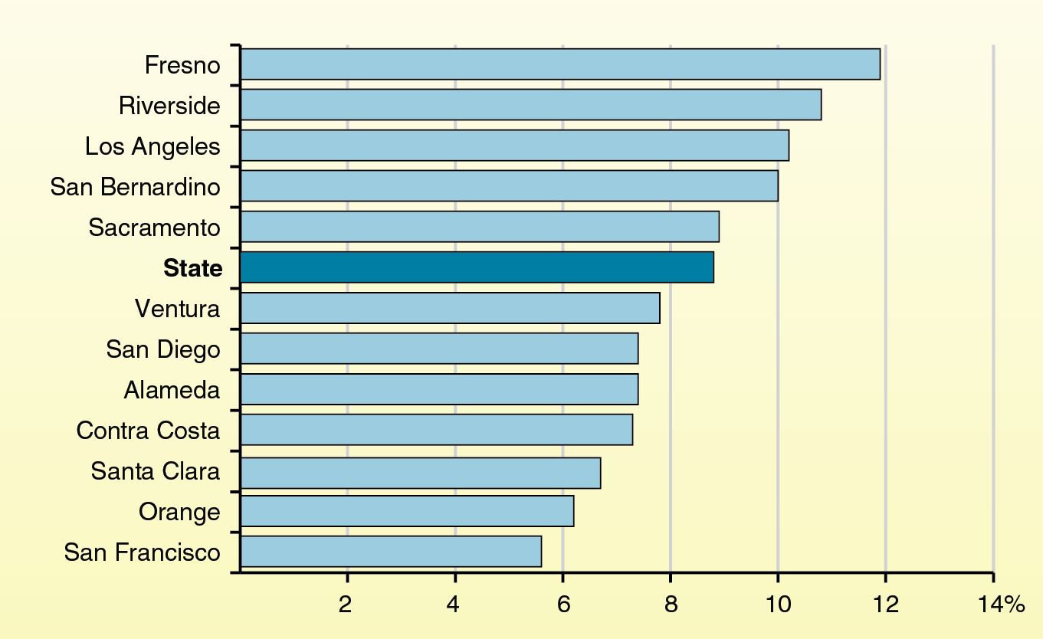
Unemployment Rate for
12 Largest Counties Varies Notably
Rate in August 2013

Slide 11
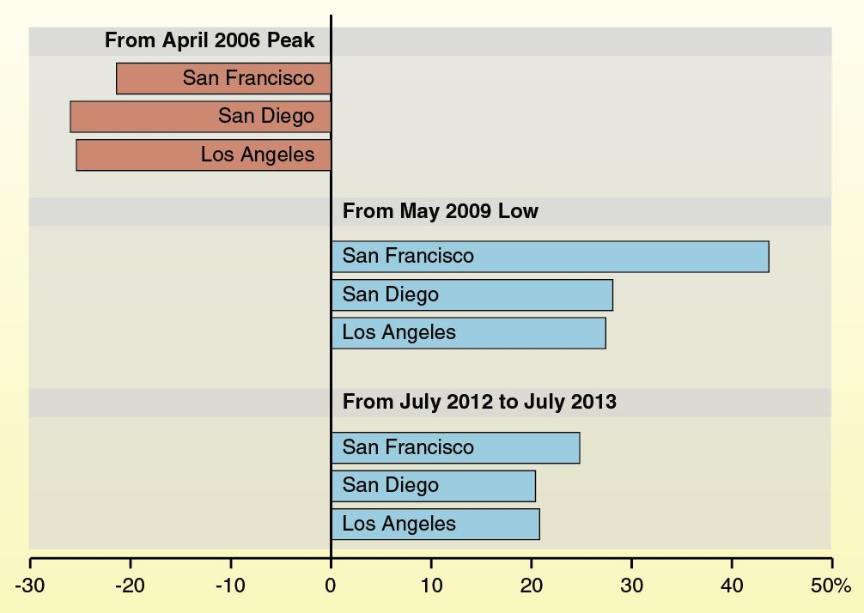
Significant Increase in Housing
Prices in State’s Large Metropolitan Areas
Percent Change

Slide 12
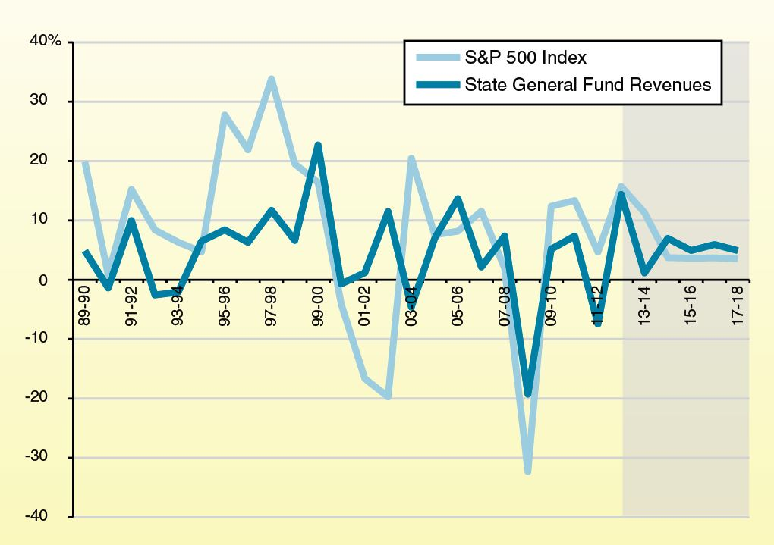
State Revenue Growth Linked With
Stock Market Growth
Year-Over-Year Percent Change

Slide 13
Revenue Update

Slide 14
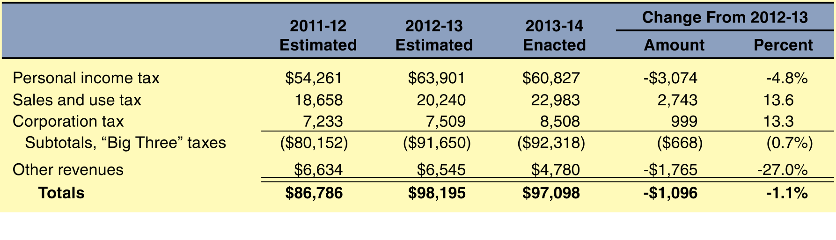
Budget Act Revenue Assumptions
General Fund and Education Protection Account Combined
(Dollars in Millions)

Slide 15
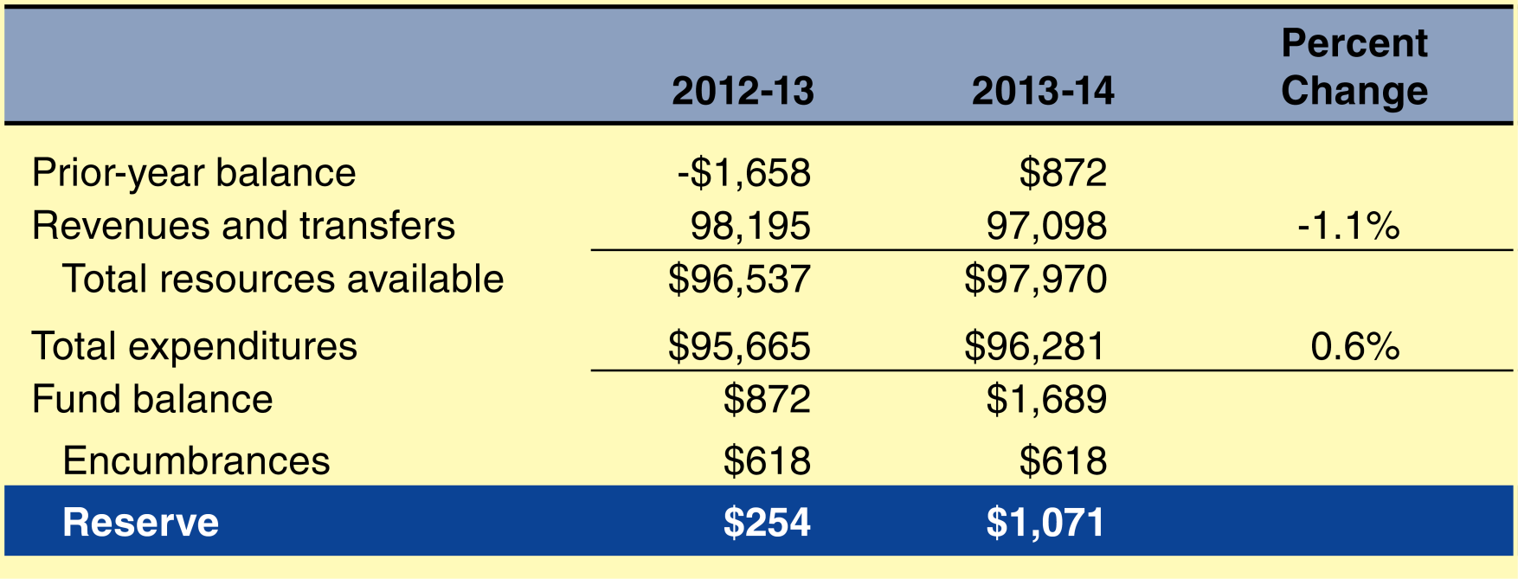
General Fund Condition
Under Budget Act
General Fund and Education Protection Account Combined
(Dollars in Millions)

Slide 16
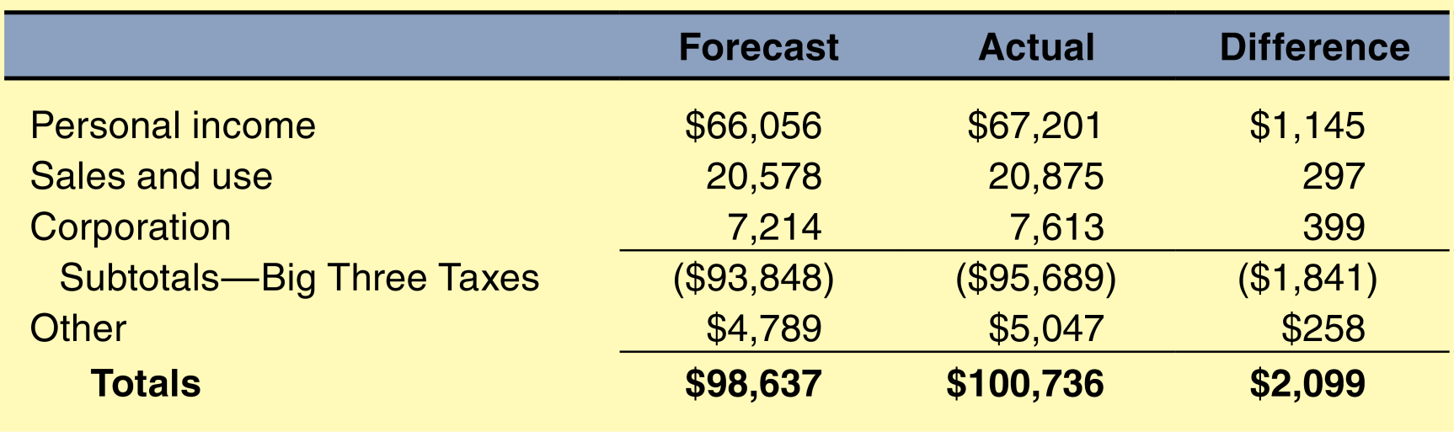
2012-13 State Revenue Update
Year End (In Millions)

Slide 17
2013-14 State Revenue Update
Personal Income Tax (PIT) Withholding Above Projections
PIT Estimated Payments Above Projections
Sales Tax Revenues Below Projections
Corporate Tax Revenues Below Projections

Slide 18
Education Budget Recap

Slide 19
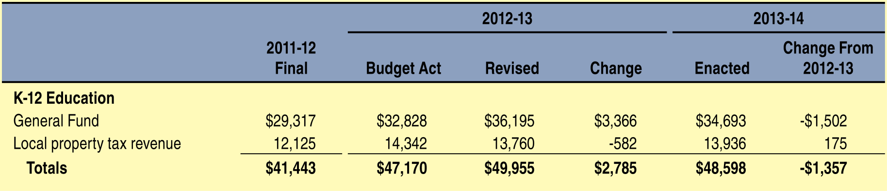
Proposition 98 Funding
In Millions

Slide 20
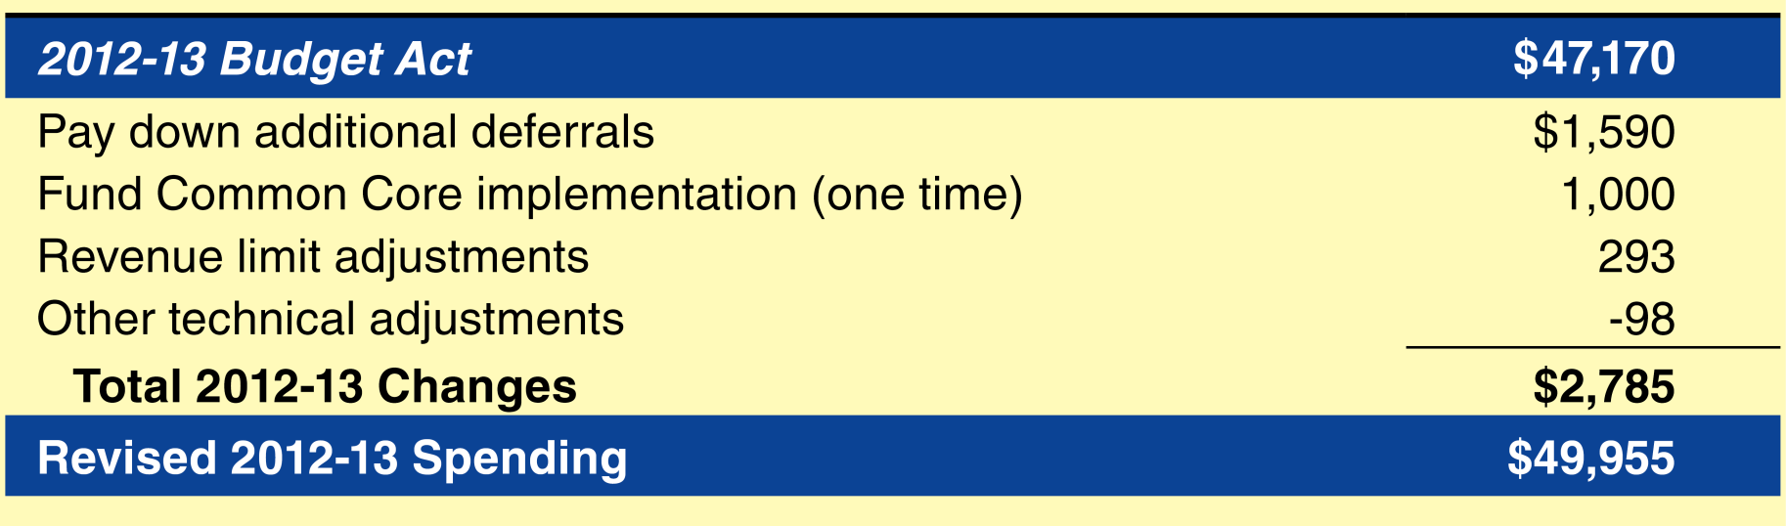
Major 2012-13 Changes
In Millions

Slide 21
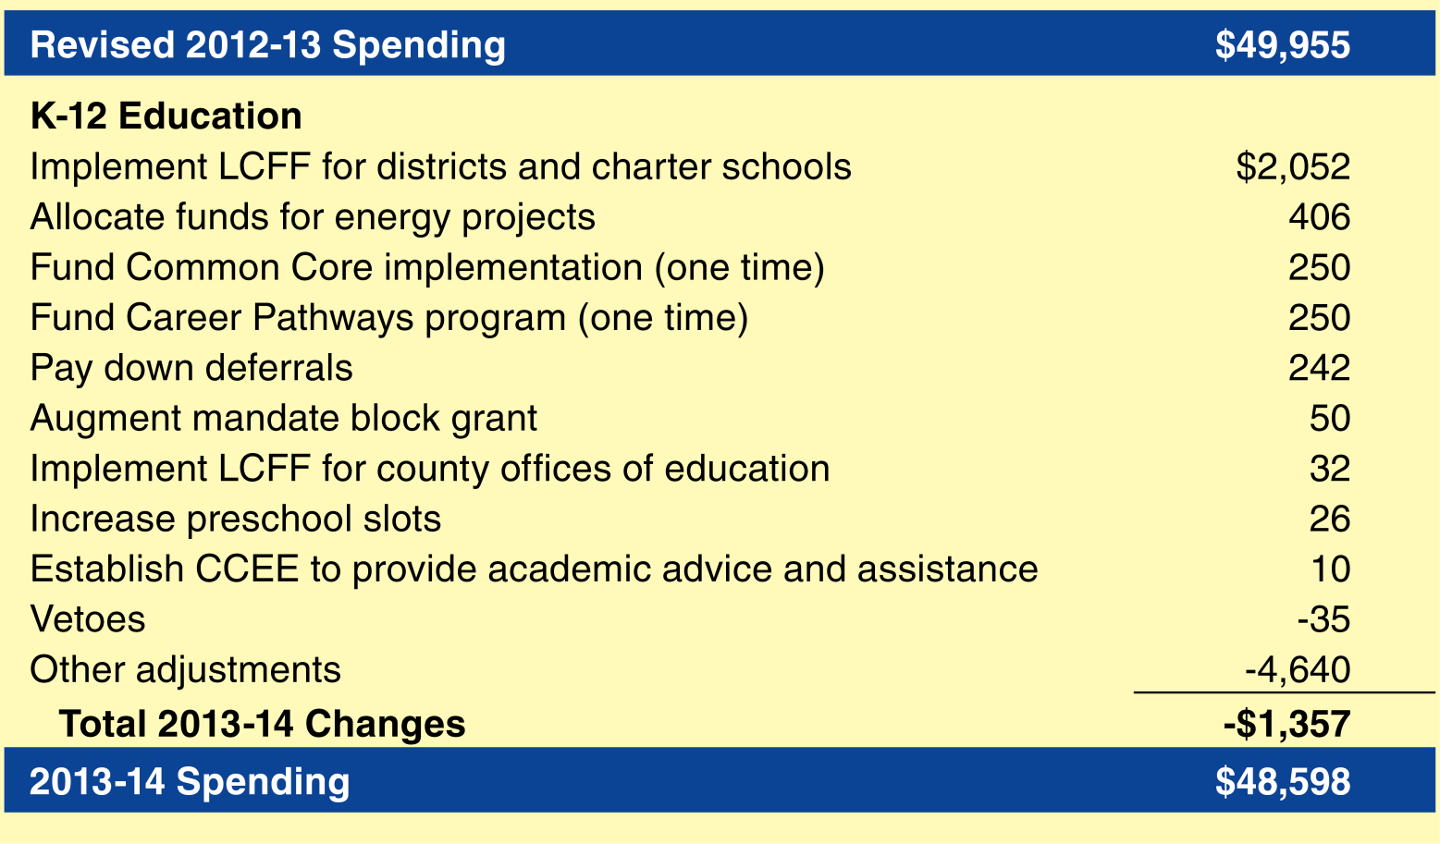
Major 2013-14 Changes
In Millions

Slide 22
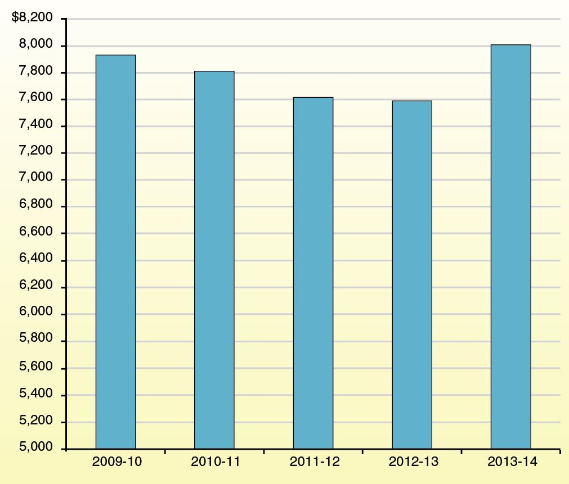
Programmatic Per-Pupil Funding Rebounding
Per-Pupil Funding in Dollars

Slide 23
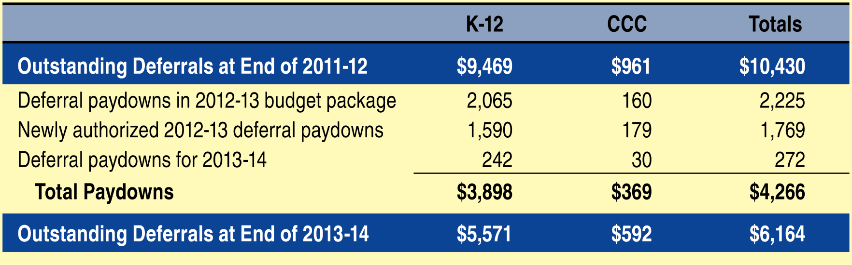
Tracking Deferral Paydowns
In Millions

Slide 24
Education Budget Outlook

Slide 25
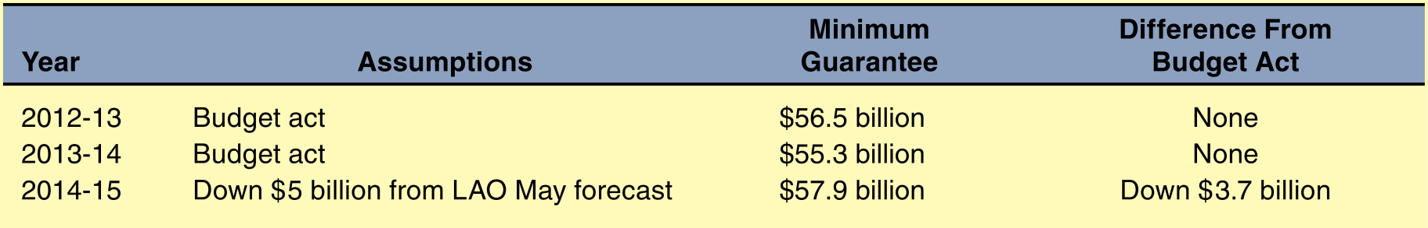
Pessimistic Scenario

Slide 26
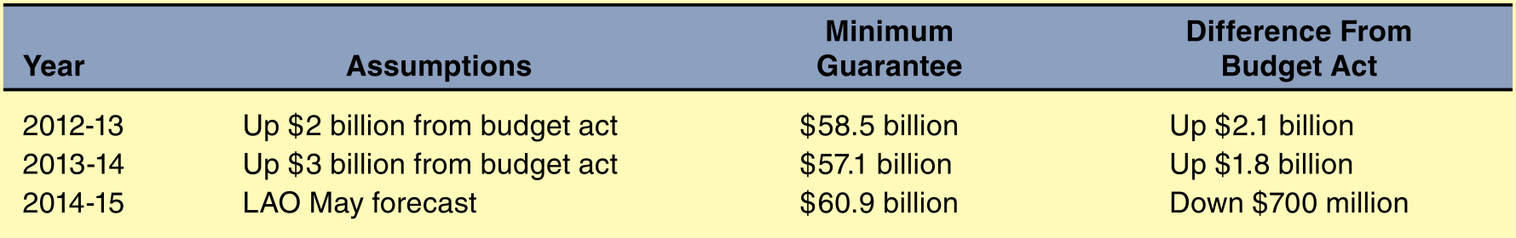
Best Guess Scenario

Slide 27
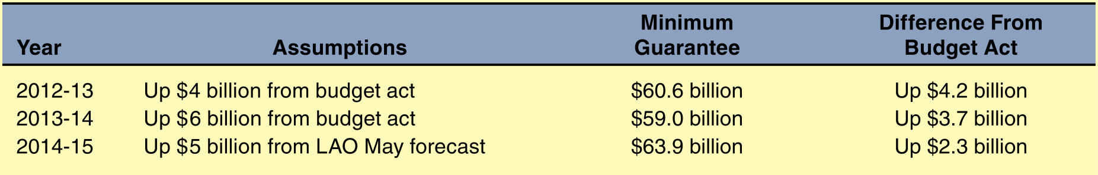
Optimistic Scenario

