Slide 1
California’s Fiscal Outlook
California School Boards Association, Annual Education Conference
December 15, 2014

Slide 2
State’s Fiscal Outlook

Slide 3
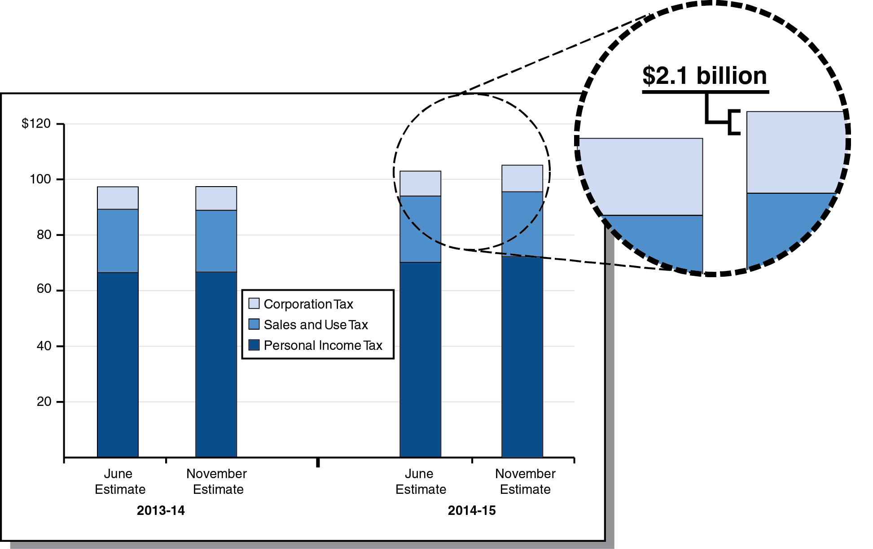
Revenue Up Slightly in 2013-14, More Notably in 2014-15
Big Three Revenues (In Billions)

Slide 4
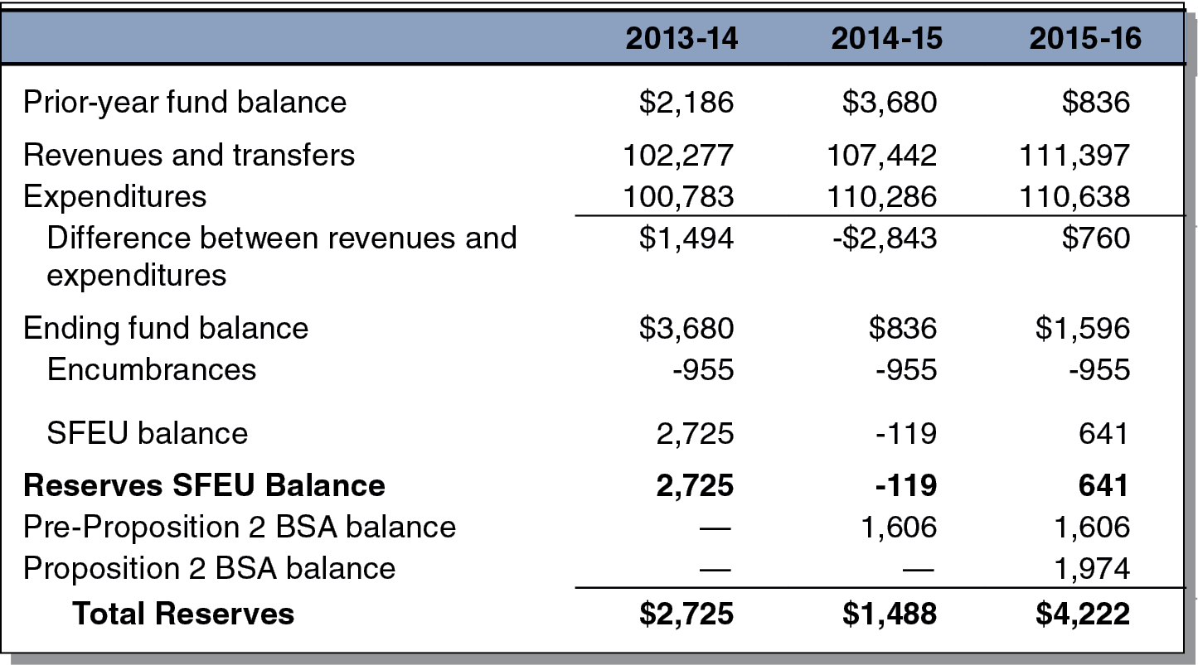
LAO General Fund Condition Under Main Scenario
(In Millions)

Slide 5
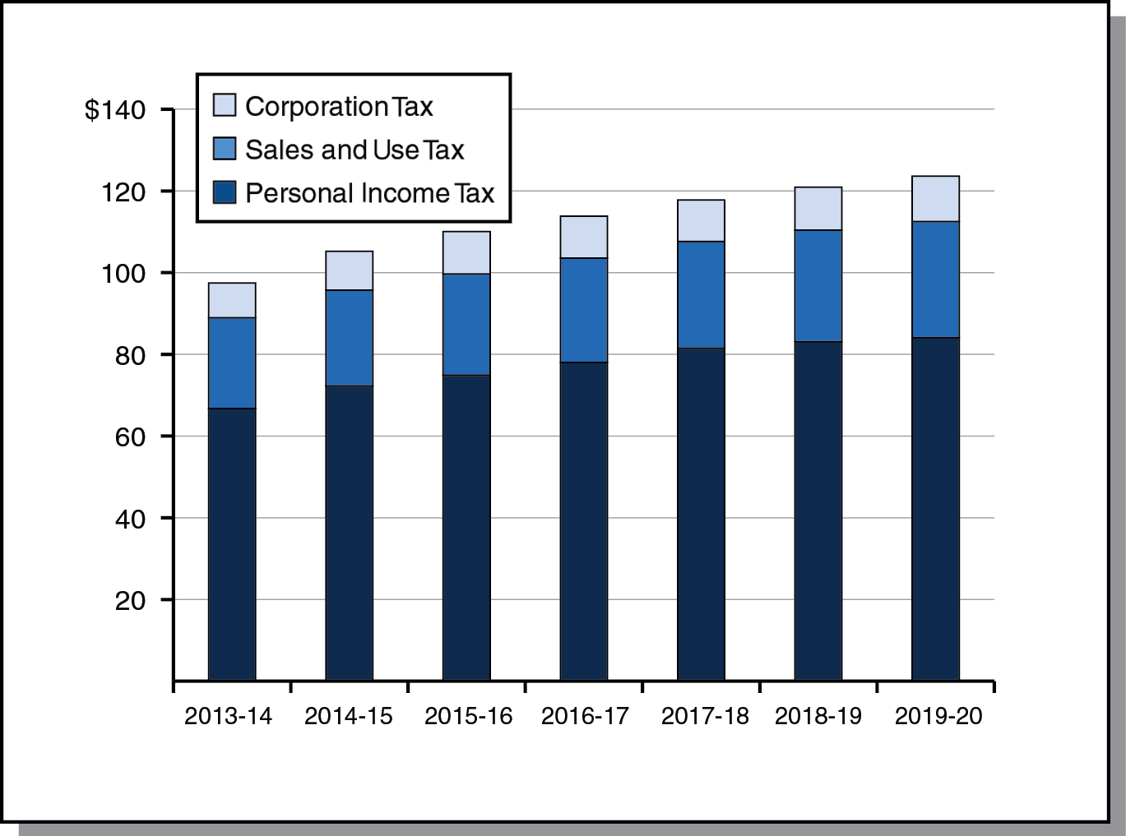
Revenue Outlook
Big Three Revenues Under Main Scenario (In Billions)

Slide 6
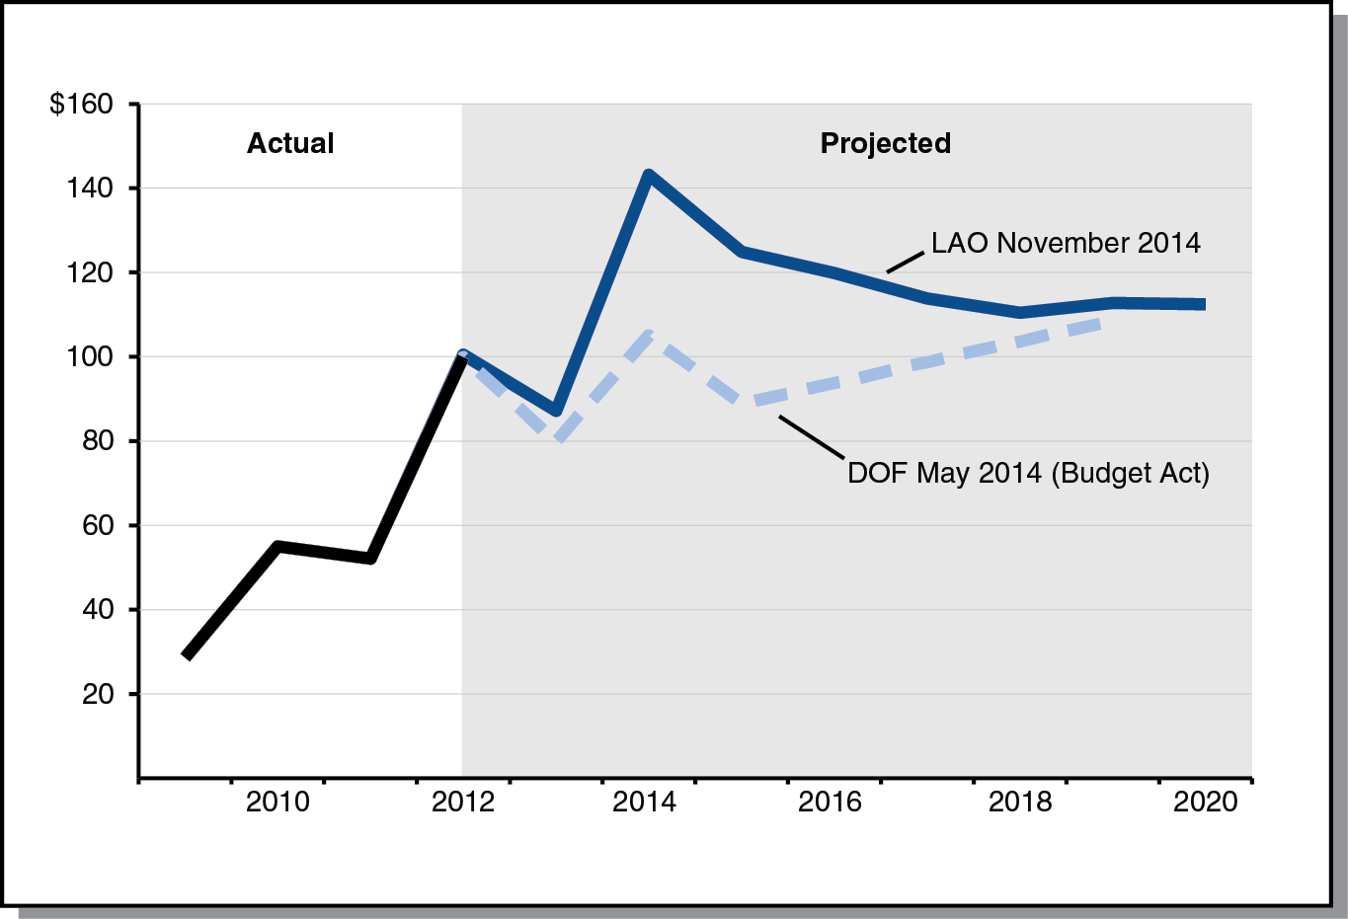
LAO Main Scenario: Lower Capital Gains After 2014
Net Capital Gains on Resident Tax Returns (In Billions)

Slide 7
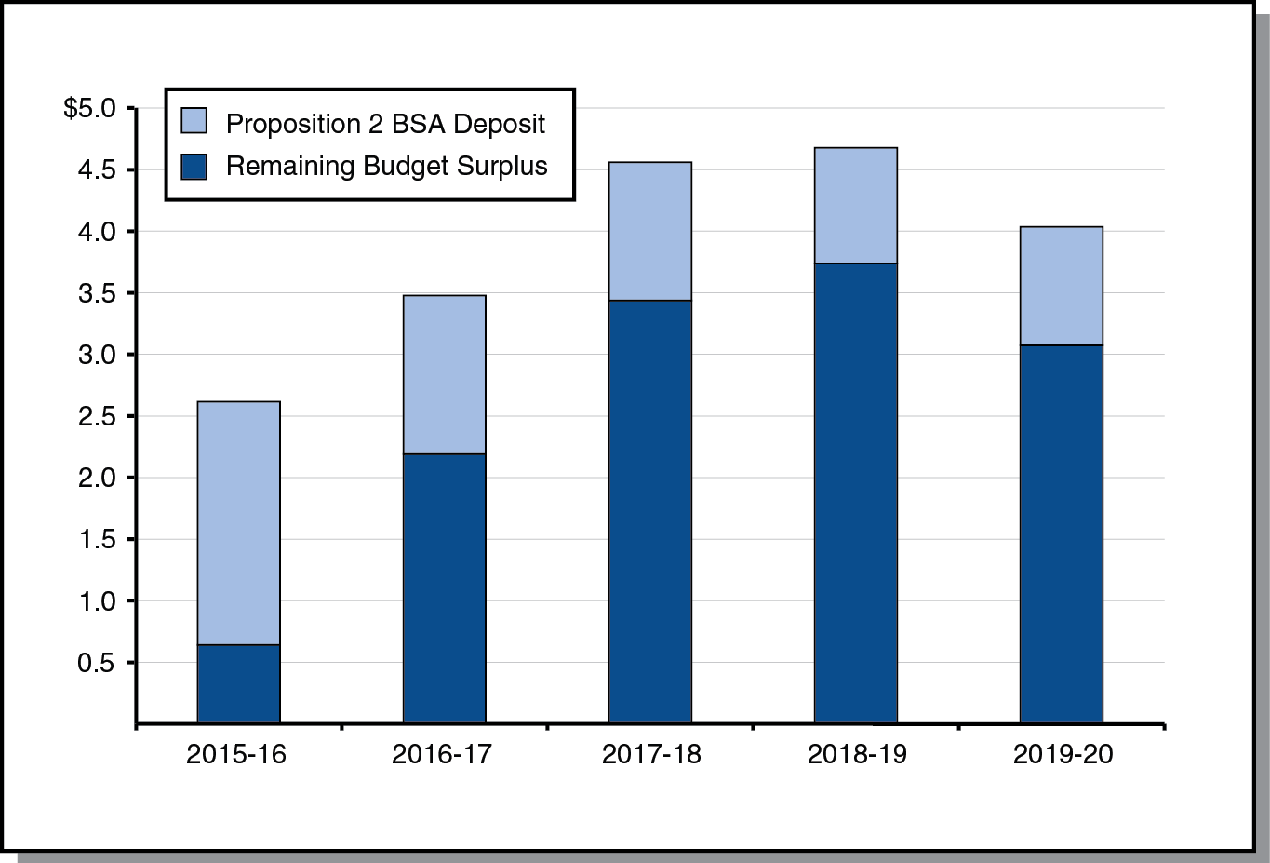
LAO Main Scenario: Reserve Deposits and Future Surpluses
(In Billions)

Slide 8
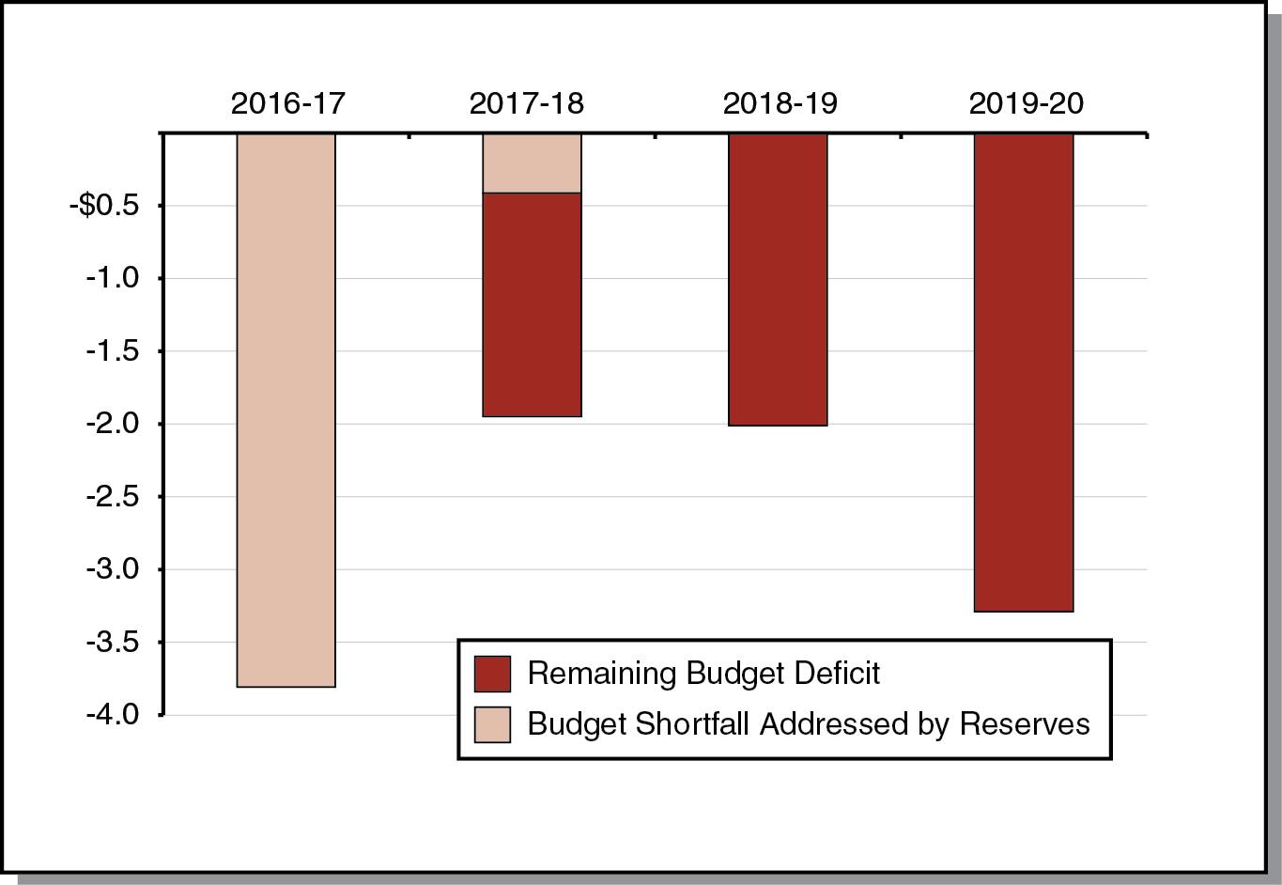
$4.2 Billion Reserve Could Cover 2016-17 Shortfall in Hypothetical Economic Slowdown
(In Billions)

Slide 9
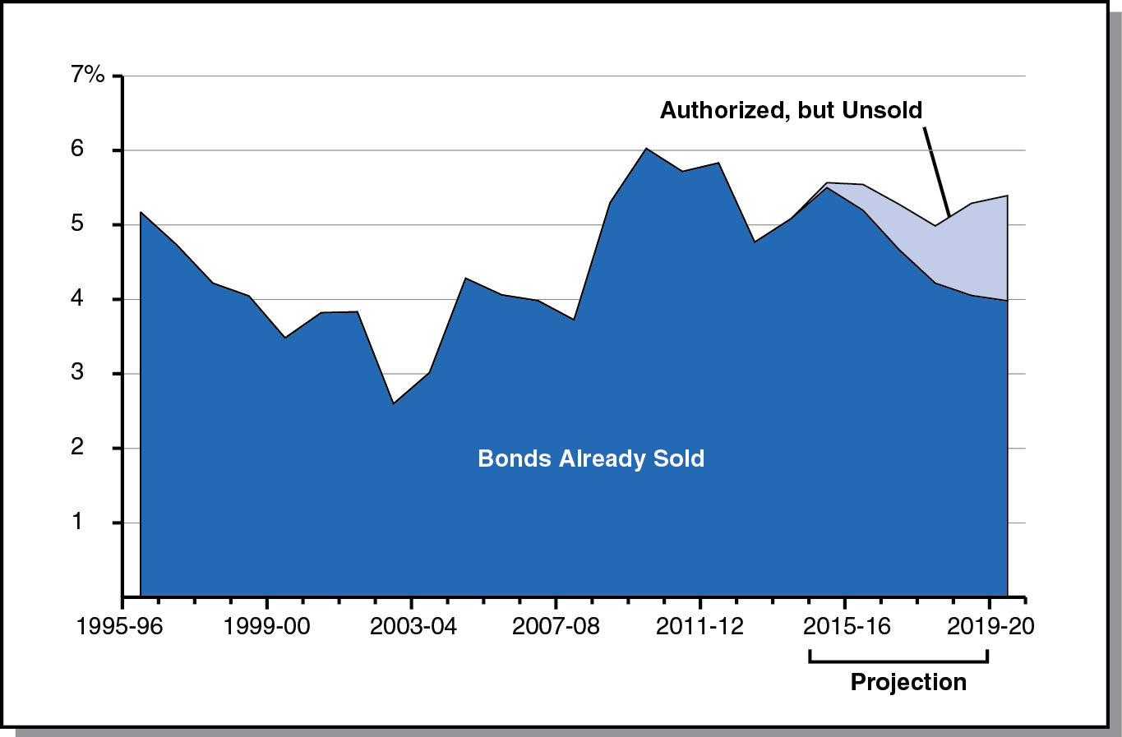
LAO Main Scenario: Debt-Service Ratio Remains Under 6 Percent
Percent of General Fund Revenues Spent on Debt Service

Slide 10
Education Outlook

Slide 11
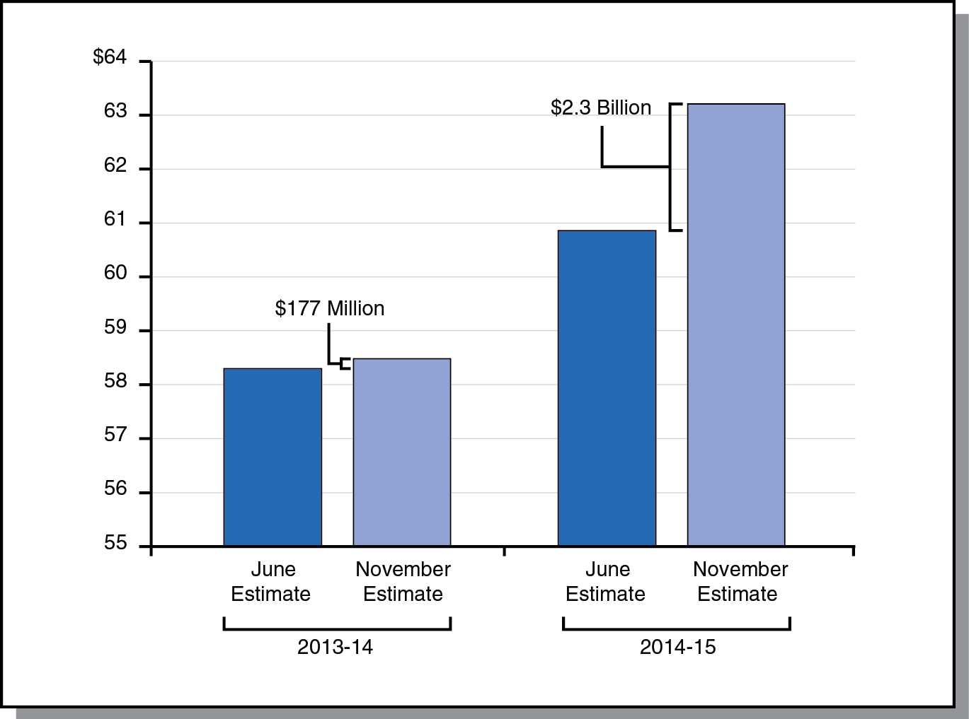
2013-14 Minimum Guarantee Up Slightly, 2014-15 Guarantee Up Significantly
Minimum Guarantee (In Billions)

Slide 12
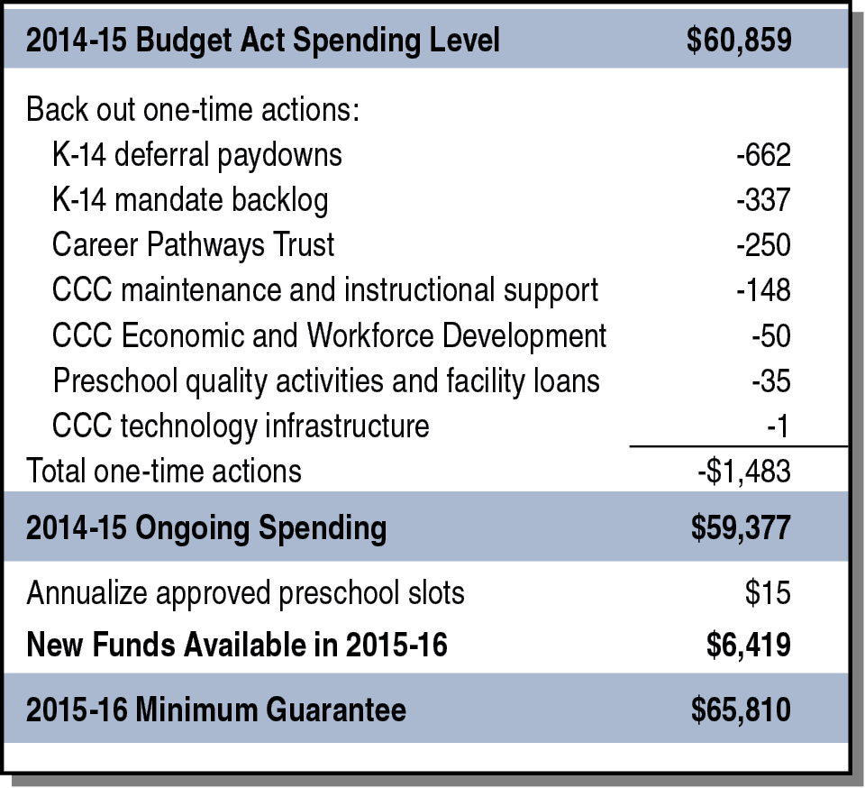
Considerable New Proposition 98 Funding Projected for 2015-16
LAO Main Scenario (In Millions)

Slide 13
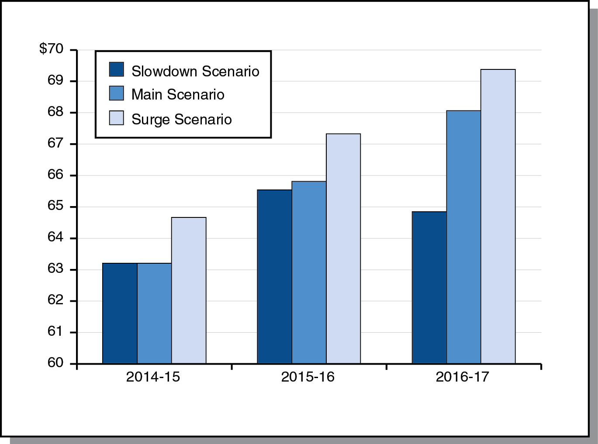
Under Slowdown Scenario, Guarantee Drops Between 2015-16 and 2016-17
Minimum Guarantee (In Billions)

Slide 14
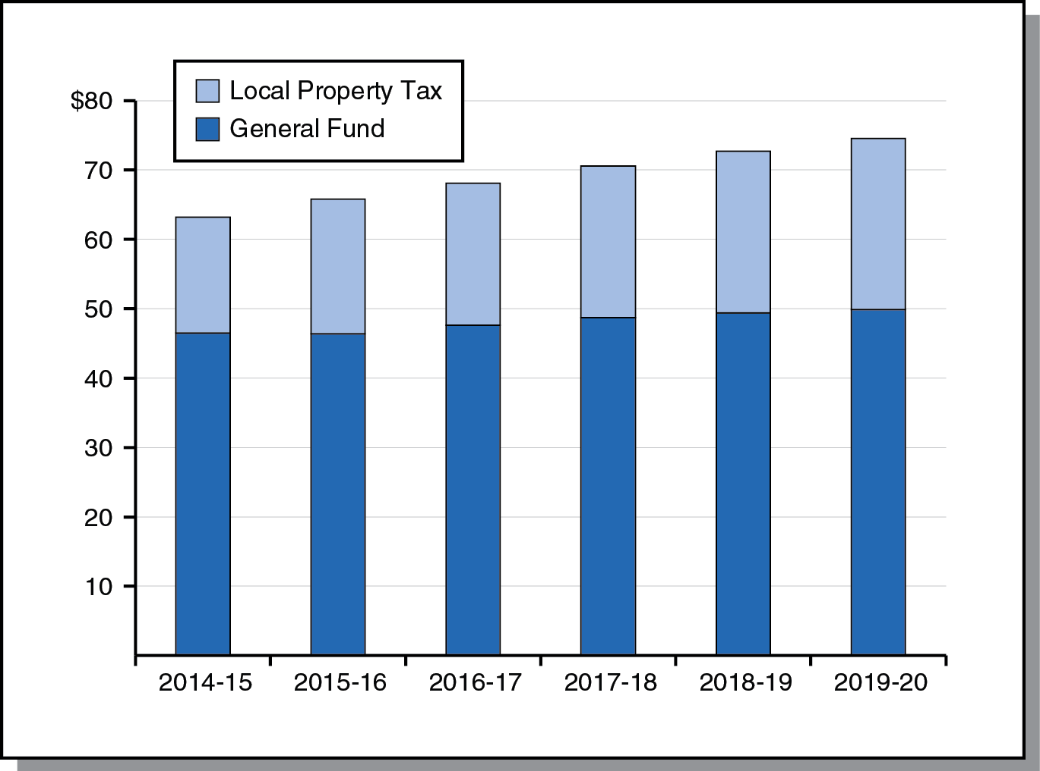
Proposition 98 Outlook
Minimum Guarantee Under LAO Main Scenario (In Billions)

Slide 15
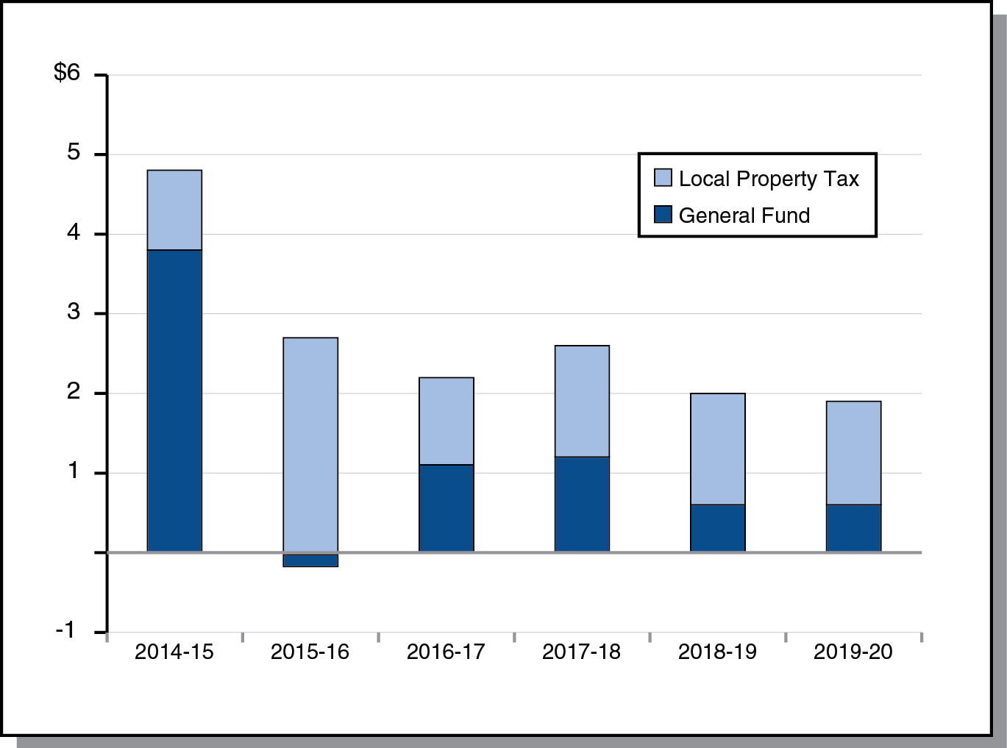
Increase in Guarantee Largely Funded by Growth in Local Property Tax Revenue
Change in Minimum Guarantee From Prior Year (In Billions)

Slide 16
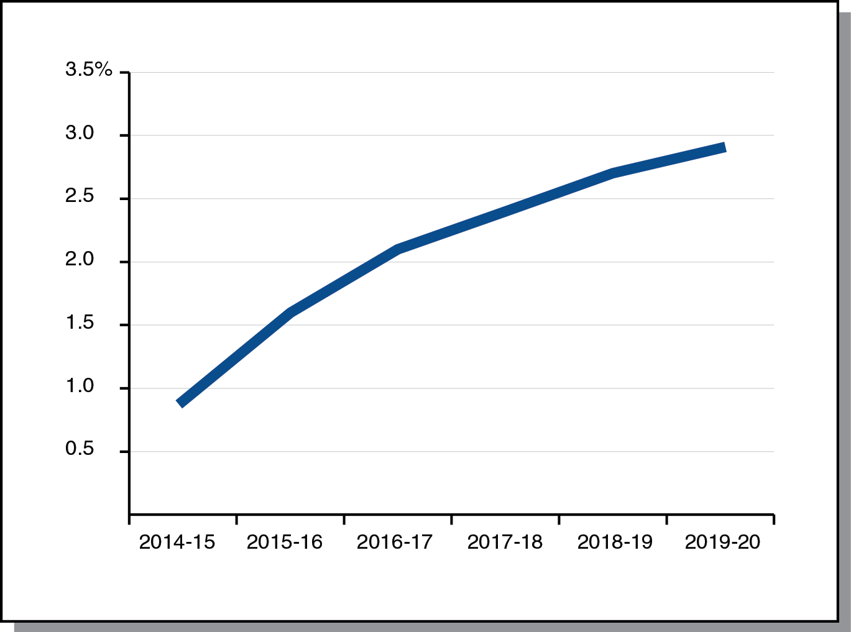
K-14 Cost-of-Living Adjustment (COLA) on the Rise Throughout Forecast Period
COLA Rate

