Slide 1
State Budget Update
Legislative Analyst’s Office
Jennifer Kuhn
California Charter Schools Conference
2/29/2012
www.lao.ca.gov

Slide 2
Overview of
Governor’s January Budget

Slide 3
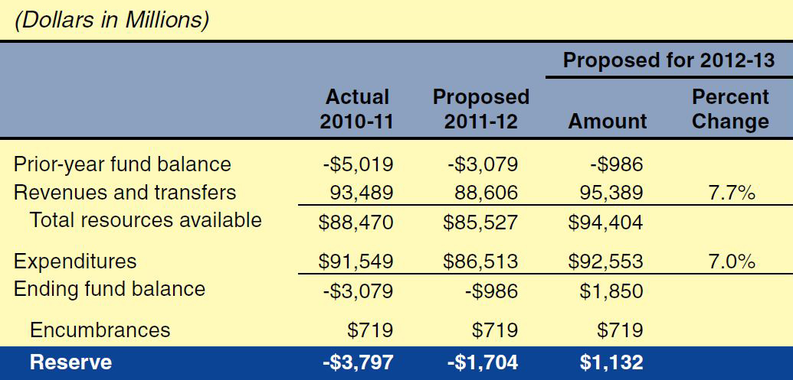
Governor's Budget:
State General Fund Condition

Slide 4
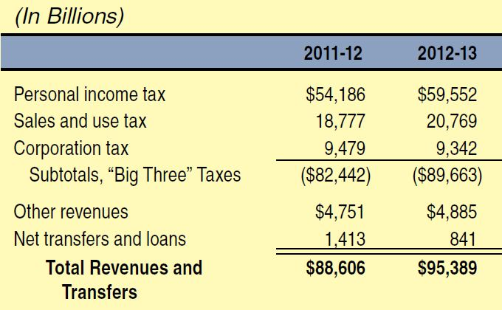
Governor's Budget:
General Fund Revenue Forecast

Slide 5
Major Components of Governor’s Budget Package
Estimates budget problem at $9.2 billion.
Proposes net $10.1 billion in solutions.
Assumes voters approve November 2012 tax measure.
Proposes $5.4 billion in trigger reductions if measure fails.

Slide 6
Budget-Balancing Actions
$7.2 billion in new revenues.
$4.0 billion in expenditures cuts.
$1.4 billion in other savings.
$2.5 billion offsetting increase in Proposition 98 guarantee.

Slide 7
Proposition 98:
Governor’s Basic Budget Plan

Slide 8
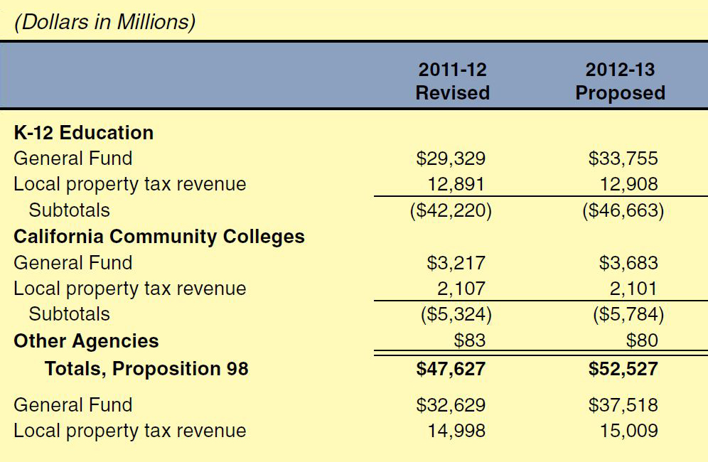
Governor's Budget:
Proposition 98 Funding

Slide 9
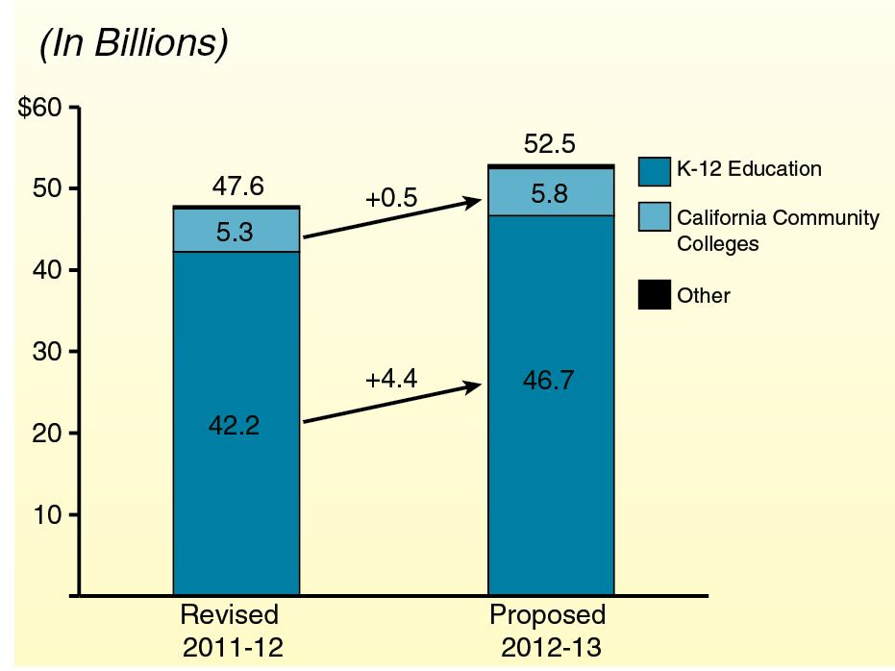
Proposition 98 Funding

Slide 10
Proposition 98:
Governor’s Back-Up Budget Plan

Slide 11
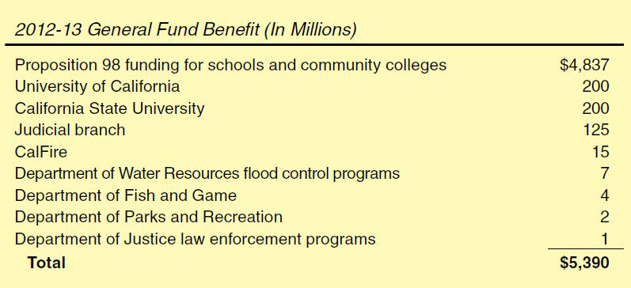
Proposed “Trigger” Reductions

Slide 12
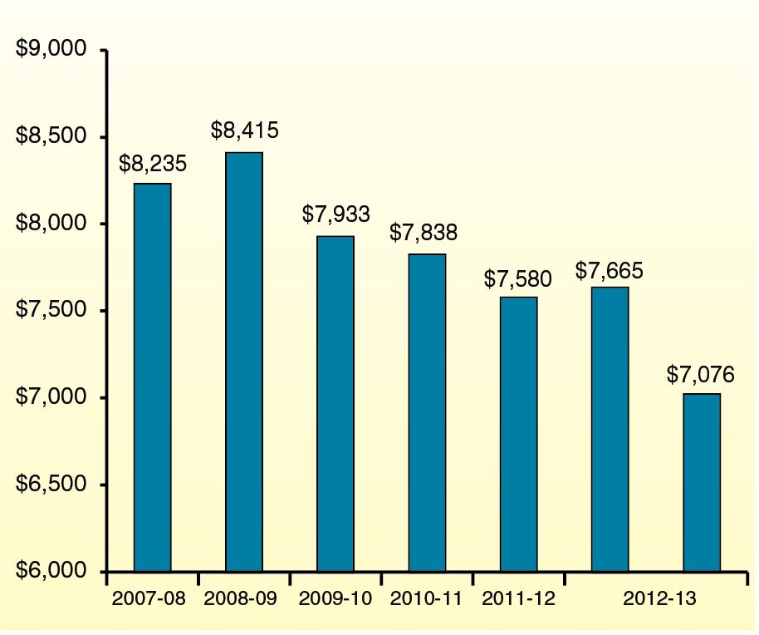
Programmatic Per-Pupil Funding

Slide 13
Provide Districts More Flexibility
Provide more flex options, effective July 1:
  Remove additional categorical and mandate requirements.
  Allow for shorter school year.
  Eliminate or suspend penalties for exceeding statutory class size caps.
  Authorize special post-election layoff window.

Slide 14
Proposition 98:
Governor’s Multiyear Payment Plan

Slide 15
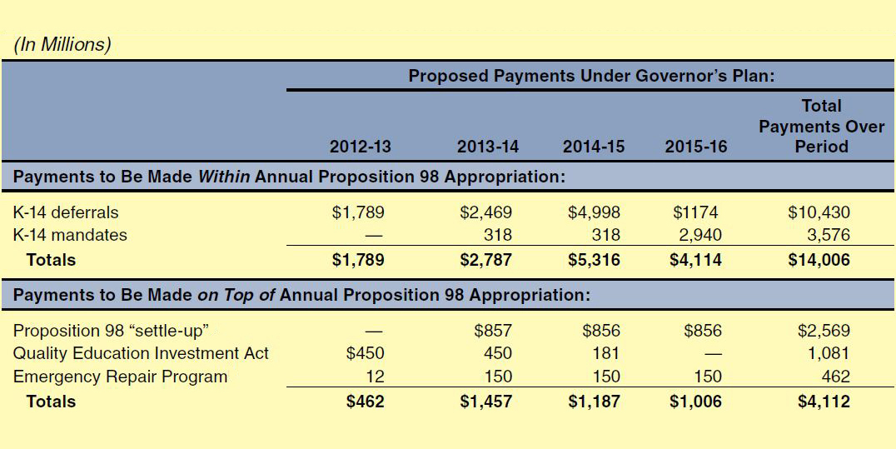
Governor’s Multiyear Payment Plan
Proposition 98:
Governor’s Multiyear Payment Plan

Slide 16
Use Governor’s Plan As
Starting Point
To increase likelihood plan is consistently implemented:
  Extend payment period.
  Spread payments more evenly over period.
  Designate settle-up funds for mandates or deferrals.
  Redirect QEIA program savings to other obligations.

