Slide 1
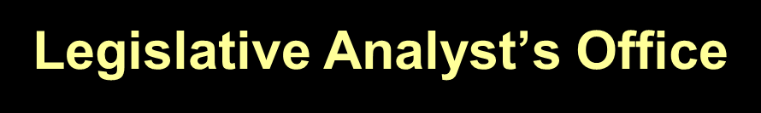
State Budget Update
Presented to: 4th District PTA
March 26, 2012
www.lao.ca.gov

Slide 2
Overview of
Governor’s January Budget
1

Slide 3
Major Components of Governor’s Budget Package
Estimates Budget Problem at $9.2 Billion
Proposes Net $10.1 Billion in Solutions
Assumes Voters Approve November 2012 Tax Measure
Proposes $5.4 Billion in Trigger Reductions if Measure Fails
2

Slide 4
Budget-Balancing Actions
$7.2 Billion in New Revenues
$4.0 Billion in Expenditure Reductions
$1.4 Billion in Other Savings
$2.5 Billion Offsetting Increase in Proposition 98 Guarantee
3

Slide 5
Governor’s Revised Tax Measure
$9.1 Billion in New Revenues
Smaller Sales Tax Increase, Larger Income Tax Increase
Income Tax Increase Lasts Seven Years
4

Slide 6
Proposition 98:
Governor’s Basic Budget Plan
5

Slide 7
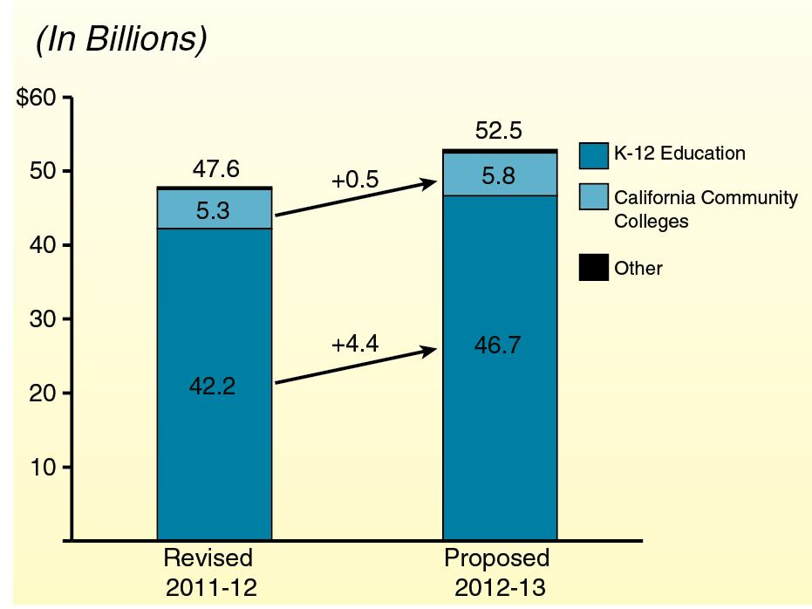
Proposition 98 Funding
6

Slide 8
Five Major Proposals
Backfill One-Time Actions ($3.0 Billion)
Pay Down Deferrals ($1.8 Billion)
Create Mandate Block Grant ($200 Million)
Hold Harmless: Weighted Student Formula ($90 Million)
Do Not Initiate Transitional Kindergarten (TK) Program ($224 Million Savings)
7

Slide 9
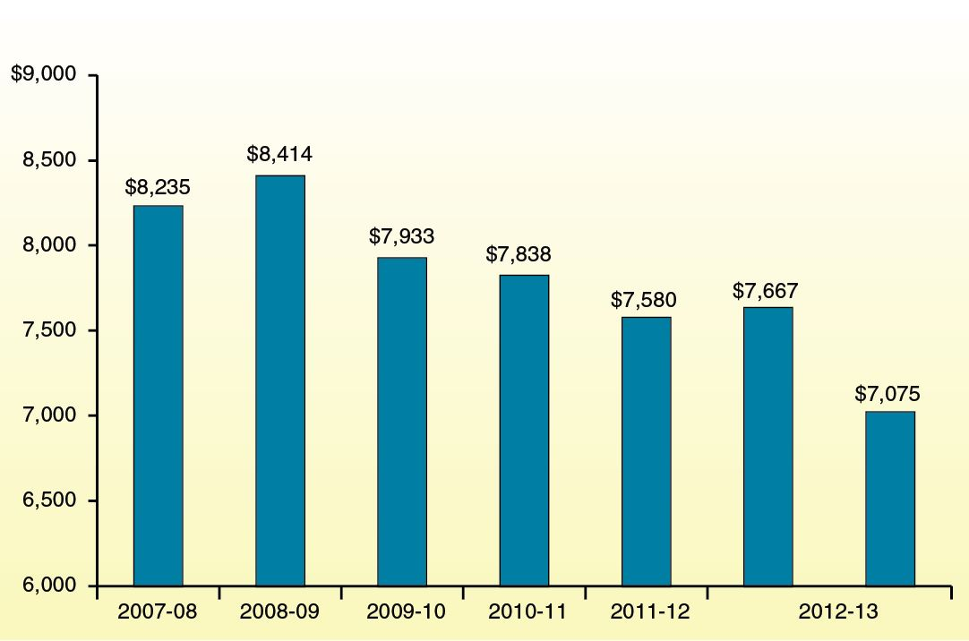
Programmatic Per-Pupil Funding
8

Slide 10
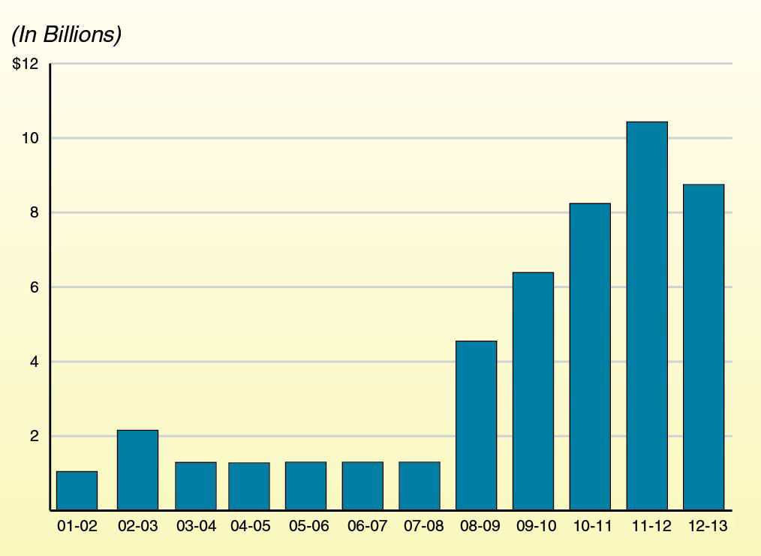
Deferrals Over Time
9

Slide 11
Education Mandates Block Grant
Eliminates About Half of K-12 Mandates
Provides $178 Million in Block Grant Funding for Remaining Activities
Sets District Funding Rate at $30 Per Pupil
Allows LEAs to Select Between Block Grant and Existing Reimbursement Process
10

Slide 12
Weighted Student Formula
Removes Strings Associated With Seven Currently Standalone Programs
Creates Weighted Student Formula
Phases in Formula Over Six Years
Directs SBE to Develop New Accountability System
11

Slide 13
Basic Plan Linked With
Tax Measure
Governor Estimates His Tax Measure Would Raise $6.9 Billion Initially:
  $2.2 billion accrued to 2011-12.
  $4.7 billion attributed to 2012-13.
Impact on Proposition 98:
  About $900 million increase in 2011-12.
  About $2.4 billion increase in 2012-13.
12

Slide 14
LAO Recommendations
If New Revenues Materialize, Use for Paying Down Deferrals in 2012-13
Create Mandate Block Grant
Adopt Either Weighted Student Formula or a Few Large Block Grants
Do Not Initiate TK Program
13

Slide 15
Proposition 98:
Governor’s Multiyear Payment Plan
14

Slide 16
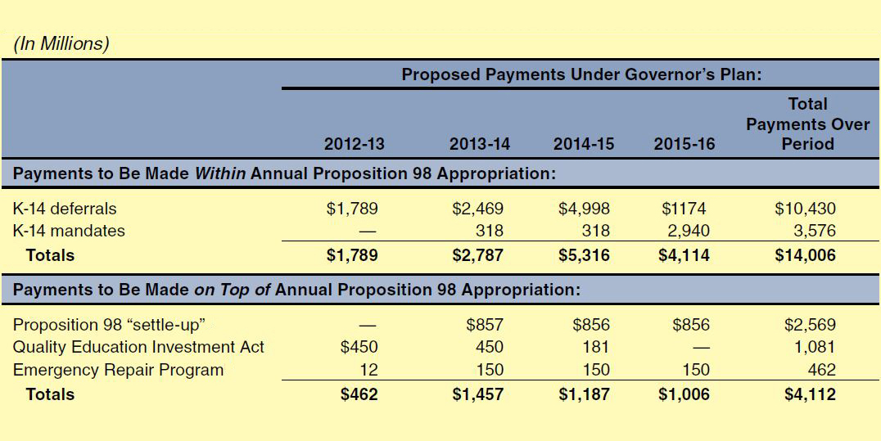
Governor’s Multiyear Payment Plan
Proposition 98:
Governor’s Multiyear Payment Plan
15

Slide 17
Use Governor’s Plan As
Starting Point
To Increase Likelihood Plan Is Consistently Implemented:
  Extend payment period.
  Spread payments more evenly over period.
  Designate settle-up funds for mandates or deferrals.
  Redirect QEIA program savings to other obligations.
16

Slide 18
Proposition 98:
Governor’s Back-Up Budget Plan
17

Slide 19
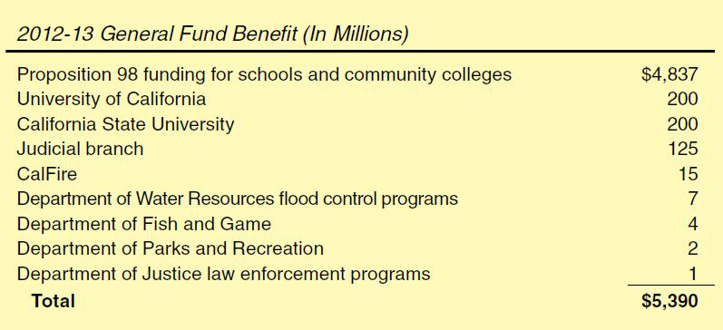
Proposed “Trigger” Reductions
18

Slide 20
Two Concerns With Back-Up Plan
Serious Policy Concerns With Debt Service Proposal
Treatment of Realignment Revenues Risky
19

Slide 21
LAO Recommendations
Reconsider Debt Service Proposal
Provide More Flex Options, Effective July:
  Remove additional categorical and mandate requirements.
  Allow for shorter school year.
  Eliminate or suspend penalties for exceeding statutory class size caps.
  Authorize special post-election layoff window.
20

Slide 22
Other Major Issues
Preschool Funding
Child Care Reductions
Our Children, Our Future Initiative
21

Slide 23
Visit the LAO website at:
www.lao.ca.gov
22

