Slide 1
CBO Hot Topics 101: State Budget Outlook
Legislative Analyst’s Office
CASBO 2012 Annual Conference
April 11, 2012
www.lao.ca.gov

Slide 2
Governor’s January Budget
1

Slide 3
Estimated Budget Problem
$9.2 Billion Budget Problem
$4.1 billion deficit in 2011-12.
$5.1 billion shortfall in 2012-13.
Baseline General Fund revenues: $89.2 billion.
Baseline General Fund spending: $94.3 billion.
2

Slide 4
Budget-Balancing Actions
Total of $12.6 Billion in Proposed Solutions
$7.2 billion in new revenues.
$4 billion in expenditures cuts.
$1.4 billion in other savings.
Offset by $2.5 Billion Increase in Proposition 98 Guarantee
3

Slide 5
Tax Measure: January Version
$6.9 Billion of Revenue Solutions
$2.2 billion accrued to 2011-12.
$4.7 billion attributed to 2012-13.
Personal Income Tax (PIT) Rate Increases: 1 Percent to 2 Percent for Five Years
Sales and Use Tax (SUT) Rate Increase: 0.5 Percent for Four Years
4

Slide 6
Tax Measure: Other Provisions
Guarantees Ongoing Revenues to Local Governments for Realigned Programs
Roughly $5.5 billion.
Removes Realigned Sales Tax Revenue From Proposition 98 Calculation
5

Slide 7
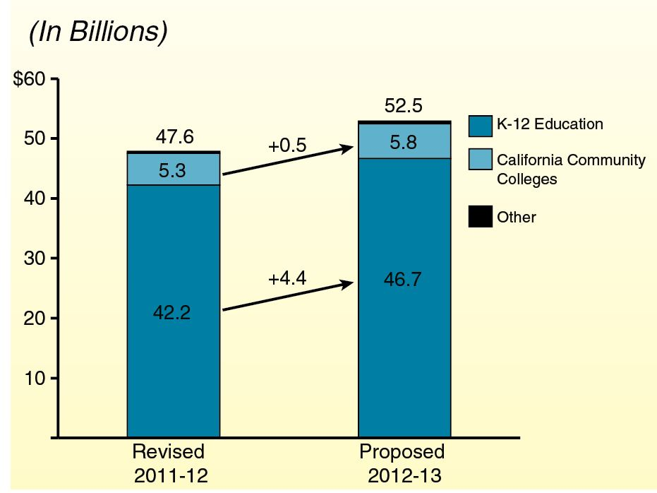
January Proposition 98 Funding Proposal
6

Slide 8
January Proposition 98 Spending Proposal
Five Major Components
Backfill one-time actions ($2.8 billion).
Pay down deferrals ($1.8 billion).
Create mandate block grant ($110 million).
Hold harmless: weighted student formula ($90 million).
Do not initiate Transitional Kindergarten program ($224 million savings).
7

Slide 9
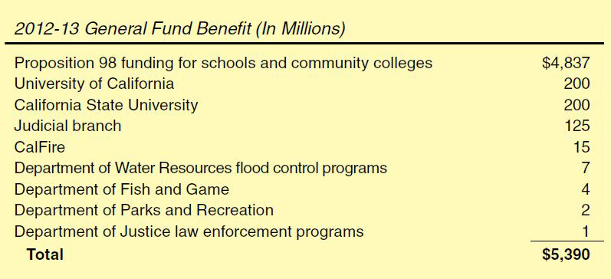
January “Trigger” Plan
8

Slide 10
LAO February Forecast
9

Slide 11
LAO February Economic Forecast
Job Growth, Economic Confidence Rising
Corporate Profits, Technology Booming
Persistent Joblessness Remains Problem
Housing Market Still Depressed
10

Slide 12
LAO February Revenue Forecast
$6.5 Billion Lower Than Administration
$3 billion lower in 2011-12.
$3.5 billion lower in 2012-13.
11

Slide 13
March Developments
12

Slide 14
Tax Measure: March Version
$6.8 Billion to $9 Billion Revenue Solution
PIT Rate Increases: 1 Percent to 3 Percent for Seven Years
SUT Rate Increase: 0.25 Percent for Four Years
13

Slide 15
March Revenue Update
March “Big Three” Tax Collections About $290 Million Below Forecast
Year-to-Date Big Three Revenues $1.1 Billion Below Forecast
Weakness in Corporate Tax Revenues Latest Concern
14

Slide 16
LAO March Proposition 98 Estimates
Based on LAO Baseline Revenue Forecast and LAO Estimate of New Tax Measure:
Proposition 98 minimum guarantee would drop about $200 million below current-year spending level.
Proposition 98 minimum guarantee in 2012-13 about $800 million lower than administration’s estimate.
15

Slide 17
California School Boards Association Lawsuit
Preliminary Superior Court Ruling Appears to Uphold State Action
Final Ruling Expected Within 30 Days
16

Slide 18
Looming Uncertainties
17

Slide 19
Comparison of Tax Measures
 | Governor | Munger
Taxes Affected | PIT and SUT | PIT
Highest PIT Rate Increase | 3% | 2.2%
Revenues Raised | $5.4 - $7.6 Billion | $10 - $11 Billion
Revenue Uses | State budget balancing | Education, preschool, budget balancing
Affects Proposition 98 | Yes | No
Operative Time | 7 years | 12 years
18

Slide 20
How Good Could It Get?
Both Tax Measures Pass
Facebook Offering Exceeds Expectations
No Trigger Reductions
State Begins Paying Down Deferrals
Education Receives Programmatic Augmentations
Few Cuts to Other State Programs
19

Slide 21
How Bad Could It Get?
Both Tax Measures Fail
Baseline Revenues Down Billions
Facebook Yields Less Than Expected
Even “Plan A” Contains Education Cuts, Deeper Non-Education Cuts
Trigger Reductions Enacted
District Flexibility Reduced Not Enhanced
20

