Slide 1
California’s Fiscal Outlook
Legislative Analyst’s Office
California Association of School Business Officials CBO Symposium
November 15, 2012
www.lao.ca.gov

Slide 2
Budget Outlook

Slide 3
$1.9 Billion Budget Problem
2012-13: $943 Million Deficit
2013-14: $936 Million Operating Shortfall

Slide 4
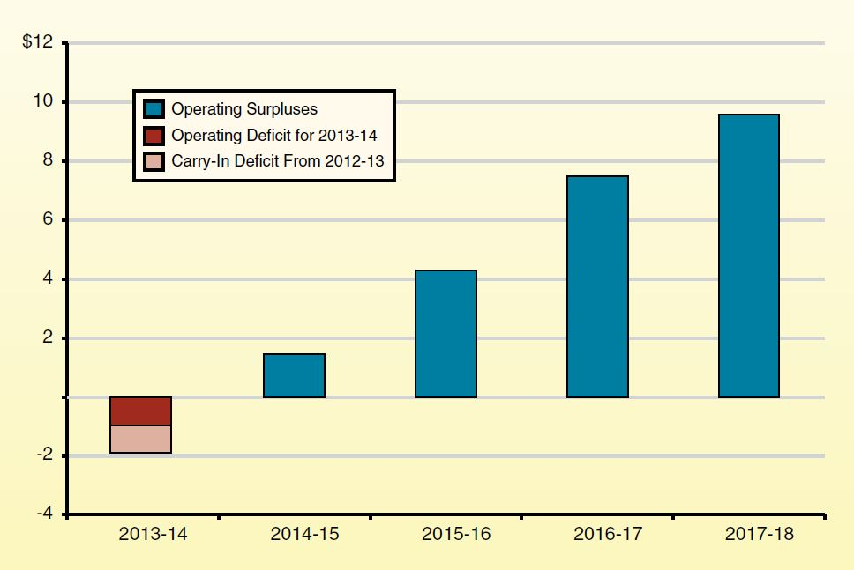
Forecasted Operating
Surpluses Beginning in 2014-15
General Fund and Education Protection Account Combined (In Billions)

Slide 5
Consider How Best to Use
Future Budget Surpluses
Build Up State Reserve
Pay Down Existing Obligations
Address Retirement Liabilities
Build Up Base Programs
Invest in Infrastructure

Slide 6
National Economic Outlook

Slide 7
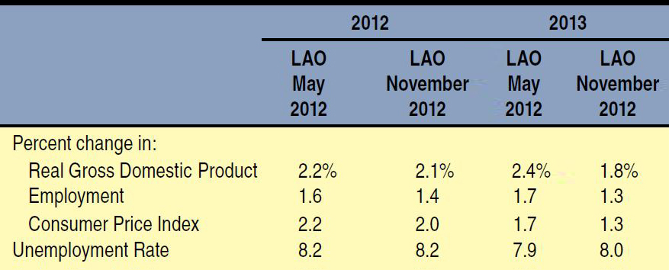
National Economic
Near-Term Outlook Worsened Slightly
Comparing LAO May and November Forecasts

Slide 8
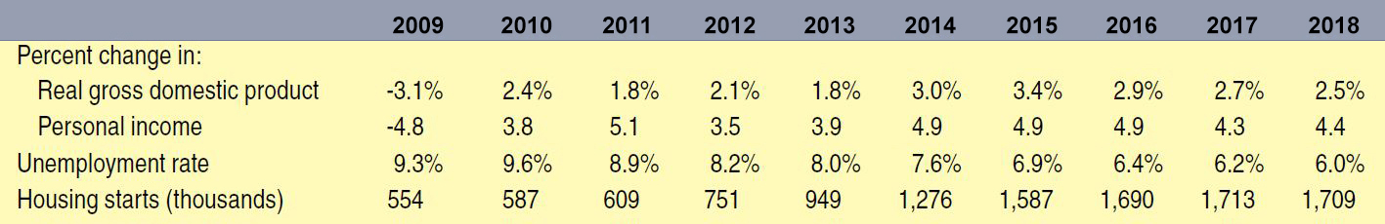
National Economic Forecast Summary

Slide 9
California’s Economic Outlook

Slide 10
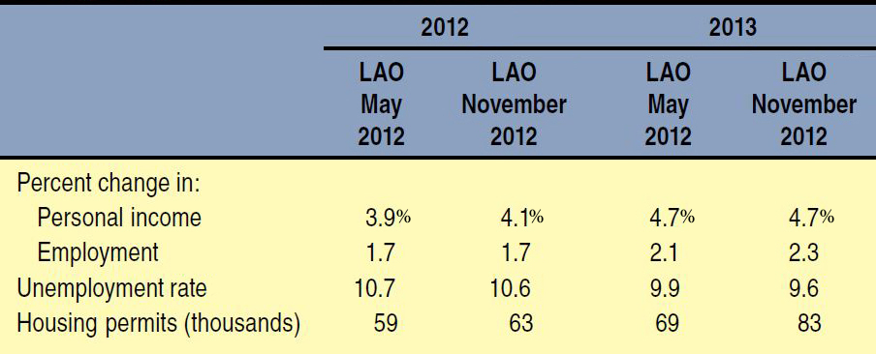
California’s Economic
Near-Term Outlook Improved Slightly
Comparing LAO May and November Forecasts

Slide 11
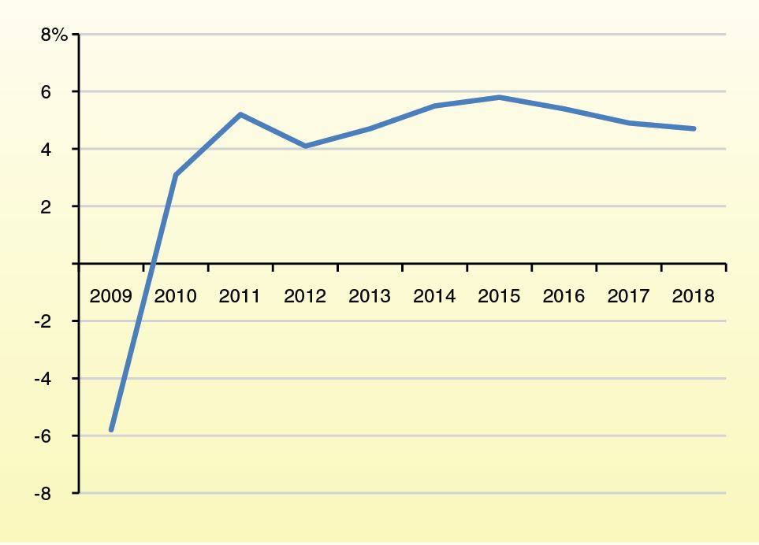
Growth in California Personal Income Projected to Hover Around 5 Percent

Slide 12
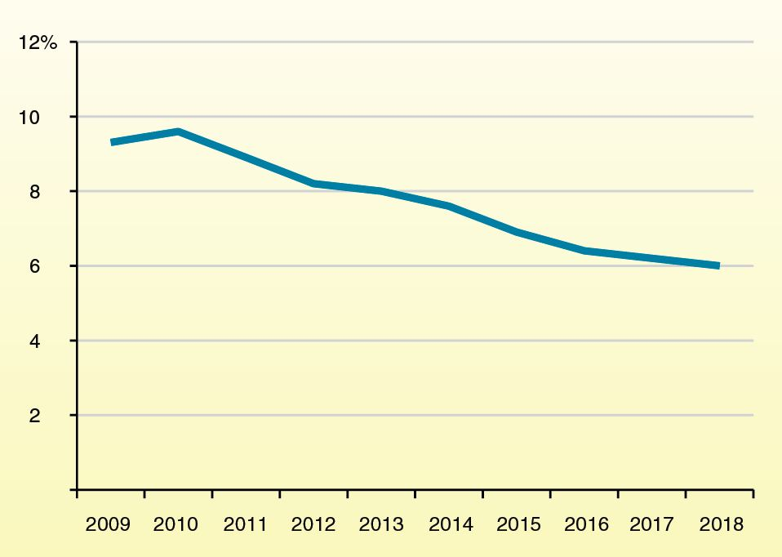
Unemployment Rate in California Projected to Decline Steadily

Slide 13
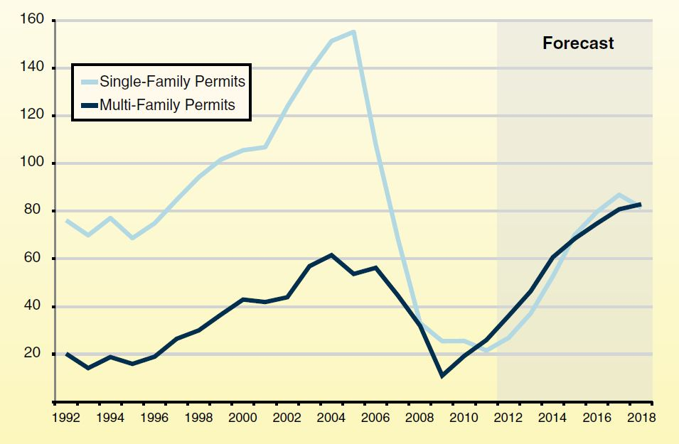
California Building
Activity Is Recovering
Annual Residential Building Permits (In Thousands)

Slide 14
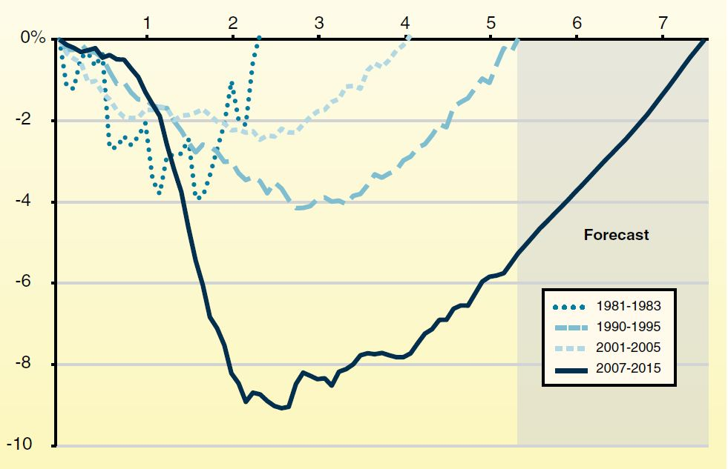
Jobs in California Growing
Much More Slowly Than Prior Recoveries
Job Loss and Years to Return to Prerecession Employment Peak

Slide 15
State Revenue Outlook

Slide 16
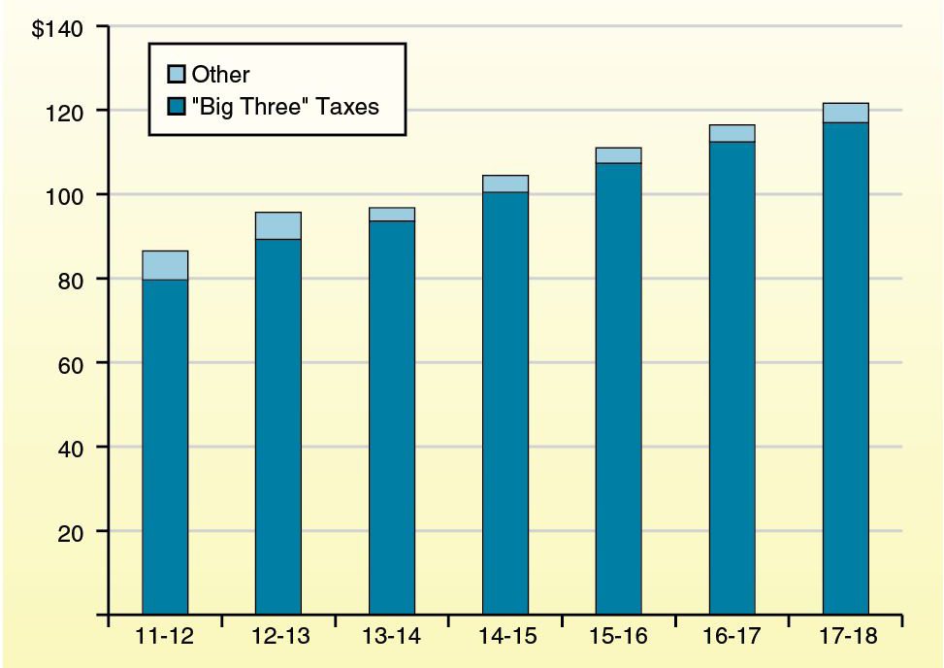
LAO Revenue Forecast
(In Billions)

Slide 17
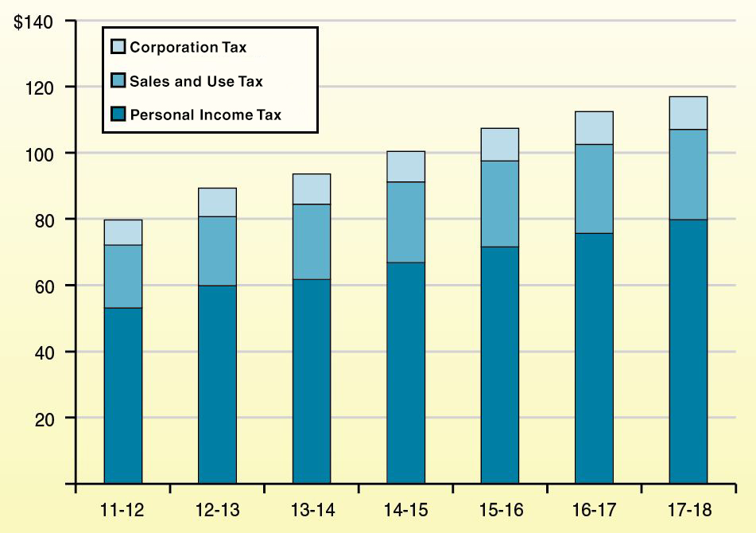
LAO “Big Three”
Revenue Forecast
(In Billions)

Slide 18
Outlook for Education

Slide 19
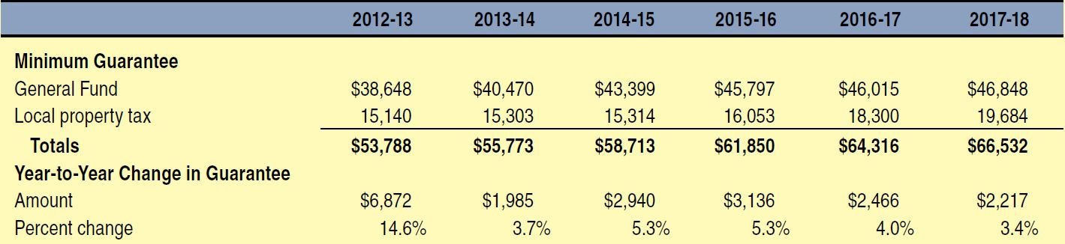
Proposition 98 Forecast
(Dollars in Millions)

Slide 20
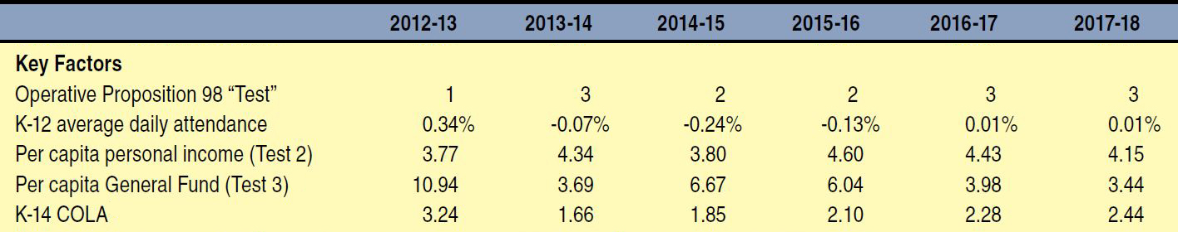
Key Proposition 98 Factors

Slide 21
Many Competing Spending Priorities
Paying Down One-Time Obligations
Building Up Ongoing Base Support
  Restoring prior-year base reductions.
  Making up foregone COLAs.
  Providing a budget-year COLA.
  Equalizing per-pupil funding rates.
  Addressing end of “categorical flexibility”/ transitioning to weighted student formula.

Slide 22
Consider How Best to Use Proposition 98 Funding Increases
Build Plan to Retire Existing, One-Time Education Obligations by End of 2017-18
Carefully Consider How to Build Up Ongoing Base Support
Caution Against More Categorical Programs

Slide 23
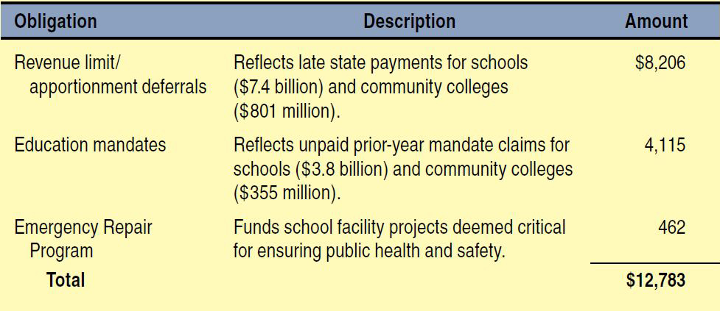
One-Time Education Obligations

