Slide 1
California’s Budget Woes: How Is Our Fiscal Health?
Legislative Analyst’s Office
Randall Lewis Seminar Series
University of California, Riverside
October 27, 2011
www.lao.ca.gov

Slide 2
Background
1

Slide 3
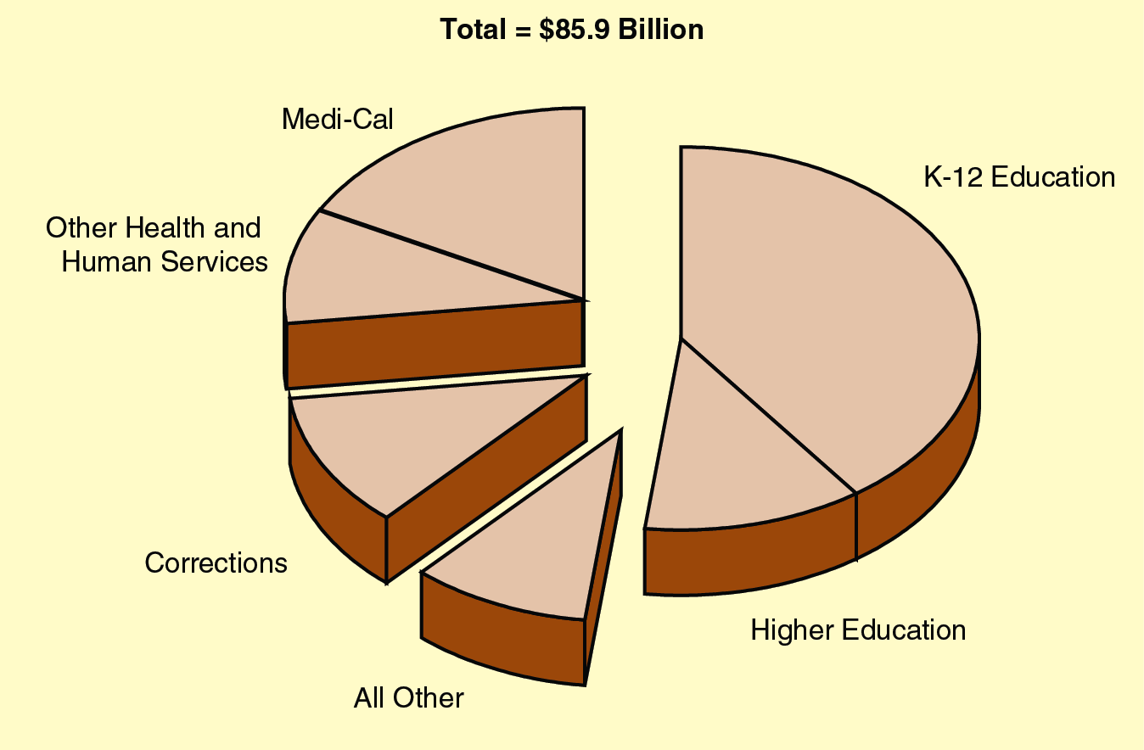
General Fund Spending By Program
2011-12
2

Slide 4
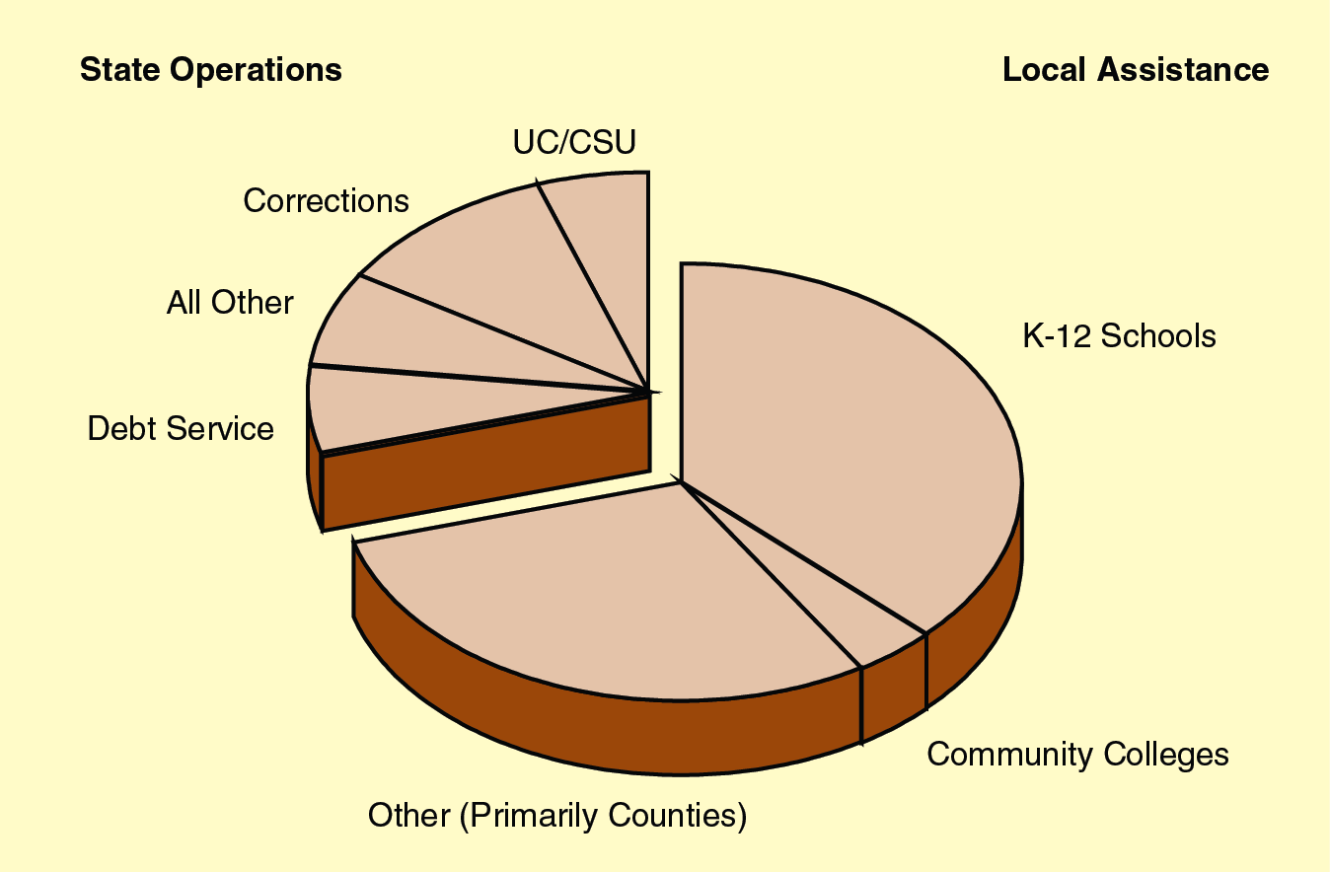
General Fund Spending By Object
2011-12
3

Slide 5
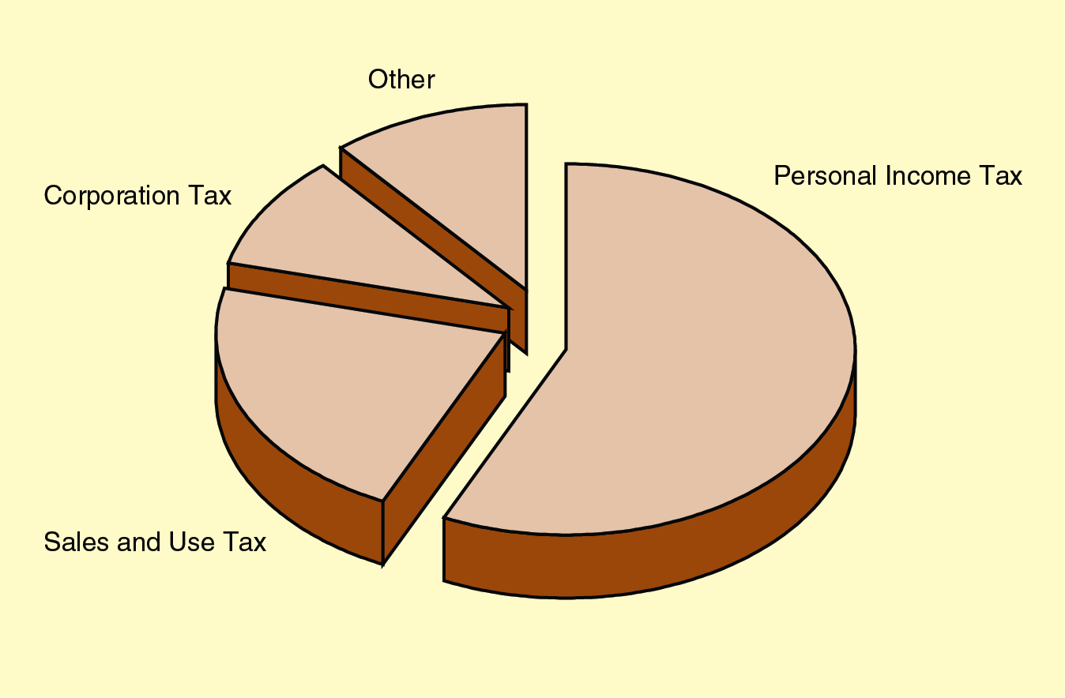
General Fund Revenues
2011-12
4

Slide 6
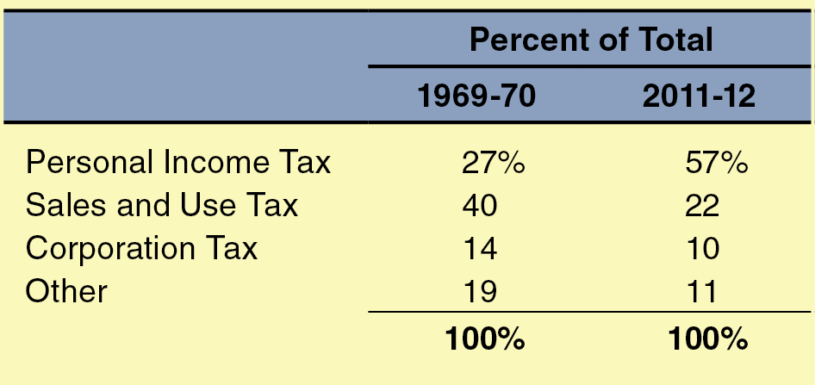
The Change in Our General Fund Revenue Structure
5

Slide 7
The Origins of Our Situation
6

Slide 8
Increasing Revenue Volatility
What Is Volatility?
State revenues change more dramatically than the economy.
From 1979-80 Through 2003-04, Revenues Were Twice as Volatile as the Economy
From 1991-92 Through 2003-04, Revenues Were 3 ½ Times as Volatile
7

Slide 9
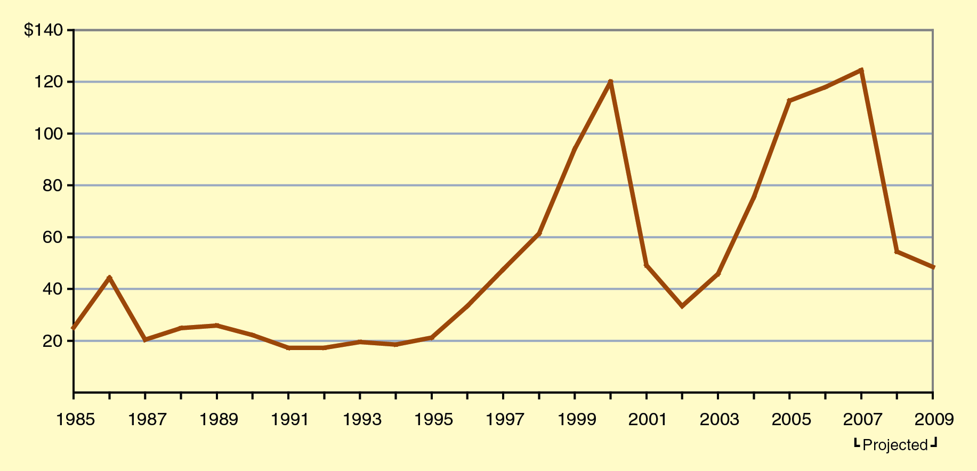
The Capital Gains Roller Coaster
Net Capital Gains Income in California (In Billions)
8

Slide 10
Poor Budgeting Practices
Failure to Build Up Reserves During the Good Times
Boom in Revenues Used for Ongoing Spending Commitments and Tax Relief
Did do some one-time spending (capital outlay).
9

Slide 11
Use of Debt to Finance Operating Shortfalls
2003-04: $10.7 Billion Deficit Financing Bond
March 2004: Voters Approved $15 Billion “Replacement” Bond Measure
10

Slide 12
End Result—State Entered Recession in Poor Fiscal Shape
State Had an Underlying Out-Year Budget Problem in Excess of $7 Billion
No Budgetary Reserve to Cushion Blow of Recession
11

Slide 13
Addressing Our Budget During the Recession
12

Slide 14
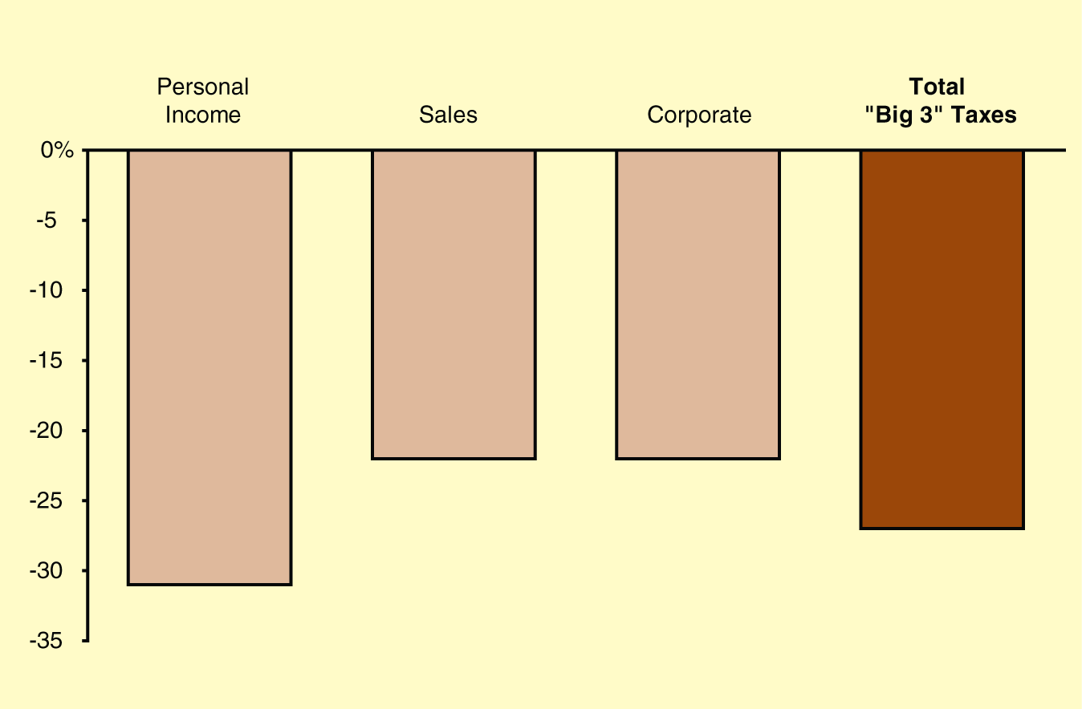
Recession Devastated State Revenues
Percent Reduction in Baseline Revenues November 2010 Estimates Compared to January 2008 Estimates
13

Slide 15
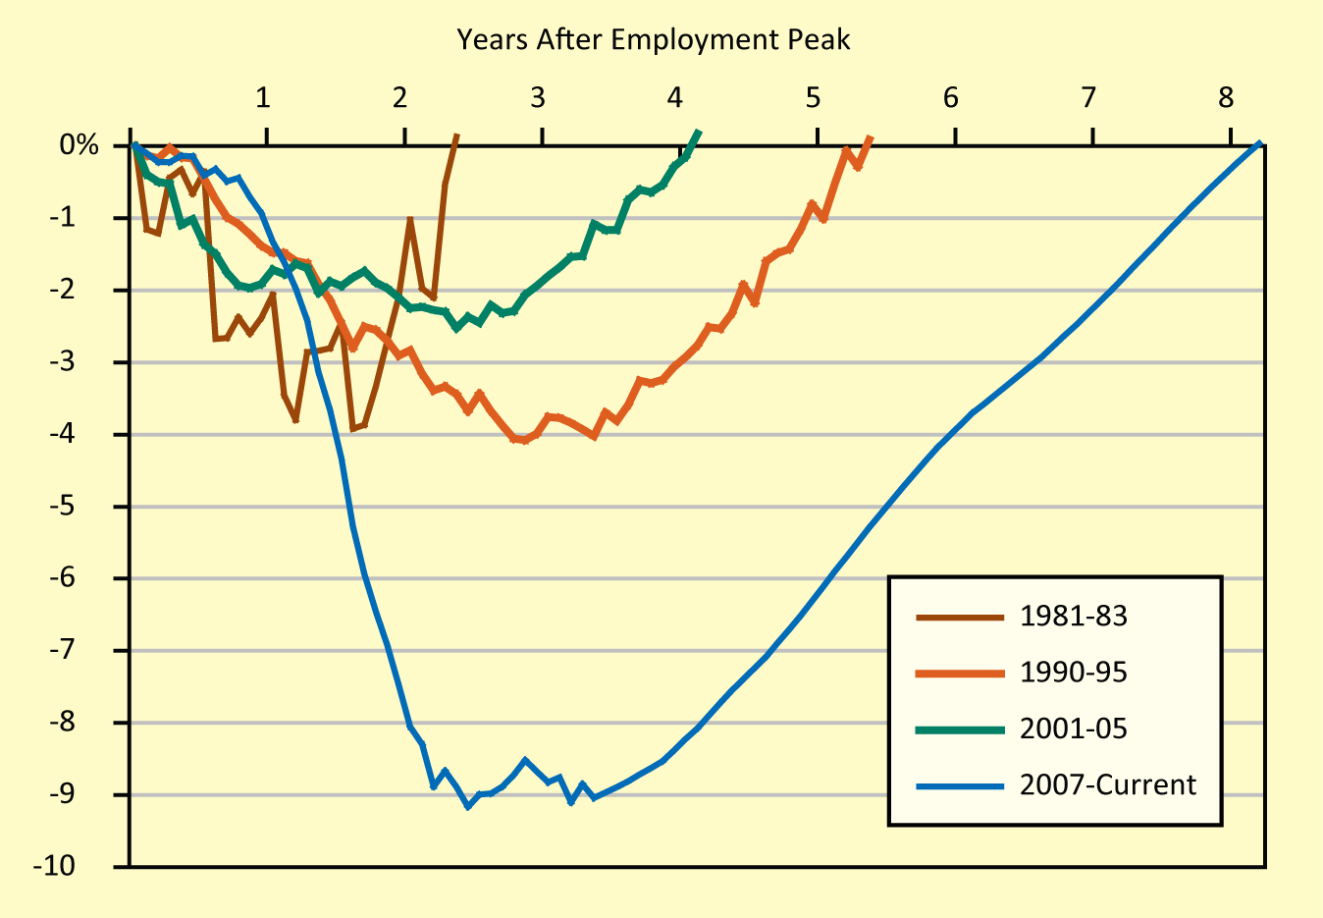
Very Modest Recovery Forecast
Job Loss in Percent
14

Slide 16
How Big Have Our Budget Deficits Been?
(In Billions)
15

Slide 17
The 2011-12 Budget
16

Slide 18
Actions to Close the 2011-12 Budget Gap
Two-Year General Fund Benefit (In Billions)
17

Slide 19
Major Expenditure-Related Actions
Two-Year General Fund Benefit (In Billions)
18

Slide 20
Major Revenue-Related Actions
Two-Year General Fund Benefit (In Billions)
19

Slide 21
Revenue-Related Proposals Not Included in the Budget
Extension of Tax Rate Increases Adopted in 2009
Personal income tax (PIT), sales and use tax (SUT), vehicle license fee (VLF)
Tax Provisions
Mandatory single sales factor.
Changes to enterprise zone credits.
Sales tax exemption for manufacturing equipment.
20

Slide 22
Impacts on Local Government
21

Slide 23
Realignment—Major Shift in Services From State to Counties
Transfers Over $6 Billion in Services
Adult and juvenile offenders and parolees.
Mental health programs.
Foster care and child welfare services.
Provides Counties With Equivalent Ongoing Funding Sources
Just over 1 percent of state sales tax.
Certain VLF revenues.
22

Slide 24
Realignment—Major Service Delivery Changes in Correctional Programs
Lower-Level Offenders, Parole Violators, and Parolees Will Now Be Served Locally
Estimated to Reduce State Prison Population by 40,000 Inmates (About 25 Percent) by 2014
23

Slide 25
Redevelopment Agencies
One Bill Eliminated All Redevelopment Agencies
A Second Allows Existing Agencies to Continue if They Make Payments to Other Local Agencies
State Savings of $1.7 Billion in 2011-12 and $400 Million Annually Thereafter
Currently Challenged in Courts
24

Slide 26
The Trigger
25

Slide 27
Mechanism Established to Address Revenue Shortfall
Given $4 Billion Revenue Assumption, State Adopted Cuts to Go Into Effect Mid-Year if Monies Fail to Materialize
Spending Reductions Would Cover About 60 Percent of Potential Shortfall
26

Slide 28
Trigger Reductions Fall Into Two Tiers
Tier 1: Revenues Fall at Least $1 Billion Short
$600 million in specific cuts (such as $100 million to the University of California).
Tier 2: Revenues Fall More Than $2 Billion Short
Up to $1,860 million in education cuts, primarily K-12.
K-12 cut prorated, based on revenue shortfall.
27

Slide 29
Key Challenges
28

Slide 30
Closing Our Remaining Budget Gap
The State Made Much Greater Progress in 2011-12 in Reducing Structural Budget Problem
We Are Still Likely to Have a Significant Problem Next Year
Revenues will be key.
Our Mid-November Fiscal Forecast Will Estimate Remaining Problem in 2012-13 and Out-Years
29

Slide 31
Deciding on the Size of the Public Sector
Much of the Debate—at Both State and Federal Level—Comes Down to:
What is the appropriate size of government?
Your Answer Determines Whether You Support New Revenues or Expenditure Reductions
If Governor Has His Way, You Will Have a Chance to Vote on Revenue Increases This November
30

Slide 32
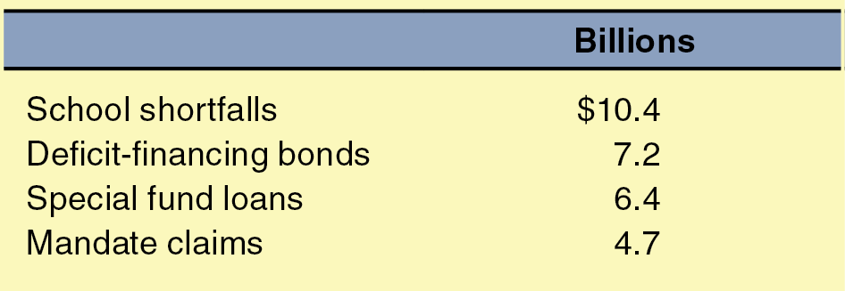
Addressing Budget-Related Obligations
The State Has Accumulated a Variety of Deferred Expenses Over the Past Decade:
31

Slide 33
Addressing Public Employee Post-Retirement Obligations
The State Has Unfunded Liabilities—Pension and Retiree Health—Probably Well Over $150 Billion
Two Major Implications:
Increased state costs to begin to address these obligations.
Continued pressure to modify benefits— primarily related to future employees.
32

Slide 34
Addressing Our State Unemployment Insurance Shortfall
The State Currently Owes Over $9 Billion to the Federal Government Related to Our Unemployment Insurance Program
We Will Need to Raise Employer Costs and/or Reduce Future Benefits to Bring Our Account Back to Balance
33

Slide 35
Making Choices on Infrastructure
The State Has Huge Infrastructure Demands:
Water, highways, universities, schools, etc.
Capital Outlay Spending Is Also One of the Only Ways for State to Contribute Immediately to Economic Growth
The Tradeoff?
Every $5 billion in new bond spending generates $350 million in debt service payments.
34

Slide 36
Achieving Budgetary Reform
Key Is Addressing Revenue Volatility By:
Taking revenues off the table during good times.
Building up and maintaining reserves that will be there in bad times.
Many Other Possibilities
Performance based budgeting.
Two-year budgeting.
Improved program reviews.
35

Slide 37
Considering Tax Reform
Incredibly Difficult Task With No Clear Consensus on What to Do
Most Widely Discussed Topics
PIT: reducing volatility.
SUT: broadening base and not taxing business-to-business transactions.
36

Slide 38
Visit the LAO website at: www.lao.ca.gov
37

